Slide 1

THECB Accountability System Update
Texas Higher Education
Coordinating Board
Bill Abasolo
Director of Strategic Planning and Analysis
TAIR Conference
Corpus Christi, Texas
February 14, 2018

Slide 2
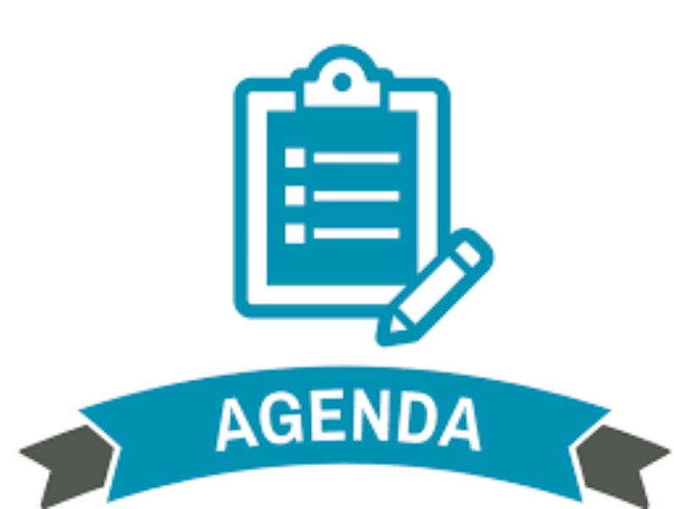
Session topics
Rollover Feb 9 – new year added
Features added to the system since soft-launch
Different uses of interactive to manipulate and download data
Future enhancements – what’s to come

Slide 3

How did we get here?
Soft-launch of redesigned website
Stakeholders invited to comment on website and proposed measures
[March 2017]
Stakeholder comments to proposed measures received, reviewed, and integrated
[March-June 2017]
Final proposed measures for public institutions adopted by Board
[July 2017]
First rollover of redesigned website
[February 2018]
Institutional portal open for data entry
CBM data certified by all public institutions
[January 2018]
Continuous enhancements to website based on requirements and user feedback
[March 2017 – Ongoing]

Slide 4

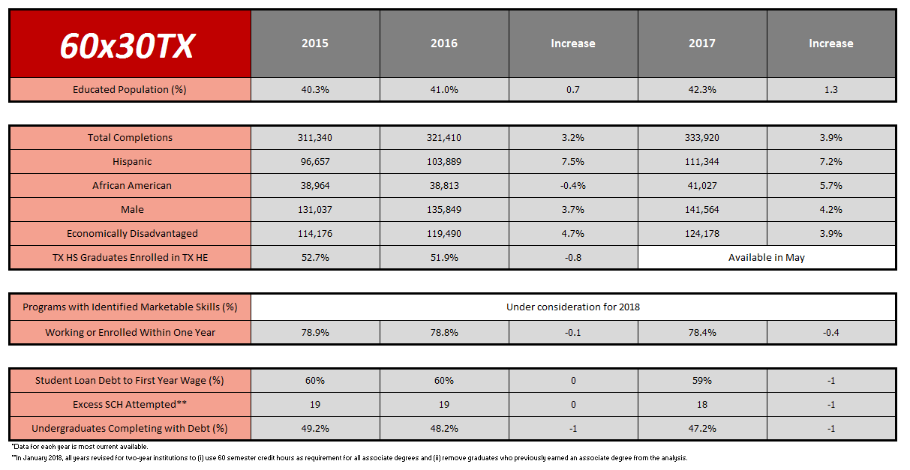

Slide 5

Methodology Change to Excess SCH for Two-Year Institutions
Two-year institutions requested students having previously received an associate degree be removed
Challenge applying associate degree SCH requirements based on data reported to THECB
  Changing requirements based on legislation
  2016 program inventory shows 60.48 as average SCH requirement
  Return to using 60 SCH as requirement
3. With rollover, excess SCH measures were restated for all years presented

Slide 6

Features added since soft-launch
Printable accountability reports – beta just released!
Continued addition of data tables
In-table filtering expanded
Options in interactive added
User guides

Slide 7
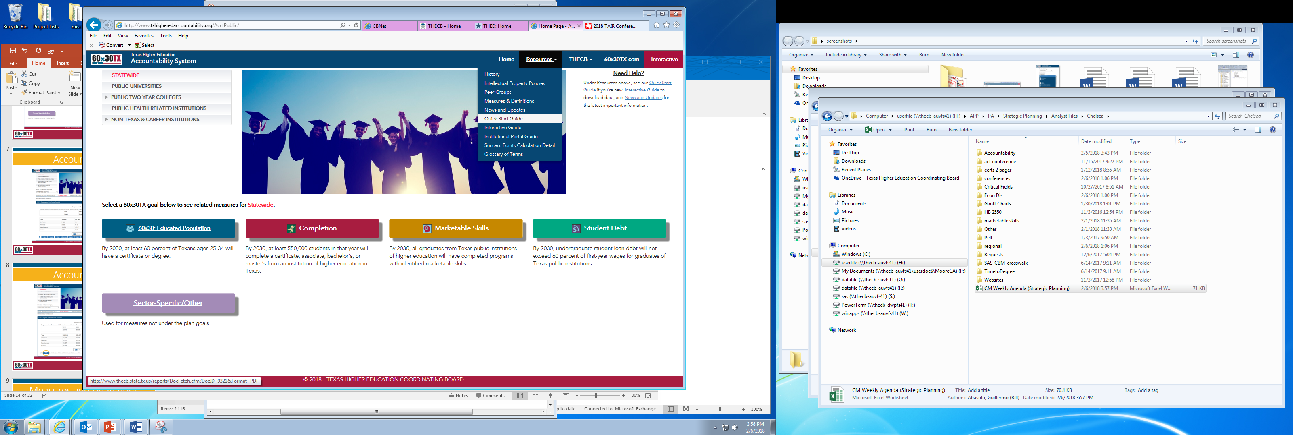
Resources: Quick Start Guide

Slide 8
Live Demo
Brief look at features added
Examples of using interactive to manipulate and download data in different ways

Slide 9

Future enhancements
Final accountability reports
More tables in interactive
  Add FICE to output
Improved navigation based on user feedback
More ‘system is working’ indicators

Slide 10
Questions?
Bill Abasolo
Director
Strategic Planning and Funding Division
Texas Higher Education Coordinating Board
bill.abasolo@thecb.state.tx.us
512-427-6531

