Slide 1
Building Effective Relationships & Project Management
Jeff Martin-Moreno & Laura Wichman
McLennan Community College

Slide 2
Overview
Building relationships with the different areas of campus can be challenging, but it is ultimately rewarding and beneficial for the entire college. We will share how we have built meaningful and effective relationships with various departments, and how we have efficiently managed the increase in projects due to those relationships being formed.

Slide 3
Who?
Faculty
Staff
Administration
Community Members
Students

Slide 4
Why?
Break down the silos
Information sharing
Get data in the right hands
Help support decision making
IR has resources and software

Slide 5
How?
Make the first move
  Introduce yourself
  Invite yourself to the conversation
  Be involved in the difficult and fun conversations
Ask questions
  Question what data they have to support their thoughts or decisions
  Where do the data come from
Offer to help!

Slide 6
Areas of Relationships
Completion Center
  Success Coaches
  Disability Services
Learning Frameworks Faculty
Campus Scheduling

Slide 7
Building Relationships – Completion Center
Completion Center
  1st - Meeting during employment transitions
    Open communication
    Honest discussion of previous hardships
    Discussion of needs and expectations from both parties
      Preconceived ‘requirements’ vs. actual needs
  2nd – Smaller meetings with individual programs (i.e. Support & Empowerment Program, disability services, first-generation and success coaches)
  Open communication via email or office visits if needed

Slide 8
Building Relationships – Completion Center
Outcomes
  Answers to questions generation more question
  More respectful of the processes
    What it take to gather data from students
    What it take to report that data
  Developing a process for gathering and reporting data
    Built data gathering into appointment times
  More realistic expectations of timelines for reporting

Slide 9
Building Relationships – Disability Services
Developed departmental survey of students and faculty
Contacted them and offered assistance in the future
  Easier distribution
  Easier reporting
They initiated contact for assistance
Built needed surveys via email in one afternoon

Slide 10
Building Relationships – Disability Services
Outcomes
  Awareness of more efficient resources
  More effective and meaningful feedback
  More respect between departments
    We are not the enforcers or decision makers
    It isn’t as intimidating as they thought

Slide 11
Building Relationships with Faculty
Learning Frameworks Faculty
  Send email out each semester for ESAP testing
  Not hesitant to contact with issues
    The faculty trust in knowing it can be fixed
  Individualized reporting upon request
  Yearly reporting for QEP
    Worked with Director of QEP/Dean/VPI
  Presenting the data puts a face with a name
    Faculty
    Board of Trustees

Slide 12
Building Relationships with Faculty
Reporting
  Evaluations
  Grade Distributions
  Category Recommendation Support
  Program and Course Tracking
History is the best predictor
  Unbiased
  Communicate openly
  Timely
  Deliver requested information

Slide 13
Campus Scheduling
Control of campus schedule once finalized
  Meetings
  Events
  Testing/Exams
  Rearrange course locations
Building usage reporting
  Informer sends next days events
    Automated
    Opens communications

Slide 14
Campus Scheduling
Introduced himself to departments
Established procedures
  All request are emailed
  Follows up with those who don’t place nice
Not afraid to have difficult conversations
  This is ‘our’ building/classroom
  Outside vendors
Planning ahead
  Faculty have to plan ahead now

Slide 15
Future Relationships
Registrar’s Office
Admissions
Human Resources
Instructional Departments
Faculty

Slide 16
Project Management
Yearly Calendar
  Yearly reports
    QEP
    Grade Distribution
    Course Evaluations
  Federal/State reporting
    IPEDS
    Licensure
    Placement
  Planning Cycle
    SACSCOC
    ULPs
    Program Review
  Perkins
Project Database (Access)
  Project Details
  Types
  Status
  Requestor
  Assigned Staff
  Dates
    Assigned
    Due
    Start
    Completed
  Project File Links
  Project Notes
  Time Spent

Slide 17
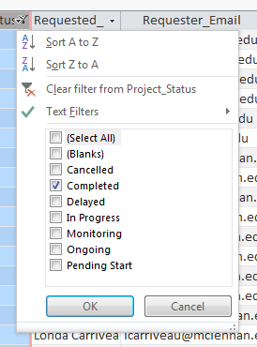
Project Details

Slide 18
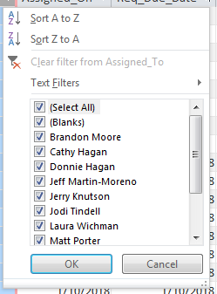
Project Details
Project Delegation
  Assigned projects
  Volunteer
Staying on task
  Weekly meetings

Slide 19
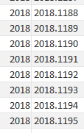
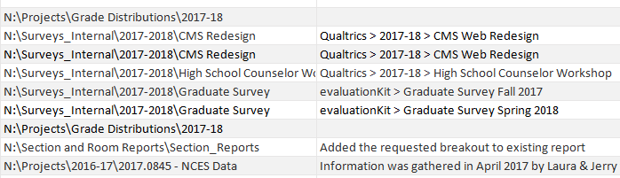
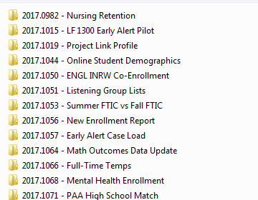
Project Organization

Slide 20
Questions
Jeff Martin-Moreno
  Research Analyst
  McLennan Community College
  jmartin-moreno@mclennan.edu
Laura Wichman
  Director Institutional Research
  McLennan Community College
  lwichman@mclennan.edu

