Slide 1
Do Transfer Hours Matter? An Analysis of Excess Hours of Bachelor Degree Graduates
Gabriela Borcoman MD, PhD
Strategic Planning and Funding

Slide 2
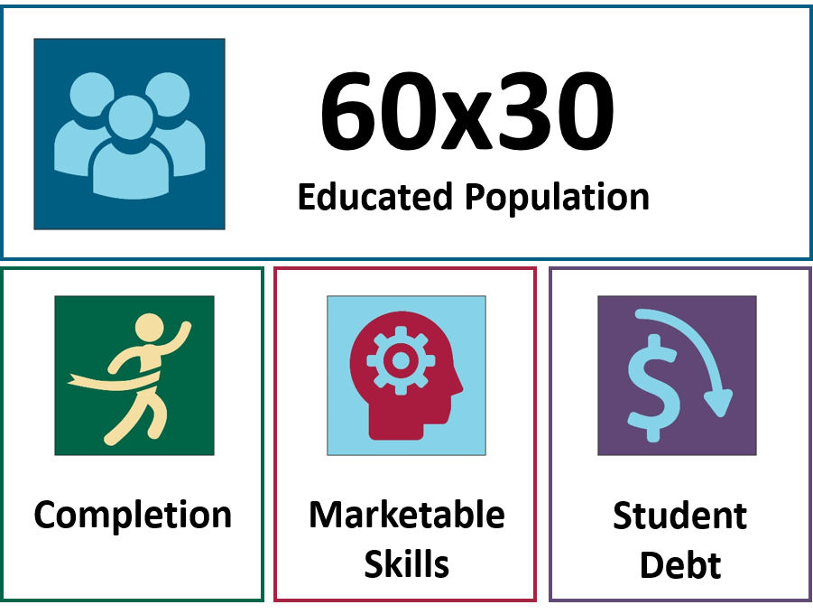
60x30TX: Texas Bold, Texas Achievable
Notes:
60x30TX has four student-centered goals, with the overarching goal that 60 percent of 25-34 year-olds will have a postsecondary credential or degree by 2030
It is critical that Texas produce an educated workforce that is able to adapt to change and compete at the highest levels, nationally and internationally.
60x30TX emphasizes all forms of post high school education, from undergraduate certificates to associate and bachelor’s degrees, to graduate and professional education.
Our success in achieving the goals of the plan requires collaboration among higher education, K-12, and the workforce.
60x30TX provides latitude for two- and four-year institutions and encourages local creativity in pursuing the plan’s goals as institutions continue to pursue their own unique missions.

Slide 3

STUDENT DEBT
Goal: By 2030, undergraduate student loan debt will not exceed 60 percent of first-year wages for graduates of Texas public institutions.
Texas could experience greater shortages in important fields if student loan debt spikes to the point at which a majority of students choose programs based entirely on potential income.
Notes:
The fourth goal is - By 2030, undergraduate student loan debt will not exceed 60 percent of first-year wages for graduates of Texas public institutions.
Student debt as percentage of wage
Percent of students with debt
Excess Hours

Slide 4
STUDENT DEBT
Goal: By 2030, undergraduate student loan debt will not exceed 60 percent of first-year wages for graduates of Texas public institutions.
SCH to degree
  CBM001, CBM009, CBM00N
  Undergraduate Degrees (Bachelor’s and Associate)
  All attempted SCH in the last 10 years
  DE and dual credit hours not included
Excess semester credit hours (SCH)
  The difference between Total SCH attempted by the graduate and Total SCH needed for a degree (Bachelor’s) or 60SCH (Associate).
  Calculated by starting at same or other institution than the one graduating from
  Graduates with previous higher degrees earned are excluded
Notes:
The fourth goal is - By 2030, undergraduate student loan debt will not exceed 60 percent of first-year wages for graduates of Texas public institutions.
Student debt as percentage of wage
Percent of students with debt
Excess Hours

Slide 5
Texas Higher Education Coordinating Board
POWERS AND DUTIES OF THE BOARD:
Texas Education Code establishes the Coordinating Board with its functions powers and duties
Sec. 61.0515. SEMESTER CREDIT HOURS REQUIRED FOR BACCALAUREATE DEGREE.
(a) To earn a baccalaureate degree, a student may not be required by a general academic teaching institution to complete more than the minimum number of semester credit hours required for the degree by the Southern Association of Colleges and Schools or its successor unless the institution determines that there is a compelling academic reason for requiring completion of additional semester credit hours for the degree.
(b) The board may review one or more of an institution's baccalaureate degree programs to ensure compliance with this section.
Added by Acts 2005, 79th Leg., Ch. 1230 (H.B. 1172), Sec. 12, eff. June 18, 2005.

Slide 6
Texas Higher Education Coordinating Board
POWERS AND DUTIES OF THE BOARD:
Texas Education Code establishes the Coordinating Board with its functions powers and duties
Sec. 61.05151. SEMESTER CREDIT HOURS REQUIRED FOR ASSOCIATE DEGREE.
(a) To earn an associate degree, a student may not be required by an institution of higher education to complete more than the minimum number of semester credit hours required for the degree by the Southern Association of Colleges and Schools or its successor unless the institution determines that there is a compelling academic reason for requiring completion of additional semester credit hours for the degree.
(b) The board may review one or more of an institution's associate degree programs to ensure compliance with this section.
Added by Acts 2013, 83rd Leg., R.S., Ch. 528 (S.B. 497), Sec. 1, eff. June 14, 2013.
Added by Acts 2013, 83rd Leg., R.S., Ch. 1155 (S.B. 215), Sec. 33, eff. September 1, 2013.

Slide 7
STUDENT DEBT
Goal: By 2030, undergraduate student loan debt will not exceed 60 percent of first-year wages for graduates of Texas public institutions.
Time to degree
  CBM001, CBM009, CBM00N
  Undergraduate Degrees (Bachelor’s and Associate)
  All years and months since they were reported as FTIC (the last 10 years)
Graduates with no more than 3 excess hours
  The difference between Total SCH attempted by the graduate and Total SCH needed for a degree (Bachelor’s) or 60SCH (Associate) not to be greater than 3
Notes:
The fourth goal is - By 2030, undergraduate student loan debt will not exceed 60 percent of first-year wages for graduates of Texas public institutions.
Student debt as percentage of wage
Percent of students with debt
Excess Hours

Slide 8
About 41% of the Bachelor graduates did not start at the same institution they graduated from
The majority of the Bachelor’s graduates start at a university and graduate from the same institution (59% in the last three years)
During their academic life, students transfer to one or more institutions before they graduate
The transfer can be from 2-year to a 4-year institution or between two 4-year universities
  About 30% started at community or technical college
  About 10% started at another university

Slide 9
Students who start at another institution attempt more SCH toward a degree and have more excess SCH than those who start at the graduating institution
Cohort | All Graduates | Graduates Starting at the Same Inst. | Graduates Starting at Another Inst.
2017
Avg SCH | 137 | 131 | 146
Excess SCH | 14 | 8 | 24
2016
Avg SCH | 138 | 131 | 146
Excess SCH | 15 | 8 | 24
2015
Avg SCH | 139 | 133 | 147
Excess SCH | 15 | 8 | 25

Slide 10
The number of SCH attempted may be different based on influencing factors
Did the graduate originally started at a community/ technical college (CTC) or at a university?
Did the graduate take any dual credit (DC) classes while in high school?
Was the graduate in any developmental education classes before starting college-level courses?
Does gender or ethnicity matter?
Does field of study (FOS) completion decrease excess SCH?
Does the completion of a course influence the number of SCH attempted?

Slide 11
Graduates starting at another 4-year university attempt slightly more SCH toward a degree and have more excess SCH than those who start at CTC
Cohort | Graduates Starting at the Same Inst. | Graduates Starting at CTC | Graduates Starting at Another 4-year
2017
Avg SCH | 131 | 147 | 148
Excess SCH | 8 | 25 | 25
2016
Avg SCH | 131 | 146 | 148
Excess SCH | 8 | 24 | 26
2015
Avg SCH | 133 | 148 | 150
Excess SCH | 8 | 26 | 27

Slide 12
Even though dual credit (DC) courses are not included in the calculation of average SCH, 37% of the graduates took DC
Cohort | All Graduates | Graduates Starting at the Same Inst. | Graduates Starting at Another Inst.
2017
Percent with DC | 37% | 44% | 27%
Avg DC SCH | 5.7 | 7.1 | 3.7
2016
Percent with DC | 37% | 44% | 27%
Avg DC SCH | 5.5 | 6.9 | 3.5
2015
Percent with DC | 36% | 44% | 25%
Avg DC SCH | 5.1 | 6.5 | 3.1

Slide 13
Graduates who took DC tend to have less excess hours
Cohort | All Graduates | Graduates Starting at the Same Inst. | Graduates Starting at Another Inst.
2017
Excess SCH noDC | 19 | 11.6 | 27.5
Excess SCH DC | 6 | 2.3 | 14.6
2016
Excess SCH noDC | 19.9 | 12.5 | 27.9
Excess SCH DC | 6.5 | 3.0 | 14.6
2015
Excess SCH noDC | 20.5 | 13.0 | 28.7
Excess SCH DC | 5.8 | 2.7 | 13.9

Slide 14
Developmental education (DE) courses are not included in the calculation of average SCH, 28% of the graduates took DE
Cohort | All Graduates | Graduates Starting at the Same Inst. | Graduates Starting at Another Inst.
2017
Percent with DE | 26% | 12% | 46%
Avg DE SCH | 7.4 | 5.1 | 8.3
2016
Percent with DE | 28% | 14% | 49%
Avg DE SCH | 7.5 | 5.4 | 8.4
2015
Percent with DE | 30% | 15% | 50%
Avg DE SCH | 7.5 | 5.4 | 8.4

Slide 15
Graduates who took DE tend to have more excess hours
Cohort | All Graduates | Graduates Starting at the Same Inst. | Graduates Starting at Another Inst.
2017
Excess SCH noDE | 9.9 | 5.9 | 19.9
Excess SCH DE | 26.4 | 20.2 | 28.7
2016
Excess SCH noDE | 10.5 | 6.5 | 20.0
Excess SCH DE | 26.3 | 19.7 | 29.0
2015
Excess SCH noDE | 10.3 | 6.2 | 20.4
Excess SCH DE | 26.9 | 21.1 | 29.6

Slide 16
Males attempt more SCH toward a degree and have more excess SCH than females
Cohort | All Graduates | Males | Females
2017
Avg SCH | 137 | 140 | 134
Excess SCH | 14 | 17 | 12
2016
Avg SCH | 138 | 141 | 135
Excess SCH | 15 | 18 | 13
2015
Avg SCH | 139 | 142 | 136
Excess SCH | 15 | 18 | 14

Slide 17
African-American graduates have the highest number of average SCH attempted and excess hours
Cohort | All Graduates | White | African-American | Hispanic | Asian | Other
2017
Avg SCH | 137 | 133 | 146 | 138 | 138 | 136
Excess SCH | 14 | 11 | 24 | 16 | 15 | 14
2016
Avg SCH | 138 | 135 | 146 | 139 | 140 | 138
Excess SCH | 15 | 12 | 24 | 16 | 17 | 15
2015
Avg SCH | 139 | 136 | 147 | 141 | 140 | 139
Excess SCH | 15 | 12 | 25 | 17 | 16 | 16

Slide 18
Graduates who completed an FOS attempt more SCH toward a degree and have more excess SCH than those who don’t
Cohort | All Graduates | No FOS Completed | FOS Completed | % of FOS Completers
2017
Avg SCH | 137 | 136 | 143 | 1.15%
Excess SCH | 14 | 13 | 21
2016
Avg SCH | 138 | 137 | 144 | 1.01%
Excess SCH | 15 | 14 | 22
2015
Avg SCH | 139 | 138 | 147 | 0.96%
Excess SCH | 15 | 14 | 25

Slide 19
Ninety percent of the attempted SCH were successfully completed with grade of A, B,C, Pass
Cohort | Average SCH Attempted | Average SCH Successfully Completed | Percent of Successfully Completed SCH
Start at the Same Institution | 131 | 120 | 92%
Start at CTC | 146 | 132 | 90%
Start at Another University | 148 | 133 | 90%
Total | 138 | 125 | 91%

Slide 20
Contact Information
Gabriela Borcoman, Ph D
  Senior Program Director
  Texas Higher Education Coordinating Board
  Gabriela.borcoman@thecb.state.tx.us
  (512) 427-6134

