Slide 1
The Assessment Leadership Institute: A Partnership
Texas Association for Institutional Research (TAIR)
Corpus Christi Conference
February 2018
Presented by Chris Daley
Coordinator of Institutional Research
Trinity Valley Community College

Slide 2
Assessment Leadership Institute
Agenda
The Team
Assessment Leadership Institute (ALI)
ALI History
ALI Pilot
What Did We Learn From The Pilot
ALI Pilot Participant Thoughts
Consortium Assessment Leadership Institute (CALI)

Slide 3

The Team:North Texas Community College Consortium (NTCCC)
Vision: The North Texas Community College Consortium is a premier regional network providing high-quality, low-cost, close-to-home professional development opportunities for our member institutions.
Mission: To provide professional development and growth opportunities through seminars, conferences, workshops, forums, and regular Consortium-wide communications.
To support member college and Consortium-wide activities in institutional planning, institutional research, and institutional effectiveness.
To improve communication and collaboration among member community colleges and between member community colleges and the University of North Texas.
Motto: Communicating, Cooperating, Collaborating
  ntccc.unt.edu

Slide 4

The Team: Tarrant County College
Tarrant County College (TCC) was established by a countywide election on July 31, 1965.
It is comprised of five physical campuses and one virtual campus spread across the county - South Campus (est. 1967), Northeast (1968), Northwest (1976), Southeast (1996), Trinity River Campus (2009) and TCC Connect Campus (2015).
Enrollment growth of credit students exceeded 50,000 in the fall of 2011which makes TCC the seventh-largest college or university in Texas.
TCC celebrated its Golden Jubilee, recognizing 50 years since the college was established in 1965. Find out more information about TCC's 50th Anniversary at http://www.tccd.edu/50th/.

Slide 5

The Team:Trinity
Valley Community
College
TVCC has campus locations in Athens, Terrell, Kaufman and Palestine. The college has grown to an enrollment of more than 6,500 students.
Founded in 1946 as Henderson County Junior College.
Mission Statement: Trinity Valley Community College is a learning-centered college that provides quality academic, workforce, college preparatory, student support, and community services programs that prepare and empower students for success and promote and enhance life-long learning for all communities served.

Slide 6
Assessment Leadership Institute
The Assessment Leadership Institute (ALI) provides faculty and administrators with knowledge and guidance to create effective assessment plans. Assessment is a critical component of education, but many have difficulty with the formal process. The ALI was designed to break down the pieces of the assessment life-cycle and provide training and exercises for each component.
The ALI helps faculty and administrators understand the process for creating assessment plans and helps them to create better plans as well as improve the reporting on results.

Slide 7
Assessment Leadership Institute
The colleges that have participants will have more effective assessments and outcomes. This improvement will not only facilitate reporting for state and accreditation requirements but also help improve student learning and enhance the college processes. The goal of assessment is continuous improvement and the ALI facilitates that goal.
Participants in the ALI will be able to take their new knowledge back to their colleges and departments in order to help train their peers.

Slide 8

Assessment Leadership Institute History
October 2015
NTCCC Research and Institutional Effectiveness Committee
June 2016
NTCCC Board Meeting
October 2016
Pilot began at Tarrant County College
June 2017
NTCCC Board Meeting

Slide 9
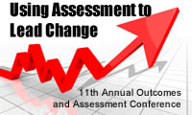
Assessment Leadership Institute History
Research found program at University of Northern Colorado
  Program built from their program
  Dr. Jay Lightfoot, keynote speaker at October 2016 Outcomes and Assessment Conference
Tarrant County College
  Sponsored the pilot
  Kicked off during October 2016 Outcomes and Assessment Conference

Slide 10
Assessment Leadership Institute Pilot
Headed by Marlon Mote, Director of Curriculum & Instructional Assessment, Tarrant County College District
CLARA project to facilitate from one to many colleges
  What and how to change?
  Will the ALI work across multiple colleges?

Slide 11
Assessment Leadership Institute Pilot
7 Sessions across 7 months held at Tarrant County College Opportunity Center
Assessment Basics
Program Mission
Program-Level Student Learning Outcomes
Curriculum Mapping
Assessment Methods, Measures, and Criteria
Assessment Data Management
Analyzing and Using Assessment Results

Slide 12
Assessment Leadership Institute Pilot
Assessment Life Cycle
Annual Review
Annual Review
College Mission Statement
Program Mission Statement
Program Level Outcomes
Curriculum Map
Updates
Updates
Updates
Updates
Course
Teaching Methods
Student Learning Outcomes
Assessment Methods
Assessment Data Capture
Did we turn those words into understanding?
How can we improve the student’s understanding?
How can we take this class from one college to multiple colleges?
Data Analysis
Identify Improvements

Slide 13

What Did We Learn From The Pilot
Surveyed students each class meeting
Observed classes for questions and participant learning
Final class, asked students their opinions of program

Slide 14

What Did We Learn From The Pilot
Having a mentor from your
college is necessary.
The mentor can tell the
participant the process
at their college.
Time outside of class for homework is hard to find.
Homework can be added to class sessions if class session is extended.
An overview of assessment at the start would be beneficial.
Assessment flows were created and will be covered at the beginning at a high level.

Slide 15

ALI Pilot Participant Thoughts
What benefit did you get from this program?
  “I was able to see assessment being taught from the beginning.
  I enjoyed hearing faculty from various divisions and to see how they looked at assessment.”
  “Nice clear plan to pull together organized program assessment.”
  “Good tool for us to use to prepare for accreditation.”
  “I learned about what assessment is.”
  “I see lots of potential in getting the assessments to be recorded and analyzed to see how we introduce and reinforce the learning”

Slide 16

ALI Pilot Participant Thoughts
What would you tell
someone who is considering
taking this program?
  “I would tell them that this is an excellent program to introduce faculty to assessment. It is a slow thorough program. I like the steps that they take to teach assessment.”
  “Assessment is important for the student’s future. I urge them to take this program to engage/collaborate eventually in a learning community.”
  “Yes, to become aware of the processes from a different approach that the usual demand and left with questions on how…”
  “It would be beneficial for others in every discipline to go through this course…”

Slide 17
Consortium Assessment Leadership Institute (CALI)
Combined sessions due to travel
Used ongoing student feedback to improve student learning outcome
  Overall assessment flowcharts
  More in-class exercises
First class started October 2017 at Outcomes and Assessment Conference

Slide 18
Consortium Assessment Leadership Institute (CALI)
The Consortium Assessment Leadership Institute:
is very affordable; the cost for 2017-18 is $350 for each member college participant and $525 for each non-member college participant
is a year-long regional instructional assessment leadership program
serves primarily department chairs and lead faculty (but everyone is welcome)
includes an online CALI course site providing participants enrichment and interaction opportunities between meetings
draws both on the expertise of external resource persons and of CALI participants themselves
affords the opportunity to work with a mentor on an individual project
creates a valuable network of colleagues in many different instructional assessment roles from many different community colleges

Slide 19
Consortium Assessment Leadership Institute (CALI)
2017-2018 Schedule

Slide 20
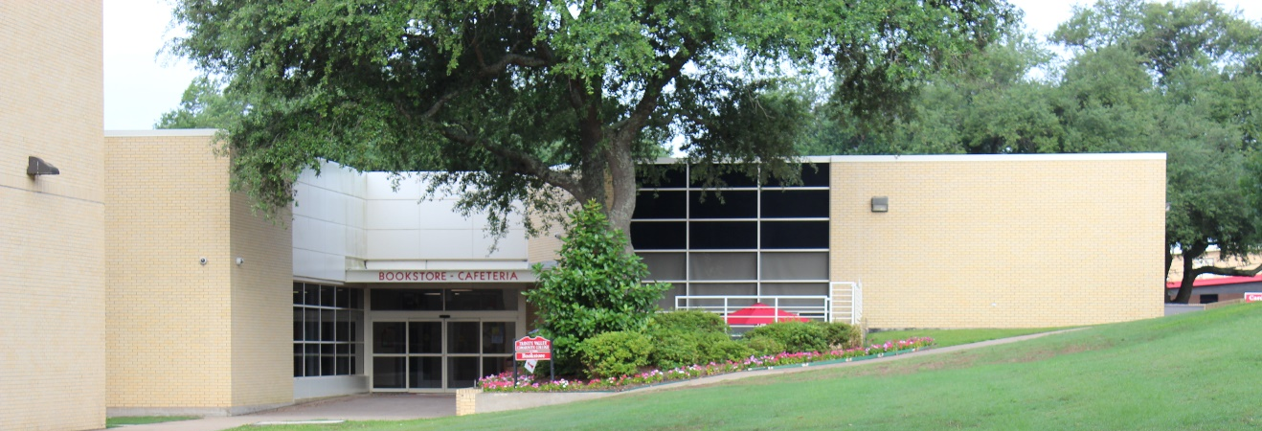
Consortium Assessment Leadership Institute (CALI)
Reasons for your college to participate
Improved assessment for accreditation
Better data for state reporting
Increased faculty participation
Better analysis and use of assessment
results

Slide 21

Consortium Assessment Leadership Institute (CALI)
Reasons for faculty to participate
Become an assessment leader
Improve your student learning outcomes
Networking with other faculty

Slide 22

Consortium Assessment Leadership Institute (CALI)
Assessment = Continuous Improvement
More information: ntccc@unt.edu
http://www.ntccc.org/leadership/cali

