Slide 1

Strategic Planning: Intentional Stakeholder Engagement Strategies
College of the Mainland
Dr. Teri Walker
Sarah Flores
Cheryl Young

Slide 2

Background
Medium sized community college – Texas City
New President – February 2017
  Decade of significant administration turnover
  Rebuilding Relationships
Institutional Effectiveness
  Decentralized for several years
Updated office responsibilities
  Planning
  Effectiveness
  Assessment

Slide 3



Considerations
Leadership support and direction from President
  Rebuilding relationships
  Internal and External engagement and communication
Board of Trustees – institutional priorities
  Student Success
  Employee Success
  Facility Improvement

Slide 4
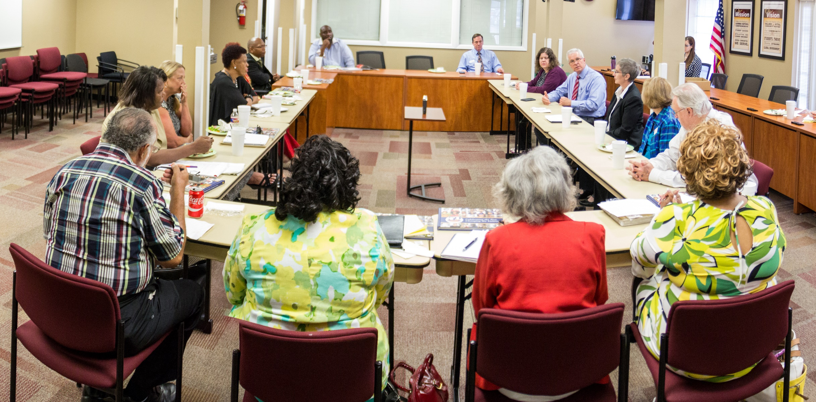
Driving Questions
External – Community and Business Partners
  How do you perceive College of the Mainland today?
  What can we do differently?
  Where do we meet your expectations?
  How can we improve services and workforce training?
  How can we partner with you?
  What does College of the Mainland need to look like?

Slide 5

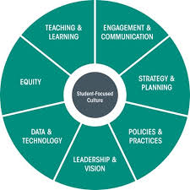
Initial Steps and Information Gathering
Emsi Analysis
  Economic Impact Study
  Demand Gap Analysis
    New program development
Administration of Institutional
Capacity Assessment Tool (ICAT)
Cabinet level review of Mission, Vision, Values

Slide 6
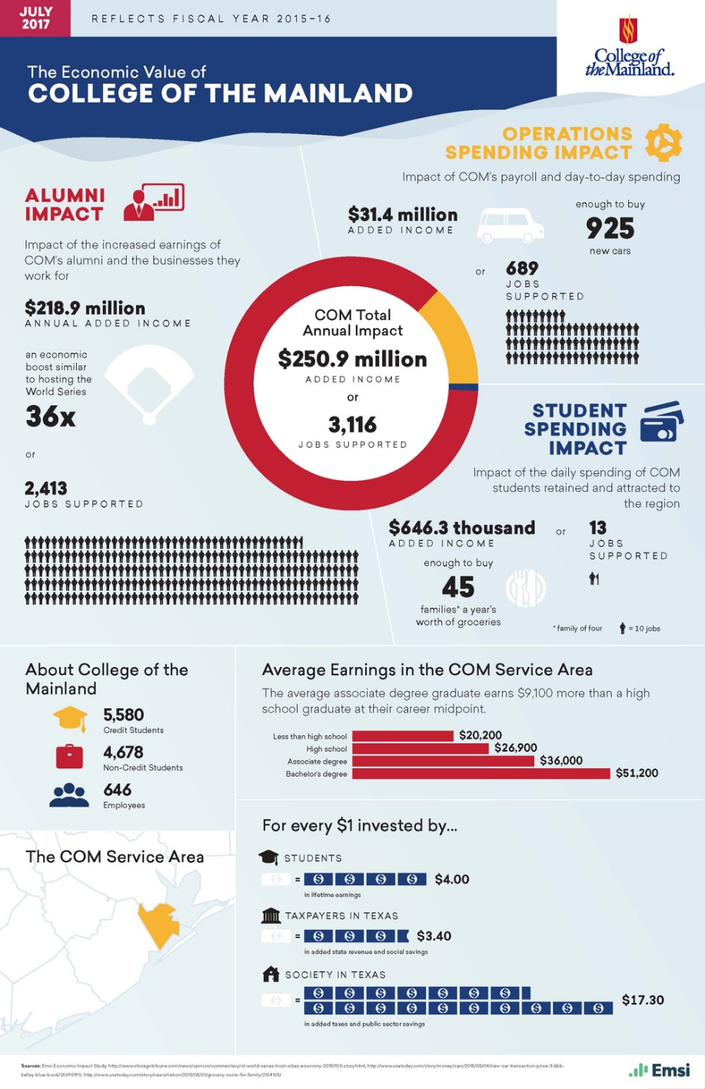
Emsi Report
Economic Impact Study
  Process
  Results
    Measurable value added
    Presentable facts
    Return on investment
Impact
  Internal
  External

Slide 7







Institutional Capacity Assessment Tool (ICAT)
Achieving the Dream leader college
Institutional Capacity framework
Leadership & Vision
Data & Technology
Teaching & Learning
Policy & Practices
Engagement & Communication
Strategy & Planning
Equity

Slide 8
ICAT Distribution
ICAT Survey
  How well is COM fulfilling different aspects of capacities?
  Distributed to all staff and faculty
    138 responses

Slide 9

World Café – ICAT discussion
70 participants
Capacity tables
Strengths
Challenges
Actions

Slide 10
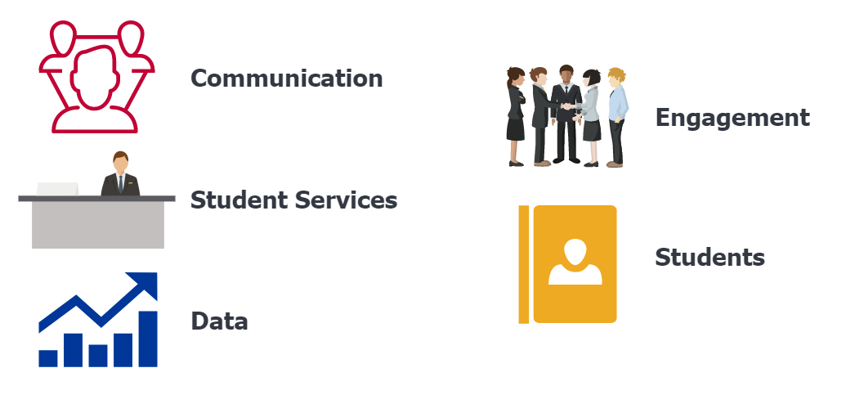
Resulting Themes

Slide 11
World Café – Student Success
Mandatory for all Staff and Faculty
3 Rounds of Discussion
  Individual
  Institutional
  Synthesize and Review

Slide 12
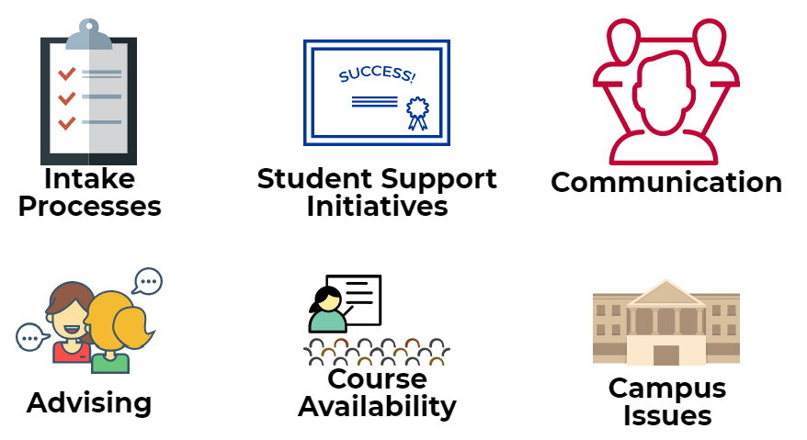
Resulting Themes

Slide 13
COMmunicate! Series – ICAT & Employee Success
Requested by Faculty Senate
Three ICAT capacities
Priority 2: Employee Success
  2 rounds – attracting and retaining employees
Teaching & Learning
Engagement & Communication
Equity

Slide 14
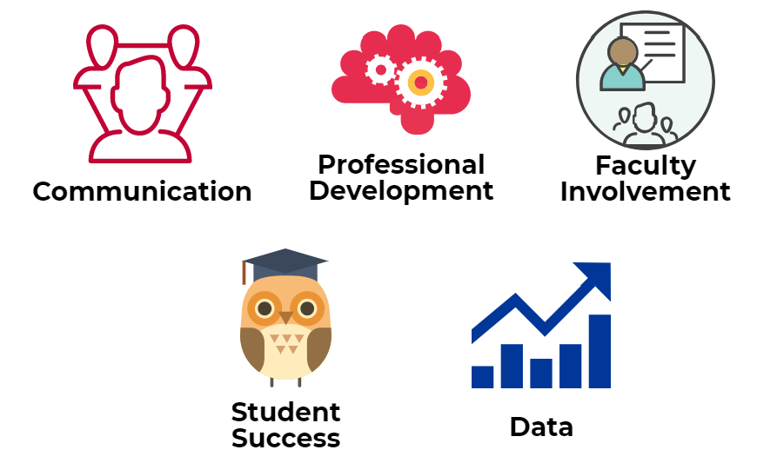
Resulting Themes

Slide 15



External Stakeholders
Chambers of Commerce, Rotary Clubs, Community Leaders, Industry
Common Themes
  Communication
  Facilities
  Student Services
  Career Preparation
Low hanging fruit

Slide 16
Measuring Success
Establishing Key Performance Indicators
Adapted 60x30 metrics

Slide 17
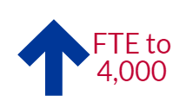

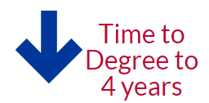
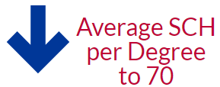
Students
Student success is our top priority. COM will be the college of choice for our community.
By 2025
Currently
>3,000 FTE
Currently
696 Awards and Certificates
Currently
Average
5 years
Currently
Average
101 SCH

Slide 18


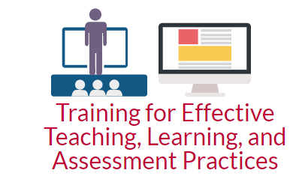
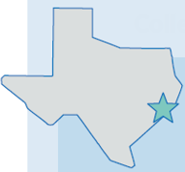

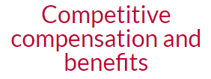
Staff, Faculty, and Administrators
Create an environment that retains and attracts administrators, faculty, and staff committed to serving our students

Slide 19





Facilities Improvement
Provide a safe, aesthetic environment conducive to learning, while addressing the workforce needs of local business and industry. Develop next generation learning environments using the 2015 master facility plan as the foundation.

Slide 20
Next Steps
Codifying Strategic Plan
Maintaining Engagement and Relationships
COMmunicate! Sessions
Focus Groups
Bond Election

Slide 21
Discussion
What have your experiences been?
What has worked well?
What obstacles have you encountered?
What has changed about strategic planning?

