Slide 1
Make Your Data Tell a Story
The Dos and Don’ts of Creating Graphics
Grace Mineta
Gmineta@southwestern.edu
Institutional Research Analyst
Southwestern University
TAIR 2018
Laguna Madre Room
13 February, 2018

Slide 2
Agenda
  Why this topic?
    A picture is worth 1,000 words
  The importance of (good) graphics
    With technology anyone can create graphics
    No mainstream training in how to create good, readable graphics
  Dos and Don’ts of creating graphics
    Quick fixes to increase readability
    Artistic interpretation exists in any formatting decision
    Graphics are visualized data not a piece of fine art
  Additional resources and Questions

Slide 3
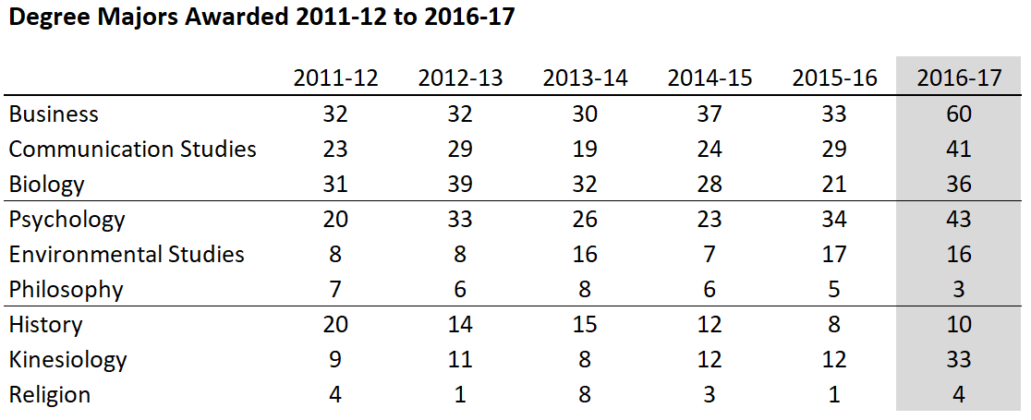
A Graphic is a pictorial representation of data

Slide 4
Graphics should
  Show the data
  Get the viewer to think about the data
  Reveal trends and conclusions (if there is one)
  Serve a reasonably clear purpose
    Describing a fact, exploring a trend, used as decoration on a report next to text?
    Why does this graphic need to exist?

Slide 5
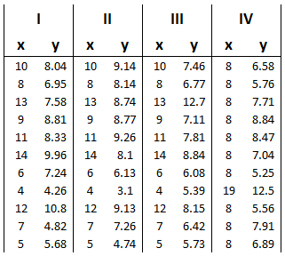
Anscombe’s Quartet
All four datasets have nearly identical descriptive statistics
Mean
X = 9
Y = 7.5
Variance
X = 11
Y = 0.816
Linear regression follows equation
y = 0.5x + 3

Slide 6
Anscombe’s Quartet in graphical form
Mean
X = 9
Y = 7.5
Variance
X = 11
Y = 0.816
Linear regression follows equation
y = 0.5x + 3

Slide 7
Anscombe’s Quartet
As a summary statistic
As a set of graphics
One makes the data and conclusion jump out at you
One lets the data just sit there

Slide 8
Steps for creating a graphic
  Research
  Edit
    filter or format data
    identify key message
  Plot
    chose chart type
    fix scale, colors, and labels
  Review
    check chart against data
    use judgement to evaluate whether your chart makes sense
    look at the chart from your reader’s perspective

Slide 9
Clustered Column Graphic

Slide 10
Clustered Column Graphic (V2)

Slide 11
Add data labels
Thin and lighten gridlines
Widen data bars
Use gradient or similar colors
  Avoid zebra pattern
  Consider contrast
Add line to x and y axis

Slide 12
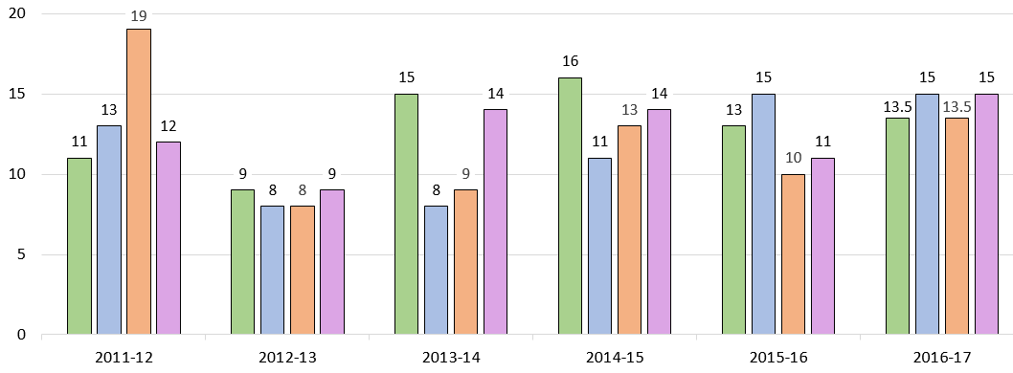
Example of bad contrast:

Slide 13
Example of bad contrast:

Slide 14
Add data labels
Thin and lighten gridlines
Widen data bars
Use gradient or similar colors
  Avoid zebra pattern
  Consider contrast
Add line to x and y axis

Slide 17
Remove background
Title x and y axis
  Label gridlines
Widen data bars
Move data labels to the outside
  Change font color
Add line to x and y axis
Use block of color to emphasize piece of data

Slide 18
Which sentence is easiest to read?
Which sentence is easiest to read?
Which sentence is easiest to read?

Slide 19
Remove background
Title x and y axis
  Label gridlines
Widen data bars
Move data labels to the outside
  Change font color
Add line to x and y axis
Use block of color to emphasize piece of data

Slide 20
Before you create a graphic
Know your data, your purpose, and your conclusion
  If you don’t know what the data says, the reader definitely won’t know.
Throw data in different graphics until your conclusion pops
  Also useful for identifying outliers
Identify your purpose and think about your indented audience

Slide 21
Where is the top?

Slide 22
Top

Slide 23
Remove 3d effects
Add data labels
Darken x axis groups
  Add dark line to x axis

Slide 26
Remove background
Remove shading
  Use color sparingly
Move x axis title to the bottom of the graphic

Slide 27
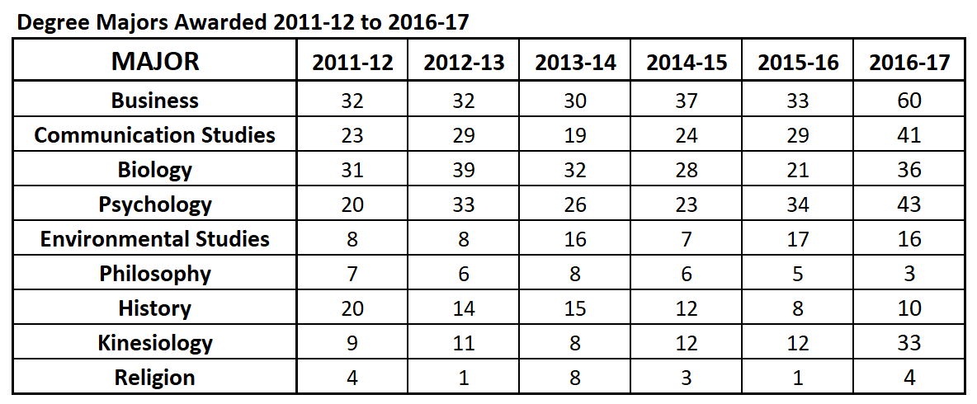

Slide 28
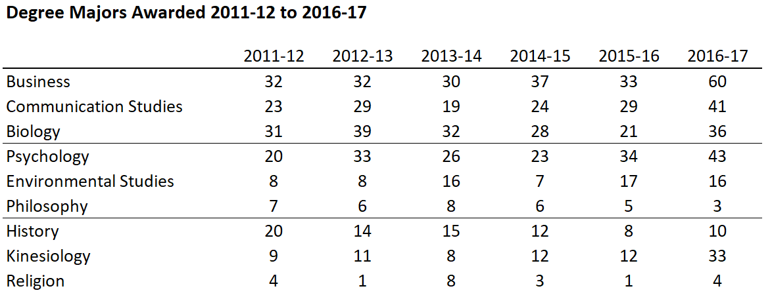

Slide 29
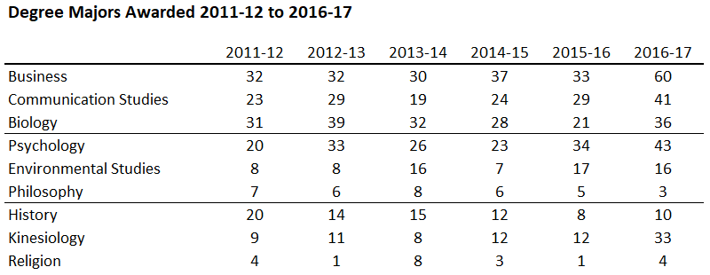
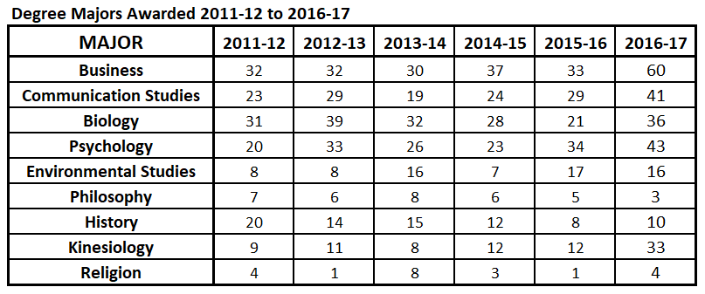
Remove most gridlines
  Put a thick line at top,
  thin lines every 3-4 rows
Minimize use of different font size, ALL CAPS, bold, or italic
Shade a row to emphasize that data
Add description of table under title (if necessary)

Slide 30
Let’s work through an example!

Slide 31
Pie
Chart

Slide 32
Pie
Chart

Slide 33
Remove 3d effects
The biggest “slice” should always go first
Put colors in a gradient / similar complimentary colors
  Use bright color to emphasize piece of data
Add data labels with percentages
Add title

Slide 34
Line
Graph

Slide 35
Line
Graph

Slide 36
Avoid long-distance labeling
  Order of legend should match last data point
Add gridlines
Thicken data lines
  Make data lines unique

Slide 37
Great for comparing different sets of data
Too many lines on the graphic obscures key information
Multi-Series Line Chart

Slide 39
If graphic has more than four lines, split it
  Panel of charts or set of multi-series line charts
Remove gridlines
Use color to emphasize
If using greyscale/gradient, most important piece of data should be the black line

Slide 40
Rules for Graphics
Keep it simple – every bit of ink must serve a purpose
Don’t use 3D
Use colors effectively
Thin out and lighten gridlines
Add data labels and axis titles when needed
Fancy formatting and tricks are unnecessary – let the data speak for itself

Slide 41
References and additional reading:
Wong, Dona. (2010). The Wall Street Journal Guide to Information Graphics (1st ed.). New York, NY: W. W. Norton & Company, Inc.
Tufte, Edward. (2001). The Visual Display of Quantitative Information (2nd ed.). Cheshire, CT: Graphic Press.
Tufte, Edward. (1997). Visual Explanations: Images and Quantities, Evidence and Narrative (8th ed.). Cheshire, CT: Graphic Press.
Nicole, A; Pexman, P. (2010). Displaying Your Findings: A Practical Guide for Creating Figures, Posters, and Presentations (6th ed.). Washington, DC: American Psychological Association.
Kosslyn, Stephen. (1994). Elements of Graph Design (1st ed.). New York, NY: W. H. Freeman and Company.

Slide 42
Questions?
This presentation will be posted on the TAIR website
My email is: gmineta@southwestern.edu

