Slide 1


2018 TAIR Conference
February 11 – February 14 | Corpus Christi, TX

Slide 2


Do Differing Levels of Participation in Developmental Education Have Differential Effects of Persistence and Degree Completion?
Kyle Lovseth and Hongwei Yu
The Center for Community College Student Engagement

Slide 3
Introduction
What is developmental education?
CORE PURPOSE is to ensure that students are adequately prepared to complete their postsecondary goals.
(Boylan & Bonham, 2007)

Slide 4
Introduction
Developmental education by the numbers
Approximately 60% of first-time community college students enrolled in at least one developmental course (Bailey, Jenkins, & Leibach, 2005)
44% of developmental students took between 1 and 3 developmental courses (Attewell, Lavin, Domina, & Levey, 2006)
Large numbers of students classified as “developmental” based on placement test scores

Slide 5
Introduction
Current Developmental Theory
Humanist approach emphasizes individual worth of each student
Inherent desire to learn
Underprepared students deserve opportunity for advancement
Students move from one level of knowledge to the next through the process of learning (Boylan, 1988)….

Slide 6
Introduction
Vygotsky’s Zone of Proximal Development
Learning occurs when students are working within an appropriate learning “zone”
Educator provides appropriate levels of challenge and support to produce learning
“Scaffolding” – student advances by completing tasks they may not have been able to do on their own (Hammond & Gibbons, 2005)
Each individual develops at a unique rate
As individuals pass from one level to the next, knowledge from previous levels are integrated into the current level

Slide 7
Introduction
Pressure on institutions to demonstrate effectiveness of existing developmental education programs
Questions surround validity of individual placement tests, with a push for multiple measures
Courses typically do not count for credit
Slow progress toward graduation
Increase cost of earning certificate/degree
Nearly half of developmental students placed in developmental education did not finish their sequences

Slide 8
Introduction
Developmental Efficacy?
Literature has suggested that developmental education can have negative/null effects on:
  Credit accumulation and persistence (Martorell & McFarlin Jr., 2011)
  Degree completion (Calcagno & Long, 2008)
  Labor Market outcomes (Martorell & McFarlin Jr., 2011)
Bettinger and Long (2005) found that developmental education was unrelated to academic outcomes after student background characteristics were held constant
However, Attewell et al. (2006) found a positive relationship between developmental education and degree completion after controlling for high school academic preparation

Slide 9
Current Study
Why the disconnect?
Previous studies have different source types for data (national survey data, transcripts, etc.)
We used transcript data from 17,085 students (future studies will seek to add national survey data as well)
Each student is unique…community college students live complex lives
We controlled for student demographic characteristics AND academic success characteristics
Previous research tends to treat all developmental students equally, and only include students that are near college-readiness
We divide students into varying levels of developmental entry level
Research outcomes tend to focus on degree completion
We focus on both short term outcomes (gateway course completion) AND long term outcomes (graduation)

Slide 10
Current Study
Research Questions
What are the characteristics of students enrolled in developmental education?
  Demographics
  Academic success
  Developmental entry level
Is there a relationship between starting level of developmental education and both short term and long term outcomes?
  Short term - Gateway math & English course completion
  Long term - Graduation

Slide 11
Methodology
Participants
17,085 community college students
28 US community colleges
Colleges matched IDs from CCSSE surveys completed between 2005 and 2013
Colleges then provided demographic and transcript data
Student IDs were encrypted
Students whose first year was after 2011 were excluded due to insufficient time to earn their degree
Developmental and NON-developmental students included

Slide 12
Methodology
 | Overall Distribution of Participants
 | Analysis Data |  | National Data
Demographic | N | % | Percent*
All Students | 17085 | 100%
Gender
Male | 6984 | 41% | 41%
Female | 10038 | 59% | 59%
Age
Traditional | 10732 | 63% | 51%
Non-traditional | 6229 | 37% | 49%
Race/Ethnicity
African-American | 1724 | 10% | 14%
White | 10248 | 61% | 60%
Latino/Hispanic | 3453 | 21% | 13%
Other | 1286 | 8% | 13%
*2013 CCSSE Cohort Data from IPEDS

Slide 13
Methodology
Developmental Entry-Level Variable
We identified all developmental courses in transcripts
Then, two independent researchers assigned a “level” to each course, using institutional course programs
Next, the two researchers compared their results…
…any courses that did not receive the same score for developmental level, were subject to debate amongst the entire research team at CCCSE until all parties agreed on a final score
Finally, based on the course start dates, it was determined which developmental course each student took first

Slide 14
Methodology
 | Students' Initial Level of Developmental Math
 | Low Level |  | Middle Level |  | High Level |  | Not Developmental
Demographic | N | % | N | % | N | % | N | %
All Students | 2825 | 17% | 2920 | 17% | 2231 | 13% | 9109 | 53%
Gender
Male | 889 | 13% | 1,111 | 16% | 945 | 14% | 4039 | 58%
Female | 1913 | 19% | 1801 | 18% | 1286 | 13% | 5038 | 50%
Age | n | % | n | % | n | % | n | %
Traditional | 1623 | 15% | 1781 | 17% | 1530 | 14% | 5798 | 54%
Non-traditional | 1200 | 19% | 1133 | 18% | 698 | 11% | 3198 | 51%
Race/Ethnicity | n | % | n | % | n | % | n | %
African-American | 451 | 26% | 385 | 22% | 251 | 15% | 637 | 37%
White | 1372 | 13% | 1664 | 16% | 1388 | 14% | 5824 | 57%
Latino/Hispanic | 764 | 22% | 637 | 18% | 391 | 11% | 1661 | 48%
Other | 173 | 13% | 163 | 13% | 177 | 14% | 773 | 60%

Slide 15
Analysis
Short Term Outcomes
Logistic Regression
Dependent variables:
  Completion of Gateway English Course
  Completion of Gateway Math Course
Independent variables:
  Gender
  Enrollment Status
  Age
  Race
  Entering Developmental Math Level
  Entering Developmental Writing Level
  Entering Developmental Reading Level

Slide 16
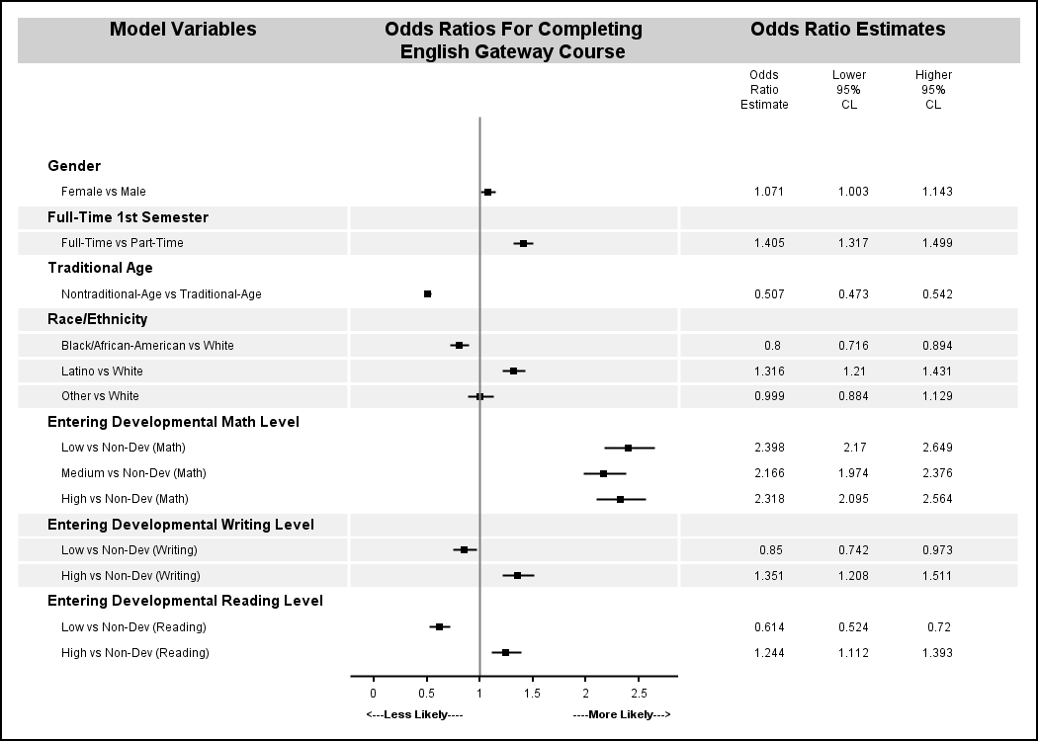
Results – Short Term Outcomes

Slide 17
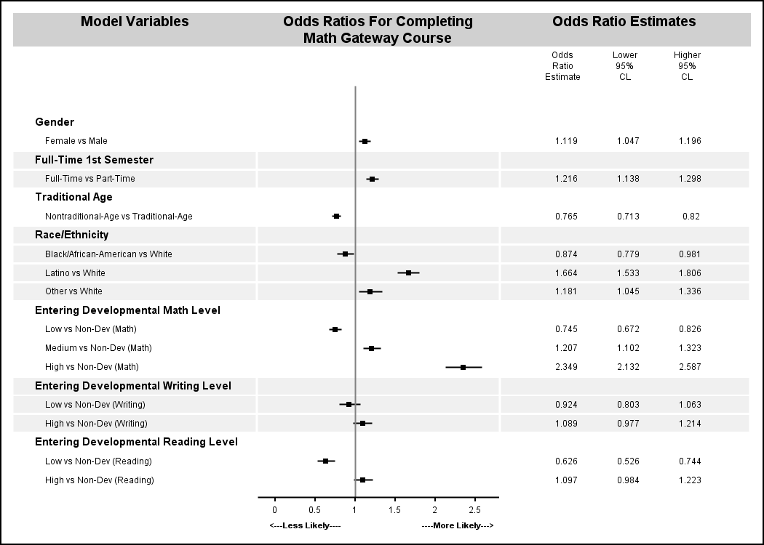
Results – Short Term Outcomes

Slide 18
Summary
Short Term Outcomes
Enrolling in developmental courses can increase odds of completing gateway courses
But, the lowest levels of developmental entry level still underperform non-developmental students
In many cases (and often in relevant subject areas), as students’ developmental entry level increases, the odds of completing gateway courses also increases

Slide 19
Analysis
Long Term Outcome
Logistic Regression
Dependent variable:
  Graduation
Independent variables:
  Overall GPA
  Total Terms Enrolled
  Total Courses Withdrawn/Dropped
  Gender
  Enrollment Status*
  Age
  Race
  Entering Developmental Math Level
  Entering Developmental Writing Level
  Entering Developmental Reading Level

Slide 20
Analysis
Enrollment Variable
Incorporates the realistic fluid nature of community college enrollment status throughout entire tenure at college:
Enrollment Pattern | Count | Percent
Always full-time | 2,569 | 15%
Always part-time | 2,960 | 17%
Start as full-time, switch to part-time, no other changes | 2,586 | 15%
Start as part-time, switch to full-time, no other changes | 1,380 | 8%
Start as full-time, multiple changes | 3,480 | 20%
Start as part-time, multiple changes | 4,110 | 24%
Total | 17,085 | 100%

Slide 21
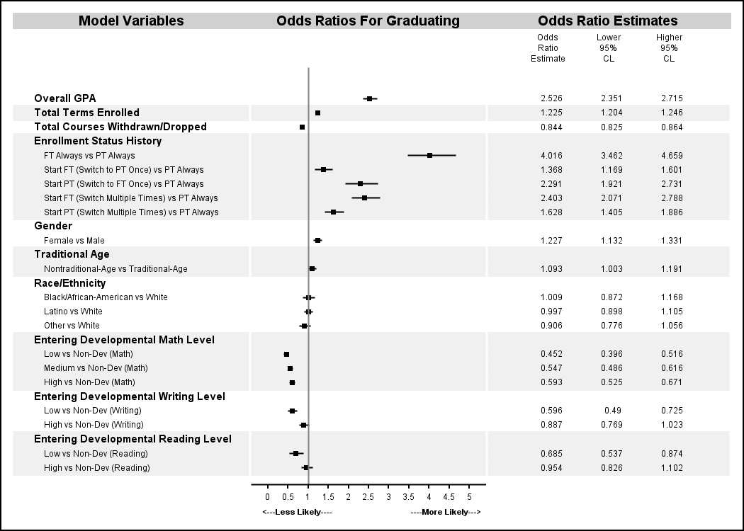
Results – Long Term Outcome

Slide 22
Summary
Long Term Outcome
Enrollment in developmental courses was resoundingly associated with decreased odds of graduating compared to non-developmental students
This was the case, regardless of level of developmental entry level…

Slide 23
Summary
Conclusions
Data appear to support Zone of Proximal Development theory
Scaffolding appears to be taking place, particularly when it involves passing a single course
Developmental enrollment can increase odds of passing gateway courses, as long as students’ ZPD is not too far from the gateway course’s ZPD
In the end, even though developmental students may demonstrate incremental learning, overall, factors such as extra coursework, which leads to extra semesters enrolled, may deter students from completing their ultimate goals of obtaining a degree/graduating

Slide 24
Questions & Contact Info
Kyle Lovseth
Research Associate
512.232.6453
lovseth@cccse.org
Hongwei Yu
Research Associate
512.471.9935
yu@cccse.org
Mike Bohlig
Assistant Director of Research
512.232.6456
bohlig@cccse.org
Center for Community College Student Engagement
Program in Higher Education Leadership
The College of Education
The University of Texas at Austin

Slide 25
Supplemental Material
 | Number of Development Areas Student Enrolled In
 | One |  | Two |  | Three
Demographic | N | % | N | % | N | %
All Students | 5280 | 57.21 | 2226 | 24.12 | 1675 | 18.15
Gender | n | % | n | % | n | %
Male | 2026 | 58.18 | 866 | 24.87 | 590 | 16.94
Female | 3237 | 57.14 | 1351 | 23.85 | 1077 | 19.01
Age | n | % | n | % | n | %
Traditional | 3135 | 54.21 | 1460 | 25.25 | 1188 | 20.54
Non-traditional | 2138 | 63.16 | 761 | 22.48 | 486 | 14.36
Race/Ethnicity | n | % | n | % | n | %
African American | 460 | 8.92 | 372 | 17.1 | 407 | 24.61
White | 3278 | 63.55 | 1079 | 49.59 | 686 | 41.48
Latino/Hispanic | 1088 | 21.09 | 543 | 24.95 | 410 | 24.79
Other | 332 | 6.44 | 182 | 8.36 | 151 | 9.13

Slide 26
Supplemental Material
Outcome Measure: Pass Gateway English
 | Not Developmental in Subject Area |  | Developmental Entry Level
 |  |  | Low |  | Middle |  | High
Subject Area | N | % | N | % | N | % | N | %
Math | 9109 | 45.3 | 2825 | 64.7 | 2920 | 64.1 | 2231 | 66.4
Reading | 13839 | 52.6 | 968 | 47.9 | N/A | N/A | 2278 | 68.6
Writing | 13550 | 52.4 | 1399 | 54.3 | N/A | N/A | 2136 | 68.0

Slide 27
Supplemental Material
Outcome Measure: Pass Gateway Math
 | Not Developmental in Subject Area |  | Developmental Entry Level
 |  |  | Low |  | Middle |  | High
Subject Area | N | % | N | % | N | % | N | %
Math | 9109 | 34.2 | 2825 | 28.3 | 2920 | 38.9 | 2231 | 54.8
Reading | 13839 | 36.8 | 968 | 25 | N/A | N/A | 2278 | 40.8
Writing | 13550 | 36.8 | 1399 | 31.3 | N/A | N/A | 2316 | 39.8

Slide 28
Supplemental Material
Outcome Measure: Graduation
 | Not Developmental in Subject Area |  | Developmental Entry Level
 |  |  | Low |  | Middle |  | High
Subject Area | N | % | N | % | N | % | N | %
Math | 9108 | 42.7 | 2825 | 20.1 | 2920 | 26.3 | 2231 | 29.9
Reading | 13838 | 37.5 | 968 | 15.1 | N/A | N/A | 2278 | 15.5
Writing | 13549 | 37.9 | 1399 | 13.7 | N/A | N/A | 2136 | 24.49

