Slide 1
Visual Solution to Room Usage Reporting
Jerry Knutson, McLennan Community College

Slide 2
Quick Reminder
Please remember to turn your cell phone on after the class.

Slide 3
The why…
SACSOC 5th Year and 10 Year Documentation
Room Utilization – Especially Computer Labs
Listed schedules can be hard to follow

Slide 4
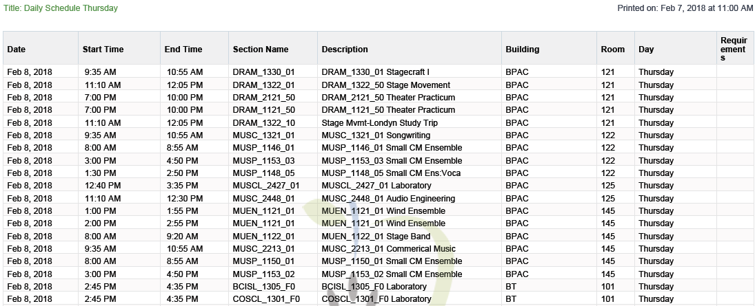
Weekly Schedule
Notes:
Informer Reports
Almost 20 reports that are generated automatically, on a schedule and are e-mailed to the appropriate person

Slide 5
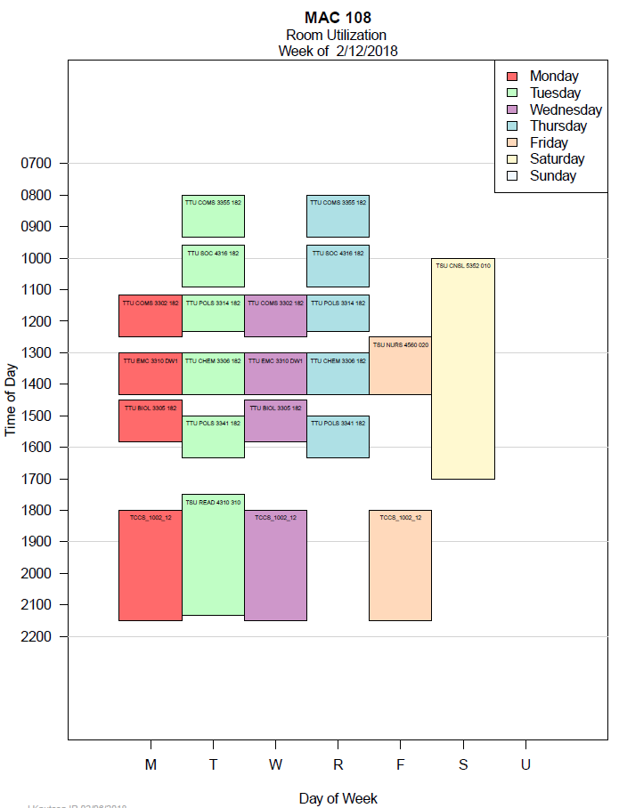
Weekly Graphical Schedule
Notes:
Saw this at TAIR 2 years ago
Adapted for our use, with our data

Slide 6
How did we get there
Colleague Data
Informer Report
Data manipulation in SAS, which creates CSV files for each building
R scripts which produce a PDF for each building
Specialized reports for certain populations
Notes:
Certain Populations include computer labs and University Center

Slide 7
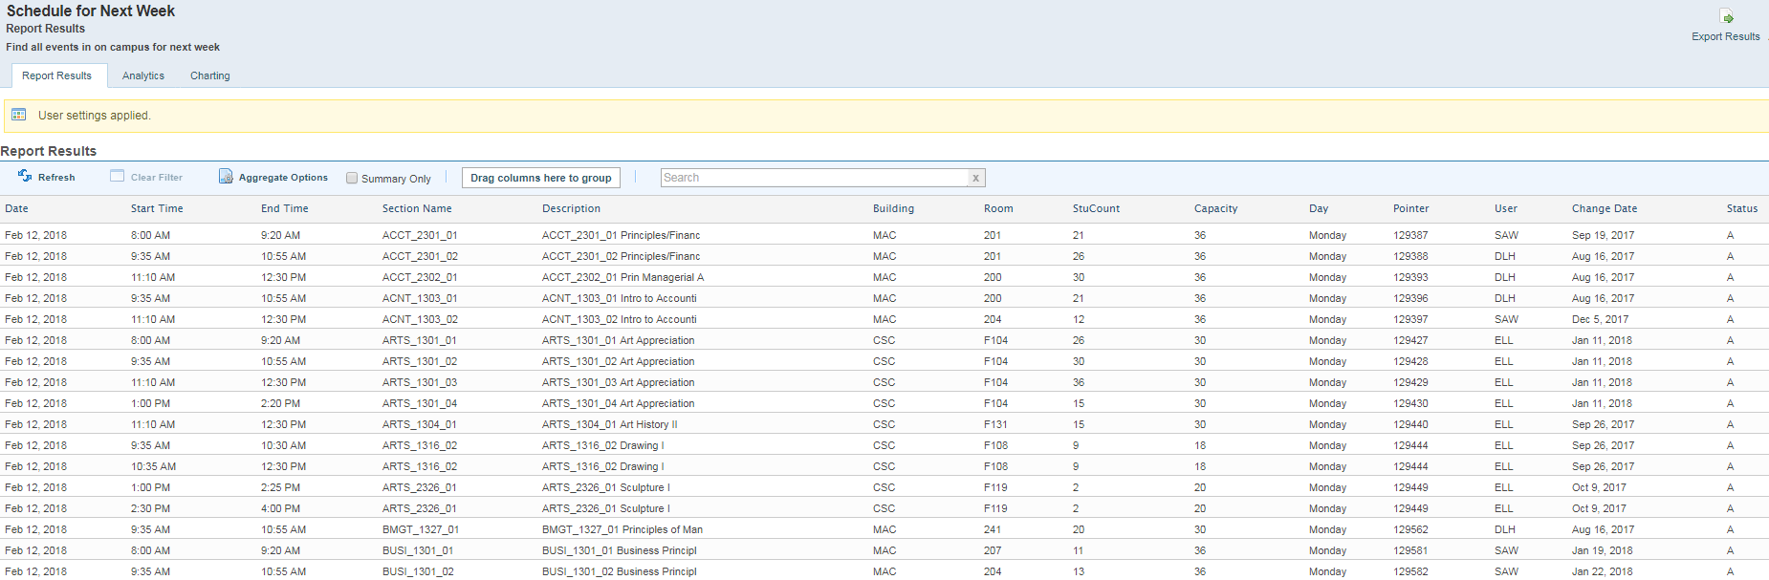
Informer to CSV
Notes:
Current Reporting Option
More data here than these reports use… most reports have more than one purpose… At least the internal ones I use do

Slide 8

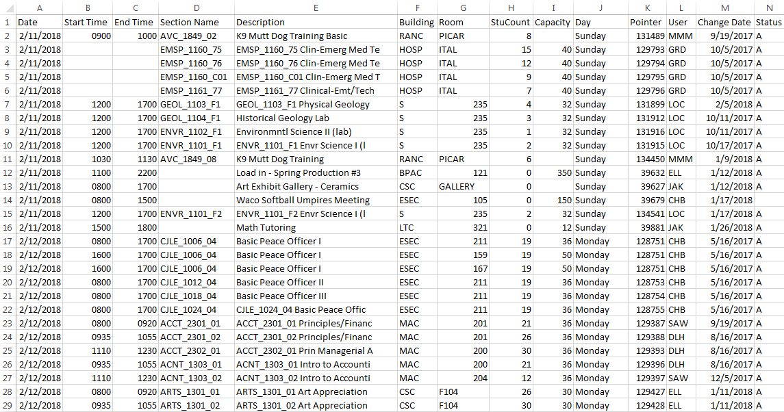
Minor manipulation in Excel
Screen shot Excel with Macro buttons

Slide 9
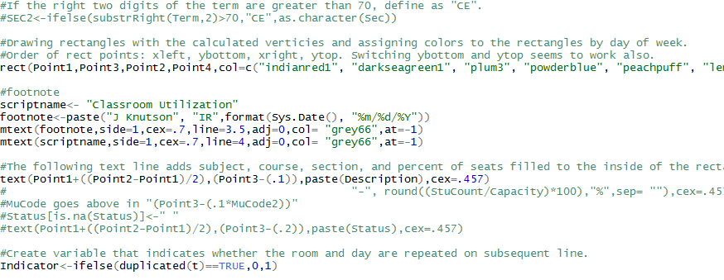
R Script
Notes:
Just a snippet of one of the parts that does the drawing.

Slide 10
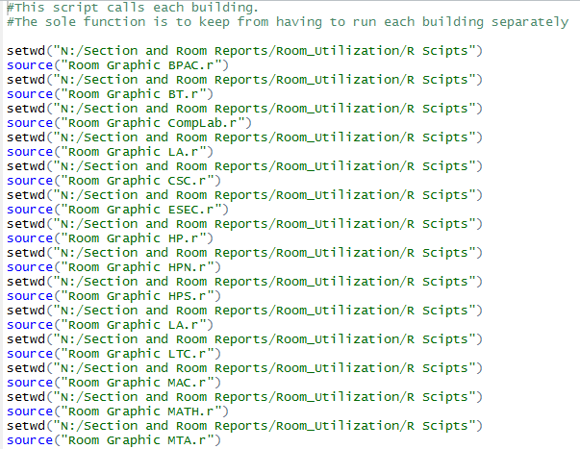
Run them all…
Notes:
My favorite Script

Slide 11
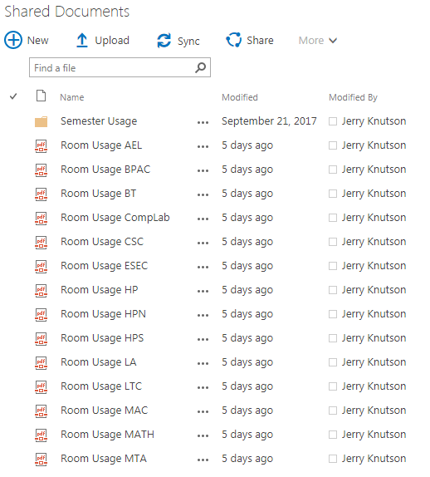
SharePoint
Notes:
No more e-mailing. Just copy them when they are done generating.

Slide 12
More to come
Capacity Percentages
Pending classes
Colors by type of class instead of weekday
Calling R script from within SAS… The next step to automation

Slide 13
Semester Usage Stats
The process as it was
How long it took
Not doing that again
Notes:
Before I did this, and the first time I did this it was a process that was done in Excel.
Data in, manipulation to calculate time periods of events, Pivot tables to consolidate data, graphs from the data
The first time I completed the process it took almost 2 weeks, working on it about 30-40% of the day

Slide 14
The flow
Informer Report to CSV data
Minor Manipulation in Excel
Import into SAS & Process
PDF report for each building showing all of the rooms, broken down by part of day
Notes:
Similar to the weekly schedule, just no R

Slide 15
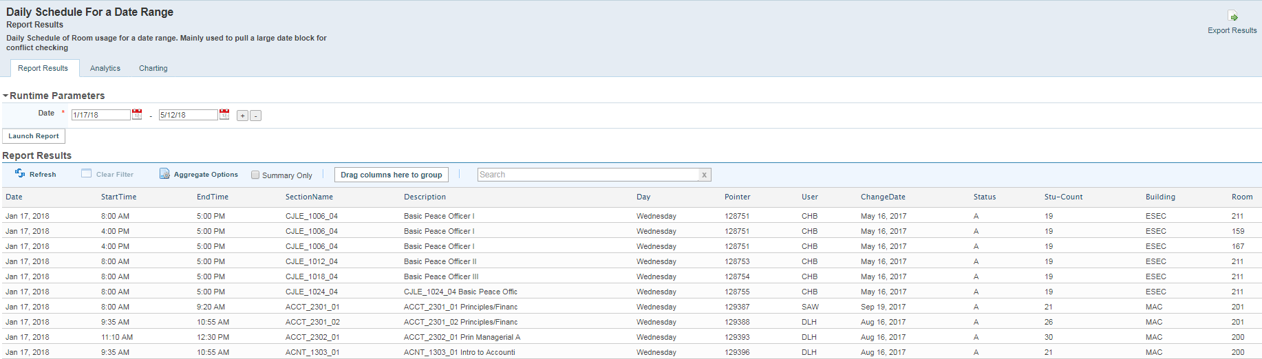
Informer

Slide 16
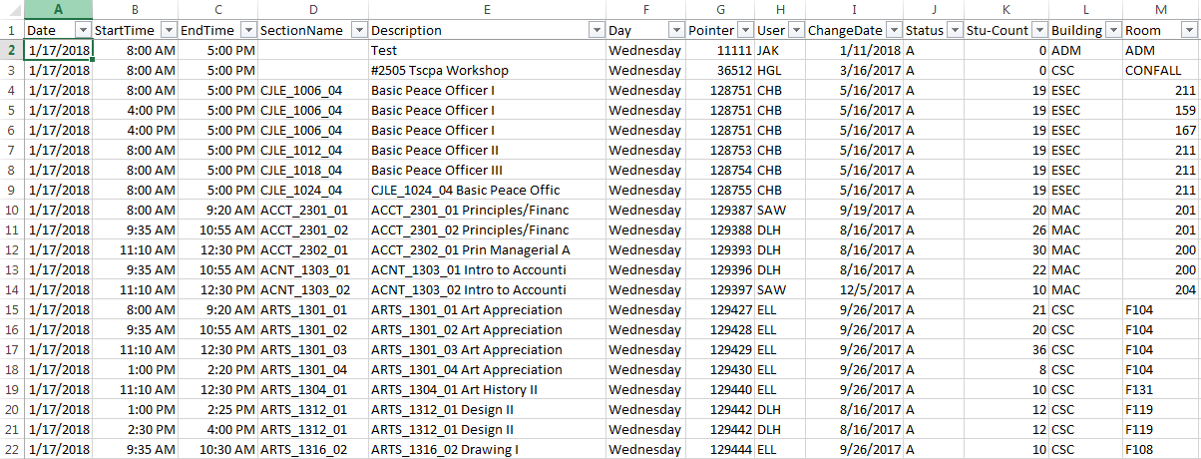
Excel

Slide 17
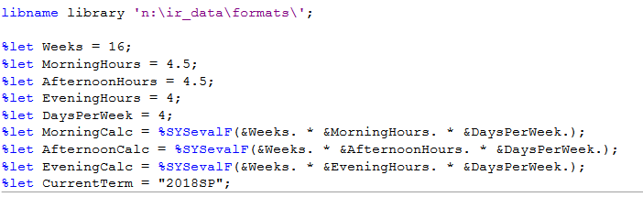
SAS Code Process
Notes:
Some variables that are used everywhere… change it here & everything calculates with new math

Slide 18
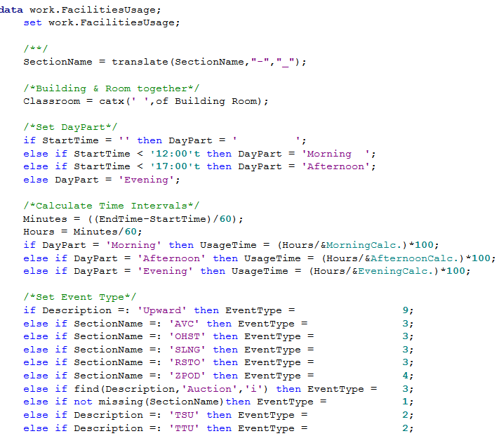
SAS Code Process
Notes:
Take the under bar out of section title
Calculate part of day
Calculate usage time as a percentage of day for each record
Assign Event Types for color coding later

Slide 19
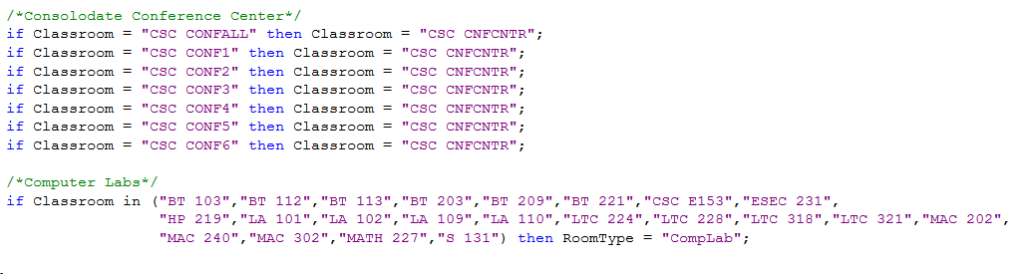
SAS Code Process
Notes:
Consolidate Conference Center
Assign code to computer labs
Not Shown: assign division code of ‘Other’ to University Center & non-class events

Slide 20
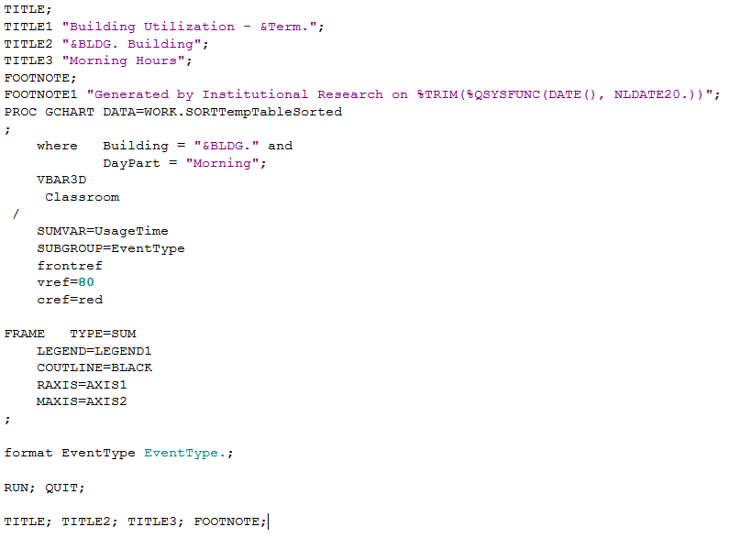
Report Code
Notes:
This is just the code that produces the bar chart. There are some proc format codes that apply to the output for readability

Slide 21
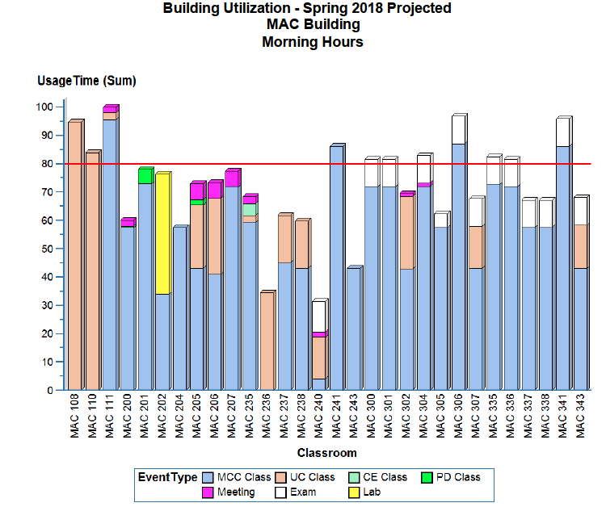
Report
Notes:
One Building, showing all rooms and what the use is

Slide 22
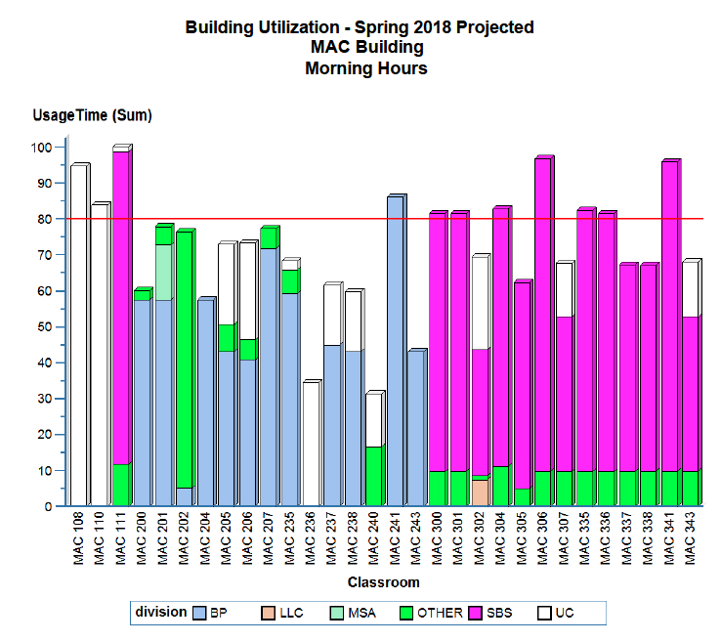
Special
Request
Notes:
Someone needed to see usage by division.
Adding the division to the data and cloning the report and changing it to breakdown on department instead of type took about 20 minutes total

Slide 23
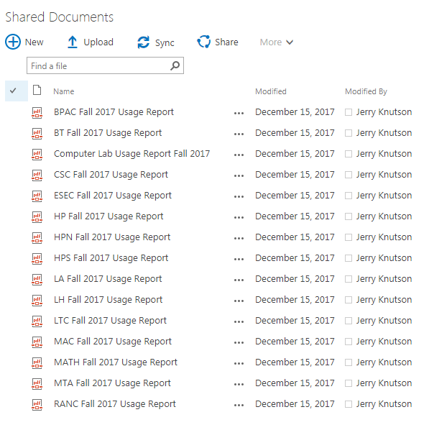
Distribution
Notes:
Yes, I like SharePoint A LOT because of this

Slide 24
Special Thanks
Collin College
Notes:
Collin College did a presentation on weekly schedules 2 years ago and were kind enough to share their code with me.

Slide 25

Jerry Knutson
McLennan Community College
jknutson@mclennan.edu

