Slide 1

What Makes a Difference: Research on Student GPA Using ANCOVA
Sam shi
Fangyu / Brody Du
TAIR 2018, Corpus Christi, TX

Slide 2




Strategic Analysis and Reporting
UNT Dallas
Strategic Analysis and Reporting. New Trend.

Slide 3

Student Performance _ Abstract
Purpose of Analysis - Find out what makes a difference on student GPA
How to do it - Find patterns using students’ information
Which method - ANCOVA
What software- SPSS

Slide 4



Student Performance _ Summary
Why it matters
Dataset introduction
Target students selecting
Introduction
ANCOVA
Data Analysis
Usage
Future Topic
Practical Meanings

Slide 5
Student Performance _ Introduction
Why it matters
Dataset introduction
Target students selecting

Slide 6

Student Performance _ Introduction _ Why it matters
GPA has strong correlation with retention
GPA influence graduation rate
For advising purpose

Slide 7
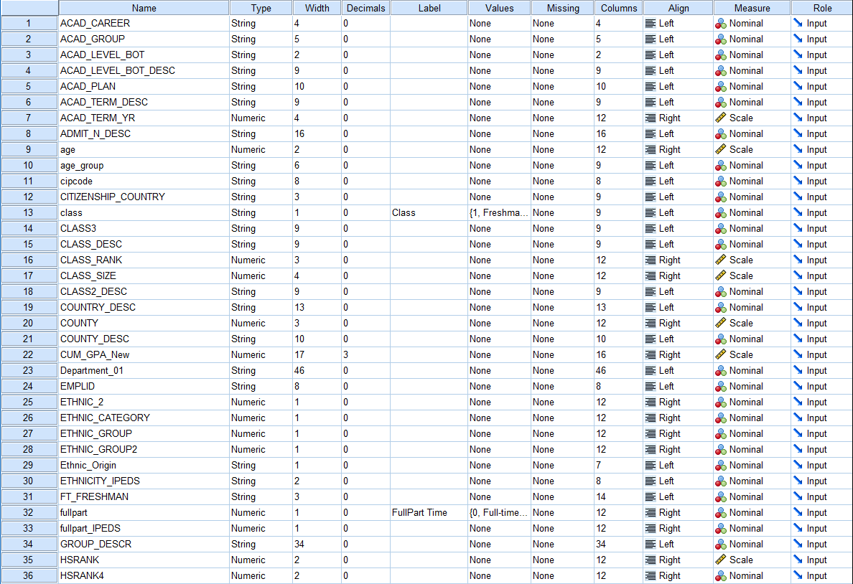
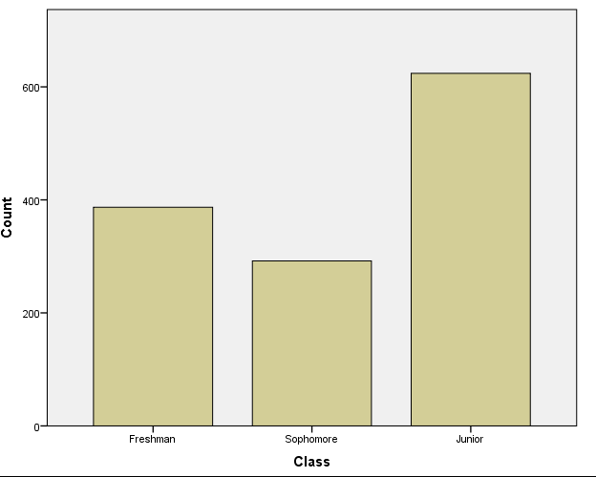
Student Performance _ Introduction _ Dataset
Fall 2016
Only Freshman, Sophomore, and Junior
21 Variables about students

Slide 8
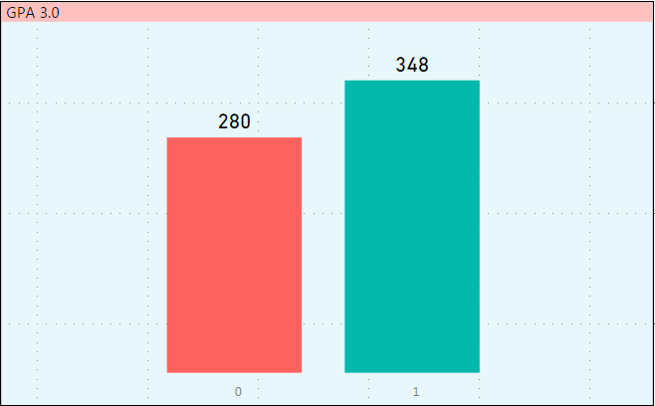
Student Performance _ Introduction _ Target Students
Use 3.0 as cut-off point according to previous research result
The differences of the pattern maximum when cut off by 3.0
The best cut-off point may varies across institutions

Slide 9
Student Performance _ Analysis
ANCOVA

Slide 10
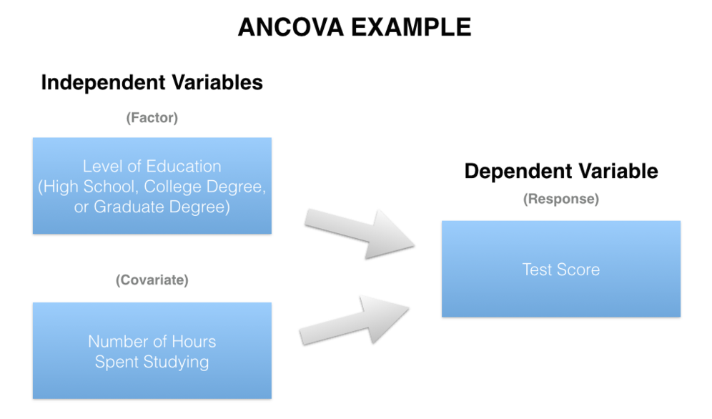
Student Performance _ Analysis _ ANCOVA
A General Linear Model
From observations about an item to conclusions about the target value
Only shows significant variables and how significant.

Slide 11
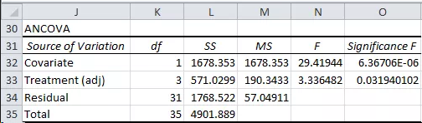
Student Performance _ Analysis _ ANCOVA _ Example
Result of ANCOVA

Slide 12
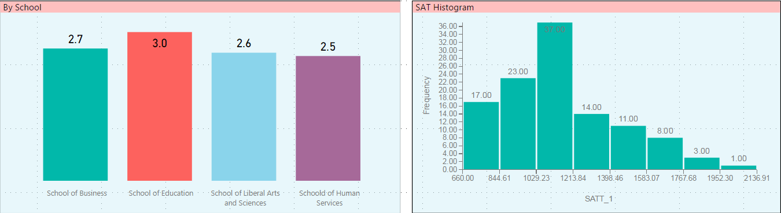
Student Performance _ Analysis _ ANCOVA
Goal 1 – If the GPA of a student is higher or lower than 3.0
Goal 2 – Which variable makes difference
Variables – Full-time, Part-time, School, Gender, SAT …

Slide 13
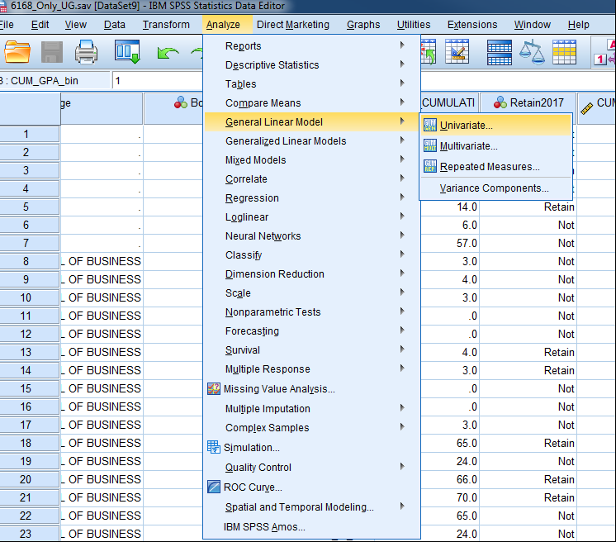
Student Performance _ Analysis _ Decision Tree
Process – Analyze – GLM - Univariate

Slide 14
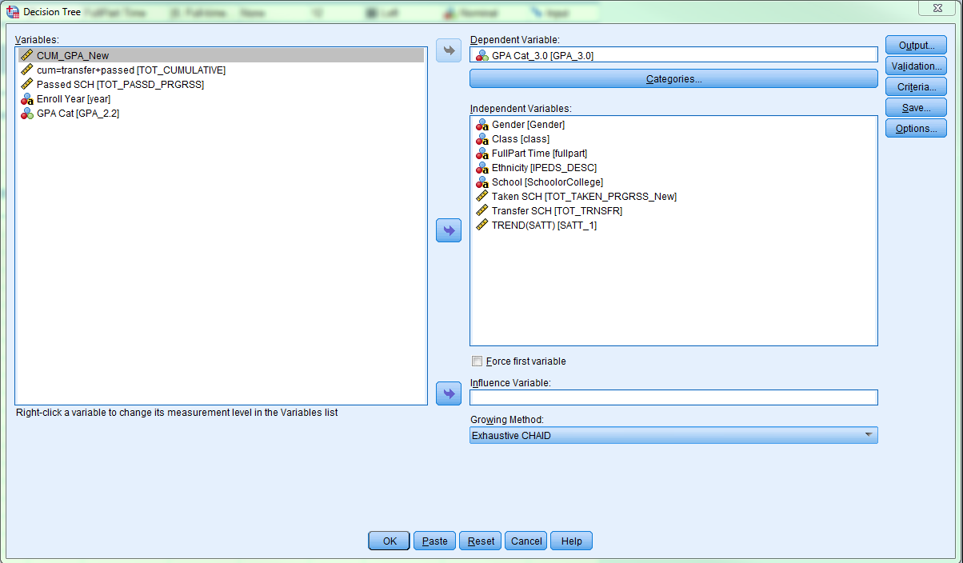
Student Performance _ Analysis _ Decision Tree
Dependent variable – higher or lower than 3.0
Independent variable - predictors

Slide 15
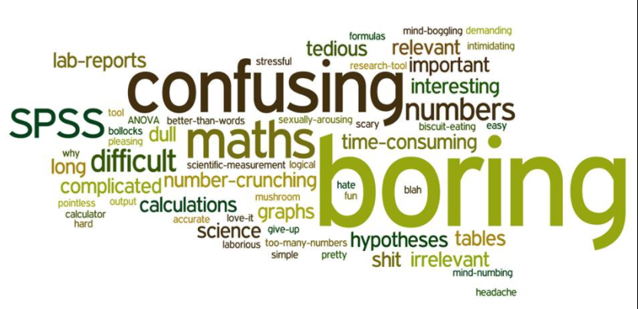


Student Performance _ Analysis _ Decision Tree

Slide 16
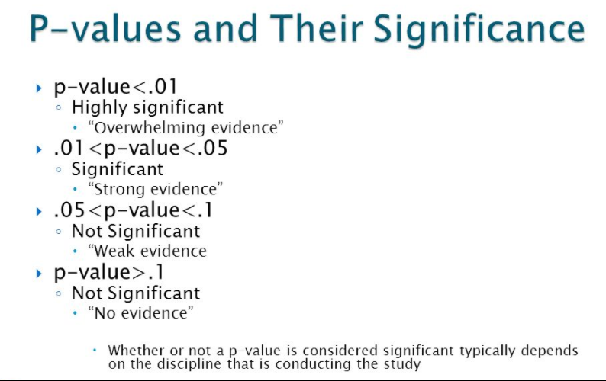
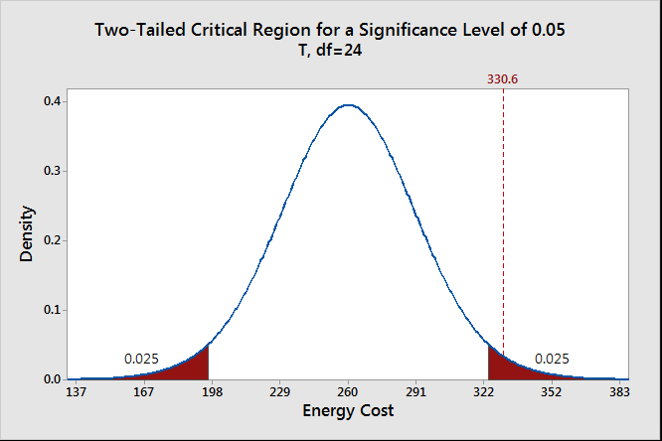
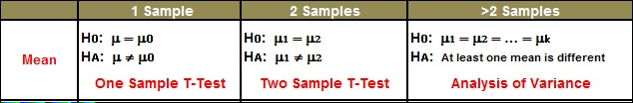
Student Performance _ Analysis _ P-value
P-value
Significant

Slide 17
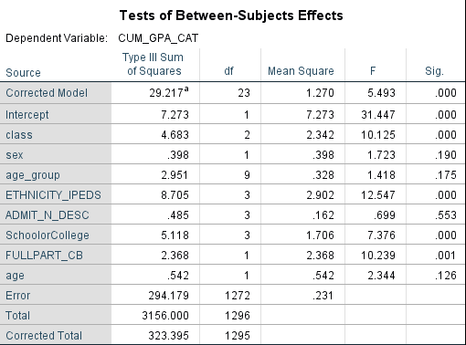
Student Performance _ Analysis _ Decision Tree
Result – All tree
Variables picked – Class, Ethnicity, School, FullPart

Slide 18
Student Performance _ Practical Meanings
Usage
Future Topic

Slide 19
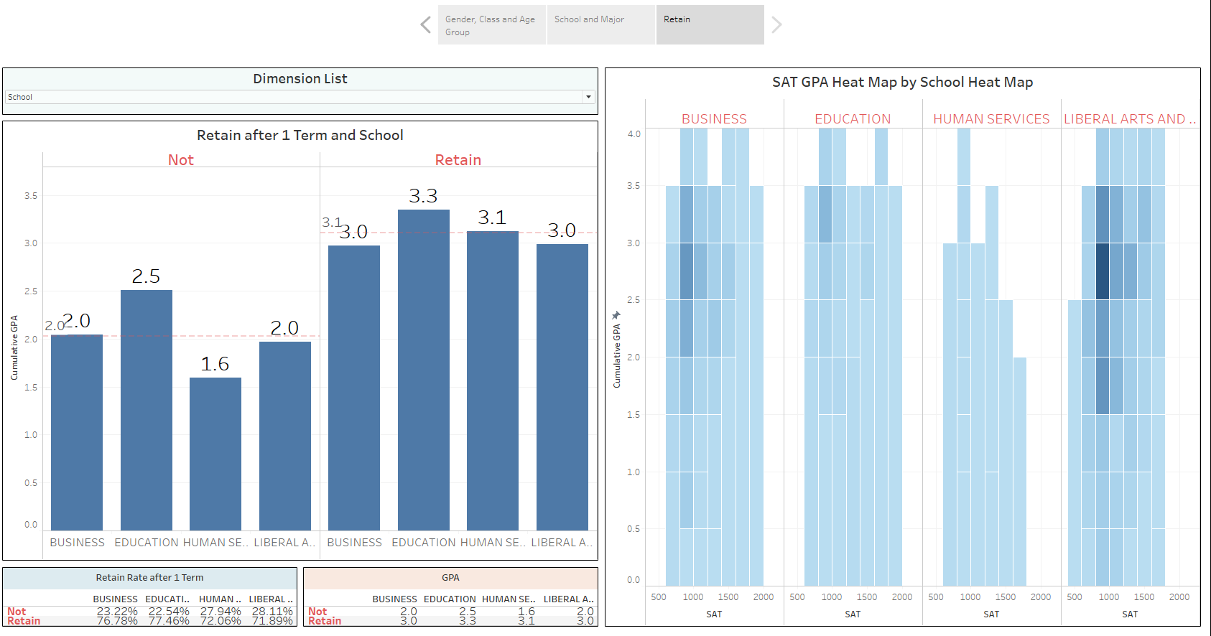
Student Performance _ Practical Meanings
Using the rule to predict new-coming students and send early alter to advisors
Know the trend of the students’ performance

Slide 20
Student Performance _ Future Topic
Compare interaction methods and test if significant difference exist
Collaborate with other universities to create more general rules

Slide 21

Thank you! Questions?
Thank you!
Contact us anytime if you need help!
Sam Shi Sam.Shi@untdallas.edu 972-338-1785
Brody Du Brody.Du@untdallas.edu 972-338-1343
Please come take a name card and stay in touch!

Slide 22
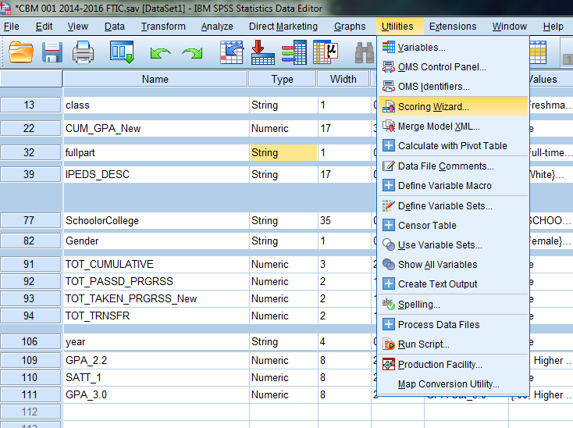
SPSS _ Analysis _ Decision Tree
Generating rules – Rules – Export – Save
Use rules – Utilities – Scoring Wizard

