Slide 1


Transparency and Non-Profit Private Institutions of Higher Education: Where Do We Go From Here?
Elizabeth M. Puthoff, Vice President for Research and Policy Analysis, ICUT
Jenna Cullinane Hege, PhD, Deputy Assistant Commissioner for Strategic Planning, THECB

Slide 2
Who are we?
Our Mission
Our Vision
ICUT supports Texas independent nonprofit colleges and universities by strengthening member institutions through advocacy, policy research and collaboration.
Specifically, our programs help our member institutions:
advance educational opportunities for students,
address financial needs of families,
promote economic opportunities for communities,
foster relationships with businesses, and
inform and advise policymakers.
ICUT will continue to be an integral, vibrant and sustainable component of the higher education landscape in Texas and will champion the diverse traditions, approaches and populations of our member institutions.
The higher education system in Texas is made stronger by including Texas independent, regionally-accredited, nonprofit colleges and universities.

Slide 3
Our Members
ICUT is a Texas non-profit membership corporation, a 501 (c)(6) organization.
ICUT has 39 member institutions that are non-profit, 501(c)(3) multipurpose independent colleges and universities whose main campuses are located in Texas. ICUT also includes the Baylor College of Medicine, a nationally-ranked, top-tier private medical school.
Regular member institutions must be accredited by the Southern Association of Colleges and Schools Commission on Colleges (SACSCOC), the Liaison Committee on Medical Education, or the American Bar Association.
Each ICUT member has a main campus location but many ICUT institutions have branch campuses throughout the state. Increasingly, ICUT institutions are also delivering courses online.
All ICUT member institutions meet the same accreditation standards as Texas’ public colleges and universities.

Slide 4
ICUT’s Three Primary Responsibilities
Advocacy and Public Policy
Membership Services
Research and Data Collection

Slide 5

Closing the Gaps: THECB Strategic Plan, 2000 – 2015
Closing the Gaps (CTG) was adopted by The Coordinating Board in 2000.
The intent of CTG was to close educational gaps within Texas and between Texas and other states by 2015. It included four goals:
  Participation: By 2015, close the gaps in participation rates to add 630,000 more students.
  Success: By 2015, award 210,000 undergraduate degrees, certificates, and other identifiable student successes from high-quality programs.
  Excellence: By 2015, substantially increase the number of nationally-recognized programs or services at Texas colleges and universities.
  Research: By 2015, increase the level of federal science and engineering research and development obligations to Texas institutions to 6.5 percent of obligations to higher education institutions around the nation.

Slide 6
Current Reporting Requirements
CBM 001 – Student Enrollment Report
  Private Institutions: 26 data elements
  Public Institutions: 49 data elements
CBM 009 – Student Graduation Report
  Private Institutions: 21 data elements
  Public Institutions: 27 data elements
FADS – Financial Aid Database
  Private Institutions: 113 data elements
  Public Institutions: 113 data elements

Slide 7
Accountability
Transparency

Slide 8
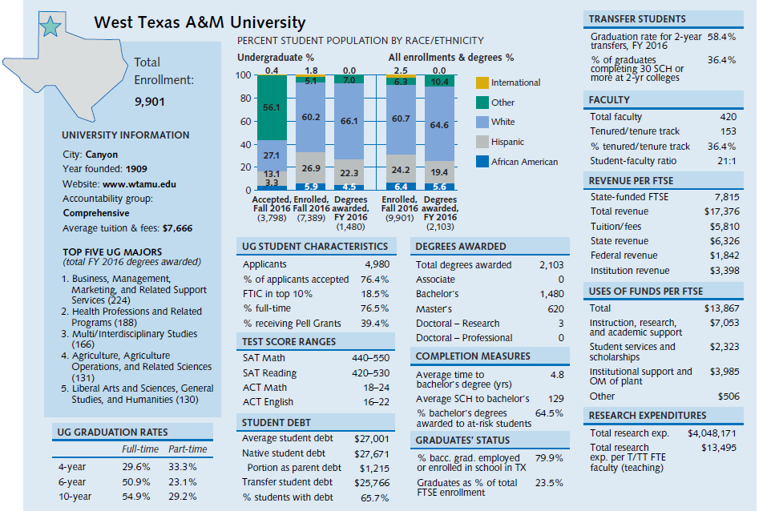

Slide 9
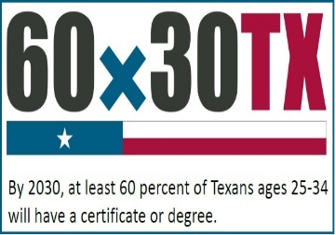
60x30TX: THECB Strategic Plan, 2015 – 2030
60x30TX was adopted by The Coordinating Board in 2015. Its intent is to advance completion and success through four goals:
  Educated Population: By 2030, at least 60 percent of Texans aged 25-34 will have a postsecondary credential or degree.
  Completion: By 2030, at least 550,000 students in that year will complete a certificate, associate, Bachelors, or Masters at a Texas public, independent, or for-profit college or university.
  Marketable Skills: By 2030, all graduates from Texas public institutions of higher education will have completed programs with identifiable marketable skills.
  Student Debt: By 2030, undergraduate student loan debt will not exceed 60 percent of first-year wages for graduates of Texas public institutions.

Slide 10
ICUT institutions are included in many 60x30TX goals and targets at the state or regional level
60x30 Educated Population: Implicitly counted
Completion Goal: Explicitly counted
  Targets for Hispanic, African American, male, and economically disadvantaged completion
  High school to higher education direct enrollment target
Marketable Skills Goal: Voluntary participation
  Target for percent found working or enrolled after graduation
Student Debt Goal: Not included in overall goal or excess hours target
  Target for percent of undergraduates with debt
Notes:
Thank you and I welcome any questions or comments you have.

Slide 11
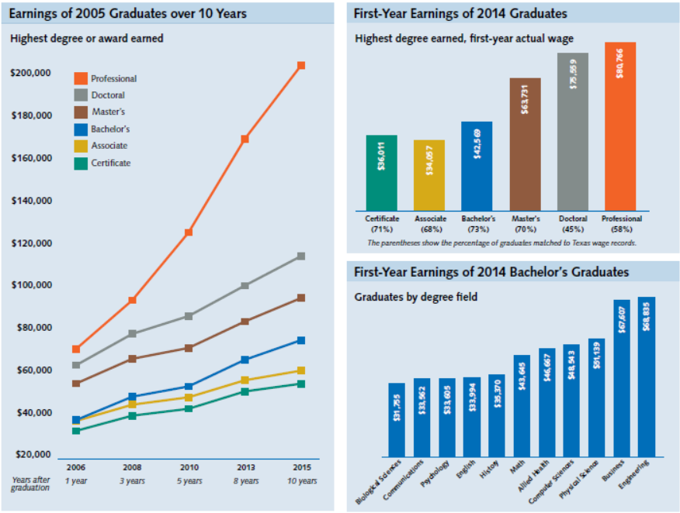
Higher education data linked to workforce data, primarily for public institutions
Notes:
Thank you and I welcome any questions or comments you have.

Slide 12

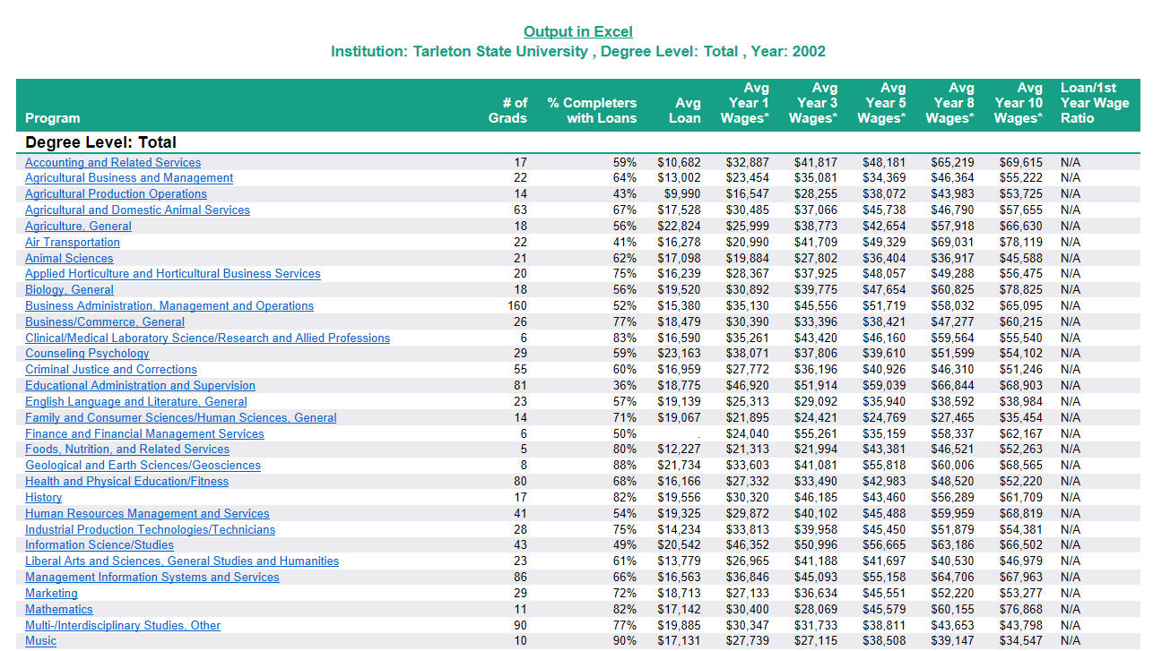
Higher education data linked to workforce data, primarily for public institutions
Notes:
Thank you and I welcome any questions or comments you have.

Slide 13
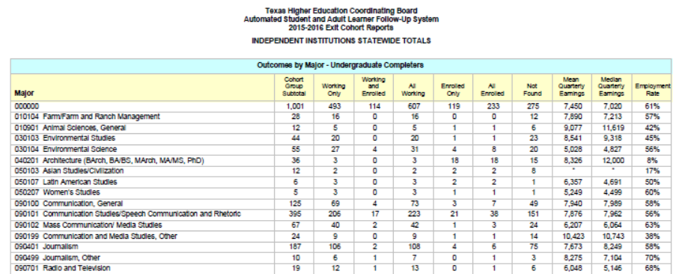
Exit cohort reports include ICUT statewide totals. Institutional reports available upon request
Notes:
Thank you and I welcome any questions or comments you have.

Slide 14
Regional Targets Overview
Notes:
Thank you and I welcome any questions or comments you have.

Slide 15
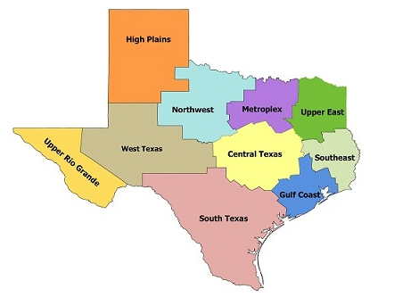
Why approach 60x30TX regionally?
Regions and institutions differ in many ways
However, institutional actions and outcomes are embedded in regional context
  High school feeder patterns
  Transfer networks
  Local labor market
Institutional target-setting is improved by considering regional context
Encourages tactical planning
Notes:
Setting regional targets is a compelling strategy for several reasons. The first is that one size doesn’t fit all. Our 10 higher education regions identified on the map differ by population growth and demographics and are home to different labor markets. When it comes to the 60x30TX goals, regions are starting in different places. Institutions within those regions differ dramatically by mission, funding, and student population, just to name a few.
We also know from analysis of state data that students are very mobile, but predominantly students stay within their region (on average 80% of Texas students enroll in-region). This trend applies to high school to college matriculation, and in transfer patterns among higher education institutions.
We also believe regional target-setting improves the effectiveness of institutional target-setting. Working in cooperation with other institutions and regional stakeholders knowledgeable about their local context, colleges and universities can consider factors outside of their single institution.

Slide 16
What is the scope of the regional targets?
THECB has developed preliminary regional targets in three areas:
60x30 Educated Population Goal
Completion Goal of 550,000 CABMs
65% High School-to-Higher Education Direct Enrollment
Notes:
The process for which we seek approval has two parts.
The first step is for the Coordinating Board staff to replicate the methodology that produced 60x30TX goals with regional data in 3 areas. The first is the 60x30 educated population goal. The second is the completion goal of 550,000 CABM degrees. And the third is the target of 65% of high school graduates enrolling directly in higher education by 2030.
While all of the goals and targets of the strategic plan are critical for the future of Texas, these three areas are particularly well-suited to regional work.
In the second step, higher education regions will be asked to bring together institutions and other stakeholders to identify at least one powerful strategy for each of the three regional target areas listed here. We will also ask them to set their own numeric targets by institutions for the completion goal in 2020, 2025, and 2030.
I will not present the preliminary targets again today, but have the information available should you wish to discuss them.

Slide 17
What are regions being asked to do?
THECB has developed preliminary regional targets in three areas:
Regions bring together institutions and other stakeholders to:
60x30 Educated Population Goal
Completion Goal of 550,000 CABMs
65% High School-to-Higher Education Direct Enrollment
Identify at least one powerful strategy for each of the three areas
Set numeric targets by institution for completion
Notes:
The process for which we seek approval has two parts.
The first step is for the Coordinating Board staff to replicate the methodology that produced 60x30TX goals with regional data in 3 areas. The first is the 60x30 educated population goal. The second is the completion goal of 550,000 CABM degrees. And the third is the target of 65% of high school graduates enrolling directly in higher education by 2030.
While all of the goals and targets of the strategic plan are critical for the future of Texas, these three areas are particularly well-suited to regional work.
In the second step, higher education regions will be asked to bring together institutions and other stakeholders to identify at least one powerful strategy for each of the three regional target areas listed here. We will also ask them to set their own numeric targets by institutions for the completion goal in 2020, 2025, and 2030.
I will not present the preliminary targets again today, but have the information available should you wish to discuss them.

Slide 18
Coordinating Board will work with regions and institutions to roll out targets in AY 2017-2018
Activity | 2017 – 2018 Timeline
Pilot regional target process and support materials in South Texas | October – December 2017
Data fellows trainings | November 2017
Starter kit released | January 2018
THECB-led regional kickoff webinars for other 9 regions | January – February 2018
Accountability meetings | March – April 2018
Preliminary regional targets become official regional targets | May 2018
Regional target submission forms (detailing strategies and institutional targets) due | August 2018
Notes:
We originally discussed rolling out the regional work for everyone this fall. After a healthy spoonful of reality about the magnitude of this work, we have decided to pilot one region this fall, which will be the large South Texas region. This region includes both the San Antonio area and the rio grande valley. Activity with the other 9 regions will begin after the first of the year, starting with THECB-led webinars. We will be asking regions to take the lead after that point, although CB Staff will be available for virtual or in-person support.
We will also be aligning some of our regular agency convenings to layer on support for this work, including use of the fall Data Fellows meetings to train people on the regional data workbooks and the Spring accountability meetings to foster regional collaboration and discussion of best practices.

Slide 19
Completion
Number of students completing a certificate or associate, bachelor’s, or master’s degree (CABM)
Region |  | 2016 (actual) | 2020 (projection) | 2025 (projection) | 2030 (projection)
 | High Plains | 15,891 | 18,803 | 22,754 | 27,509
 | Northwest | 5,220 | 6,497 | 7,863 | 9,506
 | Metroplex | 73,774 | 93,552 | 113,213 | 136,870
 | Upper East Texas | 12,600 | 14,206 | 17,192 | 20,784
 | Southeast Texas | 8,814 | 9,760 | 11,811 | 14,278
 | Gulf Coast | 56,762 | 80,866 | 97,861 | 118,310
 | Central Texas | 54,410 | 68,273 | 82,622 | 99,887
 | South Texas | 49,621 | 63,644 | 77,020 | 93,113
 | West Texas | 4,745 | 6,880 | 8,304 | 9,965
 | Upper Rio Grande | 9,507 | 13,519 | 16,360 | 19,778
Statewide |  | 321,410 | 376,000 | 455,000 | 550,000
Regional Target, THECB estimations
Notes:
Next, here are the regional targets for completions. We utilized the current proportion of public, independent, and career school enrollment in the regions to divvy up future growth. As we roll out the completion targets, we will supplement regional projections with data on the current distribution of enrollment and completions by institution. When we ask institutions to determine their own completion targets, this data should help guide the discussion within regions.

Slide 20
EXAMPLE: Metroplex Completion Goal, Actual and Projections
Regional Completion Targets*
Projections for 2020, 2025, 2030 to reach 60x30TX Completion Goal
 | 2016 | 2020 | 2025 | 2030
Region - Total Completions | 73,774 | 93,552 | 113,213 | 136,870
Statewide - Total Completions | 321,410 | 376,000 | 455,000 | 550,000
Statewide Hispanic | 103,889 | 138,000 | 198,000 | 285,000
Statewide African American | 38,813 | 48,000 | 59,000 | 76,000
Statewide Male | 135,849 | 168,000 | 215,000 | 275,000
Statewide Economically Disadvantaged | 119,490 | 146,000 | 190,000 | 246,000

Slide 21
EXAMPLE: Metroplex Completion Goal, Actual and Projections
Completions (Certificate, Associate, Bachelor's, Master's) by Institution of Higher Education - Race/Ethnicity, Gender, Economically Disadvantaged Students - FY 2016
Metroplex | Total | White | Hispanic | African American | Other | Male | Female |  | **Economically Disadvantaged
Public Institutions (All Sectors) Total | 64,215 | 28,650 | 13,195 | 9,102 | 13,268 | 26,136 | 38,079 |  | 25,324
All Institutions (All Sectors) Total | 73,774 | 34,422 | 14,347 | 9,900 | 15,105 | 30,398 | 43,376 |  | 27,088

Slide 22
EXAMPLE: Metroplex Completion Goal, Actual and Projections
Public Four-Year Institutions | Total | White | Hispanic | African American | Other | Male | Female |  | **Economically Disadvantaged
U. OF TEXAS AT ARLINGTON | 11,321 | 4,714 | 2,164 | 1,413 | 3,030 | 4,222 | 7,099 |  | 3,892
UNIVERSITY OF NORTH TEXAS | 8,271 | 4,568 | 1,529 | 1,010 | 1,164 | 3,585 | 4,686 |  | 3,241
U. OF TEXAS AT DALLAS | 6,594 | 1,878 | 629 | 308 | 3,779 | 3,631 | 2,963 |  | 1,428
TEXAS WOMAN'S UNIVERSITY | 3,561 | 1,700 | 650 | 709 | 502 | 397 | 3,164 |  | 1,323
TEXAS A&M UNIVERSITY-COMMERCE | 3,257 | 1,732 | 379 | 523 | 623 | 1,286 | 1,971 |  | 1,074
TARLETON STATE UNIVERSITY | 2,880 | 2,076 | 424 | 210 | 170 | 1,097 | 1,783 |  | 1,350
UNIV. OF NORTH TEXAS AT DALLAS | 567 | 73 | 236 | 218 | 40 | 159 | 408 |  | 373
Total | 36,451 | 16,741 | 6,011 | 4,391 | 9,308 | 14,377 | 22,074 |  | 12,681
Independent Institutions | Total | White | Hispanic | African American | Other | Male | Female |  | **Economically Disadvantaged
SOUTHERN METHODIST UNIVERSITY | 3,267
TEXAS CHRISTIAN UNIVERSITY | 2,559
DALLAS BAPTIST UNIVERSITY | 1,382
UNIVERSITY OF DALLAS | 681
SOUTHWESTERN ASSEM OF GOD UNIV | 596
TEXAS WESLEYAN UNIVERSITY | 532
AUSTIN COLLEGE | 276
SOUTHWESTERN ADVENTIST UNIV | 139
PARKER UNIVERSITY | 76
SOUTHWESTERN CHRISTIAN COLLEGE | 29
PAUL QUINN COLLEGE | 22
Total | 9,559 | 5,772 | 1,152 | 798 | 1,837 | 4,262 | 5,297 |  | 1,764

Slide 23
Questions? Comments?
Notes:
Thank you and I welcome any questions or comments you have.

