Slide 1


I’ve Got the
Power (BI)

Slide 2

Introductions
James “Kent” McShan
Director, Analytics
Analytics and Institutional
Reporting

Slide 3

Introductions
Janet Flores
Manager, Client Relations and
Communications
Analytics and Institutional
Reporting

Slide 4

Introductions
Jason Kot
Manager, BI Analytics
Analytics and Institutional
Reporting

Slide 5
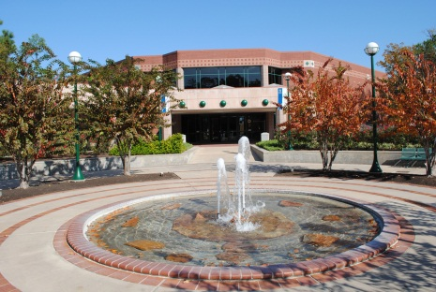


About LSC
89,000 credit students each semester, total enrollment of more than 99,000 (credit and non-credit).
One of the top 3 largest colleges in the nation.
One of the fastest-growing college systems in U.S.
Added 39,603 students fall 2006 to fall 2016, an 86% increase.
11 school districts, 1,400 square miles, population of 2 million.
7,813 employees (part-time and full-time).

Slide 6
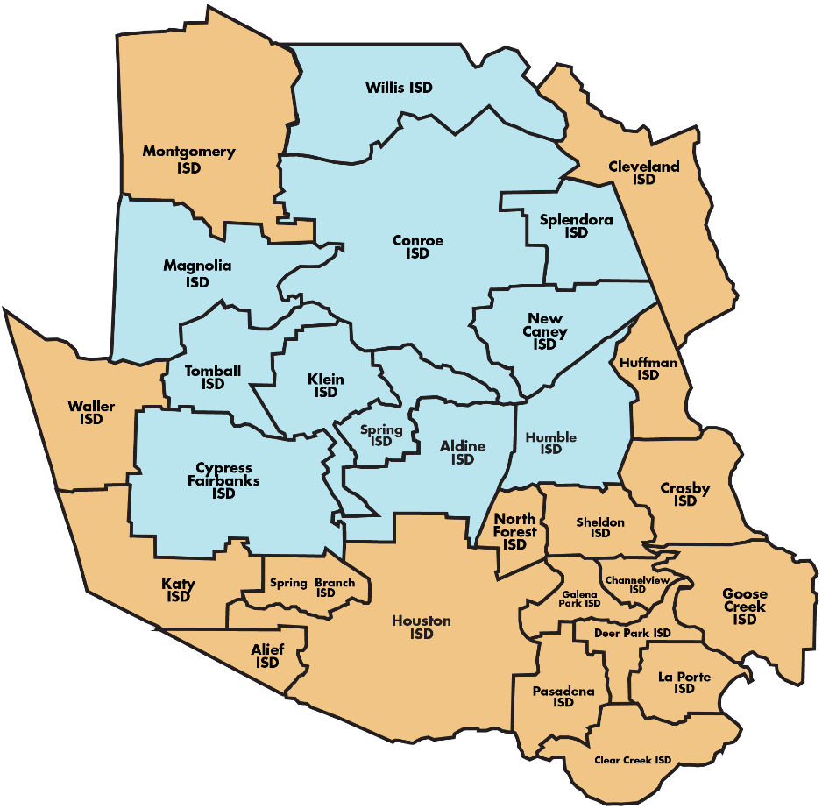
About LSC
11 school districts
99,000 students
2.1 M population
1,400 square miles
$347 M operating budget
7,813 employees

Slide 7

Overview
An introduction to Power BI at Lone Star College
A quick tour of our current Power BI offerings at Lone Star College
Discuss a few examples of how we’re empowering our clients with Power BI
Closing and questions

Slide 8

Intro to Power BI at LSC
So, how did we get here?

Slide 9
Intro to Power BI at LSC
IR to BI Analytics
Making the Transition Work
Notes:
As you might recall if you attended TAIR last year, we presented on our transition from IR to BI Analytics and how we were making that transition work. We discussed how we were moving from a traditional IR shop to one where BI analytics would be the main focus, incorporating more self service options like dashboards and visualizations to support our clients.

Slide 10




Intro to Power BI at LSC
Notes:
We discussed how a big part of that transition was the adoption of the MicroSoft BI suite of tools…..with three main keys to success for us.

Slide 11
Intro to Power BI at LSC
Notes:
A main key of that that we’ll be discussing today, Power BI

Slide 12

Intro to Power BI at LSC
So how has this empowered us and our clients?
Notes:
So how has this empowered us and our clients?
Users can explore the data behind their dashboard using intuitive tools that make finding answers easy. Data and reports can be accessed from anywhere with the Power BI Mobile apps, which update automatically with any changes to your data.
Users can create their own visualizations utilizing AIR data models or their own datasets
Users can identify research questions and explore trends by analyzing data in a new way

Slide 13


Intro to Power BI at LSC
Create Reports
Deliver Reports
Notes:
It’s changed how we create and deliver reports to our clients…..
We used to create PDFs that were emailed to our customers.
Now we are able to create interactive reports that are accessible to a wide audience. With our 6 colleges and 8 centers, what is interesting to one location will likely be interesting and useful to all.

Slide 14

Intro to Power BI at LSC
How often do you want that static PDF report created?
Notes:
It’s changed how we communicate with our clients…..

Slide 15
Intro to Power BI at LSC
What can we create for you that you can use anytime you need current data?
Notes:
It’s changed how we communicate with our clients…..
We can announce new dashboards to the entire system or to specific work groups or departments. We utilize templates to make these email announcements, publish articles in our monthly newsletter, etc.

Slide 16

Intro to Power BI at LSC
Notes:
It’s changed how we train our clients to navigate and utilize our reports.
We periodically hold team meetings to share recent dashboard/report development and share those meeting notes with the entire AIR team.
We conduct workshops for other teams who want to learn more about how to navigate in Power BI and get the visualizations they need for presentations, i.e. Grants Dept.
We hold WebEx sessions for individual users as well as one-on-one meetings.

Slide 17
Intro to Power BI at LSC
As a result, it’s given us and our clients “the Power (BI)”
Notes:
As a result, it’s given us and our clients “the Power (BI)......

Slide 18


Intro to Power BI at LSC

Slide 19

Intro to Power BI at LSC
Power at the client’s fingertips
Notes:
So essentially, what we’re trying to consistently do with Power BI is provide power at our client’s fingertips. Let’s look at some real world examples of what we have out there already

Slide 20

Quick Tour of
Power BI at LSC
Notes:
Let’s take a quick tour of our current Power BI offerings at Lone Star College….

Slide 21
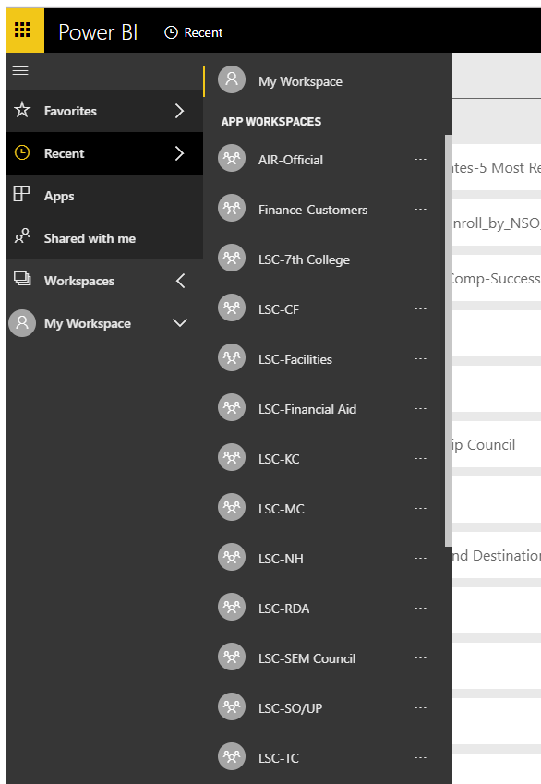
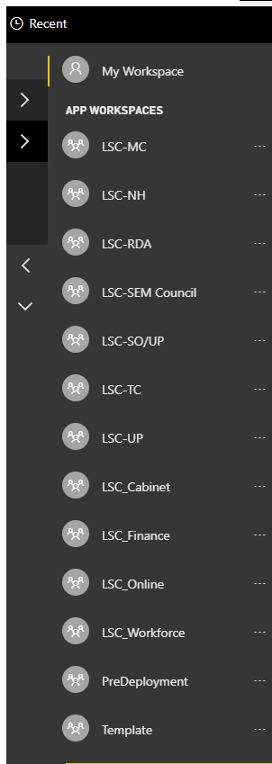
Quick Tour of
Power BI at LSC
Notes:
In LSC’s Discovery cloud, we have several workspaces that we’ve created for client groups, some by college location, some by department, and some for high level leadership.

Slide 22
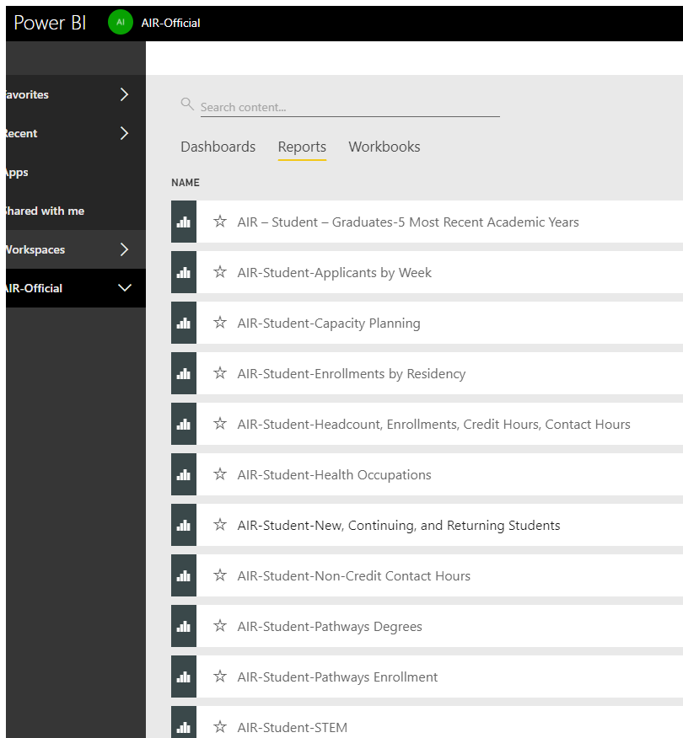
Quick Tour of
Power BI at LSC
Notes:
For this quick tour, we’ll focus on our AIR Official Workspace which houses our AIR approved reports. These are reports that clients know have been developed and reviewed by us so that they are official and as accurate as possible. Some of the other workspaces are playgrounds for clients so the reports there cannot always be considered accurate

Slide 23
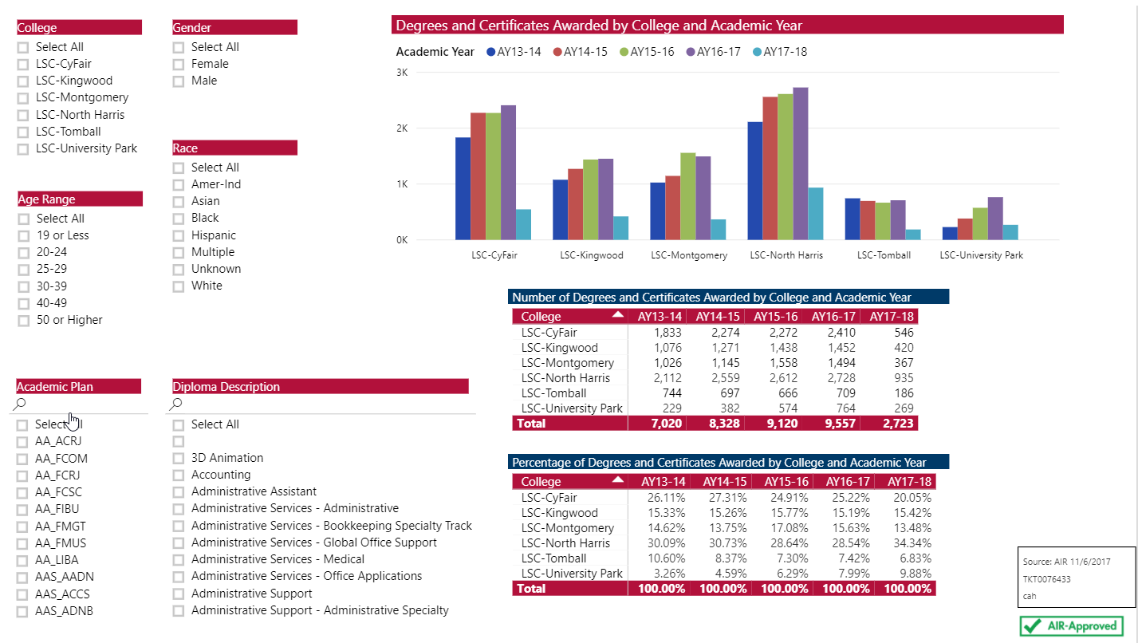
Quick Tour of
Power BI at LSC
Notes:
Here’s one that shows degrees and certificates awarded. Note the slicers to the left that will allow client’s to change the data they’re viewing.

Slide 24
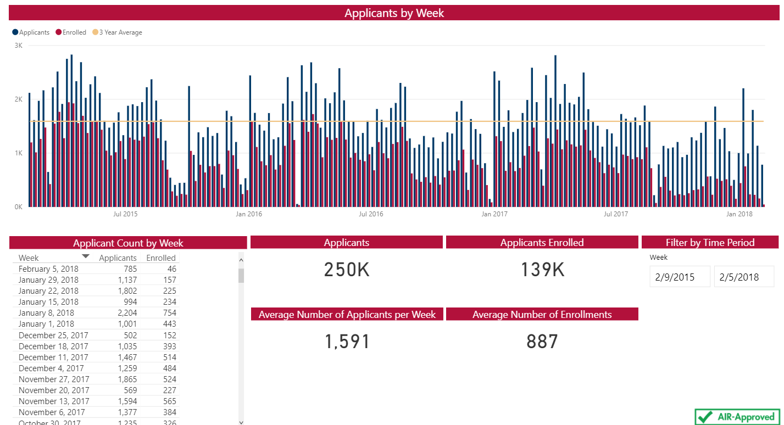
Quick Tour of
Power BI at LSC
Notes:
Here’s an Applicants by Week report. Note the filter by time period slicer that will affect the visuals

Slide 25
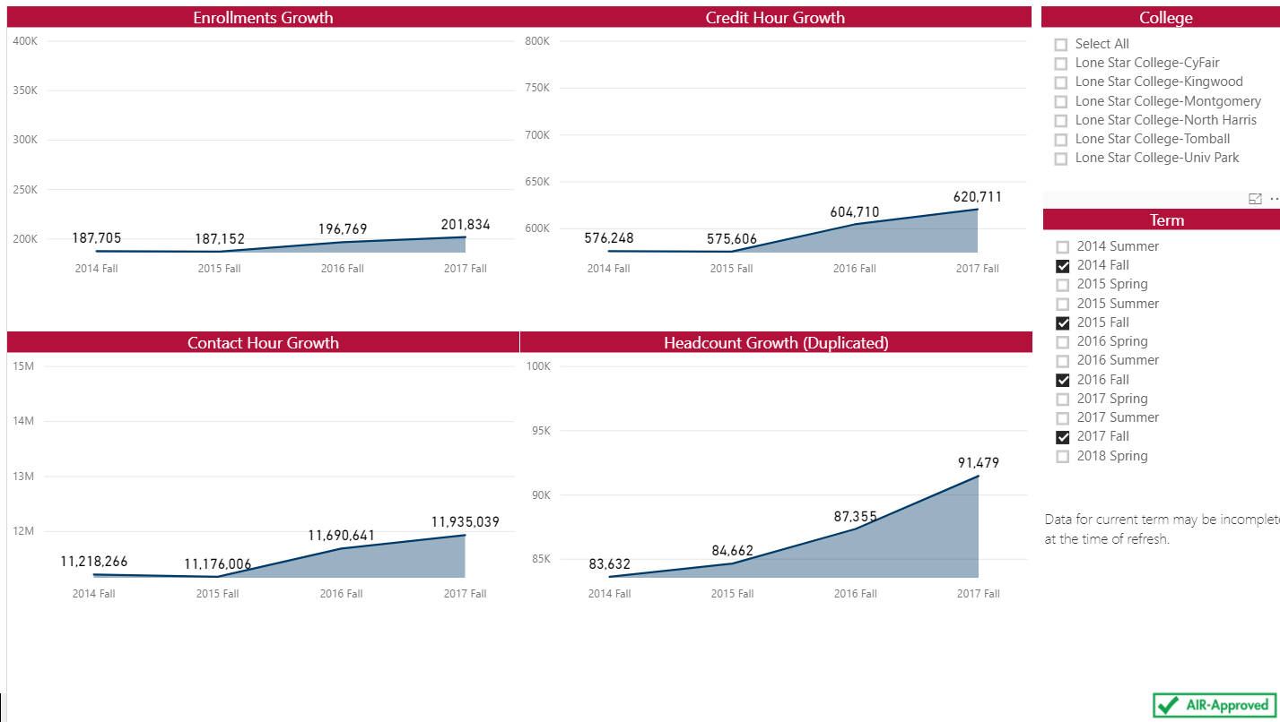
Quick Tour of
Power BI at LSC
Notes:
Here’s one that shows headcount, enrollments, credit hours, and contact hours. Note at the right that fall terms have been selected in the slicer but all are available to clients

Slide 26
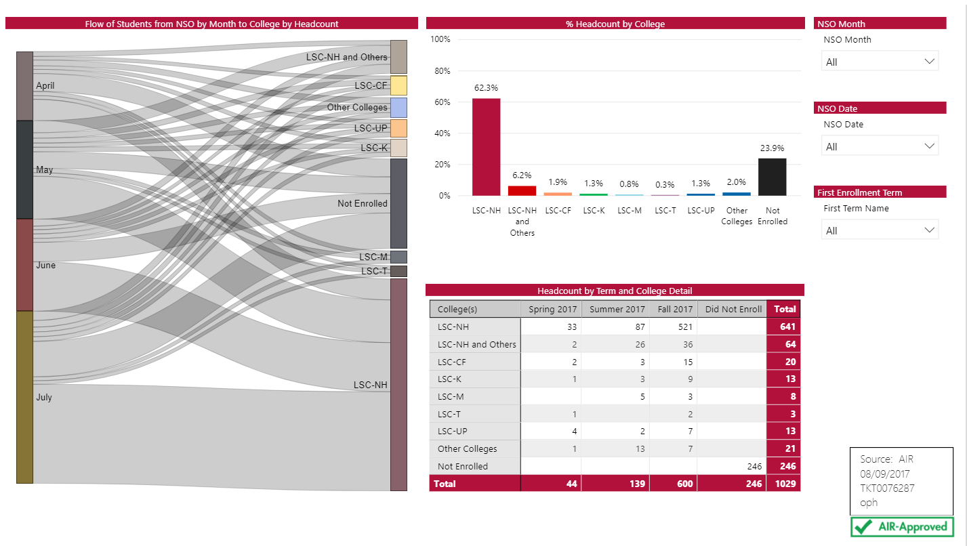
Quick Tour of
Power BI at LSC
Notes:
Here’s a few on New Student Orientation for one of our locations and where they end up enrolling… Note the Sankey visual at the left that shows the flow which can be utilized as a slicer as well as show the data counts when hovered on an individual flow

Slide 27
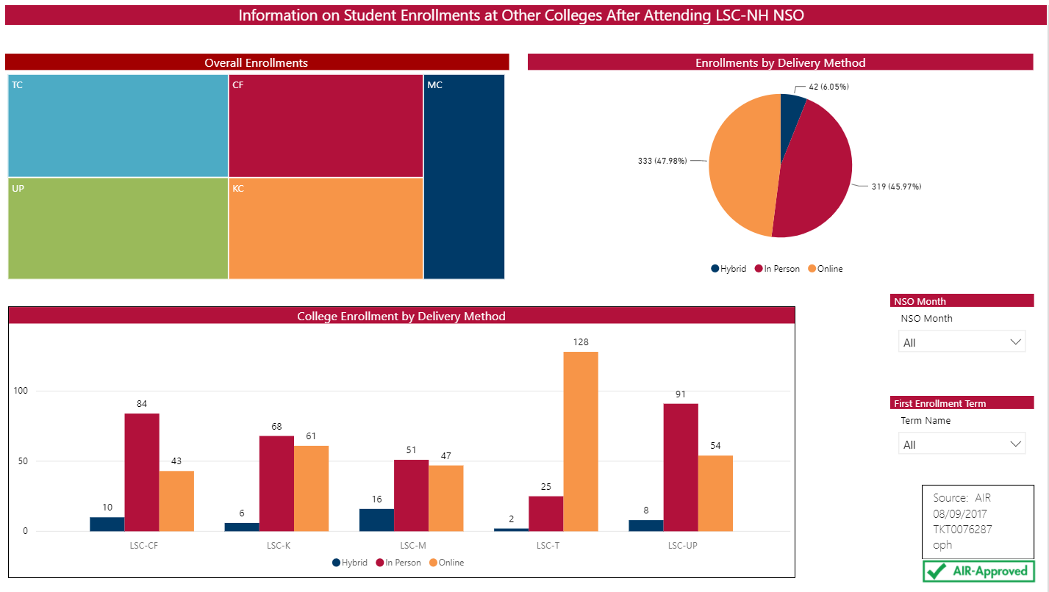
Quick Tour of
Power BI at LSC
Notes:
Another one showing the TreeMap visual at the top left and other visuals with a few slicers.

Slide 28
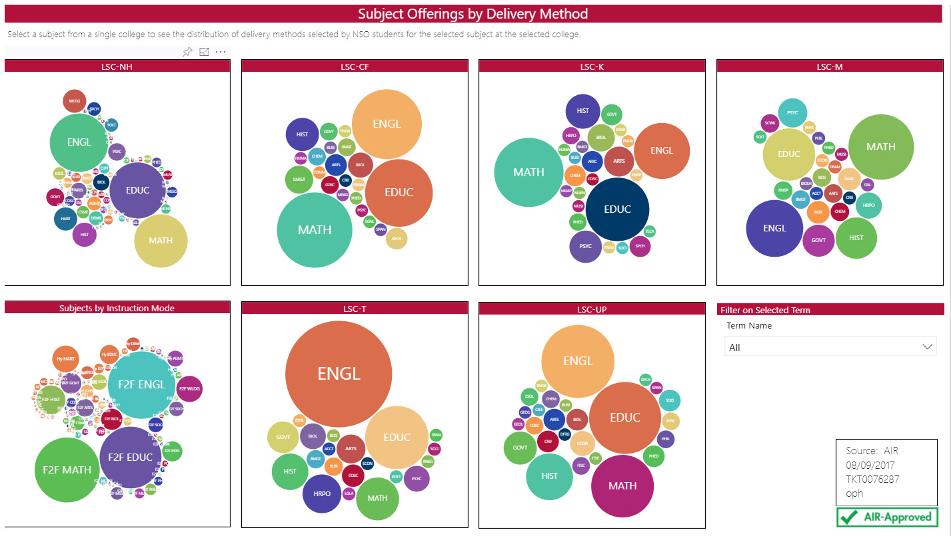
Quick Tour of
Power BI at LSC
Notes:
And here’s one with SuperBubble visuals that are animated and allow you to click on each bubble as a slicer that affects the rest of the visuals on the page.

Slide 29

How We’re Empowering our Clients
Empowering our clients by:
Developing Power BI reports with various types of data
Refreshing those reports to keep them up to date
Providing our clients with accessibility and portability
Notes:
Now that you’ve seen a sampling of what we currently have available to our LSC clients, we’re going to talk about how we’re empowering our clients. We empower them by developing Power BI reports with various types of data, refreshing those reports, and providing our clients with accessibility and portability.

Slide 30

How We’re Empowering our Clients
How we used to get data

Slide 31
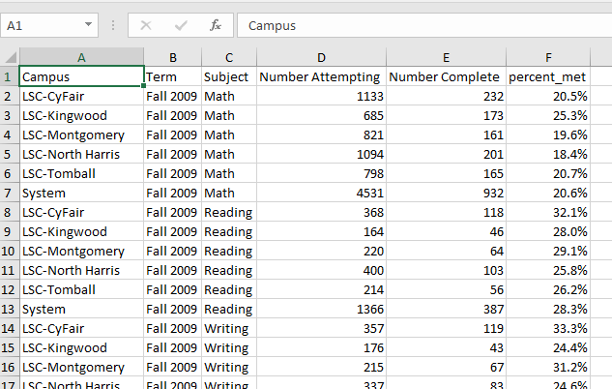
How We’re Empowering our Clients
Spreadsheets

Slide 32
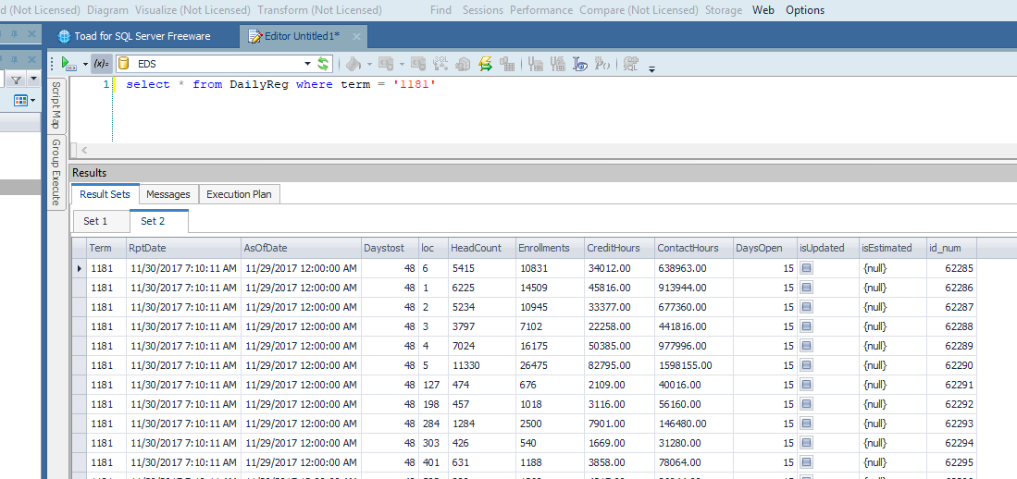
How We’re Empowering our Clients
SQL Server Databases

Slide 33
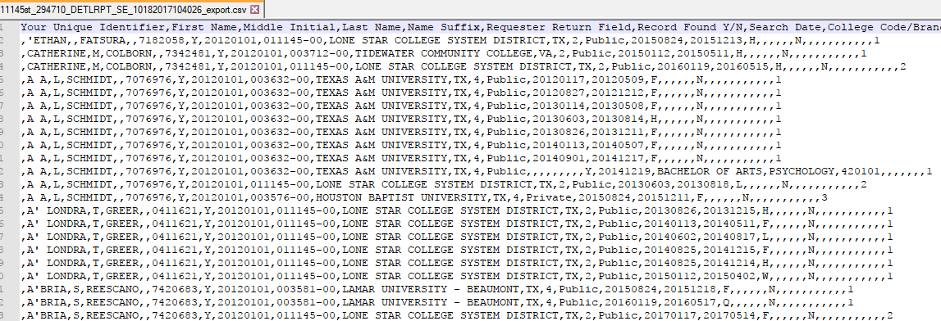
How We’re Empowering our Clients
Text Files

Slide 34

How We’re Empowering our Clients
How we used to work with data

Slide 35
How We’re Empowering our Clients
How we used to work with data
Pivot tables in Excel
Combine data with other database programs
  Access
  Filemaker Pro
Getting updated data usually meant following back through same steps

Slide 36
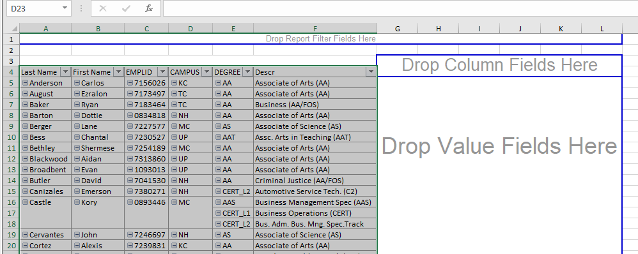
How We’re Empowering our Clients

Slide 37

How We’re Empowering our Clients
Getting and Working with Data Now

Slide 38
How We’re Empowering our Clients
Getting and working with data now
Still use the same sources
Connect directly to data sources with Power BI
Can use text and Excel files also
Once all steps are set up user can get updated data by clicking “refresh”

Slide 39
How We’re Empowering our Clients
Excel files in Power BI
Can be preformatted or formatting can be handled within Power BI
  Removing blank spaces
  Changing number and date formats
Can refresh data with a new Excel file if old file is replaced with the new file

Slide 40

How We’re Empowering our Clients
Importing from Excel

Slide 41
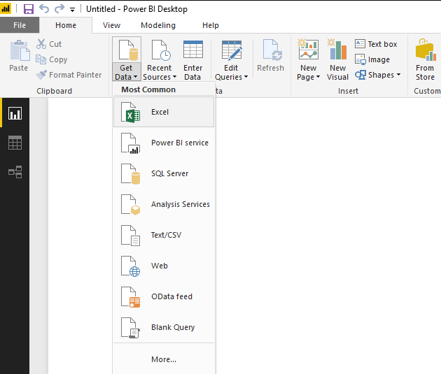
How We’re Empowering our Clients

Slide 42
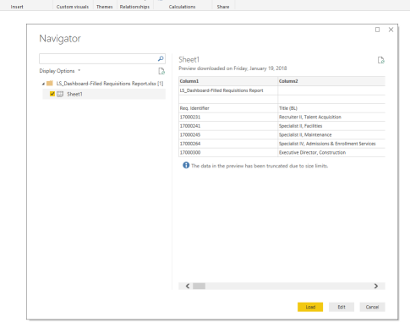
How We’re Empowering our Clients

Slide 43
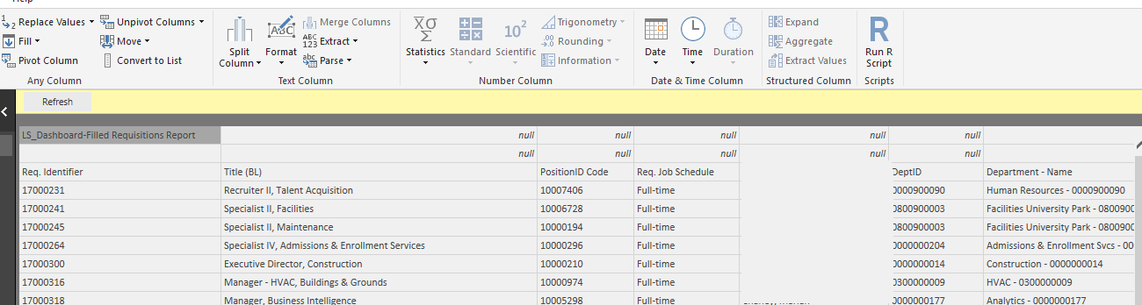
How We’re Empowering our Clients

Slide 44
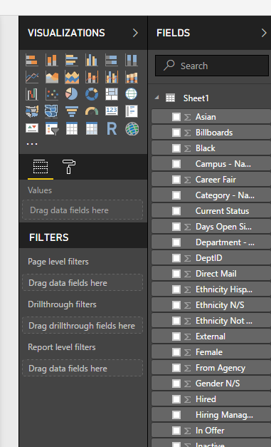
How We’re Empowering our Clients

Slide 45


How We’re Empowering our Clients
Importing from Oracle SQL

Slide 46
How We’re Empowering our Clients
Importing from Oracle SQL
Can navigate through tables or use a prewritten query
Imports data from database
Can perform additional transformational steps once imported
  Create calculations
  Change formats
  Create calculated columns
Can import multiple queries into different tables and create relationships
Must have Oracle ODAC software installed
  Can use either TNS file or enter in server and service name

Slide 47
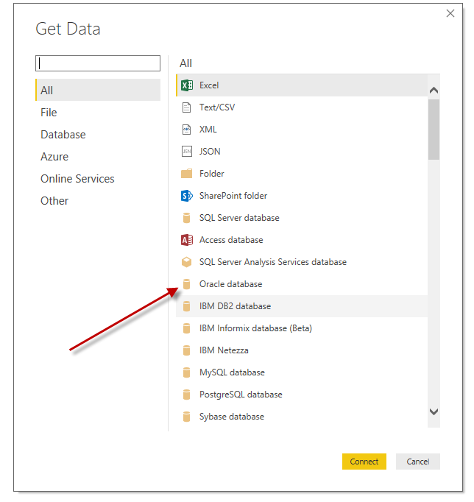
How We’re Empowering our Clients

Slide 48
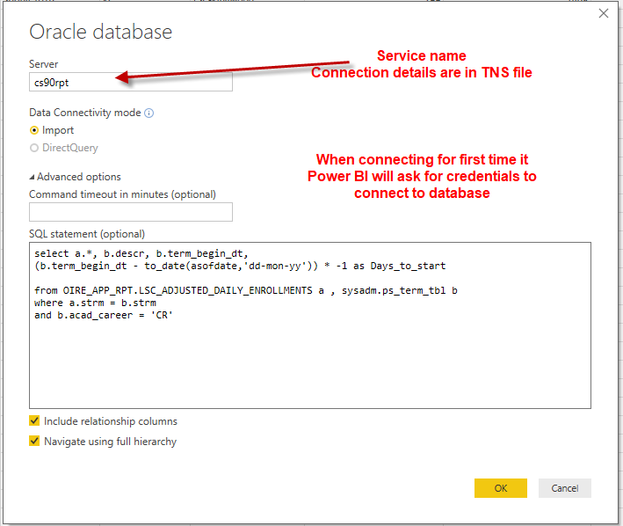
How We’re Empowering our Clients

Slide 49
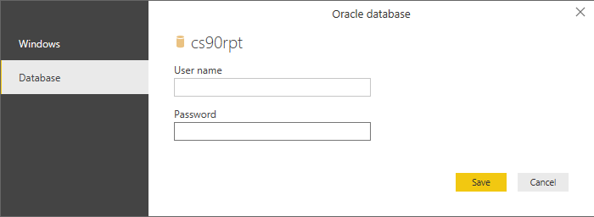
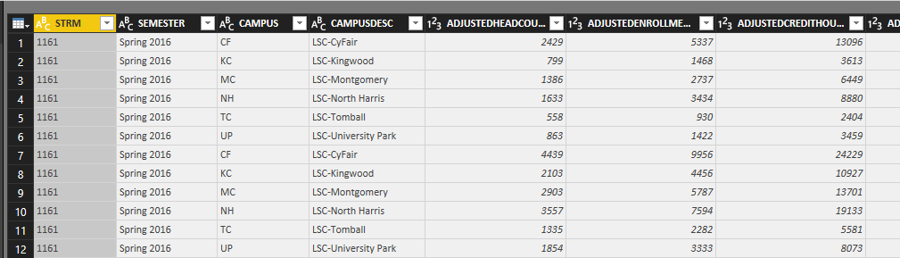
How We’re Empowering our Clients

Slide 50

How We’re Empowering our Clients
Importing from MicroSoft SQL Server

Slide 51
How We’re Empowering our Clients
Importing from MicroSoft SQL Server
Similar to importing from Oracle SQL
No need for additional software
Credentials may be same as your computer login

Slide 52
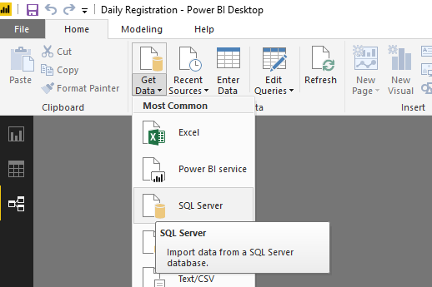
How We’re Empowering our Clients

Slide 53
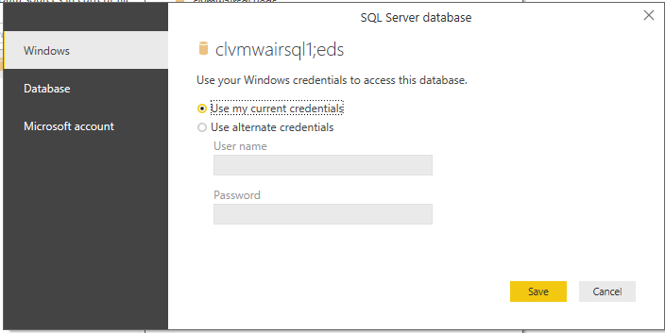
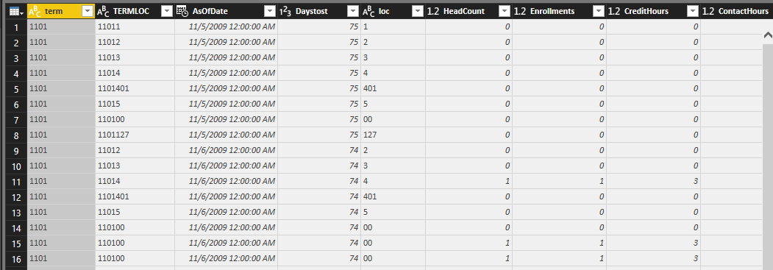
How We’re Empowering our Clients

Slide 54
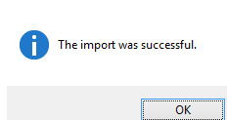
How We’re Empowering our Clients
After the Import

Slide 55
How We’re Empowering our Clients
After the import
Can add calculated fields and columns
Can set up relationships to utilize data from multiple tables
  Can be as few as two tables or as many as your imagination allows
Easy drag and drop visualizations
Refreshing data is one click away

Slide 56
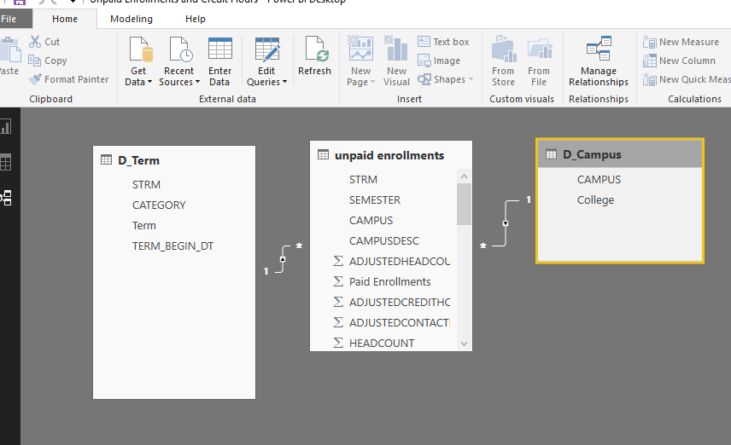
How We’re Empowering our Clients

Slide 57
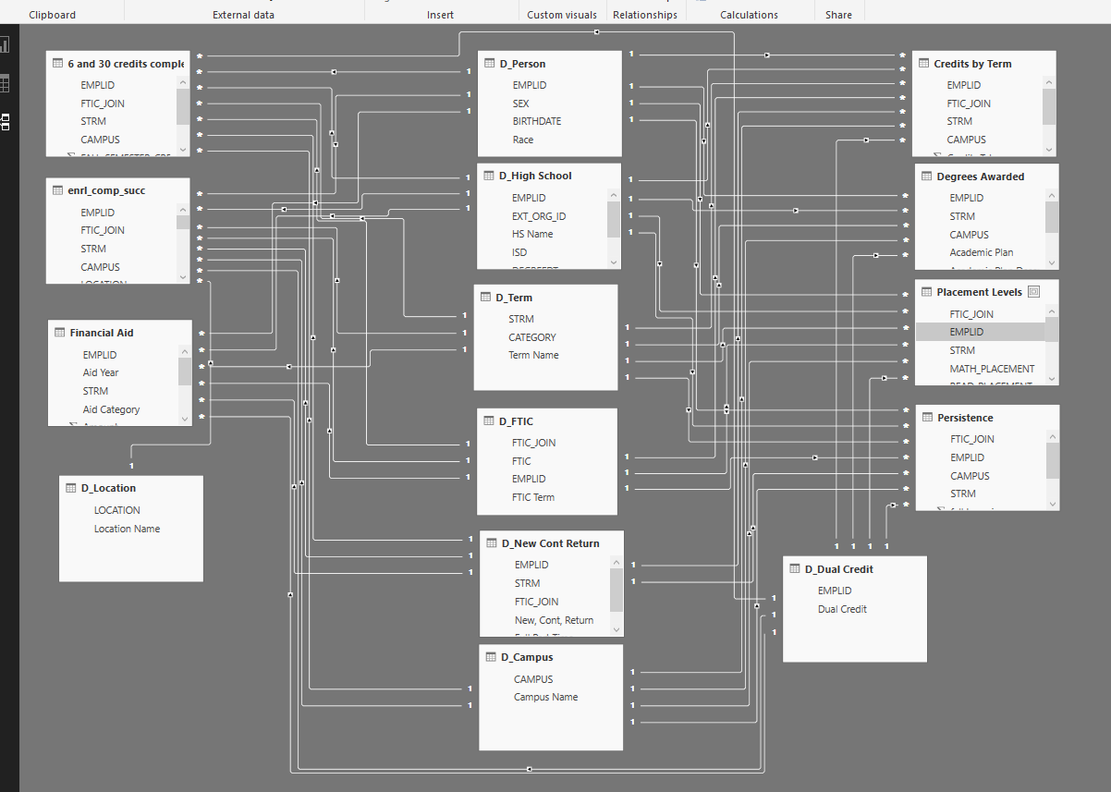
How We’re Empowering our Clients

Slide 58

How We’re Empowering our Clients
Refreshing Power BI Reports

Slide 59
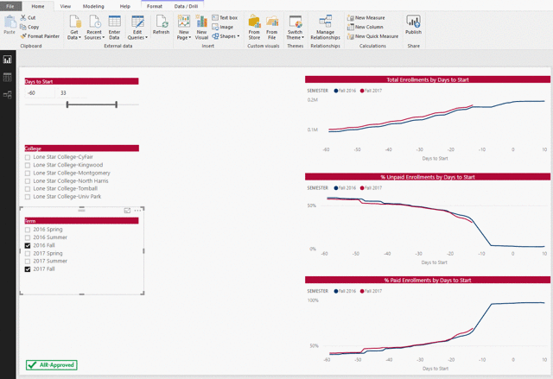
How We’re Empowering our Clients

Slide 60
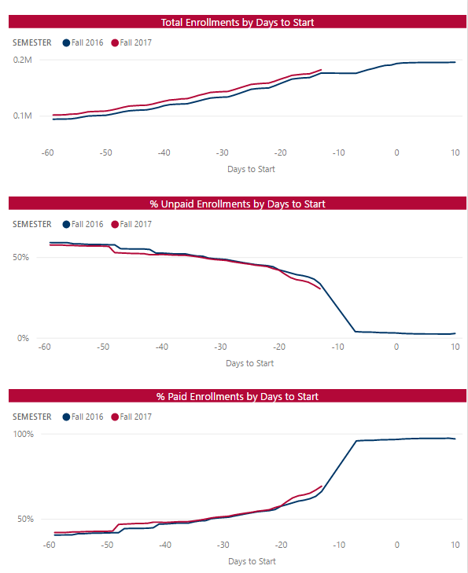
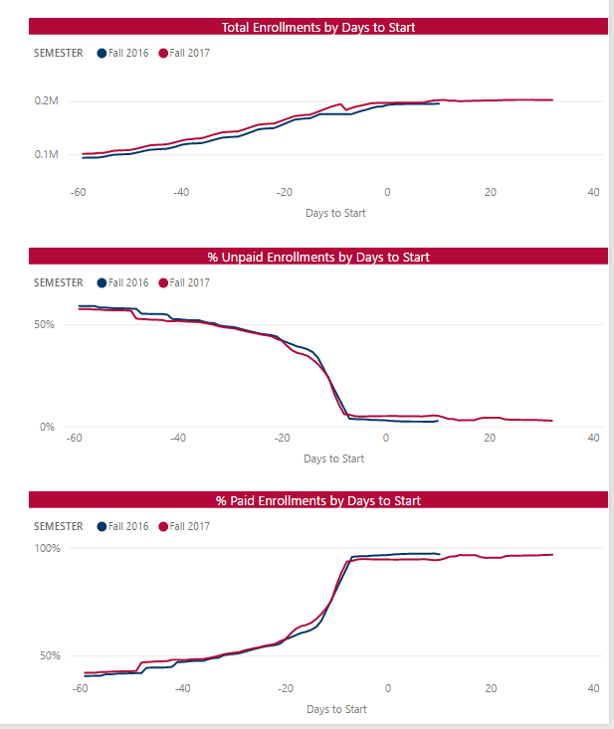
How We’re Empowering our Clients
Notes:
Before refresh to after refresh

Slide 61

How We’re Empowering our Clients
Accessibility and Portability
Notes:
We’re also focusing on making our Power BI reports accessible and portable for our clients…..

Slide 62
How We’re Empowering our Clients
Notes:
From our Discovery cloud location, to our client’s Power BI desktop….

Slide 63

How We’re Empowering our Clients
Notes:
To their tablets…..

Slide 64

How We’re Empowering our Clients
Notes:
To their smart phones. Our reports are available to them at any time and anywhere. (Janet and Kent demo iPad and smart phone access.)

Slide 65


Closing
We’ve ALL
Got the
Power (BI)
Notes:
So our goal at LSC is to use Power BI to delight our customers with interactive reports and visualizations that provide answers long after delivery. In doing so, we’ve ALL got the Power (BI)!

Slide 66
Questions?
Notes:
Does anyone have any questions?
All

Slide 67
Thank you!
Notes:
Thank you for attending our session today!!

