Slide 1
TAIR Presentation
Tableau – thinking outside the box

Slide 2
Toni Rhodes Tarleton State University
My hope is this presentation will inspire you to create your own dashboard.

Slide 3
First-time in College Retention
A Different Perspective
Photo Credit: Dudley Barker
Stephenville NIRA rodeo

Slide 4
Link to Viz
https://public.tableau.com/profile/jamie.wood7668#!/vizhome/TarletonStateUniversityFTICFall2011/TarletonStateUniversityFTICFall2011?publish=yes

Slide 5
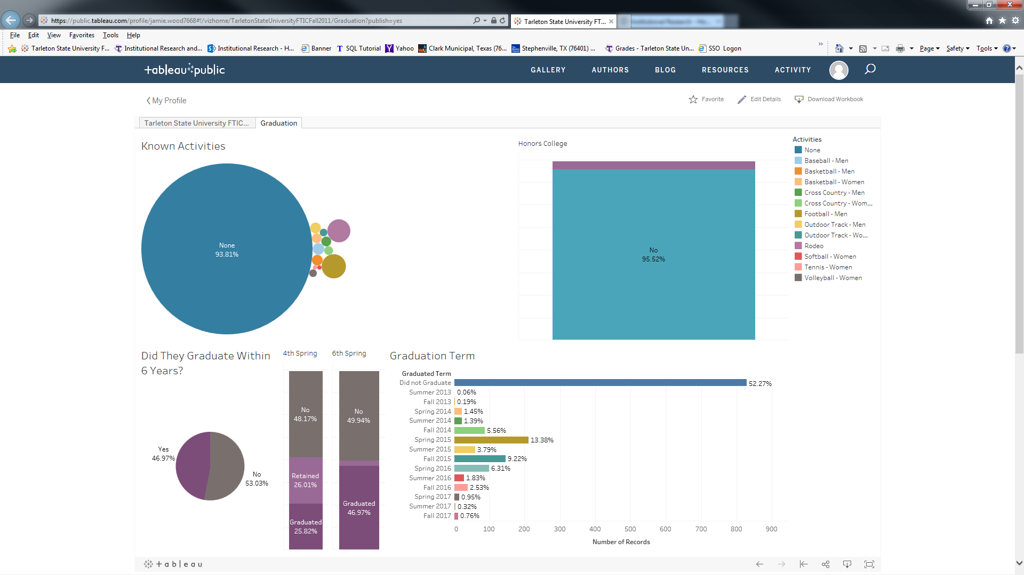
How does a student being involved in Rodeo or any other activity influence retention/
Graduation?

Slide 6
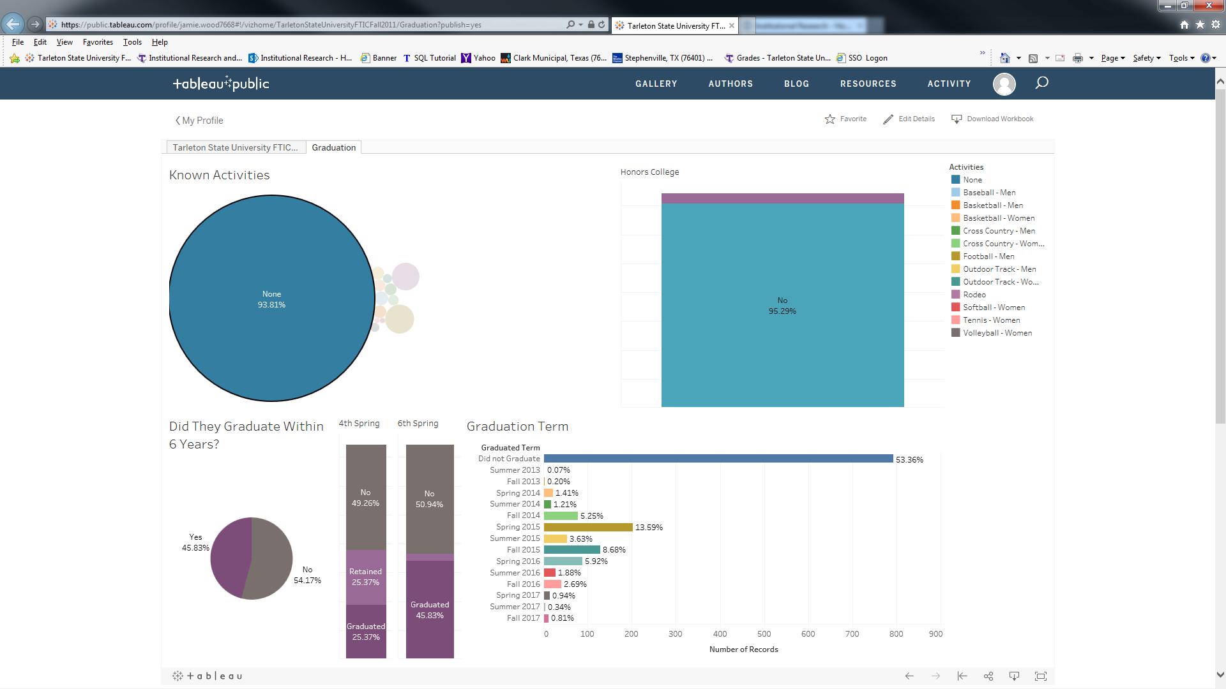
Students not in any known activity

Slide 7
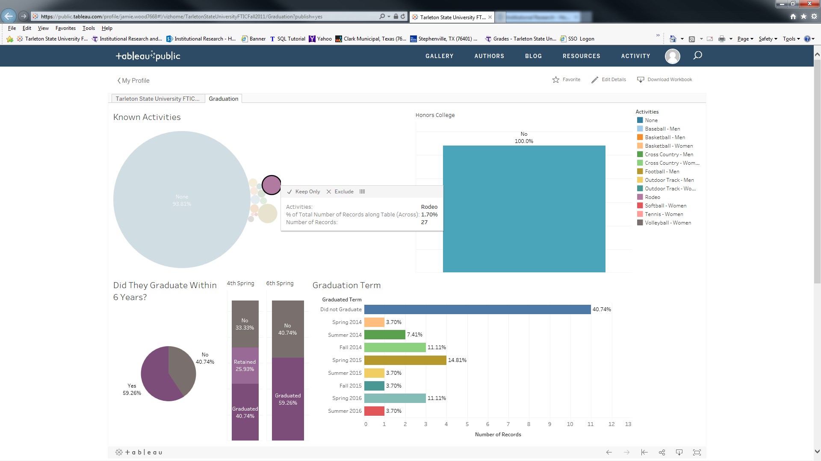
Higher percent of students involved in rodeo graduate

Slide 8
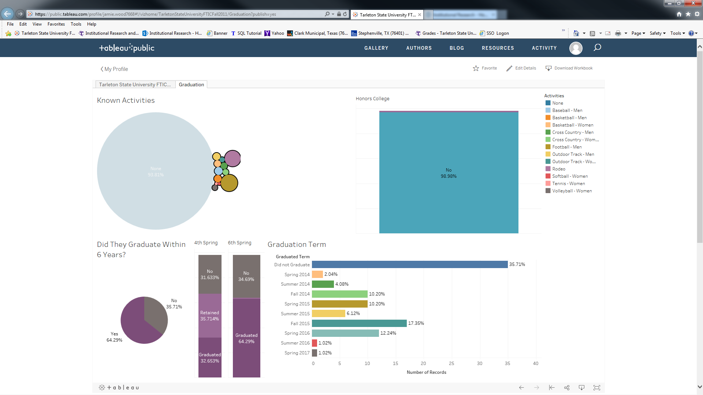
Even higher percent of students involved in known activities
graduate

Slide 9
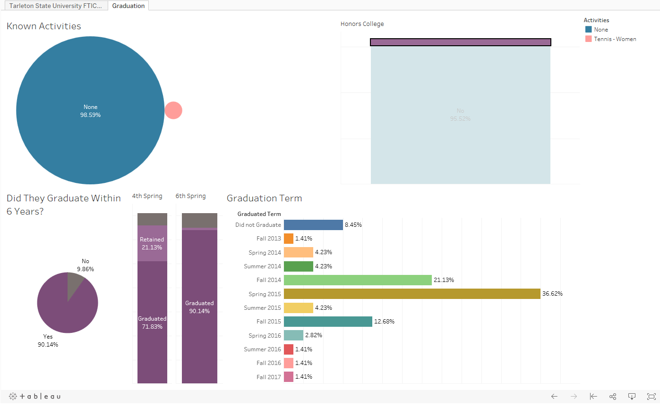
What about Honors College students?

Slide 10
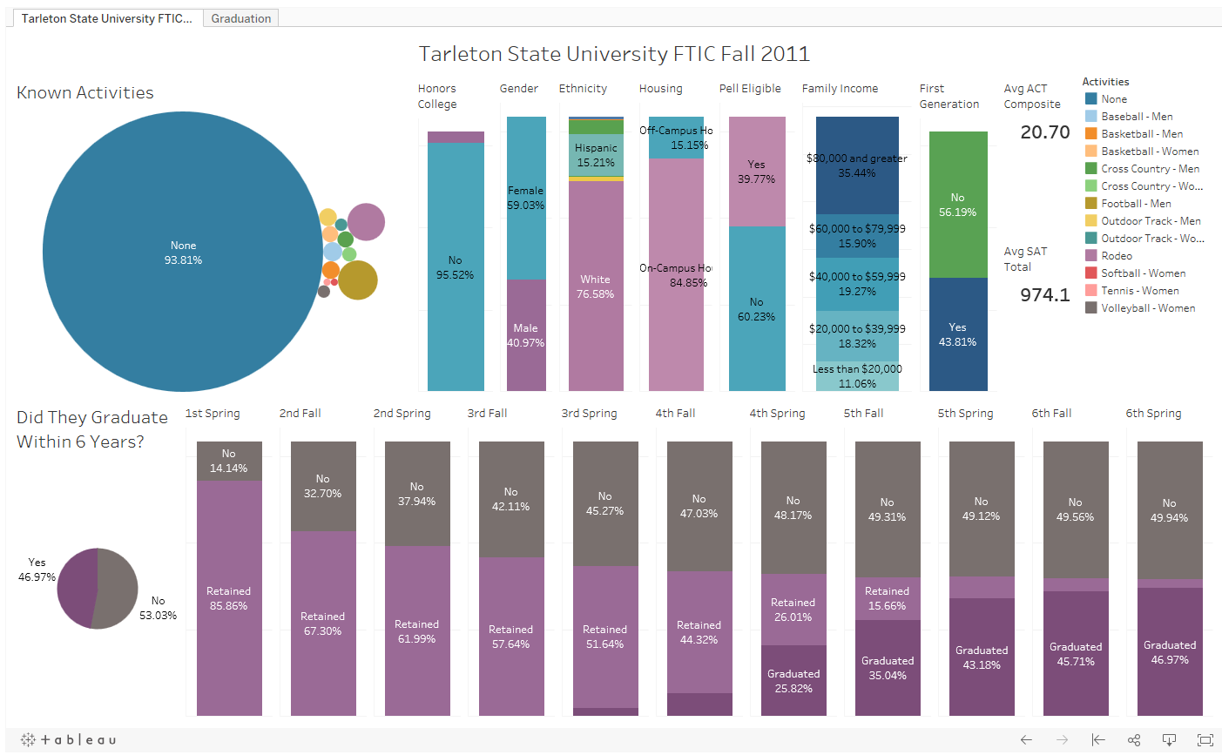
Lets look at some other factors
Hunch:
Rodeo students come from higher income families.
Do they?

Slide 11
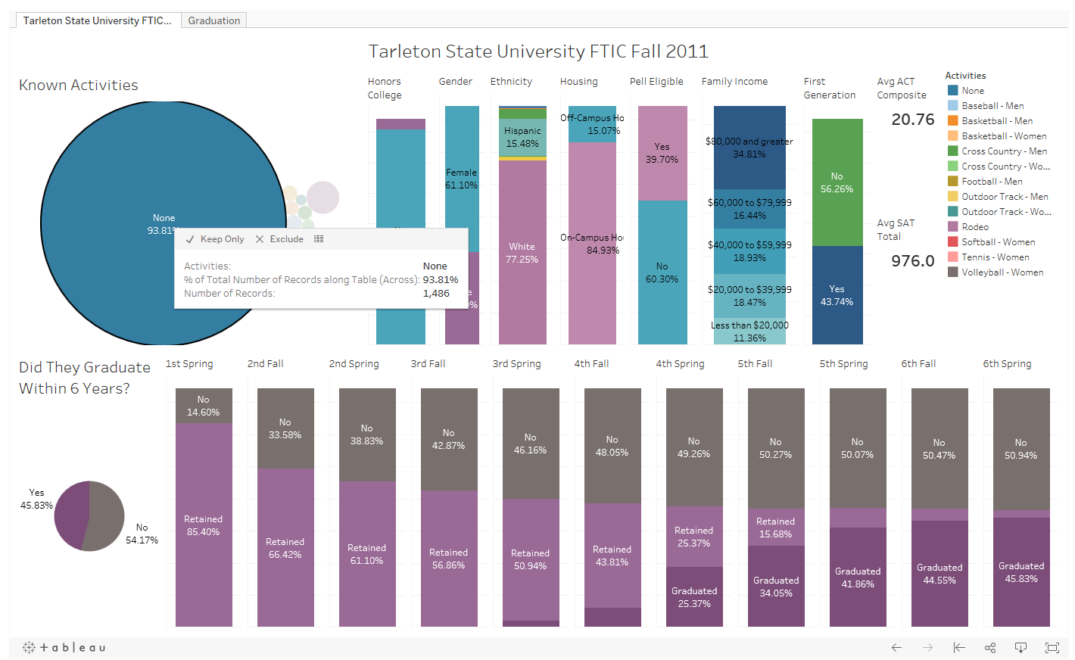
Students with no known activities.

Slide 12
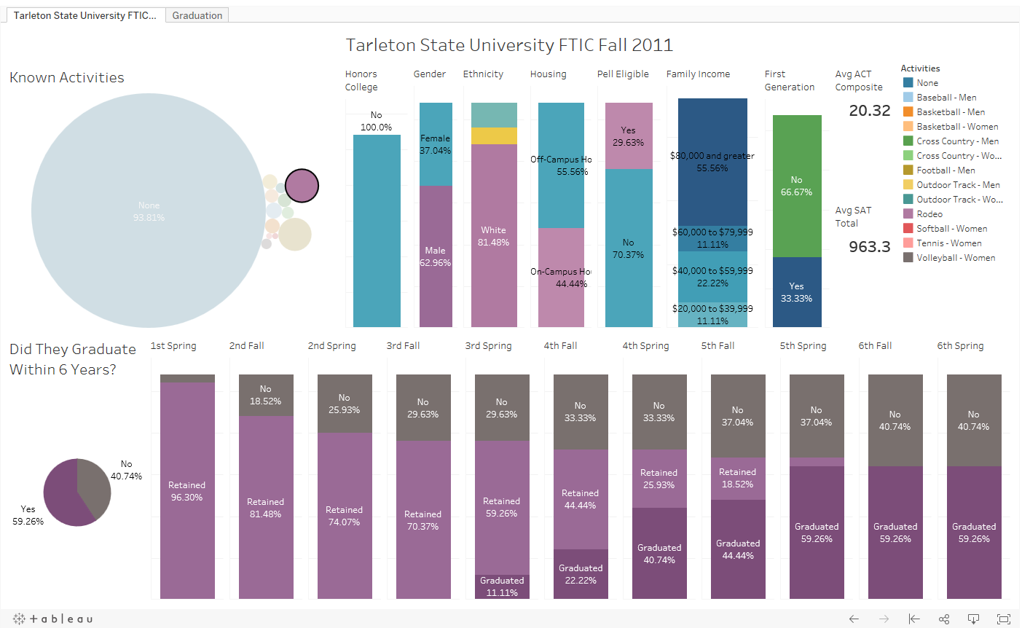
Over 20 % higher in the 80000 and greater range.
Lowest range family income 20000-39999.
Looks like higher family income than students with no known activities

Slide 13
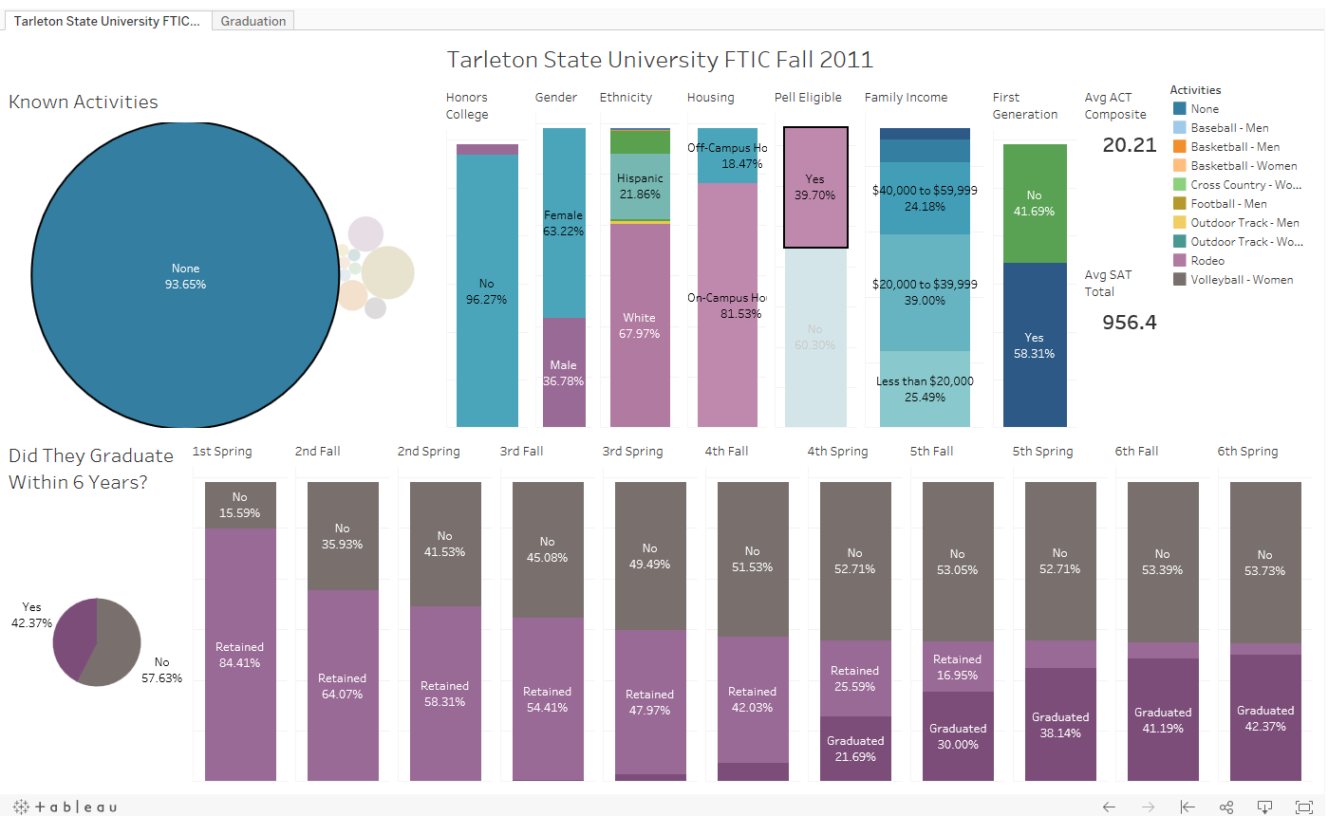
Lets look at Pell Eligible students

Slide 14
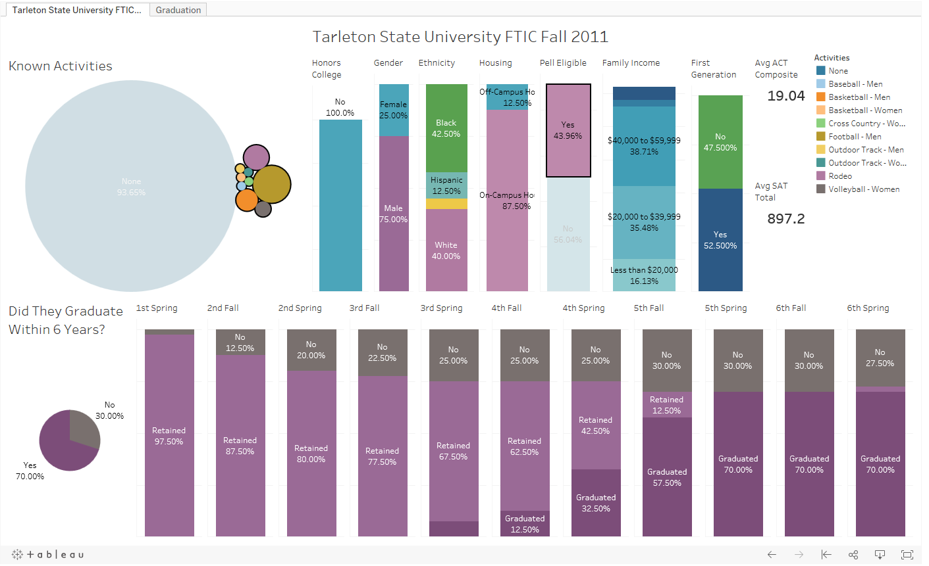
Pell Eligible students involved in known activities had a 26% higher graduation rate.

Slide 15
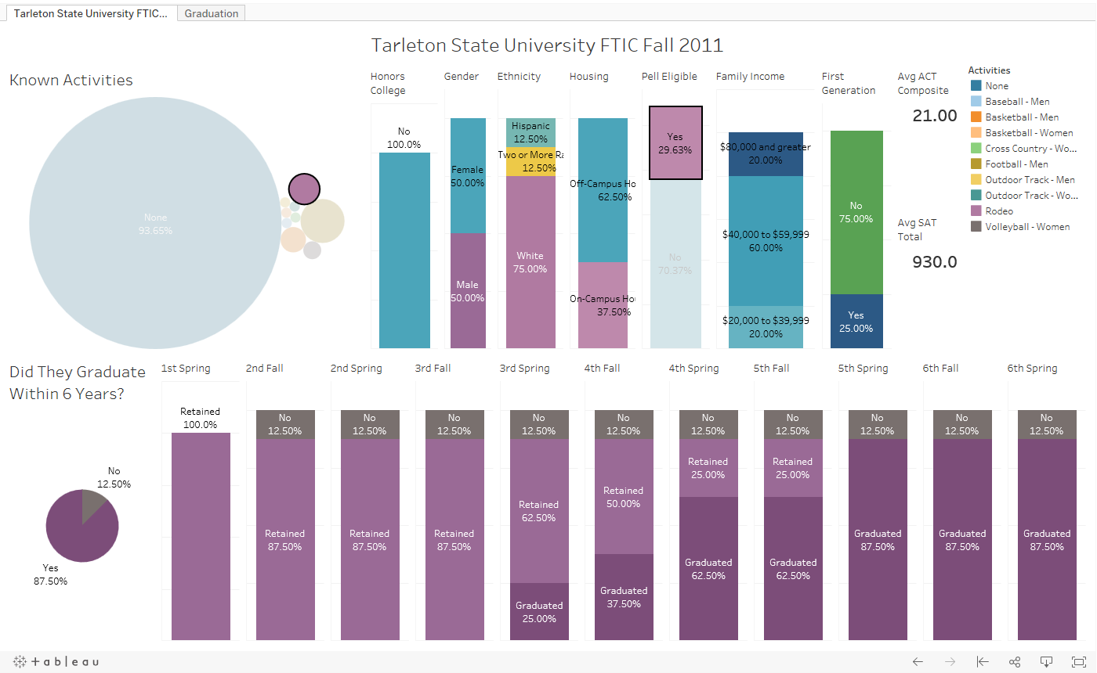
Even higher percentage of the Pell eligible rodeo students graduated

Slide 16
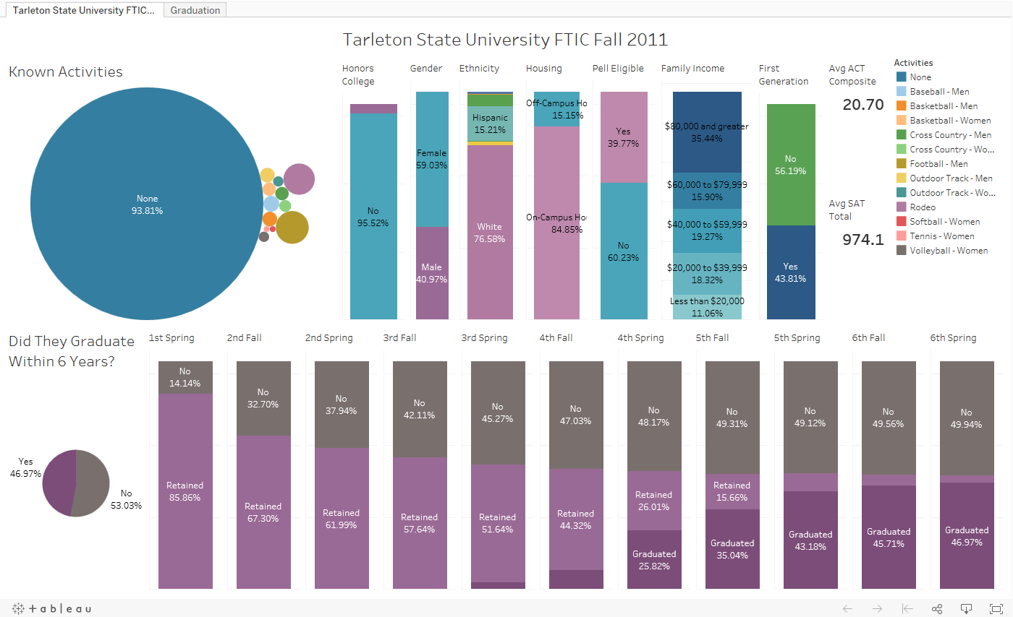
Did living
on-campus 1st term
have any influence?

Slide 17
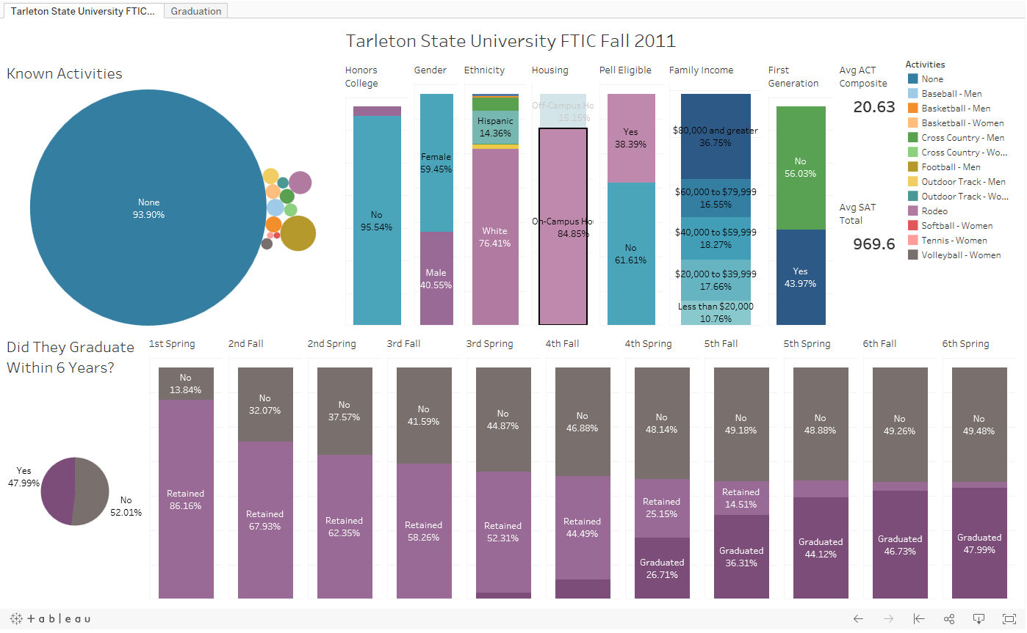
Only a slightly higher percentage
of on-campus students graduated

Slide 18
Lets investigate housing further.

Slide 19
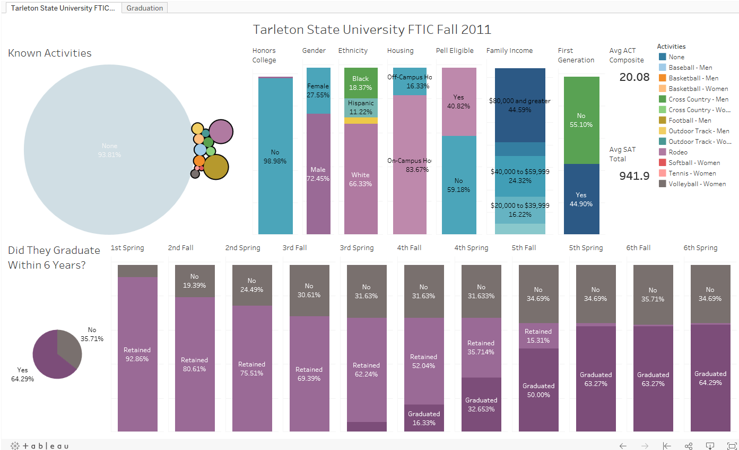
Looks like almost the same on-campus percentage of students involved in activities as those who are not.
But……….

Slide 20
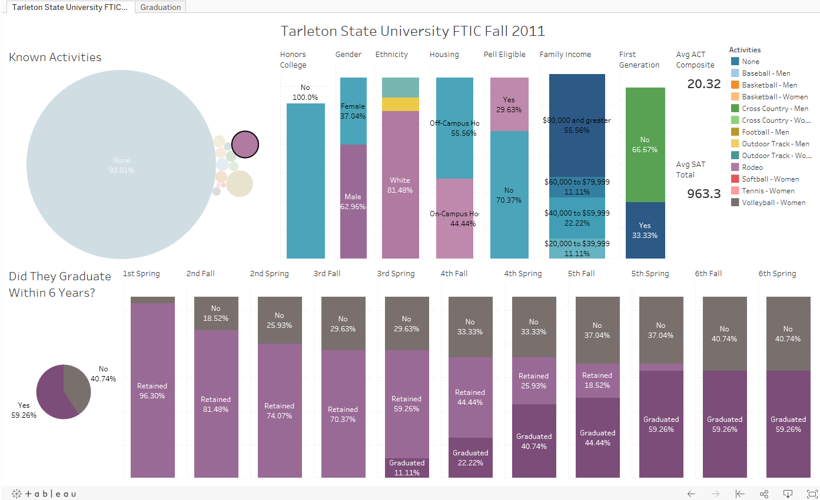
Let look at the students involved in rodeo.
Interesting….
A much higher percentage live off-campus.

Slide 21
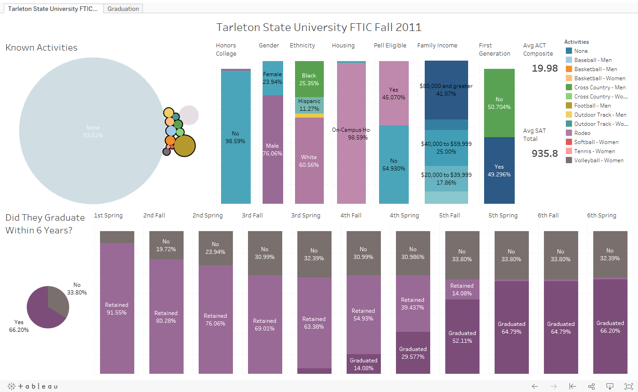
So as you might suspect…..
A much higher percentage of all other students with known activities live on-campus.

Slide 22
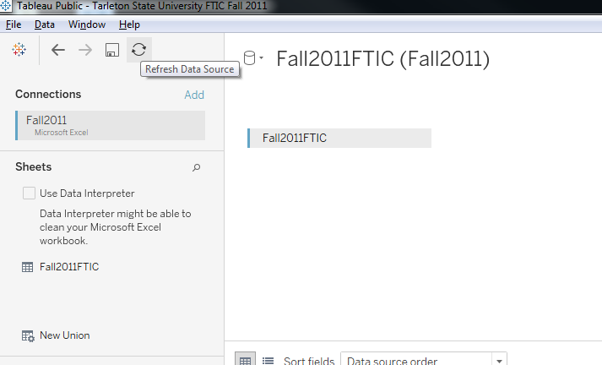
Problem I encountered while working on this Viz:
When I updated the data source it change all my colors I had set.
Solution: When possible use Refresh Data Source
If you need to update you data source. Use Refresh Data Source.

Slide 23
Helpful Hints:
SAVE OFTEN!!!
Occasionally make a backup copy, so you can go back to it if needed.
Check to make sure filters are working as you go.
Use refresh data source if you need to update or replace your data source.
Look at Viz on a different computer/device if possible.

Slide 24
My Discoveries
It seems that being involved in anything that makes a student feel connected improves retention.
Tableau takes some time to learn, but the results are worth the effort.
Even creating one dashboard with basic sheets can create a synergistic result leading to more ideas and discoveries.
So why not try creating a Viz and see what you can discover?

Slide 25
Contacts
Toni Rhodes rhodes@tarleton.edu
Jamie Wood jlwood@tarleton.edu
Simon Smith sdsmith@tarleton.edu

