Slide 1
Quantitative assessment of tutoring and supplemental instruction
Faron Kincheloe - Baylor University

Slide 2
University &
SI Program
Profile
Baylor University
SI Program
14,316 undergrads
Few commuters
Average SAT: 1280*
Excellent Pre-med Program
Excellent Accounting Program
2017-2018: 68-70 leaders
2 sessions per week
Fall 2016: 38,995 contact hours
Averaged 26 students per session
2017-2018: 16 Mentor/SI leaders (dual role)
UMKC Accredited
*2016 Redesigned Scale

Slide 3
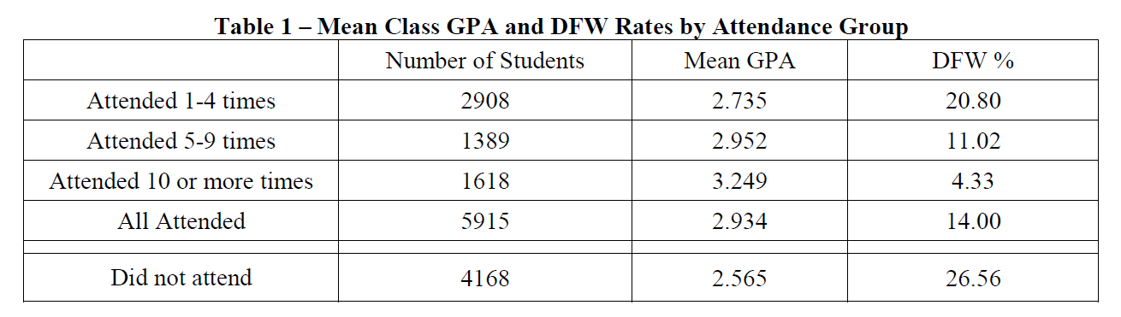
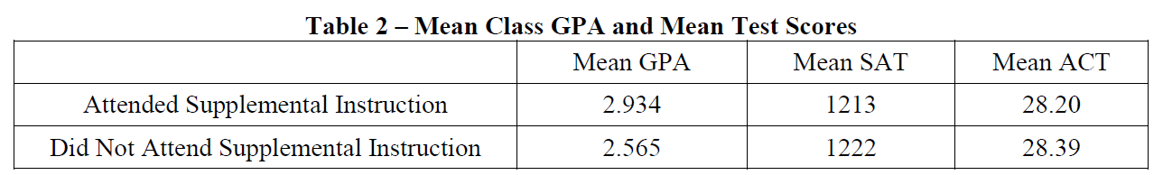
A long history of analysis of supplemental instruction

Slide 4
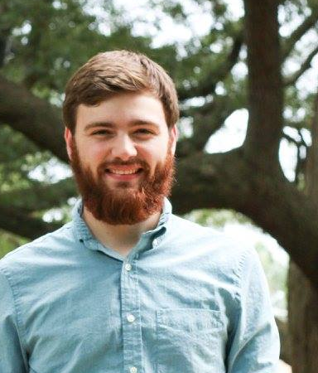
How do Leaders know if They’re getting better?
Blaise Langan
  Pre-med Religion major
  Proposed formula - 2015
Measuring Effectiveness of SI
  Plenty studies about effectiveness of SI
  Nothing to measure individual SI leader effectiveness
Asked peers…
  “It just get’s easier”
  “I have a lot of people attending”
  “My attendees have better grades”

Slide 5



What are the “ingredients” to being a good SI leader?
Factor in Attendance
Factor in Grades
Factors harder to quantify…
How many came…
How consistently did they come…
Do you help them get better grades?
How much difference did your SI make?
How does it compare to peers’ SI grade difference?
Student ability…
Course difficulty…
Professor difficulty…
Student motivation…

Slide 6
Let’s use the stats we have to measure SI Leaders
Problems with proposed formula:
Blaise only had aggregate data for testing
Formula behaved differently on individual data
Variations in test scores overwhelmed other components of score

Slide 7
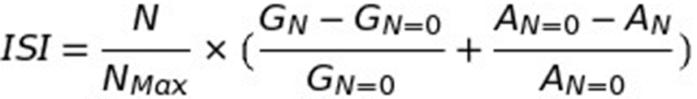
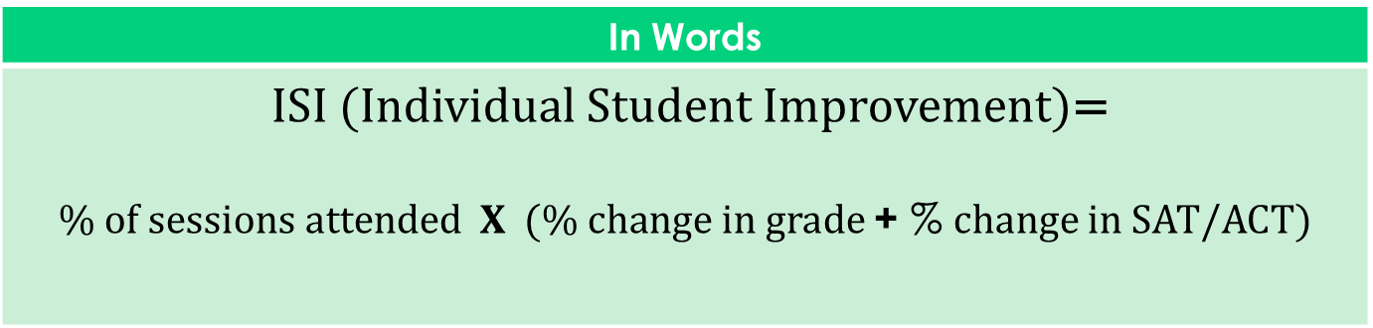
The Equation
Step 1:
We start with determining individual improvement scores of every student enrolled in the assigned sections for each leader
In Words
ISI (Individual Student Improvement)= $\% of sessions attended X (\% change in grade$+ % change in SAT/ACT)
In Math Terms
Notes:
Attendance is tracked through home-grown card swipe app.

Slide 8

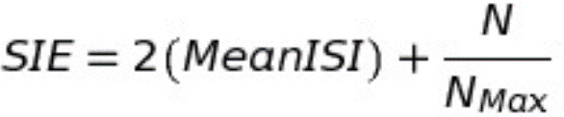
…The rest of the equation
Step 2:
In Words
Average all the ISI scores (=SIE Raw Score) ------------------------------------------------------------------------ Multiply that value by 2; Add the average overall attendance percentage to that score.
In Math Terms
Notes:
Used percentage to standardize scales

Slide 9
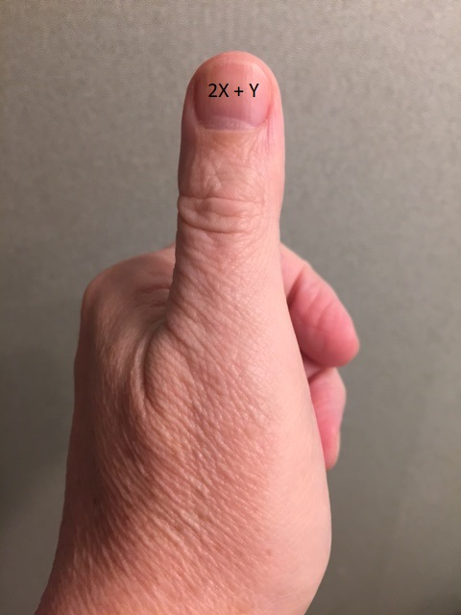
…development of Final SIE
the thumbnail approach:

Slide 10
What Do the SI Efficiency Scores look Like?

Slide 11
SI Leader | Course | SIE Raw Score | Attendee GPA | Attendee SAT Equiv. | Overall Attendance | SIE Rating
Bio Leader 1 | BIO 1305 | 0.507 | 2.8 | 1290 | 26.2% | 1.276
Chem Leader 1 | CHE 1301 | 0.389 | 2.9 | 1297 | 27.1% | 1.048
Bio Leader 2 | BIO 1305 | 0.268 | 2.3 | 1264 | 42.9% | 0.966
Chem leader 2 | CHE 1301 | 0.141 | 3.1 | 1367 | 55.0% | 0.833
Chem leader 3 | CHE 1300 | 0.159 | 3.4 | 1192 | 49.2% | 0.809
Bio Leader 3 | BIO 1305 | 0.154 | 2.8 | 1221 | 46.1% | 0.769
Chem Leader 4 | CHE 1302 | 0.264 | 2.6 | 1169 | 23.9% | 0.766
Bio Leader 4 | BIO 1305 | 0.241 | 2.8 | 1249 | 27.2% | 0.754
Business Leader 1 | FIN 3309 | 0.227 | 2.6 | 1196 | 27.8% | 0.732
Bio Leader 5 | BIO 1305 | 0.171 | 2.9 | 1262 | 34.2% | 0.683
Bio Leader 6 | BIO 1305 | 0.177 | 2.7 | 1274 | 29.5% | 0.649
Business Leader 2 | ACC 2304 | 0.184 | 3.2 | 1226 | 27.8% | 0.646
Chem Leader 5 | CHE 1301 | 0.190 | 2.5 | 1249 | 24.1% | 0.621
Chem Leader 6 | CHE 3332 | 0.067 | 2.7 | 1244 | 43.4% | 0.568

Slide 12
Corresponding Examples from Semester Report

Slide 13
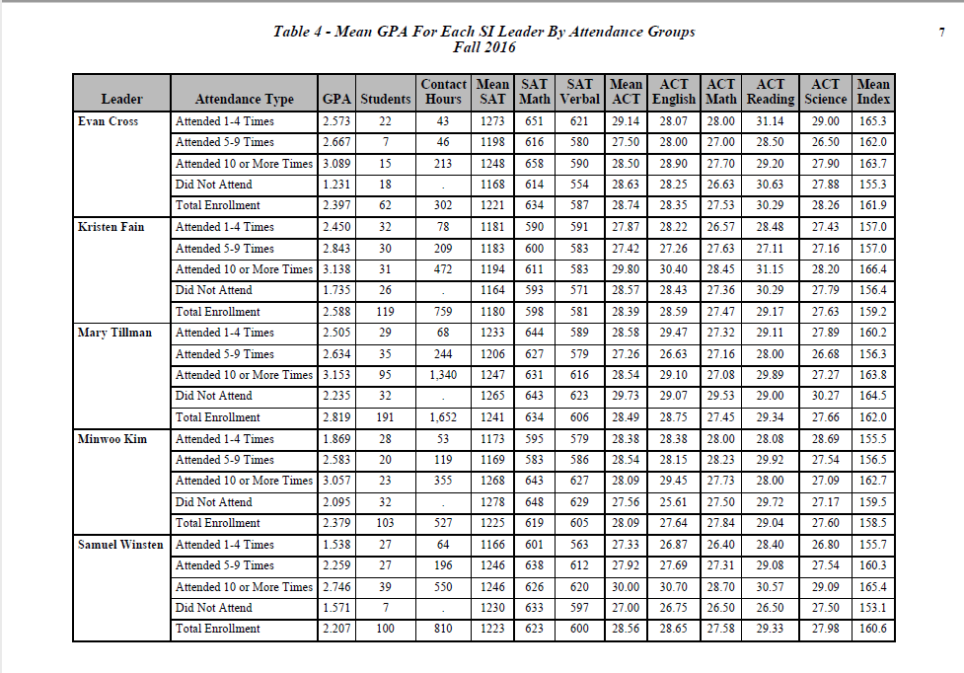
BIO 1 EC
SIE Score:
1.276
BIO 4 KF
BIO 5 MTT
BIO 7 MK
BIO 2 SW
SIE Score:
.996

Slide 14


Apples to oranges…Does it
“level the playing field”?
Problematic Comparisons
Course difficulty
Instructor difficulty
Academic propensity of class
Enrolled student motivation (academic goals)

Slide 15
Trends
What happened since we started reporting individual efficiency scores?

Slide 16
Contact Hours
66,402
+20,000
45,457
+ 17,000
28,510
*Attendance is voluntary
Notes:
Attendance is voluntary, so contact hours indicates effectiveness of program
2011-2012-28,500 contact hours with 45 leaders
2015-2016-66,402 contact hours with 65 leaders.
132.91% change in contact hours (attendance) with a 44% change in the number of SI leaders.

Slide 17
Average SI Efficiency Scores
.360
.337
.305
.228

Slide 18
An Unexpected Outcome
The Second Semester Slump

Slide 19
Percentage of “Slumpers”
 | % who did better | % who did worse
Second compared to first | 45.26% | 54.74%

Slide 20
Second Semester Slump
 | SIE Score Sem. 1 |  | SIE Score Sem. 2 |  | SIE Diff. Sem.2 - Sem. 1 |  | SIE Score Sem. 3 |  | SIE Diff. Sem.3 - Sem. 2
 | N | Ave | N | Ave | N | Ave | N | Ave | N | Ave
Starting Semester | 100 | 0.318 | 100 | 0.277 | 100 | -0.040 | 30 | 0.359 | 30 | 0.075
Fall
Spring | 37 | 0.296 | 37 | 0.257 | 37 | -0.040 | 21 | 0.312 | 21 | 0.026
Total | 137 | 0.312 | 137 | 0.272 | 137 | -0.040 | 51 | 0.340 | 51 | 0.055

Slide 21
Second Semester Slump
.340
.312
.272

Slide 22
3rd semester
Come Back
22.7% gain
9% gain
11% loss
.312
.227
.340
.383

Slide 23
Why?
Survey says….

Slide 24
I assumed I would get better without effort because I was experienced.

Slide 25
I was busier with my other coursework and extra-curricular activities my second semester

Slide 26
I became discouraged by lower attendance

Slide 27

Success center tutors want a score

Slide 28
Proposed tutoring score – spring 2017
Danae Gleason
  Success Center Data Analysis Intern
  Mechanical Engineering Major
Premise of Score
  Tutored vs. Non-tutored
  Percentile in Course vs. Percentile in Entering Cohort

Slide 29
Problems and challenges
Major setback
  Course grades are categorical
  Percentiles within cohort are continuous
Challenges
  Tutors cover multiple subjects
  Students use multiple tutors for same course

Slide 30
Tutor scoring process
Step 1:
Create end of first term linear GPA models using previous 4 years (0 – 4.0 scale)
  New Fall Freshmen based on Academic Index (composite of ACT/SAT and HS Percentile)
  New Transfers based on transfer GPA
Apply model to all current students to predict GPA (P_{N} )

Slide 31
Tutor scoring process
Step 2:
Import tutoring data from Student Success Collaborative report
Combine course rosters with tutoring data
Count number of sessions each tutor held (S_{MAX})
Count student tutoring sessions for each course (S_{C})
Count sessions with specific tutor and course (S_{T})

Slide 32

Tutor scoring process
Step 3:
Get grade points for each student in tutored classes (G_{N})
Average grade points for non-tutored students (G_{N=0})
Average predicted grade for non-tutored (P_{N=0})
Compute Student Course Outcome (SCO)
Notes:
Did not use percentages because everything on 4 point scale

Slide 33
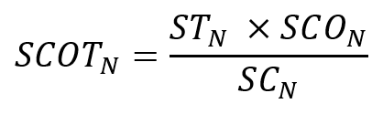
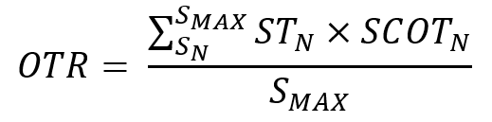
Tutor scoring process
Step 4:
Compute tutor’s portion of SCO (SCOT)
Overall Tutor Rating (OTR) = weighted average of SCOT

Slide 34
What Do the Tutor Scores look Like?

Slide 35
Tutor | Sessions | Tutor Score
T01 | 37 | 0.002
T02 | 14 | -0.060
T03 | 135 | -0.033
T04 | 1 | 0.046
T05 | 72 | -0.009
T06 | 43 | -0.135
T07 | 34 | 0.188
T08 | 33 | -0.054
T09 | 37 | -0.391
T10 | 70 | -0.075
T11 | 5 | -0.777
T12 | 116 | 0.152
T13 | 33 | -0.249
T14 | 53 | -0.392
T15 | 7 | 0.121
T16 | 31 | -0.079
T17 | 39 | 0.035
T18 | 31 | -0.002
T19 | 1 | 0.457
Notes:
Range = .757 to -.777

Slide 36
More Problems and challenges
Still a work in progress
Baylor admits academically strong students
Easier to underachieve than overachieve
Sessions not linked to course being supported
“DJ is one of my best tutors but he scored third from the bottom (-0.391)

Slide 37
DJ
62 Sessions – 37 linked to a course
13 students tutored (in 37 sessions)
  3 with positive outcomes
  10 with negative outcomes
Student X
  Attended 7 of 8 sessions with DJ
  Predicted C+ but made D-
  Accounted for -.24 points in DJ’s rating

Slide 38
Possible solutions
Use actual student GPAs after first term
Try percentage change instead of actual points
Separate models for each course

Slide 39
Questions
Faron_Kincheloe@baylor.edu

