Slide 1
Predicting Second to Third Year Retention
Jinny Case, Ph.D
Office of Institutional Research
The University of Texas at San Antonio

Slide 2
Outline
Overview of UTSA
Background
Literature review
Predictive modeling process
Variables
Population
Results
Application

Slide 3

Overview of UTSA
  Established 1969
  Over 30,000 students
  Over 4,500 FTIC students in fall 2017
  95% in-state (48% Bexar County)
  HSI
  Majority minority
  Over 40% first generation
  Over 40% Pell recipients
  Mission of access and excellence

Slide 4
Background
Matriculation model
First term GPA model
Second to third year retention model

Slide 5
Purpose
To determine probability of retention to the third year for students who made it to their second year
Develop a manageable target list of students likely to leave between their second and third year
Work with advising to contact students

Slide 6
Retention Rates
  Retention Dashboard

Slide 7
Methodology
Model Development
Model Training
Model Evaluation
Model Application
Model Improvement

Slide 8
Literature
Demographic and pre-matriculation variables impacting first year retention also influence second to third year retention (Nora, 2005)
Post-matriculation academic, financial, and social variables exert additional influence above and beyond pre-matriculation characteristics (Nora, 2005)

Slide 9
Model Building
Development
Sample Selection
-Historical second-year enrollment (fall 2012-fall 2014)
-First time, Full time only
Variable Selection
-Demographic
- Academic
- Financial
Data Preparation
-Data cleaning
-Missing Data
-Dummy Coding

Slide 10
Variable selection
Third Year Enrollment
Academic Performance
- First year GPA
- Degree Sought
- Changed Major
- Hours Earned
- Hours Enrolled
Academic Preparation
- High School Rank.
- Test Scores (SAT/ACT).
- AP
- Developmental Courses
Financial Variables
- Scholarship
- Pell Status
- Lived on Campus
Demographics
- Gender
- Ethnicity
- First Generation
- Residency

Slide 11
Variable Coding
Variable | Valid Range | Variable Type | Reference group
First Generation | 0=No, 1 = Yes | Dichotomous | Not first generation
Race/Ethnicity | Black, Hispanic, Asian, White, Other 0=No, 1=Yes | Dichotomous | White
Sex | 0=Male, 1=Female | Dichotomous | Male
Alamo Area | 0=No, 1=Yes | Dichotomous | Not in Alamo Area
Program | BBA,BS, BA,UND, Other 0=No, 1=Yes | Dichotomous | BA
AP | 0=No,1=Yes | Dichotomous | No AP credit
Class Rank | Top ten, next fifteen, second quarter, third quarter, fourth quarter, missing 0=No, 1=Yes | Dichotomous | Missing Rank

Slide 12
Variable Coding
Variable | Valid Range | Variable Type | Reference group
SAT/ACT quartile | Top 25, middle fifty, bottom 25, missing 0=No, 1=Yes | Dichotomous | SAT/ACT Missing
Pell paid first year | 0=No, 1=Yes | Dichotomous | No
Pell paid second year | 0=No, 1=Yes | Dichotomous | No
Scholarship first year | 0+ | Continuous
On campus | 0=No, 1=Yes | Dichotomous | Not living on campus
Developmental Math | 0=No,1=Yes | Dichotomous | Not in Dev. Math
Developmental English | 0=No,1=Yes | Dichotomous | Not in Dev. English
Changed Major | 0=No,1=Yes | Dichotomous | Did not change major

Slide 13
Variable Coding
Variable 0=0 | Valid Range | Variable Type | Reference group
First Year GPA | < 1.0, 1.0-1.99,2.0-2.49,2.5-2.99,3.0-3.49,3.5-4.0, Missing 0=No, 1=Yes | Dichotomous | Missing
Hours earned first year | < 24, 24-29, 30 0=No, 1=Yes | Dichotomous | Less than 24 hours earned
Hours Earned to Hours Attempted Ratio | 0-1 | Continuous
Hours Enrolled | 1+ | Continuous
Started as Freshman | 0=No, 1=Yes | Dichotomous | No
Dependent Variable = Retained to Third Year (0=No,1=Yes)

Slide 14
Descriptive Statistics
 | Mean | SD
RETAINED2YR | 0.83 | 0.380
FIRSTGEN | 0.52 | 0.500
BLACK | 0.11 | 0.314
HISPANIC | 0.56 | 0.496
ASIAN | 0.06 | 0.233
OTHER | 0.07 | 0.261
MALE | 0.46 | 0.498
BBA | 0.10 | 0.306
BS | 0.46 | 0.499
UND | 0.24 | 0.427
ALAMO_AREA | 0.48 | 0.499
TOP_TEN | 0.25 | 0.434
NEXT_FIFTEEN | 0.40 | 0.490
SECOND_QUARTER | 0.21 | 0.410
THIRD_QUARTER | 0.06 | 0.238
FOURTH_QUARTER | 0.01 | 0.082
TOP25 | 0.2490 | 0.43247
MIDDLEFIFTY | 0.4895 | 0.49993
BOTTOM25 | 0.2379 | 0.42583
 | Mean | SD
PELL | 0.60 | 0.489
PELL2 | 0.56 | 0.497
ON_CAMPUS | 0.36 | 0.479
THIRTY_HOURS_EARNED | 0.22 | 0.411
HOURS_EARNED24_29 | 0.50 | 0.500
EARNED_ATT_RATIO | 0.883 | 0.15408
DEV_MATH | 0.26 | 0.437
DEV_ENG | 0.05 | 0.222
ltONE | 0.011 | 0.10399
ONETOTWO | 0.105 | 0.30716
TWOTOTWOFOURNINE | 0.181 | 0.38492
TWOFIVETOTWONINE | 0.256 | 0.43623
THREETOTHREEFOUR | 0.278 | 0.44785
THREEFIVETOFOUR | 0.169 | 0.37473
ON_PLUS_OFF_CAMPUS1YR | 13.64 | 1.96496
SAME_MAJOR | 0.658 | 0.47460
AP | 0.21 | 0.406
SCHOLARSHIP_YEAR1 | 1359.67 | 3483.461

Slide 15
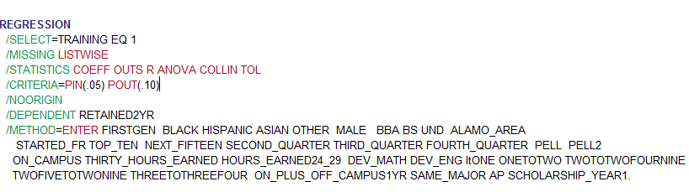
Variance Inflation Factor (VIF)
Run linear regression in SPSS for this
SAT/ACT
Notes:
I had VIFs of over 5 on SAT/ACT groups and Class rank so I combined lowest 25th percentile on SAT/ACT with Missing SAT/ACT and used that as a reference group. I also combined the 11-25 percent in class rank and missing class rank. This I used as a reference group. This resolved multicollinearity problems.

Slide 16
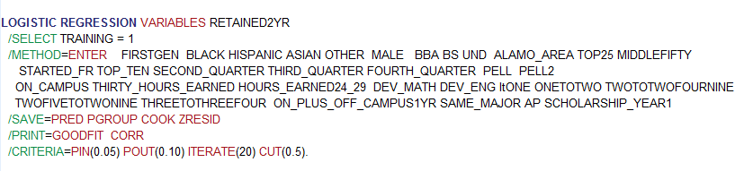
Model Training

Slide 17
Model Checking: Results with Training Data
 | Exp(B) | S.E. | Wald | Sig.
Intercept | 0.811 | 0.395 | 0.282 | 0.595
FIRSTGEN | 0.969 | 0.081 | 0.150 | 0.699
BLACK | 1.495 | 0.139 | 8.351 | 0.004***
HISPANIC | 1.518 | 0.100 | 17.462 | 0.000***
ASIAN | 1.383 | 0.178 | 3.334 | 0.068
OTHER | 1.128 | 0.154 | 0.609 | 0.435
MALE | 1.203 | 0.076 | 5.897 | 0.015**
BBA | 1.187 | 0.156 | 1.213 | 0.271
BS | 0.909 | 0.102 | 0.867 | 0.352
UND | 0.844 | 0.113 | 2.253 | 0.133
ALAMO_AREA | 1.542 | 0.084 | 26.557 | 0.000***
TOP25 | 0.588 | 0.129 | 16.952 | 0.000***
MIDDLEFIFTY | 0.835 | 0.096 | 3.488 | 0.062
STARTED_FR | 1.145 | 0.215 | 0.393 | 0.531
TOP_TEN | 1.100 | 0.108 | 0.783 | 0.376
SECOND_QUARTER | 0.853 | 0.093 | 2.941 | 0.086
 | Exp(B) | S.E. | Wald | Sig.
THIRD_QUARTER | 0.835 | 0.145 | 1.549 | 0.213
FOURTH_QUARTER | 0.771 | 0.363 | 0.512 | 0.474
PELL | 0.811 | 0.126 | 2.766 | 0.096
PELL2 | 1.488 | 0.121 | 10.719 | 0.001**
ON_CAMPUS | 1.001 | 0.086 | 0.000 | 0.986
THIRTY_HOURS_EARN | 1.432 | 0.134 | 7.201 | 0.007**
HOURS_EARNED24_29 | 1.462 | 0.096 | 15.822 | 0.000***
DEV_MATH | 0.890 | 0.093 | 1.555 | 0.212
DEV_ENG | 0.433 | 0.142 | 34.628 | 0.000***
ltONE | 0.041 | 0.393 | 66.377 | 0.000***
ONETOTWO | 0.289 | 0.164 | 57.466 | 0.000***
TWOTOTWOFOURNINE | 0.607 | 0.146 | 11.694 | 0.001***
TWOFIVETOTWONINE | 0.980 | 0.137 | 0.021 | 0.884
THREETOTHREEFOUR | 1.063 | 0.132 | 0.212 | 0.645
On_Off_Campus_YR1 | 1.126 | 0.020 | 35.269 | 0.000***
SAME_MAJOR | 0.783 | 0.079 | 9.502 | 0.002***
AP | 1.363 | 0.107 | 8.331 | 0.004***
SCHOLARSHIP_YEAR1 | 1.000 | 0.000 | 1.011 | 0.315
**p<.05, ***p<.005

Slide 18
Model Training
Training
Training Data Set
-Subset of full dataset (fall 2012-fall 2013)
N=6,221
Model Fitting
-Used logistic regression
-Estimated coefficients with training data
Test Data
-Hold-out dataset of 2014 cohort
-Used to validate predictive accuracy of training model
-Dummy Coding

Slide 19
Model Training: Checking for Outliers
Checked for outlying cases with potentially large residuals/high leverage using two techniques:
  Cook’s distance values greater than 1
  Standardized residuals greater than |3|
Only eight met the residual criteria and none met Cook’s D, so all cases were included in the final model

Slide 20
Model Training Results
Null model correctly classified 82.5% of cases in training data
Our model correctly classified 83.8% of cases in training data
Homer and Lemeshow is non-significant, indicating good model fit

Slide 21
Model Training: Setting the classification cut point
Default logistic regression classification cut-point for most software packages is .50
  i.e., if a student’s model-generated probability of second year retention is >=.50, they will be predicted to be retained
For instance, this model correctly classifies 98.3% of retained students but only 15% of non-retained students

Slide 22
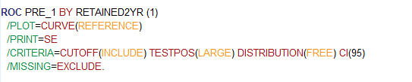
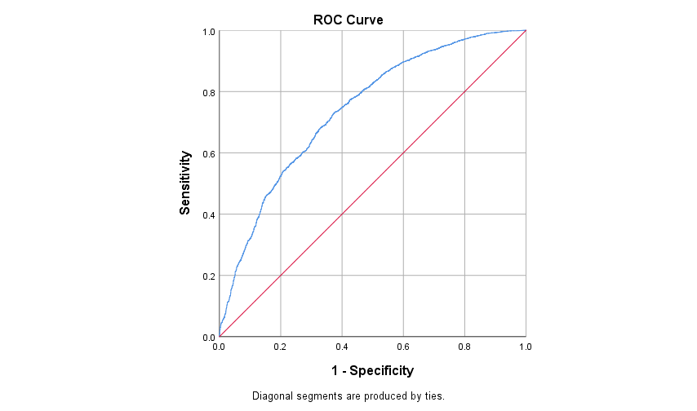
Model Training: Determine balanced CCR
Notes:
This procedure determined that the cutoff point to maximize correct classification is .74

Slide 23
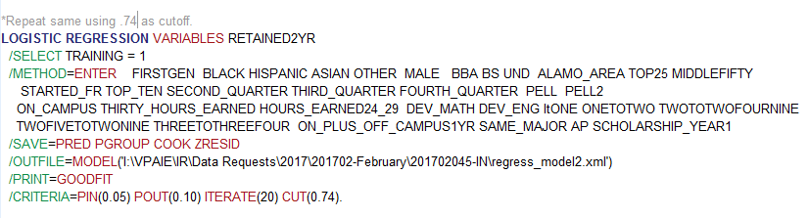
Manually adjusting cut point
Notes:
You manually adjust the cut point in your code here at the bottom and also save predicted values to a file that can be used on a new validation dataset

Slide 24
Model Predictive Accuracy
Overall model accuracy with the training data = 80%
Overall model accuracy with the test data = 80%
Training Model | Actually Retained | Actually Not Retained
Predicted Retained | 4492 | 614
Predicted Not Retained | 613 | 475
Test Model | Actually Retained | Actually Not Retained
Predicted Retained | 2796 | 410
Predicted Not Retained | 387 | 313
Notes:
Here the overall model predictive accuracy decreased a bit when we manually adjusted the cut point but now the model is correctly classifying 45% of the not retained students and 87% of the retained students. We are erring in favor of accurately predicting students who may drop out because the cost of contacting students who will be retained anyway is negligible.

Slide 25
Potential Model Application
Future Prediction
Apply model to Fall 2015 cohort data
Application
List of Students
Export list of students and their predicted
probabilities of being retained to 3rd year
Can be used by advising to target students
at some risk of not returning

Slide 26
Resources
Nora, A. (2005) Student Persistence and Degree Attainment Beyond the First Year in College in Seidman, A. College student retention: formula for student success(pp 129-153). Westport, CT: Praeger Publishers.

