Slide 1
Improving Student Success with Data
A Student Loss Analysis
ZogoTech
Brazosport College

Slide 2


https://guidebook.com/getit
https://guidebook.com/g/datasabeach/

Slide 3
What is Student Success?

Slide 4
What is the federal minimum wage in 2016?
$6.25
$7.25
$8.25
$9.25

Slide 5
$7.25

Slide 6
Occupational Safety and Health Technology (Associate) $108,000
Chemical Technology (Certificate) $94,000
Occupational Safety and Health Technology (Certificate) $93,000
Electrician (Associate) $77,000
Construction Engineering Technology (Certificate) $73,000
Compared to $15,080 (Minimum Wage Annual)
Source: Texas Higher Education Coordinating Board, http://reports.thecb.state.tx.us/ibi_apps/WFServlet.ibfs

Slide 7
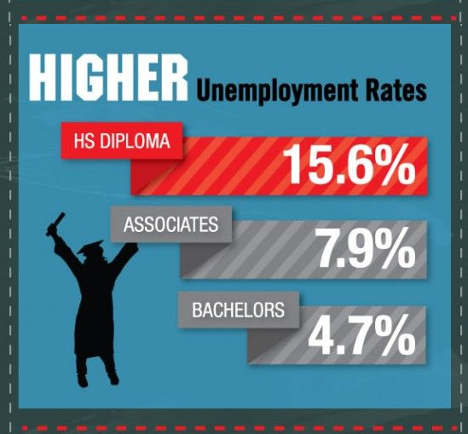
2-3x less likely to
be unemployed

Slide 8
Successful students
$830,000
earn more
2-3x
less likely to be unemployed
BUT

Slide 9
Shocking 70% of California’s community college students fail to graduate or transfer.
Arizona community colleges can also be referred to as "dropout factories," where the average three-year non-completion rate is just 80%+.
Sources:
Four-year Average Data for Student-Right-to-Know [Fall 2008 - Fall 2011] https://www.dcccd.edu/SiteCollectionDocuments/DCCCD/Docs/Departments/DO/IR/RightToKnow.pdf
Source: http://www.communitycollegereview.com/blog/new-study-70-of-california-community-college-students-fail

Slide 10
For some College is their
ONLY & LAST
chance for success

Slide 11
Angel Sanchez: From prison to college grad
https://www.youtube.com/watch?v=3Vekkjn3OZs

Slide 12
What is Brazosport College
doing to help their students?

Slide 13

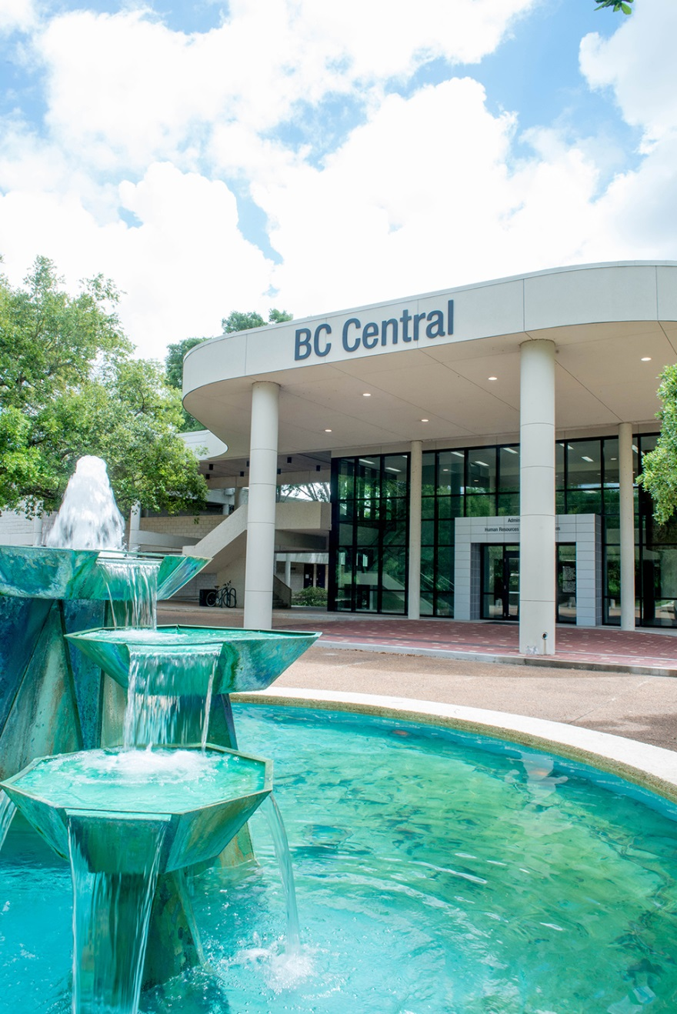
Aspen top 10 finalist
Bachelor, Associate & Certificate programs
4,200~ fall students
80% part-time students
25% dual credit
19.2% students with debt
3 yr FT Grad Rate 29.9%
3 yr PT Grad Rate 14.8%
86% working within one year after award.

Slide 14

Brazosport College
FTIC Retention Rates
Notes:
Over the past 7 years BC has seen significant declines in FTIC student retention. Fall to Spring retention declined 16 points over the past 7 years while Fall to fall dropped 10.4 points. The National Student Clearinghouse Research Center reported fall to fall retention at 49% for the Fall 2015 entering cohort. The national average is about 7 points higher than BC’s fall to fall retention.
Has anyone else seen these same declines at your institutions?
Why is this problem important?
Retaining students is important to BC because students who persist from semester to semester are more likely to stay focused on their educational goal of attaining a certificate or degree and thus completing.
BC leadership was monitoring our retention issue and even made it part of our Strategic Plan.
BC recognized student retention as a priority in managing student loss. And, a plan was put into place to investigate our retention decline.
Research finds that there are many factors that contribute to student retention such as poor student performance, financial, employment, family / childcare issues, educational options (ie, other colleges/universities to attend), and student engagement just to name a few.

Slide 15
Improving Student Success with Data
A Student Loss Analysis
What are your retention rates?
Why do think your students are not returning?
Notes:
Do you know your fall to fall and fall to spring retention rates
What % of your students are not returning
What is the revenue impact of non-returning students?

Slide 16

Improving Student Success with Data
A Student Loss Analysis
Why Don’t Students Return?
Student Centric Factors
Institutional Factors
Factors beyond the institution’s control
Notes:
Why don’t students return?
Research finds that there are many factors that contribute to student retention such as poor student performance, financial, employment, family / childcare issues, educational options (ie, other colleges/universities to attend), and student engagement just to name a few.
We’ve grouped these factors into 3 categories:
Student Centric or student centered factors
Institutional factors
Factors beyond the institution’s control
Student centric factors are factors such as poor performance, probation, financial issues, family / childcare issues, college readiness
Institutional factors are factors such as mandatory orientation, course availability, loosing good students to the competition
Factors beyond institution’s control – Hurricane Harvey (Natural disasters), strong economy

Slide 17
Improving Student Success with Data
A Student Loss Analysis
Uncovering Why Students Fail to Re-enroll
List factors that keep students from
re-enrolling at your institution
Prioritize factors
Label factors as a student centric, institutional, or beyond institution's control
Notes:
Cindy - Uncovering why students fail to re-enroll
Exercise

Slide 18
Improving Student Success with Data
A Student Loss Analysis
Fall enrollment 4,000
Retention Rate 50%
# of students not returning 2,000
Avg # of credits per semester = 9
Tuition & fees for 9 credit hours = $800
Per student state funding = $1,200
2,000 non-returning students x
$2,000 per student revenue =
$4,000,000
Notes:
Now, let’s quantify our retention and see why this issue needs to be addressed. We are going to do a little exercise. I want you to think about your own institutions retention rates. Pick a fall to fall or fall to spring retention rate.
1. What is your typical fall enrollment?
2. What is your fall to spring retention rate?
3. What percentage of your students are not returning? Now, convert that to a number.
For example if your fall to spring retention rate is 50% and you enrolled 4,000 fall students, that means that 2,000 students did not return.
4. What is the average number of credit hours your students take in a semester. Let’s say 9.
5. Now, think about your student tuition and fees, what would the tuition and fees be for 9 hours. Let’s say $800
6. Do you know the average amount of state funding received per student? Let’s say that state funding is $1,200 .
7. Let’s add tuition & fees together with state funding. That’s $2,000 in revenue per student.
If we multiply the number of students not returning (2,000) by the total revenue per student, $2,000
that equals to a 4 million dollar loss in revenue.
If we just consider the financial impact retention has on our bottom line, then it is worth exploring, don’t you think?

Slide 19

Improving Student Success with Data
A Student Loss Analysis
BC Methodology Focused on
Institutional Factors
Registration Process
Financial Aid
Course Availability
Advising
Notes:
Our retention plan mainly focused on the institutional factors but also addressed some of the student centered factors.
We called our plan the Loss Analysis.
We first talked thru our registration process for returning students with the Registrar’s office. We brainstormed what could be holding students back from re-enrolling.
Now remember, that are returning students. They’ve already successfully been through the registration process at least once.
What barriers exist to prevent or hold students back from returning.
Registration Process
Available Courses
Funds to pay for courses
is it as simple as a meningitis vaccination
What barriers exist at your institutions?
Are there different barriers for different cohorts of students?
(dual credit students vs dev ed students)

Slide 20

Improving Student Success with Data
A Student Loss Analysis
Broad Engagement with Key Stakeholders
  IT
  Registrar’s Office
  Financial Aid
  Business Office
Notes:
Involving Key Stakeholders in the creation of the Loss Analysis was vital to the success of the project.
It helped us locate pertinent fields in our student information system
The Registrar’s Office was instrumental in walking through and documenting the registration process
The Business Office helped us understand the billing / student process.

Slide 21
BC Loss Analysis
BC Loss Categories
  Returned
  Credential – BAT, transferred
  Credential – BAT, no transfer
  Credential - Associate degree, transferred
  Credential - Associate degree, no transfer
  Credential – Certificate, transfer
  Credential – Certificate, no transfer
  Transferred to 4-year
  Transferred to 2-year
  Dropped for non-payment
  Hold – Business Office
  Hold - Vaccination – Non-Dual Credit
  Hold - Transcripts (4C, 4D, 4E)
  Hold - Financial Aid
  Hold – Ace it
  Hold – all other
  Hold – Vaccination – Dual Credit
  Developmental student
  GPA <1.5
  GPA 1.5-2.0
  Withdrew all courses
  Failed all classes
  Dual Credit Student
  One term and done
  Incidental (< 10 earned credits)
  Registered but withdrew before census
  Previous Term GPA < 2.0
  Unknown Reason
Notes:
After we brainstormed possible barriers keeping students from returning, we created a list of categories.
Initially we came up with about 18 different categories.
After digging into the category data, we divided some categories up and created additional categories.
These categories were prioritized and student from the category we felt was most important were listed first down to an unknown category.
Students were only included in 1 category. However that doesn’t mean they were not in other categories.
They could fall out of 1 category and move to the next category in the list.

Slide 22
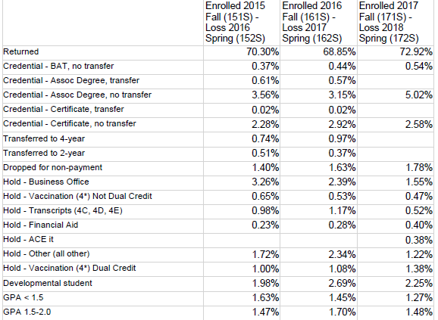
Improving Student Success with Data
A Student Loss Analysis
Notes:
This is an example of the daily report we receive during registration.
It gathers and compares the students from the fall semester and determines if they’ve returned. If non-returning, which category do they fall into? It also compares 3 fall to spring retention periods.
Using ZogoTech we can click on a category cell and get a list of students that are in the category.
This makes it easy to follow-up with students.

Slide 23
Improving Student Success with Data
A Student Loss Analysis
Notes:
We began development on the loss analysis last spring. We have been using the loss analysis for two semesters.
Unfortunately due to factors beyond the institutions control we did not see an increase in spring to fall retention.
However, this fall to spring, we experienced about a 3% increase in retention.

Slide 24
Improving Student Success with Data
A Student Loss Analysis
Quantifying Fall to Spring Retention Increase
# of Returning Students | 114
Average # of credits per semester | 7
Tuition & fees for 7 credit hours | $633.50
State funding per student | $1,693
~ Revenue gained | $265,221
Notes:
Loss of 978 = $2.4 million

Slide 25
Improving Student Success with Data
A Student Loss Analysis
Interventions
  Communications to students by category
  Business Office follow-up
  Marquee
Notes:
Communication is Key! Now we can send targeted communication - Via email! Via Text! Via Facebook
Registrar’s office sent a specific email to Dual Credit student’s not enrolled encouraging them to enroll
Sent a text to non-dual credit students with a meningitis hold giving them information on how to release their hold.
Business office is following up with students with bus ofc holds. They are being very vigilant about their follow-up. Training held with office.
Because of the Loss Analysis, lots of attention is being placed on clearing student holds. A new message about “clearing holds” was placed on our large college sign.

Slide 26
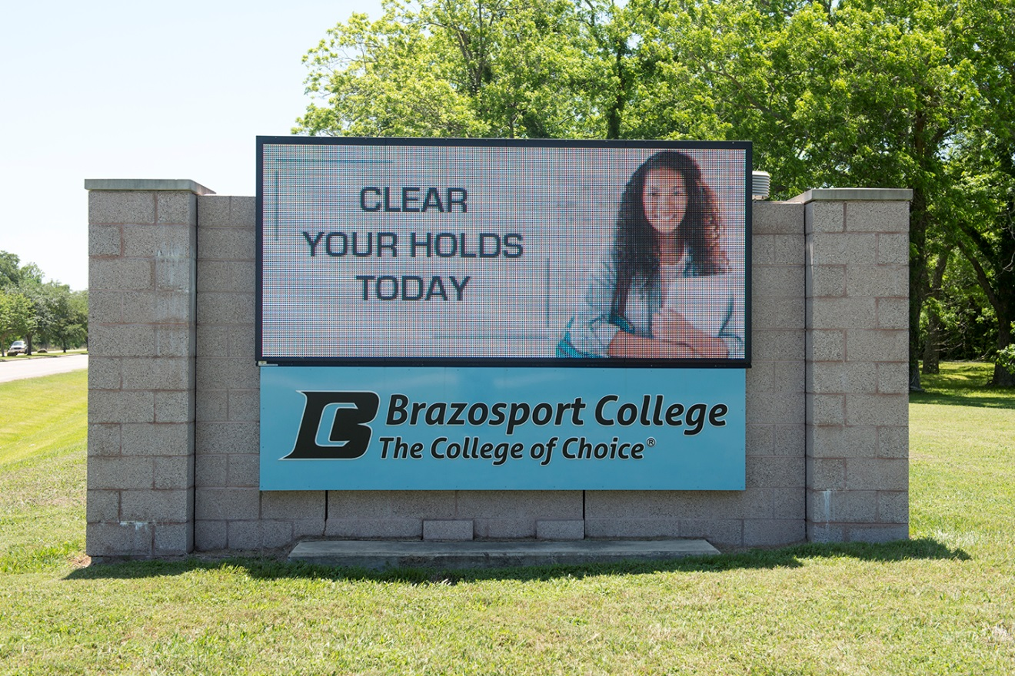

Slide 27

BC Loss Analysis
Next Steps
  Continue working with stakeholders
  Monitor effectiveness of interventions
Notes:
Stakeholders – possible workflow changes in recording contacts with students. May all be entering in ZT now.
Do stakeholders know how to follow-up
Are all interventions working?

Slide 28
Areas of Loss
Holds / Restrictions
Drop for non-payment
Academic Probation/Suspension
Financial Aid Probation/Suspension
Course withdrawals
Course is not available for student

Slide 29
Predictive Analytics
How likely is a student to return (term to term)?
How likely is a student to enroll?
How likely is a student to be on Academic OR Financial Aid Probation/Suspension?
How likely is a course to fill?

Slide 30
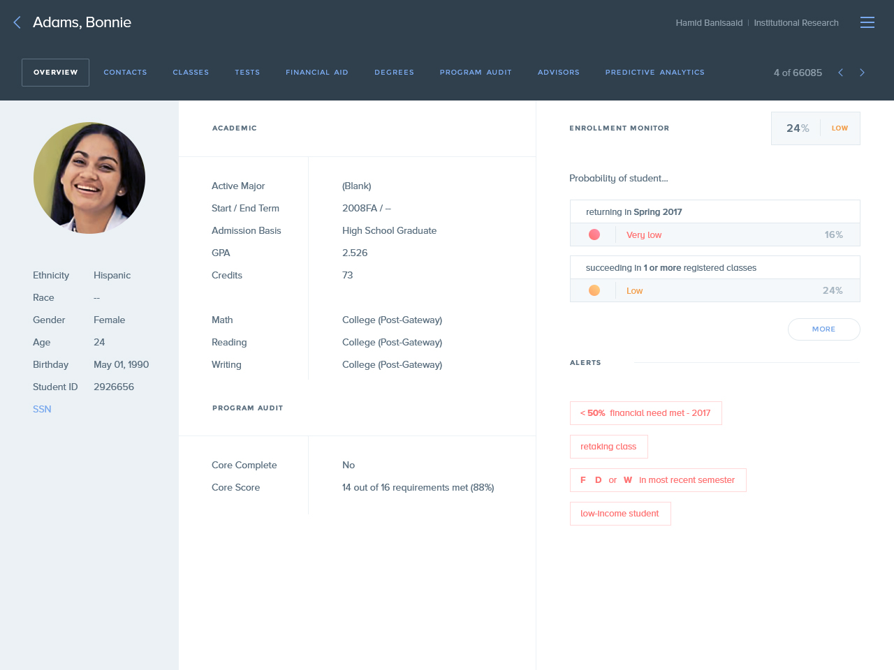

Slide 31
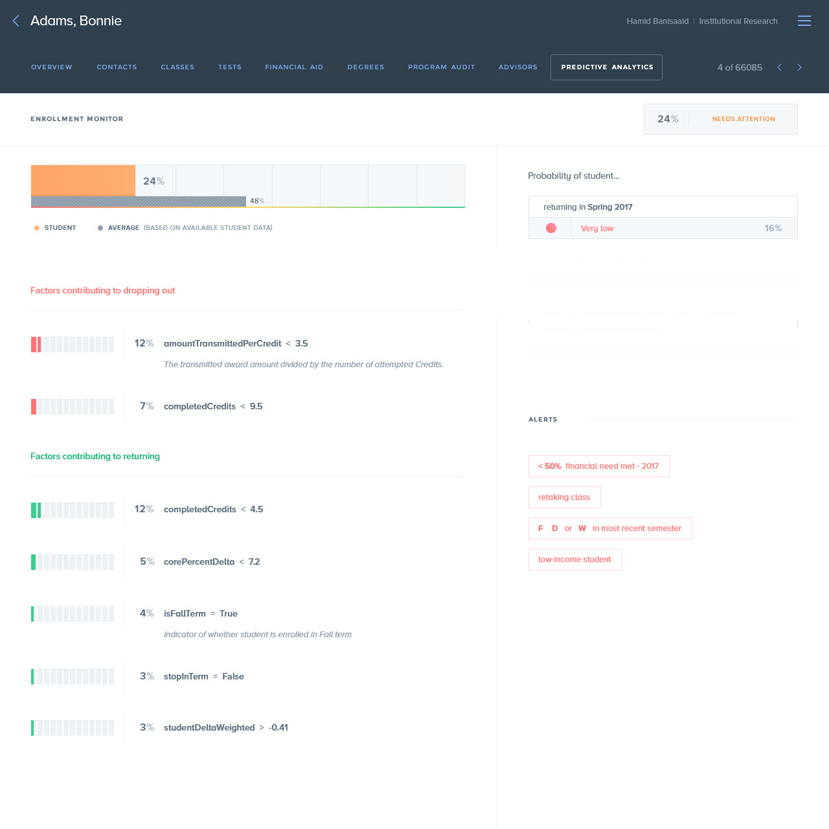

Slide 32
Improving Student Success with Data
A Student Loss Analysis
What One Area Can Your Institution Work on to Improve Student Retention?
Brazosport College focused on the Registration Process

Slide 33


Thank You for Attending!
Contact Information:
Michael Nguyen
mnguyen@zogotech.com
Cindy Ullrich
cindy.ullrich@brazosport.edu

