Slide 1
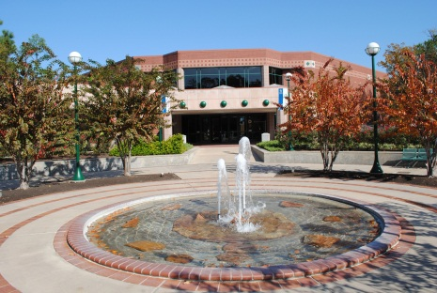
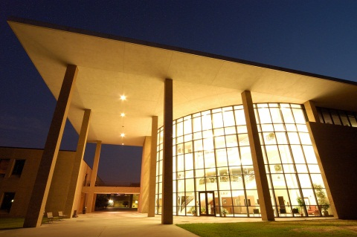
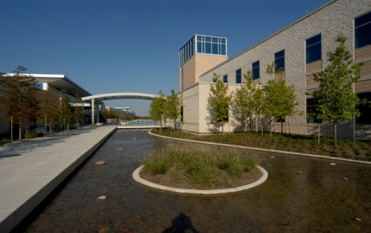
About LSC
85,000 credit students each semester, total enrollment of more than 95,000 (credit and non-credit).
Largest institution of higher education in the greater Houston area.
One of the fastest-growing college systems in U.S.
Added 39,603 students fall 2006 to fall 2016, an 86% increase.
11 school districts, 1,400 square miles, population of 2 million.
6,000 employees (part-time and full-time).
Notes:
Fast Facts fall 2016

Slide 2
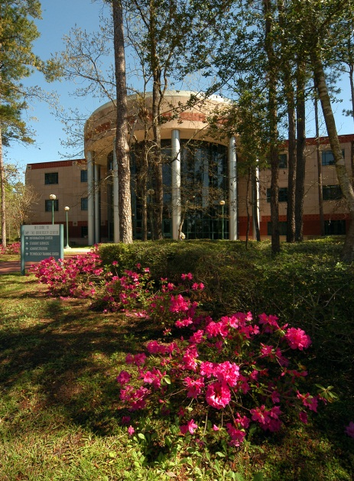

About LSC
Six colleges, eight centers, two University Centers.
Top 5 associate degree producer, ranked 4th among all community colleges in the U.S. (2014-15).
Leads state-wide Texas Completes and Texas Reverse Transfer student success initiatives.
Maintains AAA bond rating with S&P.
Economic impact of $3.1 billion annually.
Recognized as a 2016 Military-Friendly School and helps veterans fast-track to new careers with special grant funding.

Slide 3
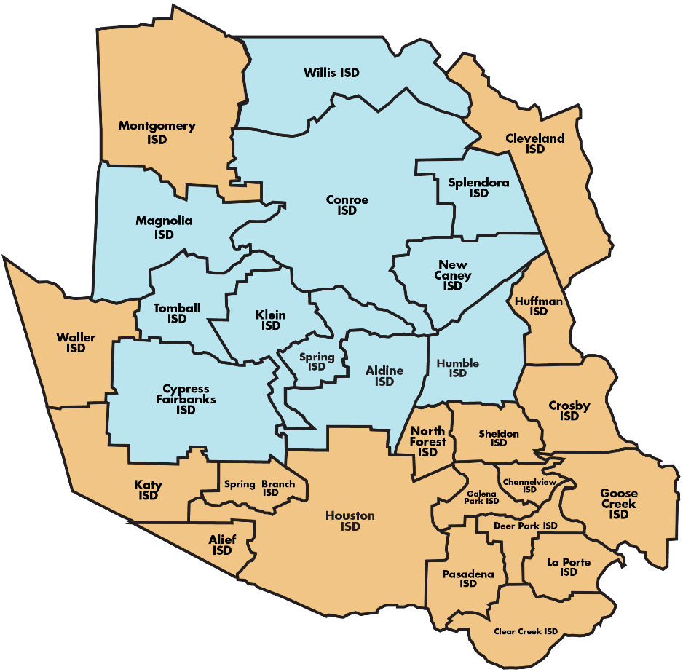
LSC System
11 school districts
More than 98,000 students
2.1 M population
1,400 square miles
$347 M operating budget
6,300+ employees

Slide 4
Building a STEM Dashboard
Goals
Identify LSC STEM Students
Measure rate of progression
Identify key roadblocks
Measure effect of interventions
Notes:
This project started after Claire, a STEM dean at one of our colleges saw my presentation that I had done for STEMtech. It was a study of STEM dual credit student trends, graduation and transfer rates, number and types of degrees awarded, how many graduated from LSC after being a dual credit student and what institutions did they attend after leaving LSC.
Those students who enrolled in LSC after high school had much higher transfer rates to 4-year institutions than all LSC students.
She had been wanting to do a study on STEM students, so we started talking about how to identify them and what did we want to know about these students.

Slide 5
Identifying STEM Students at a University
University – Students declare a major and set up their program for their entire undergraduate career.

Slide 6
Identifying STEM Students at a Community College
Community Colleges face many challenges
Developmental Studies
Early College and Dual Credit
Few choose a STEM major
Visiting and undeclared students
Degree plans offered may change
Notes:
These are a few of the reasons that identifying a STEM student in community college is so difficult.
Up to a third of our students have to take a development studies course before they can take many of the college level courses.
A large number of these students leave before successfully completing a deved course.
Do we want to count early college and dual credit students?
From a previous study , these students were very successful and the majority of them go to a 4-year university and don’t actually attend LSC.
Most students do not choose a STEM major.
Community colleges have visiting and undeclared students.
Degree plans that are offered may change.

Slide 7
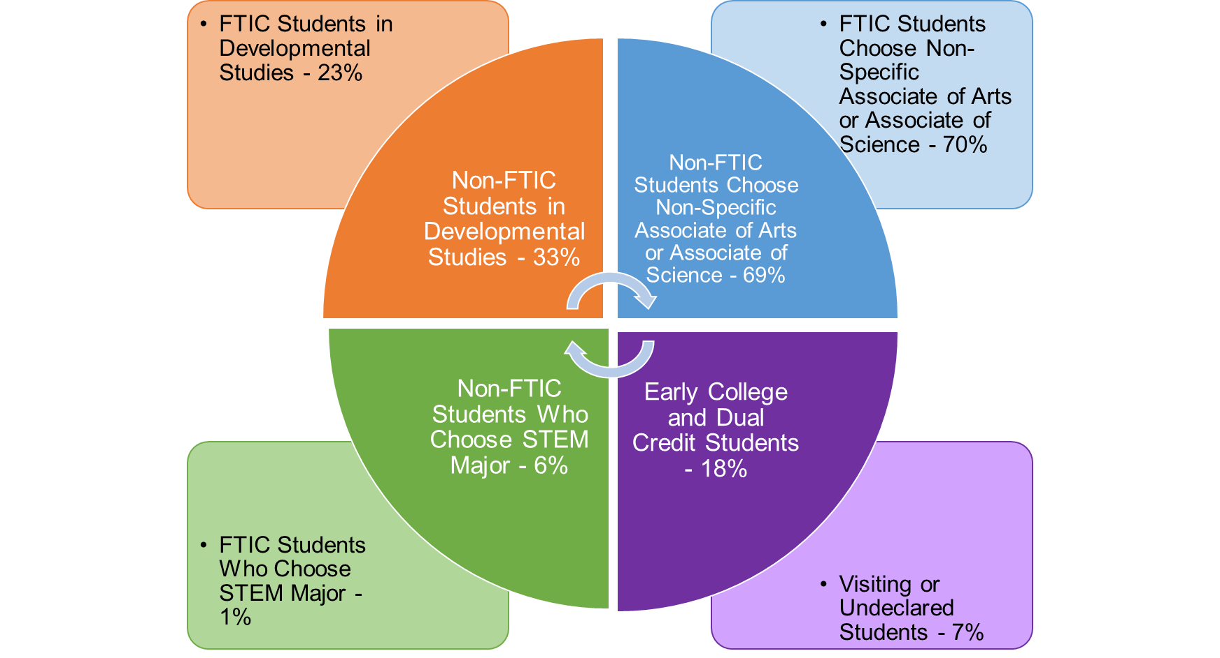
Challenges Identifying STEM Students at Lone Star College
Fall 2016
Notes:
Fall 2016
DEVED
FTIC – 23%
Non-FTIC – 33%
Not STEM degrees
FTIC – 70%
Non-FTIC – 69%
STEM Major
FTIC – 1%
Non-FTIC – 6%
Early College and Dual Credit Students – 18%
Visiting or undeclared students 7%

Slide 8

What are the STEM Programs at Lone Star College?
This turned out to be a very difficult question to answer.
Only one of our six colleges seemed to have the answer – Science, Technology, Engineering, Math, Health occupations, Psychology and Social Sciences.
Notes:
Defining what is and is not STEM proved to be more difficult than expected.
Only one of our six colleges seemed to have the answer. (on slide).
The list varied widely among the many college and university sites I explored.
The most comprehensive list I found was on the US Department of Labor website.
But their list included STEM and professions that rely on STEM knowledge.
Health professions were separated from STEM in the THECB Accountability System, so we were unsure if we should use them or not.
So we finally came up with a list that included science, math, engineering, computer technology, and health occupations.

Slide 9


What are the STEM Programs at Lone Star College?
Nope, nope, nope.
NOT all of those program areas are STEM, said the deans.
Okay, then what program areas should be included?
Notes:
Clair didn’t want her opinion to be the only one on the subject so she presented our list to the other STEM deans.

Slide 10
Initial Studies
It was decided to do some initial studies identifying students by:
Areas of Concentration
Pre-Major Course Clusters
Students who passed 9+ credit hours in an area of concentration
and
STEM Majors in Biology, Biotechnology, Computer Science and Engineering
Notes:
Knowing that few of our student declare a STEM major and drilling down to a specific STEM major is difficult, Claire came up with some initial studies to try to identify our STEM students.
Claire chose three ways to look at our student.
Areas of Concentration, Associate of Science in Biology, Engineering and Computer Science and Associate of Applied Science in Biotechnology.
This idea was influenced by a study by Jenkins and Cho in 2011 that stated students are considered a ‘concentrator’ after successfully completing 9 college-level semester credits in a particular program area.
We decided not to use cohorts for these initial studies. We looked at students enrolled in a 3 year time period, Fall 2012 to Summer 15.

Slide 11

Pre-Major Course Clusters
Math
Calculus I – III
1,226 students
71% had Associate of Science as major
33% Graduated
89% of the graduates earned an Associate of Science
Almost half of the 1,226 transferred
STEM students?
Notes:
We didn’t use cohorts at this point. We just wanted to see if we had a large enough pool of students with these groupings, their race and ethnicity, what academic plans they were in, how many graduated and with what degrees or certificates and how many transferred.
The students who took Calculus was a fairly large group that did very well, but we could not definitely say they were STEM students.
In all cases, transfers are to 4-year institutions

Slide 12
Course Clusters - Physics
University Physics I – II and Calculus I
814 students
74% had Associate of Science as Major
64% Graduated
93% of the graduates earned an Associate of Science
Over half transferred
STEM students?
Notes:
These courses alone could not tell that they were STEM students.

Slide 13

Course Clusters –
Pre-Engineering
University Physics I – II, Calculus I and General Chemistry I
11 students
91% had Associate of Science as Major
64% Graduated
100% of the graduates earned an Associate of Science
STEM students?
Notes:
Good students again. Probably STEM?
Much too small of a group to make any conclusions.

Slide 14

Course Clusters –
Pre-Pharmacy
Human Anatomy & Physiology I, General Microbiology, Organic Chemistry I - II
8 students
75% had Associate of Science as Major
75% transferred to 4-year institutions
STEM students?
Well, probably.
Notes:
Probably STEM, but so few students in this group.

Slide 15

Course Clusters –
Pre-Med
Organic Chemistry I – II, General Microbiology,
College Physics I
9 students
78% had Associate of Science as Major
1 student graduated with an Associate of Science
8 of the 9 transferred to 4-year institutions
STEM students?
Looks likely!
Notes:
Just a few students, headed toward STEM, but still in intro courses.

Slide 16
Course Clusters
Problems with Course Cluster method
We don’t know what other courses are being taken in a STEM major
Some clusters have less than 10 students
Too much overlap in courses
Majority do not have a major that is specifically STEM

Slide 17
Students who passed 9+ credit hours in an area of concentration
Engineering – Any 3 courses in:
Diesel Mechanics and Engineering Technology
  38 students took a diesel mechanics course
  Only 9 took an engineering technology course
  No students took 3 or more courses in either area
  9 students did earn a degree or certificate in one of these STEM programs
  Only 1 student transferred to a university
Notes:
This group did not prove that 9 credit hours show a concentration.
Diesel Mechanics and Engineering Technology are AAS degrees so much of course work is not transferrable. This probably is why only 1 transferred.

Slide 18
Students who passed 9+ credit hours in an area of concentration
Computer Science – Any 3 courses related to:
Data Center, Network Structure, Operating Systems and Programming
  425 students took related courses
  No students took more than 2 classes in any one area
  About 55% were enrolled in a STEM Workforce program
  Of the 199 who graduated, over 80% graduated with a STEM Associate Degree or Certificate
Notes:
So even though the 3 courses in one area of concentration did not hold true, computer science had a high graduation rate in STEM.

Slide 19
STEM Majors in Biology, Biotechnology, Computer Science and Engineering
Associate of Science - Biology
  Out of almost 500 students, 26 graduated and none in Biology
  54 transferred to a university
Associate of Applied Science - Biotechnology
  Out of almost 300 students, 26 graduated and none in Biotechnology
  59 transferred to a university
Notes:
AS-Biology fairly new program part of Texas Tuning to assist transfers

Slide 20
STEM Majors in Biology, Biotechnology, Computer Science and Engineering
Associate of Science and Applied Science – Computer Science
  3,300 students, 510 graduated, about 50% in Computer Science
  508 transferred to a university
Associate of Science and Applied Science – Engineering
  2,800 students, 510 graduated, about 33% in Computer Science
  319 transferred to a university
Notes:
Looking at these STEM majors, Computer Science is the only one that had many students graduate with an associate or certificate in their declared major.

Slide 21
Conclusion from Initial Studies
All of these methodologies have some positive results
None of them alone are a definitive way to identify STEM students
Running all of these reports on a regular basis is prohibitive because of the time factor and these reports do not cover all STEM majors or courses
All of these approaches can be used in a dashboard
Notes:
Our dashboard platform is Power BI. Some of you may have seen our departments presentation on Power BI.

Slide 22
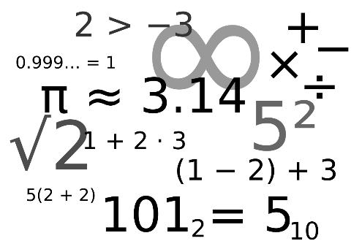

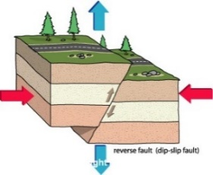




Let’s Create a Dashboard
The most difficult part of this project was getting the STEM deans to decide what programs and/or courses they wanted to include.
Science?
Math?
Engineering?
Health Professions?
Computer Technology?
Notes:
Back to the STEM deans. Yes to all.

Slide 23
Dashboard Content
Subjects
Biology
Biotechnology
Chemistry
Computer Science
Engineering
Environmental Science
Geology
Physics
Technical Calculations
Filters
Campus
Race
Gender
FTIC (First time in College)
Subject
Catalog Number
High School Attended
Notes:
So in the end it was decided to have student Completion and Success and Withdrawal trends by subject.
STEM degrees awarded. Just as dashboard was finished, deans decided they didn’t want health professions.
That same day I contacted the executive director of health professions and we were able to create a similar dashboard for them.

Slide 24
Measures
Student Completion and Successful Completion
Withdrawal Trends
Degrees Awarded
Transfers Out
Headcount by Subject
Notes:
Initial measures to use to see if these do identify areas where STEM students may have trouble.
The transfer numbers by STEM degree may not be useful because the number is so small.
It was decided to not include College Algebra because so many degree plans include so that it is not meaningful. Originally Dev Math was included, but was also removed.

Slide 25
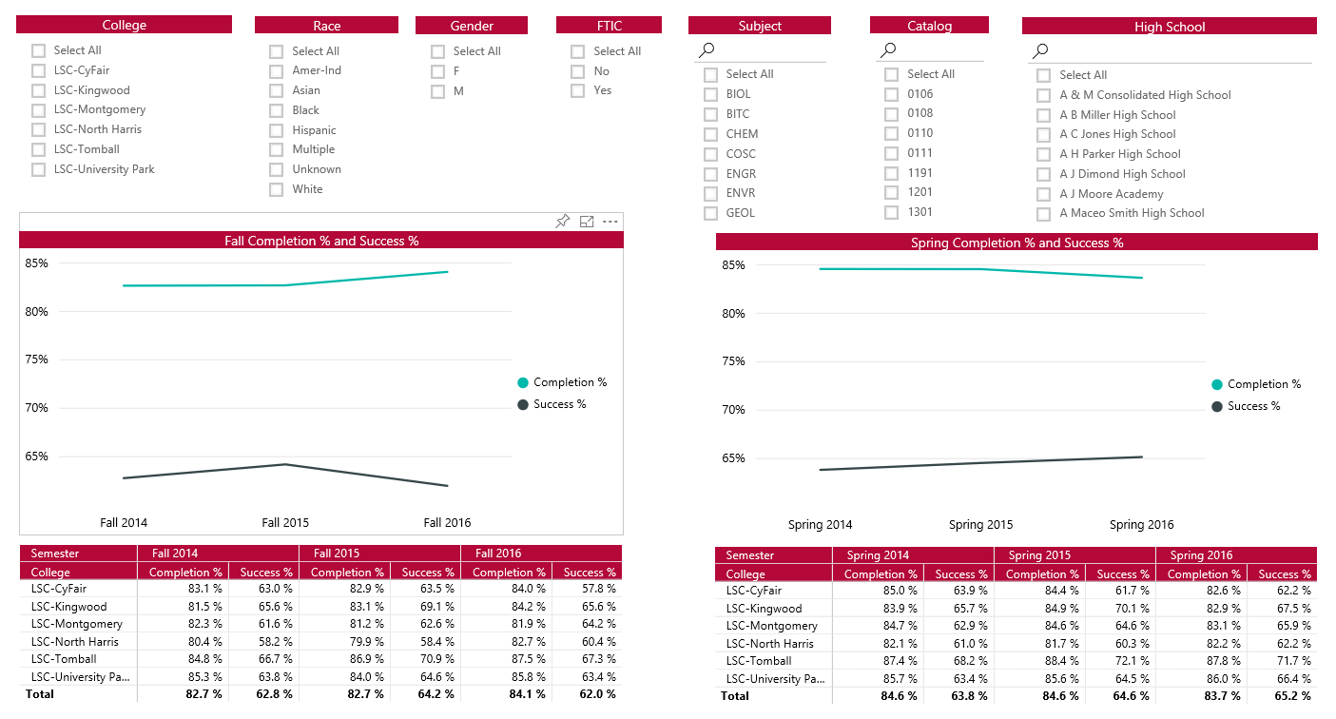
Completion and Success Trends
Notes:
Completion and Success and withdrawals.
Many of these subjects apply to more than one degree plan, but with the ability to choose more than subject and catalog at a time, we can get closer to identifying the students by Subject clusters and see the trends over 3 years.

Slide 26
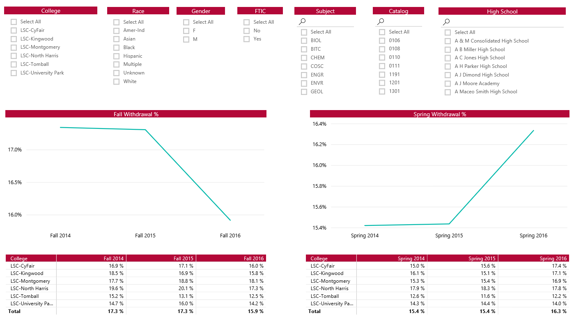
Withdrawal Trends
Snapshots of dashboard
Notes:
Multiple slides

Slide 27
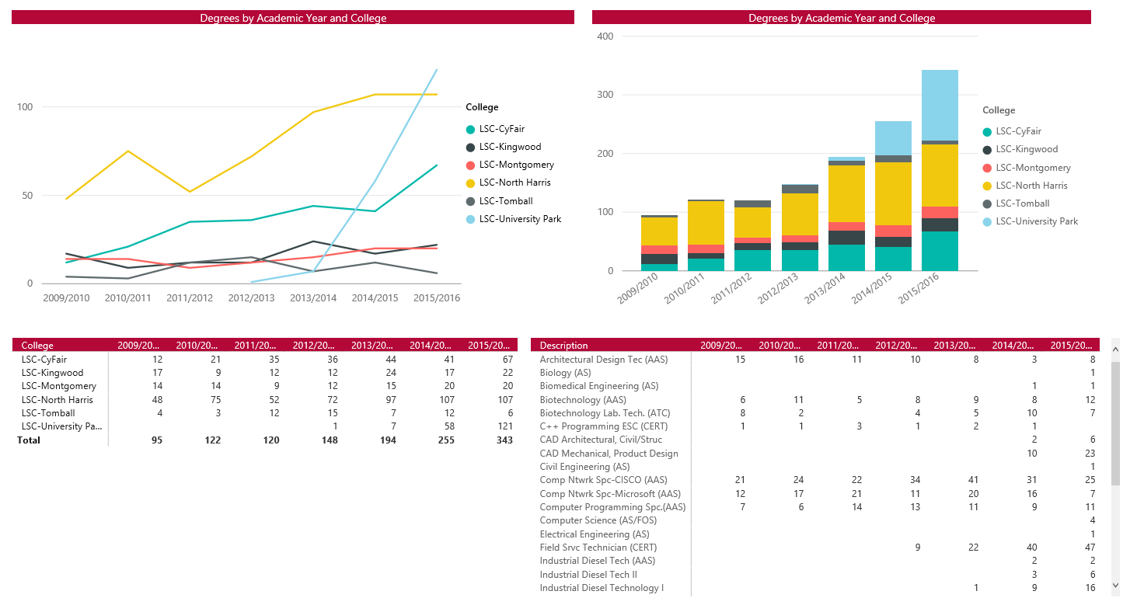
Degrees Awarded
Snapshots of dashboard
Notes:
Being able to see at a glance which programs are growing or decreasing is helpful for strategic planning.
The questions can be asked why is there only one Associate of Science in Biology?
We can go to course completion to see what subjects that are required for that degree may be a stumbling block.
More tabs or courses may be added to the dashboard later either because programs are added, courses are added or deleted, or other kinds of data may helpful in the the filters.

Slide 28
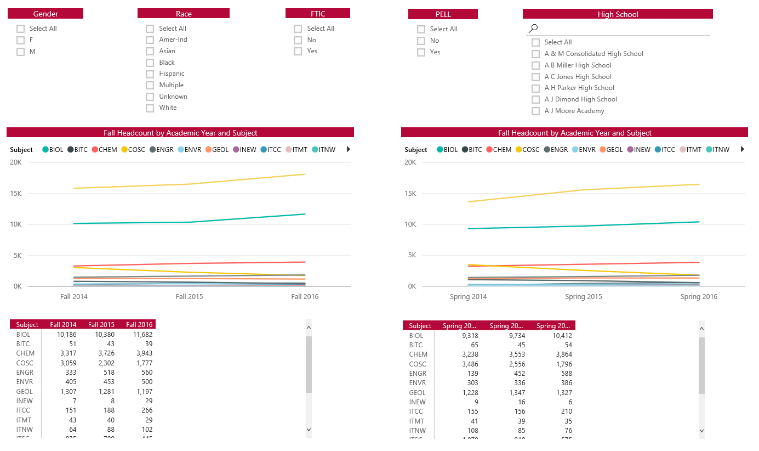
Headcount by Subject
Snapshots of dashboard
Notes:
Headcount by Subject give us a profile of the students taking certain subjects. Are there areas where particular student groups aren’t enrolling in? What high school did they attend? Were they unable to get the courses or help needed in before coming to college?

Slide 29

Finale
Well, almost
Notes:
Completion and success by students was removed because of possible problems with FERPA.
Course Completion and success by faculty was also removed. From the IR point of view, both of these would make the dashboard even more meaningful, but the deans of each college didn’t want their instructors’ performance to be compared with the others.
Unfortunately with Power BI, it is more difficult to control who sees the data. We can create a dashboard for one group but then have no control over whether the dashboard is shared with others.
Power BI is constantly evolving, so this may be something we can control in the future and include even more useful data in the dashboards.

Slide 30

Promoting Women in STEM
Today President Trump signed two bills that promote women entering and leading the STEM fields

Slide 31

For more information
Catherine Hooper – Professional Analyst
Analytics & Institutional Reporting
Check out our website!
http://www.lonestar.edu/AIR.htm

