Slide 1
Beyond the Gateway:
Examining Community College Students’
Post-developmental Reading Success
Texas Association for Institutional Research
Clear Lake City, Texas
February 28, 2017
Rebecca J. Richter, Ed.D

Slide 2
Introduction
  Developmental Education and Reading
    Developmental education participation estimates vary:
      Byrd and McDonald (2005) – 41% of first-time community college students and 29% of all entering undergraduates are underprepared
      Fulton (2012) – 40% to 60% placed into developmental education
    Developmental reading
      NCES (2011) – 14% first-time college students cannot read at an acceptable level

Slide 3
  Developmental Reading History
    Skills assessment in community colleges
      Texas history of developmental testing and placement
      TASP (1987) to the current Texas Success Initiative
    High school graduates underprepared for college
      Adelman (2006) – “challenging and rigorous coursework”
      is vital
      Abraham and Creech (2002) – taking 4 years of English is best
      Bailey (2009) – length of time out of school is a factor
      Bailey (2009) – language and cultural barriers
      Schnieders (2010); Choy, Horn, Nuñez, and Chen
      (2000) – first-generation college students

Slide 4
  Why is Inability to Read a Problem?
    Developmental education’s role in success
      Complete College America (2010) – underprepared community college students rarely receive a college credential
        Less than 10% earn an associate degree
        Less than 40% earn an occupational certificate
    Costs to provide developmental education
      Saxon and Boylan (2001) – costs are difficult to determine
        Bailey and Cho (2010) – approximately $1 billion
        Pretlow and Washington (2011) – $1.3 billion
        Schnieders (2010) - $1.4 billion
        Strong American Schools (2008) - $1.9 billion at community colleges alone plus $500 million at universities

Slide 5
  Other Problems
    Costs to students who incur substantial loan debt with no credential
      Student loan debt in 2012 was more than $1 trillion (Donoghue, 2012)
    Open admissions brings higher numbers of unprepared students
      About 60% of students are unprepared for college-level work
      “Meet students where they are and take them to where they need to be” is a common theme in community colleges
      “Last resort” in education for many students, primarily older students and minorities (Cohen & Brawer, 2003)

Slide 6
  Purpose of the Study
  The purpose of the study was to determine the effectiveness of students’ participation in community college developmental reading courses (RICCCs) on these students’ subsequent success in college courses with high level reading demands.
  Effectiveness of developmental reading programs
    Currently measure success by passing a single reading-intensive course with a grade of C or higher
    Study will take into account all of a students’ RICCCs
    Compare developmental reading students’ outcomes to students not required to take developmental reading
  Consider impact of developmental reading on students
    Persistence (number of RICCCs taken)
    Performance (accumulated grade points from RICCCs)
    Determine if demographics influence success
        Gender, ethnicity, age

Slide 7
Method
Research Design
Research Questions
Participants, Data Sources, and Context
Procedures
Data Analysis

Slide 8
Research Design
Non-experimental method (Johnson, 2001)
  Common in education research
  Examines relationships after an event has occurred. The purpose of the study is to determine whether the independent variable affected the outcome (the dependent variable) by comparing two or more groups of individuals (Johnson & Christensen, 2008)
  Not as powerful as experimental research, but acceptable when events have already occurred (ex post facto study) and conditions cannot be manipulated (Gall, Gall, & Borg, 2010)
Archived quantitative data

Slide 9
Research Questions – Persistence
What is the difference in number of reading intensive courses (RICCCs) taken as a function of developmental reading need?
What is the difference in number of reading intensive courses (RICCCs) taken as a function of developmental reading need and gender?
What is the difference in number of reading intensive courses (RICCCs) taken as a function of developmental reading need and ethnicity?
What is the difference in number of reading intensive courses (RICCCs) taken as a function of developmental reading need and age?

Slide 10
  Research Questions – Performance
What is the difference in total grade points earned in reading-intensive courses (RICCCs) as a function of developmental reading need?
What is the difference in total grade points earned in reading-intensive courses (RICCCs) as a function of developmental reading need and gender?
What is the difference in total grade points earned in reading-intensive courses (RICCCs) as a function of developmental reading need and ethnicity?
What is the difference in total grade points earned in reading-intensive courses (RICCCs) as a function of developmental reading need and age?

Slide 11
Participants, Data Sources, & Context
Two cohorts for longitudinal tracking comparison
  Completed Developmental Reading Cohort: Students who completed developmental reading in Spring or Summer 2011 and had no more than three semester credit hours of college-level coursework prior to Fall 2011
  Developmental Reading Not Required Cohort: Had no prior college credits and tested college-ready in reading based on assessment scores
  Student level data was compiled from a medium- sized Texas community college’s official state reports (CBM reports)
      CBM002 – Texas Success Initiative Report
      CBM00S – Student Schedule Report

Slide 12
Selection of Participants
Completed Developmental
Reading Cohort
Tested into developmental reading
Completed developmental reading courses in Spring 2011 or Summer 2011 terms
Earned no more than 3 credits prior to Fall 2011
Took at least 1 reading-intensive core curriculum course in the subsequent 6 terms
Developmental Reading
Not Required Cohort
Not required to take developmental reading based on assessment score
Not a transfer-in student
Took at least 1 reading-intensive core curriculum course in the subsequent 6 terms

Slide 13
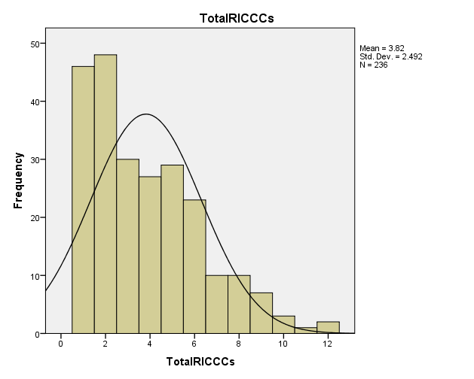
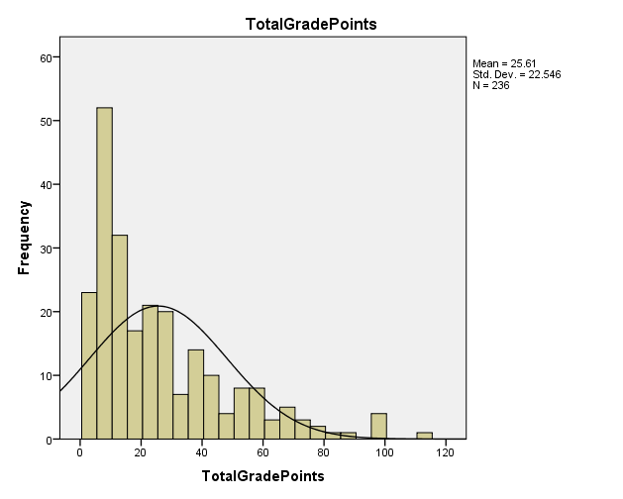
Distribution of Data

Slide 14
Data Sources (Variables)
Variable | Description
Reading status | Developmental reading levels during initial term of study (completed or not required)
Term | Students tracked for 2 years
Courses Taken | Longitudinal focus on core curriculum courses with college-level reading requirements (RICCCs)
Grade in Courses | Numeric, based on A = 4 grade points. B = 3, etc.
Persistence (calculated) | Number of RICCCs completed (A-F, withdrawals not included in totals)
Performance (calculated) | Accumulated grade points in RICCCs
Gender | Male/Female
Ethnicity | White/Black/Hispanic
Age | Grouped by traditional (<25) or non-traditional (>=25)

Slide 15
Data Analysis
Analysis was conducted using SPSS version 21
Determined if variables meet assumptions of normality
    Calculated standard skewness and standard kurtosis of the data (Onwuegbuzie & Daniel, 2002)
  Used the Levene test to check if variables met the assumption of homogeneity of variance
  Conduct appropriate statistical analyses on the data set
  Statistical significance based on alpha level = 0.05
Calculate effect size for practical significance
  Odds ratios
  Games-Howell multiple comparisons

Slide 16
Data Analysis – Persistence
Research Questions | Assumptions Violated | Procedures | Findings
What is the difference in number of RICCCs taken as a function of developmental reading need? (Threshold = 4 RICCCs or higher) | Normality | Kruskal-Wallis Odds ratio | DRNR 1.7 x that of CDR
What is the difference in number of RICCCs taken as a function of developmental reading need and gender? | Normality | Kruskal-Wallis Odds ratio | Males took more RICCCs DRNR – Female 1.66x that of CDR—Female
What is the difference in number of RICCCs taken as a function of developmental reading need and ethnicity? | Normality | Kruskal-Wallis Odds ratio | DRNR –White 2.71 that of CDR—White CDR—Non-W 1.96x that of CDR—W
What is the difference in number of RICCCs taken as a function of developmental reading need and age? | Normality Homogeneity of Variance | Welch test * Games-Howell Multiple Comparisons Odds ratio | DRNR—Trad 1.96x that of DRNR—Non-Trad and 2.58x that of CDR—Non-Trad
* Statistically significant difference

Slide 17
Data Analysis – Performance
Research Questions | Assumptions Violated | Procedures | Findings
What is the difference in total grade points in RICCCs taken as a function of developmental reading need? (Threshold = 19 TGP or higher) | Normality Homogeneity of Variance | Welch test * Odds ratio | DRNR earned more TGPs DRNR 1.95x that of CRD
What is the difference in total grade points in RICCCs taken as a function of developmental reading need and gender? | Normality Homogeneity of Variance | Welch test Odds ratio | Women far more likely to earn 19 + RICCCs, DRNR took more than CDR
What is the difference in total grade points in RICCCs taken as a function of developmental reading need and ethnicity? | Normality | Kruskal-Wallis * Games-Howell Multiple Comparisons Odds ratio | Sig difference DRNR—W and DRNR—B CDR—W 1.87x DRNR—W
What is the difference in total grade points in RICCCs taken as a function of developmental reading need and age? | Normality Homogeneity of Variance | Welch test * Games-Howell Multiple Comparisons Odds ratio | DRNR had significantly more TGPs DRNR—Trad 1.84x CDR—Non-Trad
* Statistically significant difference

Slide 18
Discussion: Implications
How does lack of reading ability affect students?
Students do not progress through college-level courses as quickly, if at all, as students with strong reading skills
  Incur substantial debt by taking additional classes
    Developmental classes
    Retaking failed classes
  Become discouraged by lack of progress
    Drop out of college without completing a credential

Slide 19
Discussion: Recommendations
What are some suggestions for further research?
Replicate the study using a larger study group
  Data are available at the state level. All community colleges report the same data to the Texas Higher Education Coordinating Board
Add more demographic variables
    Full-time versus part-time students
    Economic status/financial aid need
    Majors and fields of study differences
Expand the time frame to accommodate part-time enrollment, stop-outs, etc.

Slide 20
Questions?

