Slide 1
Texas Higher Education Coordinating Board update
Texas Association for Institutional Research
March 1, 2017
Melissa Humphries, Bill Abasolo, Doug Parker

Slide 2
Data collection on students with Intellectual and Developmental Disabilities (IDD)
&
85th Legislative Session Filed Bills on DE/TSI
Melissa Humphries
Program Director, Research
Division of Strategic Planning and Funding

Slide 3
Data Collection on Students with Intellectual and Developmental Disabilities
SB 37, 84th Legislative Session
  Requires the THECB to collect and maintain data relating to the participation of persons with intellectual and developmental disabilities (IDD) at IHEs
Two new items added to CBM001, CBM00A, and CBM0E1
  Data collection starts for Spring 2017 students
Will require communication between reporting officials and Offices of Disability Services

Slide 4
TAC Rule 4.12
Provides a broad definition of IDD
Specifies that IHEs will report to the THECB on the student record whether a student is identified as having an IDD or Autism Spectrum Disorder
Items will be added to the established CBM data collection
Specifies data is only reported for students who self-identify to institution
Data only reported for students who are in continuing technical education, undergraduate, or graduate programs

Slide 5
CBM Item: IDD Status
Individual with IDD. Student has been identified as having and intellectual or developmental disability. If a student is identified as having both an intellectual disability and identified as being on the Autism Spectrum, prioritize the reporting of the intellectual disability (enter ‘1’). Institutions may only report students who have been identified through self-identification and/or documented receipt of special services.
0. Student not identified as having an IDD
Student identified as having an IDD
Student identified as having an Autism Spectrum Disorder but not an intellectual disability (report ‘1’ if student is also identified as having an intellectual disability)

Slide 6
CBM Item: Program for students with IDD
Individual enrolled in a transitional or other program for students with IDD. Enter ‘1’ if student was ever enrolled in a program for students with ID at your institution. Report if student was enrolled in program at any time. Report only if coded ‘1’ or ‘2’ in previous item. Enter ‘0’ if student was not enrolled in a program for students with IDD.
0. Student never participated in a postsecondary program for students with IDD at this institution
Student participated in a postsecondary program for students with IDD at this institution
It is unknown if the student participated in a postsecondary program for students with IDD at this institution

Slide 7
85th Legislative Session: Filed Bills regarding TSI and DE
HB 417- Repeal of TSI Statute (TEC 51.3062)
  No statewide mandate to assess incoming students for college readiness
  No single statewide test with statewide benchmarks (does not affect availability of TSIA)
  Filed by Rep. White

Slide 8
85th Legislative Session: Filed Bills regarding TSI and DE
HB 2223
  Requires corequisites for all DE coursework
    35% by 2018-19
    65% by 2019-2020
    100% by 2020-2021
  Exempts BASE and ABE
  Filed by Rep. Giddings

Slide 9
Questions
Melissa Humphries
Research and Evaluation
Melissa.Humphries@thecb.state.tx.us
(512) 427-6546

Slide 10
Accountability System
Bill Abasolo, JD
Director of Strategic Planning and Analysis
Division of Strategic Planning and Funding

Slide 11
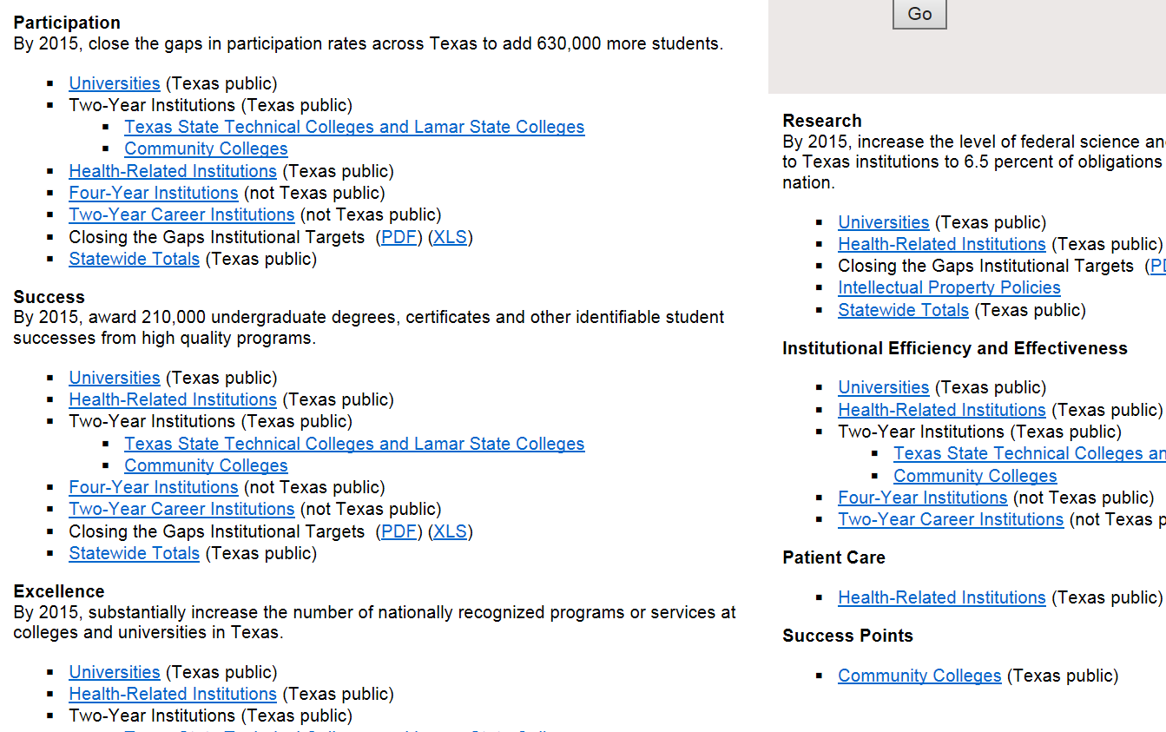

Slide 12
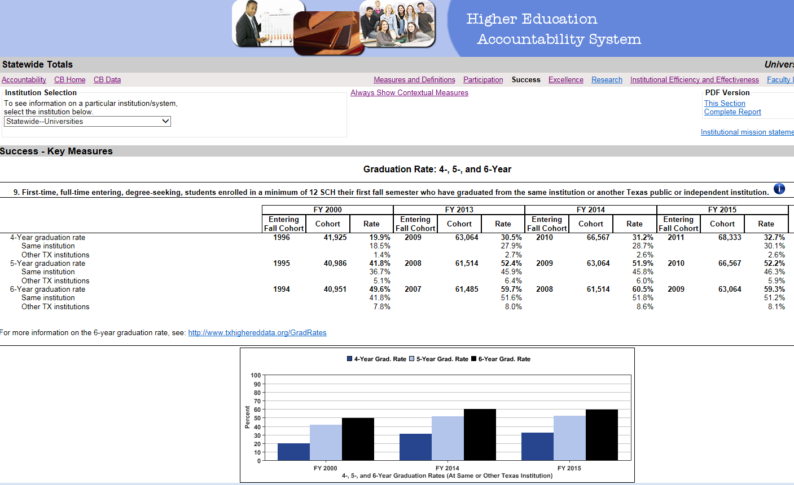

Slide 13
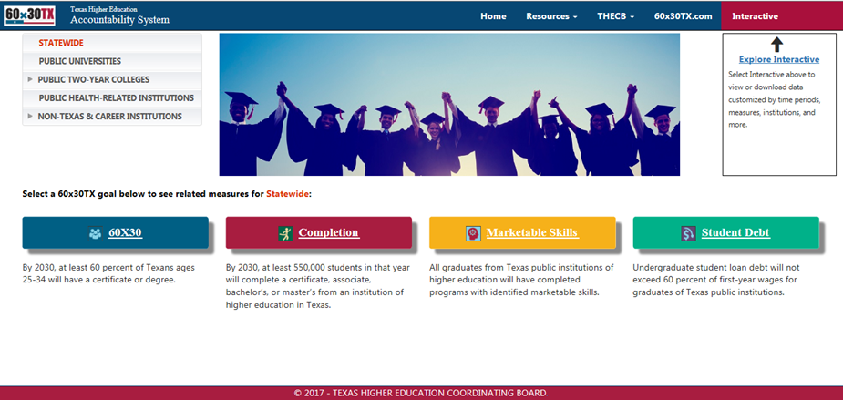
New Public Portal
Notes:
Here is the draft design of the new public facing portal. Compared with the existing home page, the new design aims to make the site simple and well organized, at the same time visually appealing to the site visitors.

Slide 14
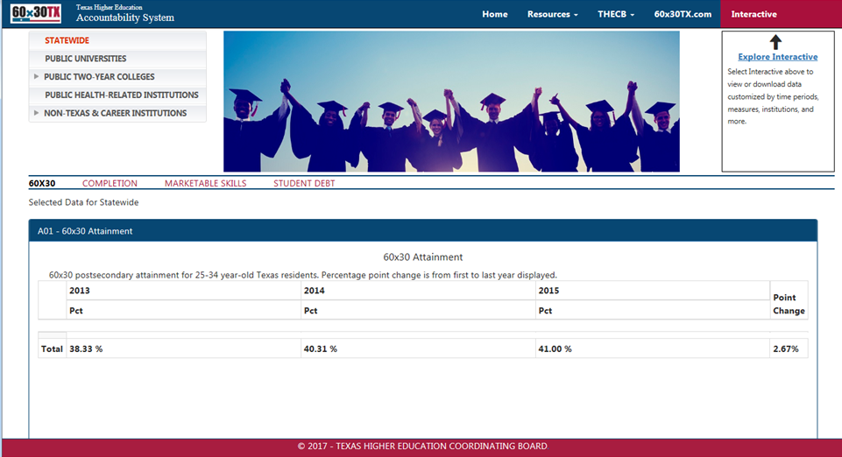
New Reports

Slide 15
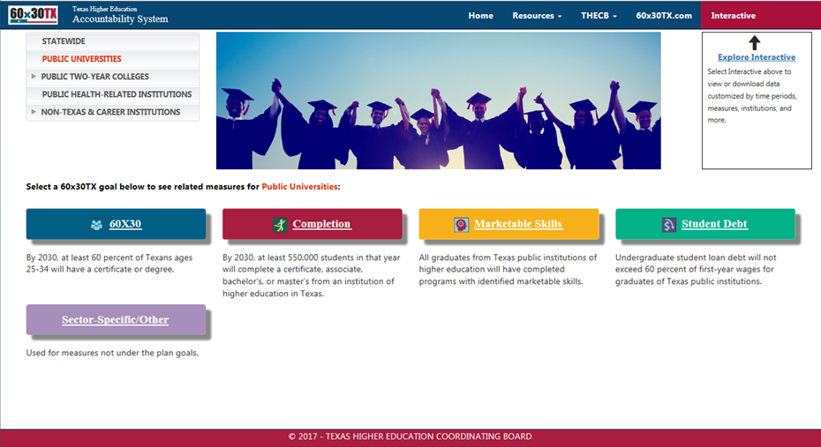
Sector Specific/Other

Slide 16
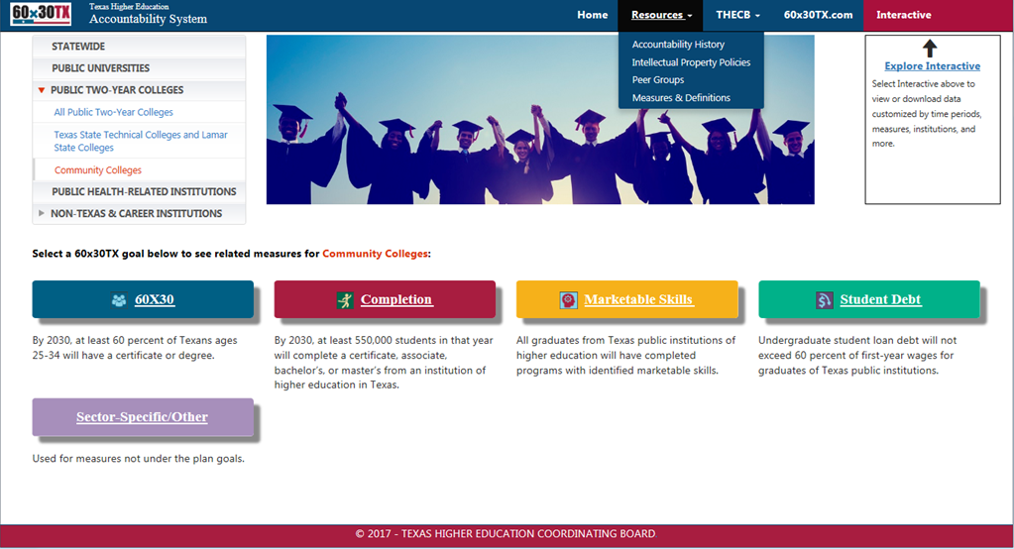
Resources

Slide 17
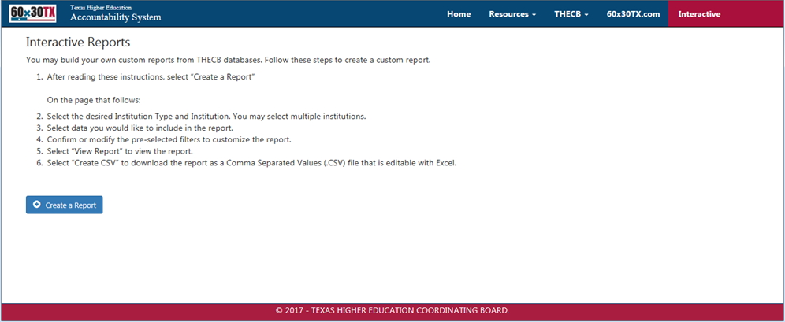
Interactive

Slide 18
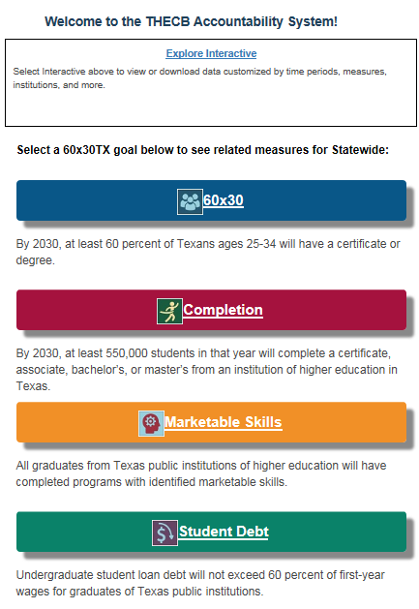
Responsive Web Design Provides Greater User Experience
Responsive Web Design is incorporated in the new Accountability public portal to provide a greater user experience for all visitors, regardless of the device they use to interact with the website.
Notes:
Responsive web design is incorporated in the new public portal to provide a greater user experience for all visitors. The new site can adjust the size and position of images, columns, and other elements based on the size of the device used by a visitor when interacting with the website.

Slide 19
Revised Accountability
Soft launch available at:
http://www.txhigheredaccountability.org/AcctPublic
Send comments to:
bill.abasolo@thecb.state.tx.us

Slide 20
Reporting Updates
2017 Annual TAIR Conference
March 1, 2017
Clear Lake, TX
Doug Parker
Director, Educational Data Center

Slide 21
Reporting updates
Thanks for getting your error-free Spring CBM001, CBM004, and CBM00C and your FY2016 certified CBM002 and CBM00S data to us
We now need you to work on certification of your Spring 2017 reports so we can send the final Formula Funding data run to the LBB
Please try to have all of your Spring 2017 reports we use for Formula Funding certified by April 3rd

Slide 22
Reporting updates
The FADS report is being rewritten with an initial due date of February 2018
It will combine data collected on “End of Year” reports with the new FADS.
There are approximately 20 new items added to the report
It will be submitted 3 times each year – February, July, and December

Slide 23
Reporting updates
Recommendation for institutions changing Student Information Systems
  The optimum time to begin is in the Summer of an odd year – after the Legislative session has convened
  Being caught mid-conversion during a Formula Funding cycle is not pleasant

Slide 24
Reporting updates
Proposed Legislation
  Collect veterans information on the student CBM reports
  Change the Disability threshold from 100% to 80% where spouse and all children (under age 26) of the disabled veteran will receive a Hazlewood exemption
  Collection of the Hazlewood Exemption data will be transferred to the Coordinating Board from the Texas Veterans Commission (September 2018)

Slide 25
Reporting updates
CBM edit program
  Problem – CTC CBM0E1 – year to year comparison – various comparisons are showing with no data from last year
  If you see others please alert your data analyst and me

Slide 26
Questions?

