Slide 1

Is High School GPA a Predictor of College Student Success?
Presented by
Mei Wang
Deseree Probasco
Lone Star College

Slide 2


Presenters
Mei Wang, M.S.
Professional Analyst II
Analytics and Institutional Reporting
At LSC for 4 Years
Deseree Probasco, M.A.
Manager, IR
Analytics and Institutional Reporting
At LSC for 10 Years

Slide 3
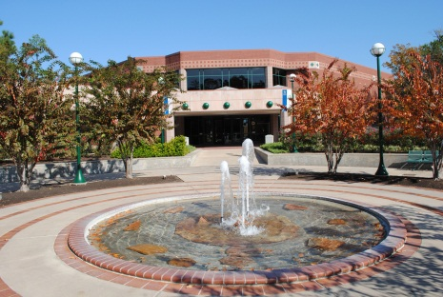
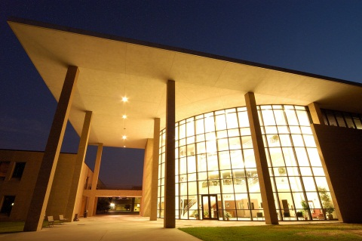

About LSC
85,000 credit students each semester, total enrollment of more than 95,000 (credit and non-credit).
Largest institution of higher education in the greater Houston area.
One of the fastest-growing college systems in U.S.
Added 39,603 students fall 2006 to fall 2016, an 86% increase.
11 school districts, 1,400 square miles, population of 2 million.
6,000 employees (part-time and full-time).
Notes:
Fast Facts fall 2016

Slide 4
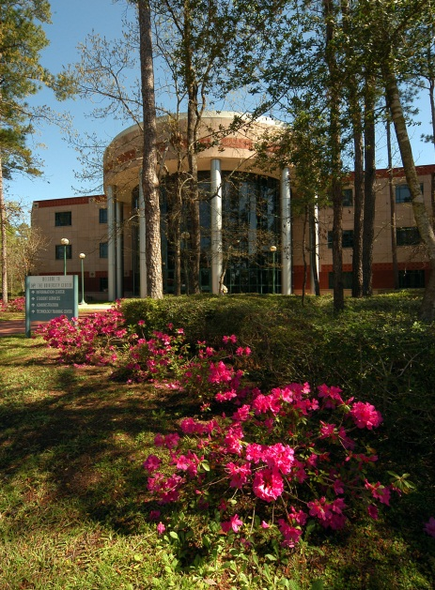

About LSC
Six colleges, eight centers, two University Centers.
Top 5 associate degree producer, ranked 4th among all community colleges in the U.S. (2014-15).
Leads state-wide Texas Completes and Texas Reverse Transfer student success initiatives.
Maintains AAA bond rating with S&P.
Economic impact of $3.1 billion annually.
Recognized as a 2016 Military-Friendly School and helps veterans fast-track to new careers with special grant funding.

Slide 5
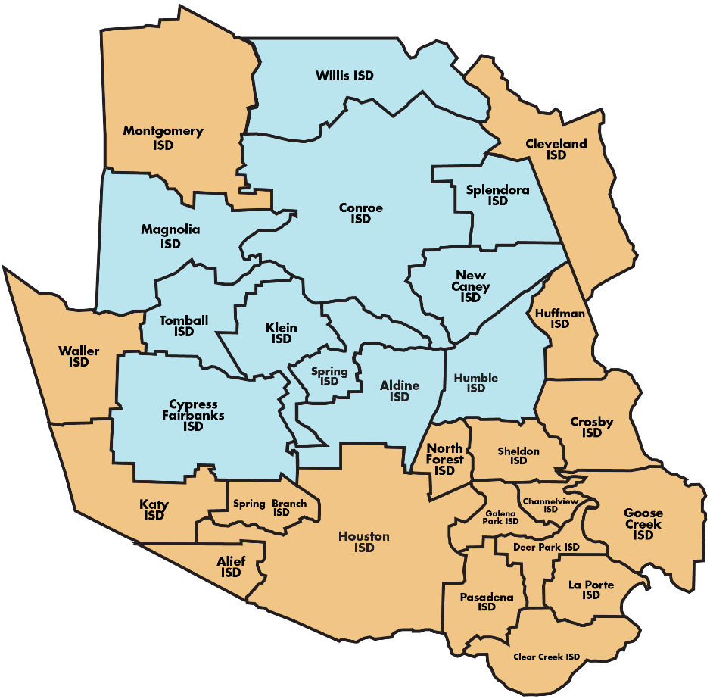
About LSC
11 school districts
More than 98,000 students
2.1 M population
1,400 square miles
$347 M operating budget
6,300+ employees

Slide 6
Access to New Data
Is High School GPA a Predictor of College Student Success?
Lone Star College recently established a protocol to import high school GPA from all submitted transcripts.
LSC’s Chancellor requested a study of student success post high school from Institutional Reporting.
The study required Institutional Reporting to collaborate with the Office of Completion and Student Records in order to bring over large amounts of data from area high schools in order to build a student sample.
The study supports the Strategic Enrollment Management initiative in process at Lone Star that was formed to monitor and support Student Success.
Study supports Civitas Illume powerful predictors for Persistence.

Slide 7

How Does Student High School GPA Impact
College Student Success?
Is High School GPA a Predictor of College Student Success?
For the institution:
Impacts institution’s strategic plan
For students:
Provides insight to student and their support network to ensure student’s future college success

Slide 8
ISDs Represented in Study
225 High Schools
Is High School GPA a Predictor of College Student Success?
Aldine
Cleveland
Conroe
CyFair
Humble
Huntsville
*Katy
Klein
Magnolia
Montgomery
New Caney
New Waverly
Splendora
Spring
Tarkington
Tomball
*Waller
Willis
High School grade scales are not cross-walked in current data.
*ISD is not in Lone Star’s service area, but a large number of students attend from these ISDs.
Notes:
Data imported from TREX into Oracle system
GPA is not weighted, and high schools can have different grade scales among schools in the ISD, and among programs within the school.

Slide 9


Academic vs. Workforce
Is High School GPA a Predictor of College Student Success?
The study differentiates between students with Workforce majors and Academic Transfer Majors
  89% Academic Transfer
  11% Workforce
  Academic Transfer students and Workforce students have different motivations and different trajectories.
  The ratio of Academic Transfer and Workforce students in the sample is representative of the LSC population.
Notes:
Academic Transfer: Take longer to complete credential. Earn credits to transfer- often without earning a degree.
Workforce: Clearer pathways. Require fewer credits to earn a credential. Tend to stop out after earning certification in order to take a position. Required to take fewer core classes for certificates.
Students in the study were recent graduates (self-reported by the student). We did not look at student age.

Slide 10



The Purpose of the Study
Is High School GPA a Predictor of College Student Success?
To examine whether high school GPA influences a student's college academic success at Lone Star College.
Academic outcomes included in this study:
First Term Persistence Rate
Course Completion Rate
Course Success Rate
Degree Completion/Transfer
Notes:
Reason, cause, purpose:
Better Partnerships with ISDs, open exchange of information
better alignment of curriculum, both academic and workforce
understanding incoming student success and red flags/ barriers to success,
Creating early alerts and predictions
budget allocation,
performance gaps among different demographics.

Slide 11
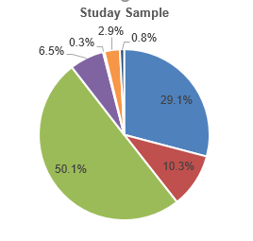
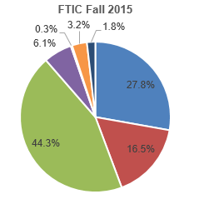
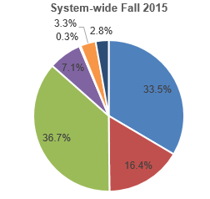

Study Sample
Is High School GPA a Predictor of College Student Success?
Fall 2012, Fall 2013, Fall 2014 and Fall 2015 FTIC students
Sample Gender and Race Distribution Compare to Student Population
N=5,180
Race | Study Sample | FTIC Fall 2015 | System-wide Fall 2015
White | 29.1% | 27.8% | 33.5%
Black | 10.3% | 16.5% | 16.4%
Hispanic | 50.1% | 44.3% | 36.7%
Asian | 6.5% | 6.1% | 7.1%
Amer-Ind | 0.3% | 0.3% | 0.3%
Multiple | 2.9% | 3.2% | 3.3%
Unknown | 0.8% | 1.8% | 2.8%
Notes:
The sample population is 51.5% female and 48.5% male, with a higher proportion of males than the overall LSC population which is 60% female and 40% male.
The sample population is 50% Hispanic, which is a larger proportion than the overall LSC population, but in line with the overall FTIC population.

Slide 12
Modeling Method
Is High School GPA a Predictor of College Student Success?
Using High School GPA as Continuing Variable:
Binary dependent variable: Logistic Regression
No Statistically Significant Difference
2. Using HS GPA as Categorical Variable: Categorical Analysis
2.5 and Below
2.51 to 3.50
3.51 to 4.50
4.51 to 6.0
Notes:
The sample population is 51.5% female and 48.5% male, with a higher proportion of males than the overall LSC population which is 60% female and 40% male.
The sample population is 50% Hispanic, which is a larger proportion than the overall LSC population, but in line with the overall FTIC population.

Slide 13

Sample GPA distribution
Is High School GPA a Predictor of College Student Success?
N=5,180
Average GPA: 3.88 Median GPA: 3.90
50.9% of students have GPA between 2.51 and 4.5.

Slide 14

Study Outcome 1: First Term Persistence Rate
Is High School GPA a Predictor of College Student Success?
Fall to Spring Persistence Rate (Overall Students)
Students with a GPA of 2.5 or below have a significantly lower persistence rate than students with a GPA above 2.51.This difference is statistically significant (P-value <0.01)
Student who have 4.51 to 6.0 GPA have a significantly higher persistence rate than students who have a GPA below 4.51.This difference is statistically significant (P-value<0.01)
First Term Persistence
High School GPA | N | Rate
4.51 to 6.0 | 1871 | 89.5%
3.51 to 4.50 | 1,218 | 83.8%
2.51 to 3.50 | 1,399 | 83.9%
2.5 and Below | 652 | 74.7%

Slide 15

Study Outcome 1: First Term Persistence Rate
Is High School GPA a Predictor of College Student Success?
Fall to Spring Persistence Rate: Academic Transfer and Workforce Students
Students with a GPA of 2.5 or below has a significantly lower persistence rate than students with a GPA above 4.51. This difference is statistically significant (P-value <0.01)
Student who have 4.51 to 6.0 GPA have a significantly higher persistence rate than students who have a GPA below 4.51.This difference is statistically significant (P-value<0.01)
First Term Persistence Rates
High School GPA | Academic Transfer |  | Workforce
 | N | Rate | N | Rate
4.51 to 6.0 | 1671 | 89.90% | 200 | 86.00%
3.51 to 4.50 | 1,086 | 84.40% | 132 | 79.60%
2.51 to 3.50 | 1,239 | 84.10% | 160 | 82.50%
2.5 and Below | 593 | 76.20% | 59 | 59.30%

Slide 16

Study Outcome 2: Course Completion Rate
Is High School GPA a Predictor of College Student Success?
First Term Course Completion Rate
Students with a GPA below 2.51 have a significantly lower course completion rate than students with a GPA higher than 2.51.
The average first term completion rate for all students is 89%, so the study population with GPAs above 2.51 have above the average rate for course completion.
This difference is statistically significant (P-value <0.01)
First Term Course Completion Rates
High School GPA | N | Rate
4.51 to 6.0 | 1871 | 92.8%
3.51 to 4.50 | 1,218 | 91.3%
2.51 to 3.50 | 1,399 | 90.7%
2.5 and Below | 652 | 86.2%

Slide 17
Study Outcome 2: First Term Course Completion Rate
Is High School GPA a Predictor of College Student Success?
Academic Transfer and Workforce Students
Students with a GPA below 2.51 have a significantly lower course completion rate than students with a GPA of 2.51 and higher.
In Workforce program data, students in the 2.51 to 3.50 range have a higher rate of completion than students in the 3.51 to 4.51 range. This may be due to the grouping of the students within the quartiles.

Slide 18
Study Outcome 3: First Term Course Success Rates
Is High School GPA a Predictor of College Student Success?
First Term Course Completion Rates
Students with a GPA below 2.51 have a significantly lower course completion rate than students with a GPA of 2.51 and higher.
The average first term completion rate for all students is 89%, so the study population with GPAs above 2.51 have above the average rate for course completion.
This difference is statistically significant (P-value <0.01)
First Term Course Success Rates
High School GPA | N | Rate
4.51 to 6.0 | 1871 | 75.2%
3.51 to 4.50 | 1,218 | 69.0%
2.51 to 3.50 | 1,399 | 68.5%
2.5 and Below | 652 | 53.5%

Slide 19
Study Outcome 3: First Term Course Success Rate
Is High School GPA a Predictor of College Student Success?
Academic Transfer and Workforce Students
Students with a GPA below 2.51 have a significantly lower course completion rate than students with a GPA of 2.51 and higher.
In Workforce program data, students in the 2.51 to 3.50 range have a higher rate of completion than students in the 3.51 to 4.51 range. This may be due to the grouping of the students within the quartiles.

Slide 20
Study Outcome 4: Graduation/Transfer Rate
Is High School GPA a Predictor of College Student Success?
Graduation/Transfer Rate
Students with a GPA below 2.51 have a significantly lower course completion rate than students with a GPA of 2.51 and higher.
The average first term completion rate for all students is 89%, so the study population with GPAs above 2.51 have above the average rate for course completion.
This difference is statistically significant (P-value <0.01)
Graduated or Transferred to Other 4 year Institutions
High School GPA | N | Rate
4.51 to 6.0 | 1871 | 33.7%
3.51 to 4.50 | 1,218 | 20.2%
2.51 to 3.50 | 1,399 | 27.2%
2.5 and Below | 652 | 13.5%

Slide 21
Study Outcome 4: Graduation/Transfer Rate
Is High School GPA a Predictor of College Student Success?
Academic Transfer and Workforce Students
Students with GPAs below 2.51 have a significantly lower course completion rate than students with 2.51 and higher.
Students with GPAs 4.51 and above have a significantly higher graduate/transfer rate than the students with below 4.51 GPAs

Slide 22

Is High School GPA a Predictor of College Student Success?
Conclusion
Students with a GPA below 2.51 are not as successful as others in key performance indicators.
Students with a GPA in the top quartile (4.51 and Above )perform significantly better than those between 2.51 and 4.50.
There is statistically no difference between students earning 2.51 to 3.51 and students earning 3.51 to 4.50.
The findings are consistent across major student success indicators: First Term Persistence Rate, Course Completion Rate, Course Success Rate and Graduation/Transfer Rate.
Notes:
Using for decision making
FYE, parent education, intervening with at-risk students early
Present research findings to the college leadership. Make recommendation on identified at-risk students.
Provide data support to the adviser committee on identify ask risk students, build realistic pathway for at-risk students to reach the goal(academic help, tutoring, financial aid etc )
SEM- Strategic Enrollment management- strategic planning- formed new committee to monitor student success, enrollment, retention/persistence, and growth. System-wide high priority initiative.

Slide 23
Is High School GPA a Predictor of College Student Success?
Next steps…
More Data will be included into analysis as it becomes available
How will LSC use these findings?
Strategic Enrollment Management
Pathways
Predictive Analytics
Notes:
Using for decision making
FYE, parent education, intervening with at-risk students early
Present research findings to the college leadership. Make recommendation on identified at-risk students.
Provide data support to the adviser committee on identify ask risk students, build realistic pathway for at-risk students to reach the goal(academic help, tutoring, financial aid etc )
**Next steps- include more data. Attempt to crosswalk GPAs across ISDs
**Civitas data reflects our study results, provides a separate level of verification- especially for lower GPAs.
**How we will use data- SEM, high school ISD partnerships, understanding early alert for incoming students.

Slide 24
Is High School GPA a Predictor of College Student Success?
Questions?
Mei Wang mei.wang@lonestar.edu
Deseree Probasco deseree.m.Probasco@lonestar.edu
Notes:
Using for decision making
FYE, parent education, intervening with at-risk students early
Present research findings to the college leadership. Make recommendation on identified at-risk students.
Provide data support to the adviser committee on identify ask risk students, build realistic pathway for at-risk students to reach the goal(academic help, tutoring, financial aid etc )
**Next steps- include more data. Attempt to crosswalk GPAs across ISDs
**Civitas data reflects our study results, provides a separate level of verification- especially for lower GPAs.
**How we will use data- SEM, high school ISD partnerships, understanding early alert for incoming students.

Slide 25

Notes:
Using for decision making
FYE, parent education, intervening with at-risk students early
Present research findings to the college leadership. Make recommendation on identified at-risk students.
Provide data support to the adviser committee on identify ask risk students, build realistic pathway for at-risk students to reach the goal(academic help, tutoring, financial aid etc )

