Slide 1

An Investigation of Effective Educational Practices Among Community College Faculty
Colleen Bullock and Dr. Richard Griffiths

Slide 2
CCFSSE
A companion survey to the CCSSE
CCFSSE asks questions about
  Teaching practices
  The ways instructors spend their time
  Perceptions of students’ educational experiences
Aligned with CCSSE to allow colleges to contrast student and faculty perceptions

Slide 3
CCFSSE Variables
FCLQUEST FCLPRESEN FREWROPAP FINTEGRAT FCLUNPREP
FCLASSGRP FOCCGRP FTUTOR FCOMMPROJ FINTERNET
FEMAIL FFACGRADE FFACPLANS FFACIDEAS FFACFEED
FWORKHARD FFACOTH FOOCIDEAS FDIVRSTUD FDIFFSTUD
FSKIPCLAS FMEMORIZE FANALYZE FSYNTHESZ FEVALUATE
FAPPLYING FPERFORM FREADASGN FWRITEANY FEXAMS
FGNGENLED FGNWORK FGNWRITE FGNSPEAK FGNANALY
FGNSOLVE FGNCMPTS FGNOTHERS FGNINQ FGNSELF
FGNDIVERS FGNETHICS FGNCOMMUN FCARGOAL FGAINCAR
FTEACH FPREP FWORKHON FADVISE FSUPERV
FWORKSTA FOUTCLAS FLECTURE FTEACHDIS FTEACHSTU
FSTUCOM FSMGROUP FSTUPRES FCLASWRIT FTESTEVAL
FPERART FEXPERI FHANDS FTEAMTEC FLINKED
FLEARNCMM FCAPSTONE FACAADV FCLINIC GRPDRNG
GRPPROJ GRPSTDYOUT GRPSTDYIN GRPTECH REQHNDSON
REQSRVLRN AVLSUPINST;

Slide 4
Exploratory Factor Analysis
A method of summarizing data

Slide 5
Exploratory Factor Analysis
A method of summarizing data
  Identifies variables to include

Slide 6
Exploratory Factor Analysis
A method of summarizing data
  Identifies variables to include
  Identifies which variables hang together

Slide 7
Who is represented?
Demographic | Percentage
Enrollment
Part-time Full-time | 47% 53%
Age
22 to 24 25 to 29 30 to 39 40 to 49 50 to 64 65 or more | <1% 4% 17% 24% 44% 10%
Gender
Male Female | 44% 56%

Slide 8
Who is represented?
Demographic | Percentage
Race
American Indian or other Native American Asian, Asian American or Pacific Islander Native Hawaiian Black or African American, Non-Hispanic White, Non-Hispanic Hispanic, Latino, Spanish Other | <1% 4% <1% 7% 80% 5% 4%

Slide 9
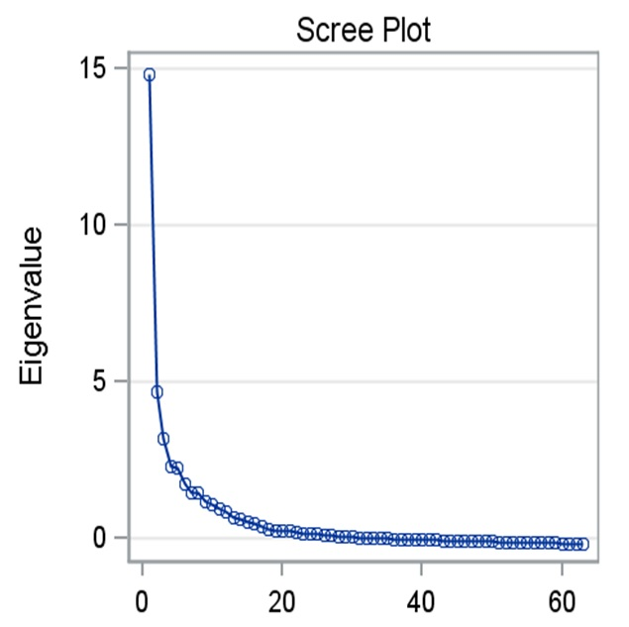

Slide 10
Factor One: Higher Level Cognitive Tasks / Expressing Ideas
FCLQUEST
FINTERNET
FEMAIL
FFACGRADE
FFACPLANS
FFACIDEAS
FWORKHARD
FOOCIDEAS
FDIVRSTUD
FDIFFSTUD
FANALYZE
FSYNTHESZ
FEVALUATE
FAPPLYING
FPERFORM
FGNANALY

Slide 11
Factor Two: Experiential Learning
  FCOMMPROJ
  FFACOTH
  FWORKHON
  FADVISE
  FSUPERV
  FWORKSTA
  FOUTCLAS
  FTEAMTEC
  FCAPSTONE
  FACAADV
  FCLINIC
  REQHNDSON
  REQSRVLRN

Slide 12
Factor Three: Collaborative/Dynamic Learning
  FCLPRESEN
  FREWROPAP
  FCLASSGRP
  FTEACHSTU
  FSMGROUP
  FSTUPRES
  FCLASWRIT
  FPERART
  GRPDRNG
  GRPPROJ
  GRPSTDYOUT
  GRPSTDYIN
  GRPTECH

Slide 13
Factor Four: Metacognition, Teaching to Comprehensive Instruction
  FINTEGRAT
  FWRITEANY
  FGNGENLED
  FGNWRITE
  FGNSPEAK
  FGNINQ
  FGNSELF
  FGNDIVERS
  FGNETHICS
  FGNCOMMUN

Slide 14
Factor Five: Technical/
Career Competencies
  FGNWORK
  FGNSOLVE
  FGNCMPTS
  FGNOTHERS
  FCARGOAL
  FGAINCAR
  FEXPERI
  FHANDS

Slide 15
Creating Factor Scores
Step 1: Standardize Variables
Step 2: Compute the Averages for Each Factor

Slide 16
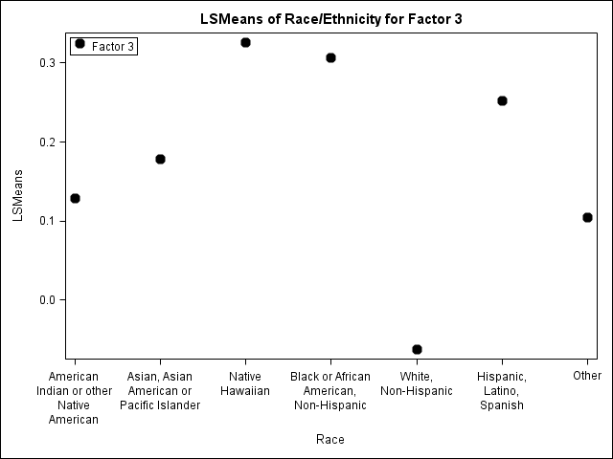
How Do Different Ethnicities Compare on Dynamic Learning?

Slide 17
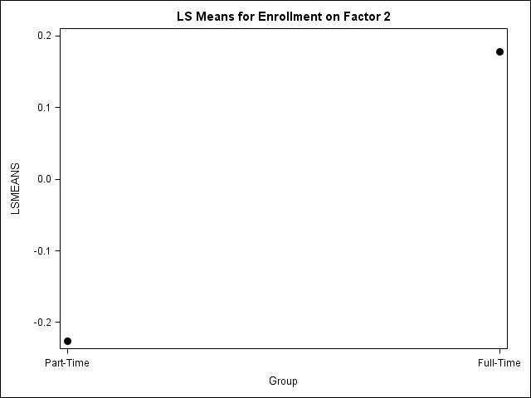
Part-Time / Full-Time and Experiential Learning

Slide 18
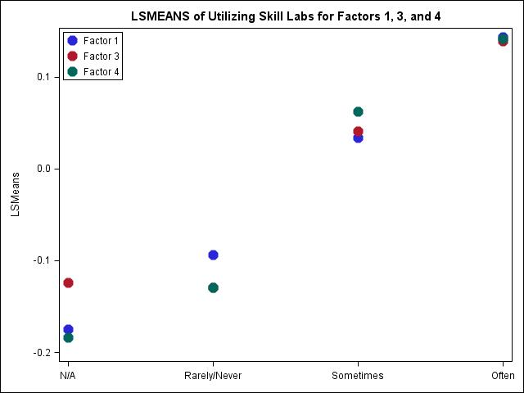
Does Incorporating the
Use of Skill Labs Matter?

Slide 19
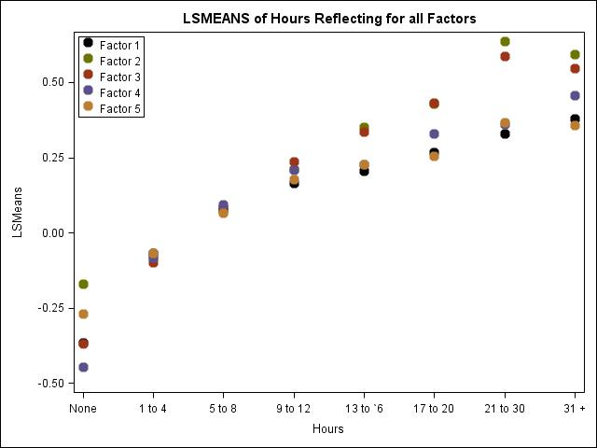
Does More Time Spent Reflecting Make a Difference?

Slide 20
Future Direction
Controlling for variables like age, faculty-enrollment status, years teaching.
Testing interactions
Confirmatory Factor Analysis
Suggestions?

Slide 21
Discussion Questions
What are some strategies and programs that your institution are using to encourage faculty to adopt effective teaching practices?
Are they working?
How do faculty spend their class time?
In what ways do faculty engage with students outside the classroom?

Slide 22
Discussion Questions
Adjunct challenges?
Faculty diversity?

Slide 23
Thanks for attending!
Colleen Bullock
bullock@cccse.org
Rich Griffiths
rgriffit@austin.cc.edu

