Slide 1


What Have Graduates Learned?
A Completer Survey for Community Colleges
Results of the 2015 Pilot Survey
Presented by
Salma Mirza
Research Analyst, Collin College
Thomas K. Martin, Ph.D.
Associate Vice President, Institutional Research, Collin College

Slide 2
Background
The Completer Survey was developed by NTCCC’s Research and Institutional Effectiveness Committee beginning in 2012.
The survey was designed
  specifically for community colleges;
  to provide a tool that would allow Consortium institutions to benchmark against one another;
  to provide institutions with critical feedback from students about perceptions of their own learning gains to help institutions triangulate on where to focus improvement efforts;
  to provide institutions with feedback from students about perceptions of the learning support environment colleges provide; and
  to be administered online.

Slide 3
Background
Survey items were designed around:
  Lumina Foundation’s Degree Qualification Profile (DQP)
  Texas Higher Education Coordinating Board’s Core Objectives
  US Department of Education’s SCANS skills for workforce education
The first pilot was conducted by Collin College in 2013 on 2012-2013 program completers with around 9% response rate.
Survey instrument included a total of 110 semantic differential type scaled items.
Survey was customized based on the awards earned by completers (i.e., not every student needs to respond to every item).
Survey allows individual colleges to do limited customization.

Slide 4
Details of the Pilot in 2015
Total number of items reduced to 91 semantic differential type scale items
Online Survey Tool: Qualtrics was selected because it facilitates collaboration and because Collin College, the North Texas Community College Consortium staff, and several other Consortium institutions have access to it.
Survey items were updated based on Lumina Foundation’s New Degree Qualification Profile (DQP2)

Slide 5
2015 Survey Design
Lumina Foundation’s DQP
  Specialized Knowledge (SK): 4 items
  Broad, Integrative Knowledge (BIK): 4 items
  Intellectual Skills (IS): 11 items
  Applied & Collaborative Learning (ACL): 5 items
  Civic and Global Learning (CGL): 4 items
THECB Core Objectives
  Communication Skills (CS): 5 items
  Critical Thinking Skills (CTS): 2 items
  Empirical & Quantitative Skills (EQS): 9 items
  Personal Responsibility (PR): 2 items
  Social Responsibility (SR): 6 items
  Team Work (TW): 4 items
SCANS Workforce Education Outcomes
  Foundations:
      Basic Skills (BS): 5 items
      Personal Qualities (PQ): 5 items
      Thinking Skills (TS): 7 items
  Workplace Competencies
      Information (INF): 2 items
      Interpersonal (INT): 8 items
      Resources (R): 3 items
      Technology (T): 3 items
RIE Subcommittee Item
  Overall Workforce Preparation: 1 item
Notes:
Each of the sources were further divided into subscales which contributed to the development of scale items.
e.g. the committee developed 11 items that fell under the DQP Intellectual skills subscale
It is important to note that many of the scale items fell under multiple subscales e.g. some items were common in the DQP Intellectual skills and the THECB Core Empirical and Quantitative Skills
These were the sources of survey design

Slide 6
Survey Structure
Completer Survey
(91 Items)
Perceptions of Learning Outcomes
(58 Items)
Perceptions of Learning Support Environment
(33 Items)
All Completers
(8 Items)
AAS/Certificate
(25 Items)
Any Associates/Core
(15 Items)
Importance/Satisfaction Rating (33 Items)
Additional Support Areas
(10 spaces)
AA/AS/Core
(10 Items)
Notes:
This slide shows the structure and survey logic in terms of how it was presented to the completers.
The survey is divided into two broad sections:
The first section invites respondents to share their perceptions about how far they feel Collin College has helped them achieve key learning outcomes.
The second section invites respondents to evaluate the support they received from key student support services at Collin
The first section has 58 items which were further divided based on the completers who would be requested to answer them. These are color-coded for our convenience in order to distinguish them.
The 8 green items were appropriate for all completers.
The 25 blue items were for completers who had been awarded AAS or were certificate completers.
The 15 red items were for any Associates degree completers or those who had completed the Texas Core.
And the 10 brown items were posed for those who had completed AA/AS or were core completers.
Completers did complete various combinations of degrees and therefore were provided different combinations of survey items.
There were 33 Perceptions of learning support items which were divided into two importance and satisfaction subscales and they were posed to all completers. The last section requested respondents to share additional support areas that they felt were important and to share their satisfaction level about them

Slide 7
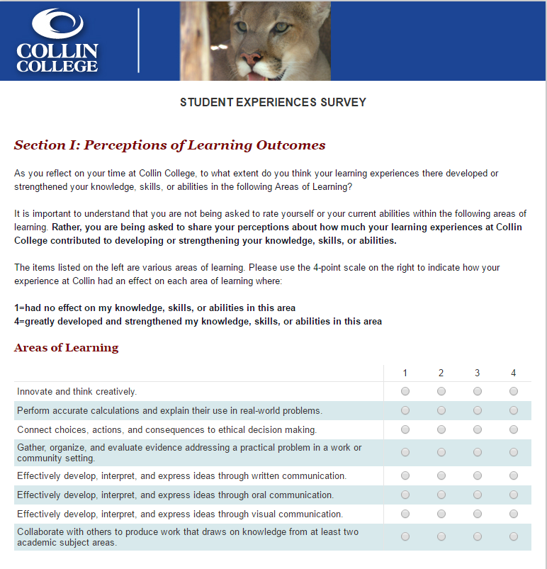
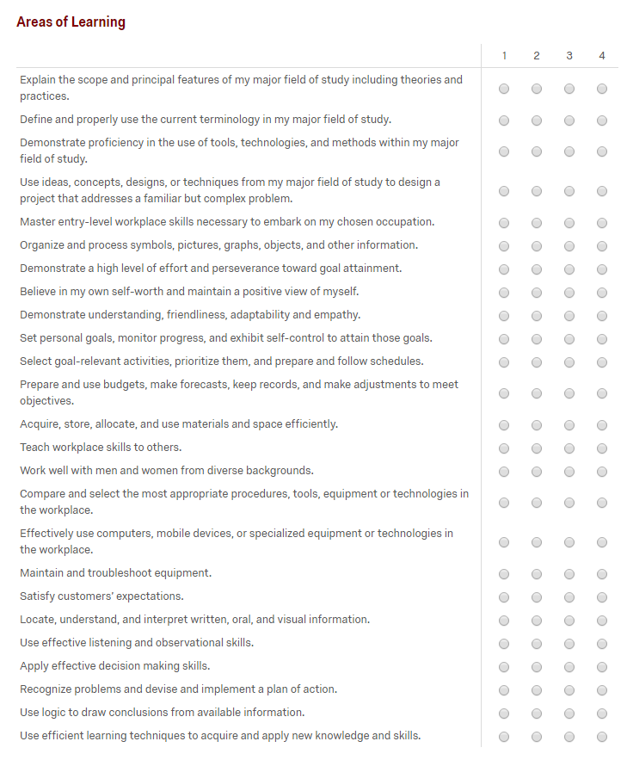
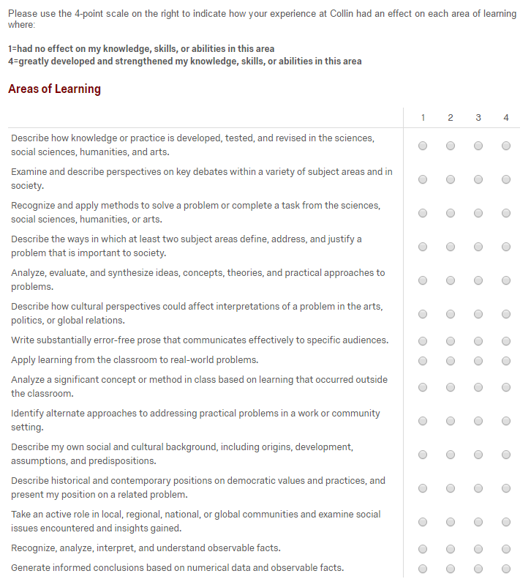
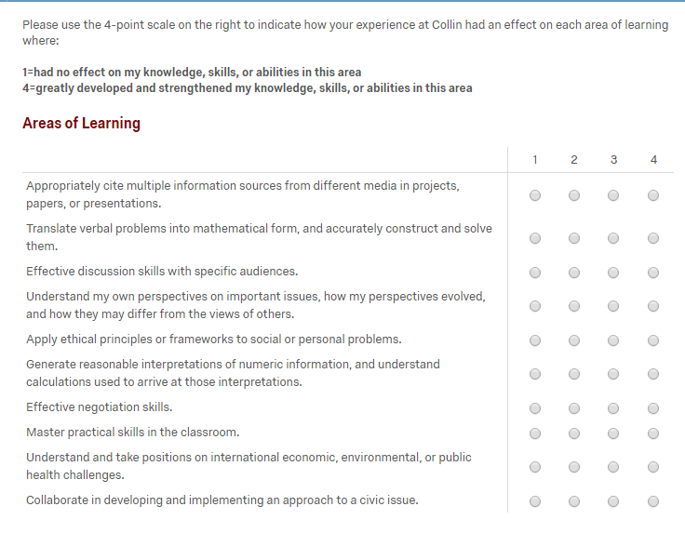
Notes:
We wanted to be sure that people understood what was being asked the explanation was added:
It is important to understand that you are not being asked to rate yourself or your current abilities within the following areas of learning. Rather, you are being asked to share your perceptions about how much your learning experiences at Collin College contributed to developing or strengthening your knowledge, skills, or abilities.
Scale of 1 to 4,
1=had no effect on my knowledge, skills, or abilities in this area
4=greatly developed and strengthened my knowledge, skills, or abilities in this area

Slide 8
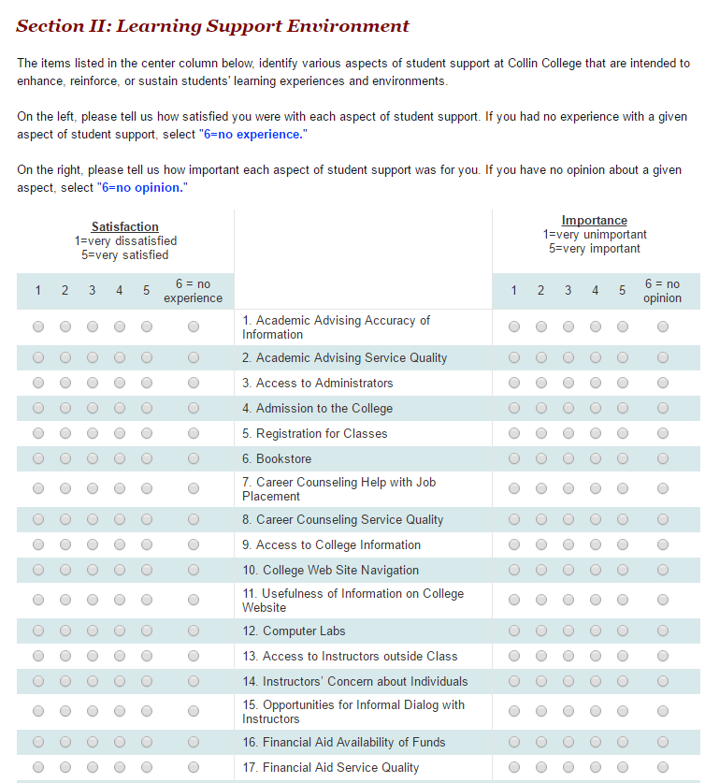
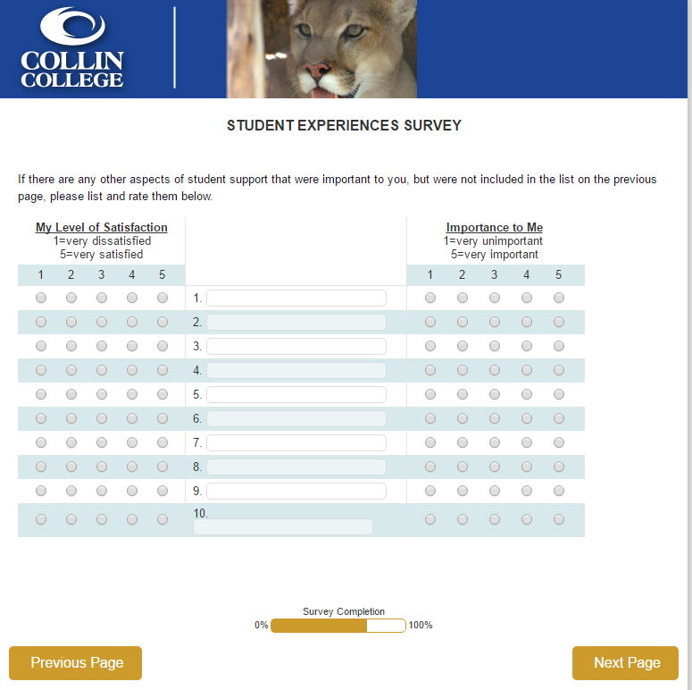
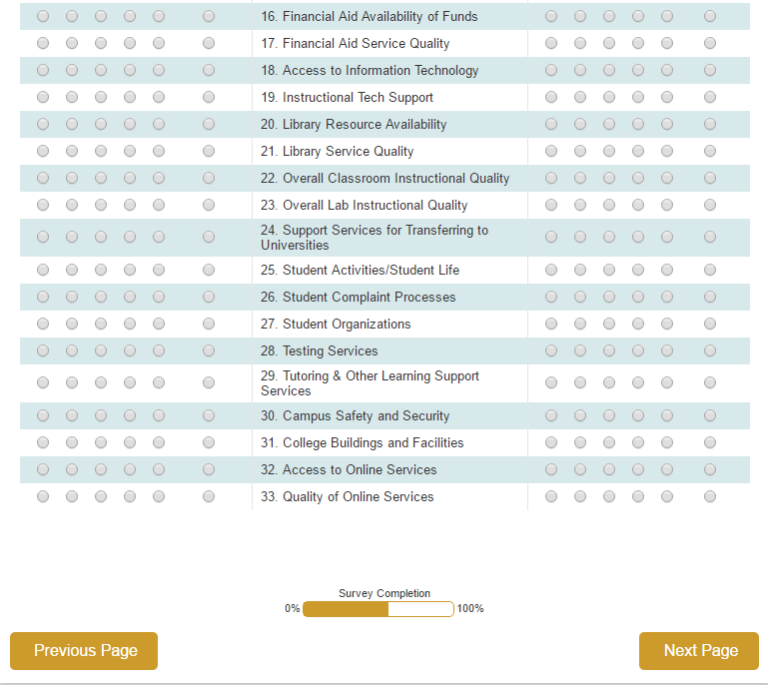
Notes:
There are 33 items that were presented to all respondents . The respondents were required to rate each support service in terms of importance as well as satisfaction on scales of 1-5 with a 6th option for no experience or no opinion. The last part of the survey invited respondents to add those services that were important but were not covered in the previous question.

Slide 9
Methodology
Invitations/Reminders | Timeline
Invitation | 11/23/2015
Reminder 1 | 12/2/2015
Reminder 2 | 12/14/2015
Reminder 3 | 1/4/2016
Reminder 4 | 1/15/2016
Reminder 5 | 1/26/2016
Reminder 6 | 2/1/2016
Survey Closing | 2/15/2016
Total number of 2014-2015 completers = 6,650
Total number of responses after data cleaning = 589
Overall response rate = 9%
Data collection tool: Qualtrics
Data analysis tools: SPSS and Excel

Slide 10
Response Rates by Perceptions of Learning Outcomes Sub-sections
Survey Sub-sections | Total No. Completers | No. of Responses Required for generalization with 95% confidence and 5% margin of error | No. of Responses Received (response rate)
Green Items | 6,650 | 364 | 589 (8.9%)
Blue Items | 1,938 | 321 | 232 (12%)
Red Items | 5,909 | 361 | 507 (8.6%)
Brown Items | 5,149 | 358 | 397 (7.7%)
Notes:
The table shows response rates by survey sections and the number of responses required for generalizations of 95% confidence with 5% error margin:
The total number of completers who were emailed the survey were 6,650. The number of responses required for 95% confidence was 364 and we received 589 total responses.
The total number of completers who were to answer the blue items was 1,938. We needed 321 responses but received 232 for this section
The total number of completers who were to answer the red items were 5,909. We needed 361 responses but received 507.
The total number of completers who were to answer the brown section were 5,149 . We needed 358 responses but received 397 instead.
So in all except one section we received a higher number than we needed to generalize the findings with 95% confidence.

Slide 11
Demographic Comparisons Between Sample and Completer Population
Notes:
The blue bar represents the sample whereas the green bar represents the completer population.
Completers aged 29 and under were underrepresented in the sample, especially the 23-29 age group. 39 percent of the population was 23-29 years of age. In comparison only 23% of the sample was in this age group.
Completers aged 30 and over were over-represented in the sample with the highest difference seen in the 41-54 age group.
Gender representation was pretty close to the population with only 4 percentage point difference existing between sample and population.

Slide 12
Demographic Comparisons Between Sample and Completer Population
Notes:
Ethnicity based comparison show very minimal differences. 81% of the sample identified themselves as non-Hispanic compared to 80% of the population.
There were some visible differences based on race. Asians and African Americans were a little over represented in the sample compared to completers who identified themselves as whites. The population had 65% whites whereas the sample constituted of only 56% whites.

Slide 13
Comparisons Between Sample and Completer Population
Notes:
The completers were taken from two award years: 2014 and 2015. there was an 8 percentage point difference between the sample and population year composition. The 2015 completers were over represented in the sample in contrast with the population.
As far as the awards comparisons are concerned, the sample included a disproportionately larger share of the AAS and certificate completers and a disproportionately smaller share of Associates degree and core completers.
The demographic comparisons facilitate our understanding of the results. It is conceivable that some bias may have creeped in due to disproportionate representation in some cases , especially so for age representation

Slide 14
Descriptive Analysis
Items grouped under DQP, Texas Core Objectives and SCANS subscales
Mean item scores and standard deviations were computed for each item.
Reliability score using Cronbach’s Alpha
Analysis of Variance (ANOVA) to gauge differences based on demographics and award completions
Notes:
For descriptive, mean item scores and standard deviations were computed for each item.

Slide 15
Sample Table
THECB-Communication Skills
Cronbach’s Alpha= 0.88 (N=111)
 |  | Extent to which learning experiences at Collin College developed or strengthened knowledge, skills, or abilities in these areas of learning? 1=had no effect on my knowledge, skills, or abilities 4=greatly developed or strengthened my knowledge, skills, or abilities
 |  | 1 | 2 | 3 | 4 | Total | Mean |  | SD
G5-Effectively develop, interpret, and express ideas through written communication. | Count | 24 | 61 | 199 | 300 | 584 | 3.3 |  | 0.82
 | % | 4.1% | 10.4% | 34.1% | 51.4% | 100.0%
G6-Effectively develop, interpret, and express ideas through oral communication. | Count | 38 | 72 | 180 | 292 | 582 | 3.2 |  | 0.91
 | % | 6.5% | 12.4% | 30.9% | 50.2% | 100.0%
G7-Effectively develop, interpret, and express ideas through visual communication. | Count | 44 | 69 | 209 | 259 | 581 | 3.2 |  | 0.92
 | % | 7.6% | 11.9% | 36.0% | 44.6% | 100.0%
B4-Organize and process symbols, pictures, graphs, objects, and other information. | Count | 15 | 33 | 60 | 89 | 197 | 3.1 |  | 0.95
 | % | 7.6% | 16.8% | 30.5% | 45.2% | 100.0%
R7-Write substantially error-free prose that communicates effectively to specific audiences. | Count | 20 | 61 | 156 | 198 | 435 | 3.2 |  | 0.86
 | % | 4.6% | 14.0% | 35.9% | 45.5% | 100.0%
Notes:
Learning outcomes items were categorized under the different subscales which had contributed to their development.
This is a sample table that shows the THECB-Communication Skills subscale that includes 5 items. 3 of them are green items that are suitable for all completers, 1 is blue which is appropriate for AAS/ certificate completers and one is red suitable for AA or AS or core completers.
We can see that for this subscales the highest mean rating was given to “Effectively develop, interpret, and express ideas through written communication” item. And the lowest mean score was given to the item, “Organize and process symbols, pictures, graphs, objects, and other information”.
To assess the reliability, we also computed the Cronbach’s Alpha scores to indicate inter-item consistency within each of the subscales .

Slide 16
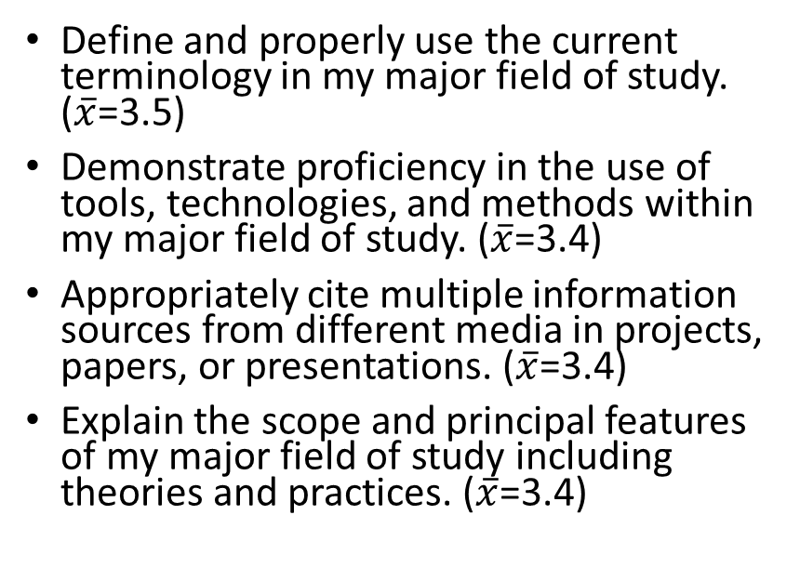
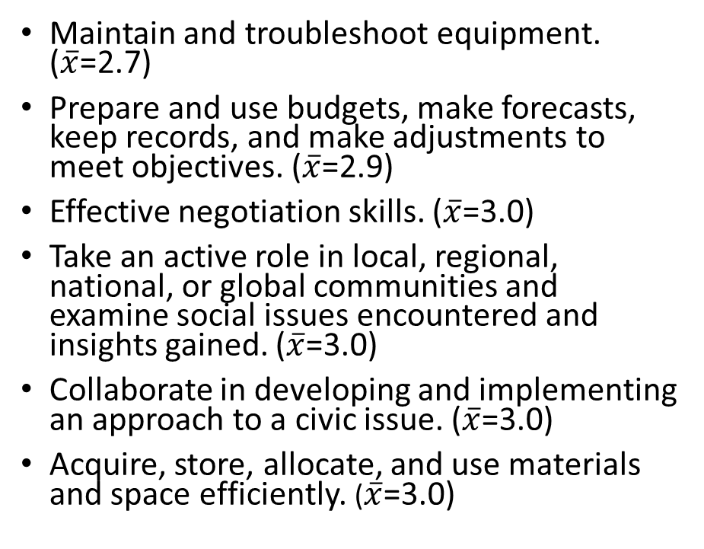
Results
Specialized Expertise and Knowledge, Intellectual Skills, Methods Related to Major Field of Study
Resourcefulness, Interpersonal/Social Skills, Civic Learning, Social Responsibility
Items with High Mean Scores
Items with Low Mean Scores
Maintain and troubleshoot equipment. ($\overline{x}$=2.7)
Prepare and use budgets, make forecasts, keep records, and make adjustments to meet objectives. ($\overline{x}$=2.9)
Effective negotiation skills. ($\overline{x}$=3.0)
Take an active role in local, regional, national, or global communities and examine social issues encountered and insights gained. ($\overline{x}$=3.0)
Collaborate in developing and implementing an approach to a civic issue. ($\overline{x}$=3.0)
Acquire, store, allocate, and use materials and space efficiently. ($\overline{x}$=3.0)
Define and properly use the current terminology in my major field of study. ($\overline{x}$=3.5)
Demonstrate proficiency in the use of tools, technologies, and methods within my major field of study. ($\overline{x}$=3.4)
Appropriately cite multiple information sources from different media in projects, papers, or presentations. ($\overline{x}$=3.4)
Explain the scope and principal features of my major field of study including theories and practices. ($\overline{x}$=3.4)
Notes:
20 subscales tables were developed that included the 58 learning outcomes items with associated reliability scores. This slides presents the items that received the highest mean rating and items that received the lowest mean rating.
The highest mean rating was awarded to “Define and properly use the current terminology in my major field of study. “
The lowest mean rating was awarded to “Maintain and troubleshoot equipment.”
The clouds above shows the summarized skills and abilities that received highest and lowest mean ratings.
So the completers perceived that Collin College’s greatest contribution was in developing skills related to Specialized expertise and knowledge, intellectual skills, methods related to major field of study
On the other hand completers perceived that Collin College’s least contribution was in developing skills that related to Resourcefulness, interpersonal/social skills, civic learning, Social responsibility

Slide 17
Differences in Means by Age
 | Age | N | Mean | F (df.) | p
R1-Describe how knowledge or practice is developed, tested, and revised in the sciences, social sciences, humanities, and arts. | 18-22 years | 99 | 3.29 | 2.611 (5,427) | 0.024
 | 23-29 years | 99 | 3.23
 | 30-35 years | 57 | 3.39
 | 36-40 years | 47 | 3.11
 | 41-54 years | 113 | 3.21
 | 55 years or older | 18 | 2.61
 | Total | 433 | 3.22
R15-Generate informed conclusions based on numerical data and observable facts. | 18-22 years | 99 | 3.34 | 2.431 (5,429) | 0.034
 | 23-29 years | 100 | 3.44
 | 30-35 years | 59 | 3.41
 | 36-40 years | 47 | 3.19
 | 41-54 years | 112 | 3.13
 | 55 years or older | 18 | 3.00
 | Total | 435 | 3.29
Research, Deduction, Critical Thinking, Reasoning Skills
Notes:
Results of Analysis of Variance in each item based on different demographic categories. The tables only show the items where differences between group means were statistically significant with 95% confidence and 5% margin of error.
Out of 58 perception of learning outcomes items there were two where age differences were found significant. In both items, the 55 years or older age group rated Collin College significantly lower compared to other age-groups.
In the first item, the 30-35 year age group rated Collin comparatively higher with a mean of 3.39.
In the second item the 23-29 age group rated Collin higher with a mean of 3.44.
Summarizing the areas where age differences were significant, we can see that Research, deduction, critical thinking, reasoning skills were areas where differences in age were found significant.

Slide 18
Differences in Means by Gender
Teamwork, Collaboration Skills, Communication Skills, Broad Integrative Knowledge
 | Gender | N | Mean | F (df.) | p
G1-Collaborate with others to produce work that draws on knowledge from at least two academic subject areas. | Female | 369 | 3.28 | 5.314 (1,581) | 0.022
 | Male | 214 | 3.10
 | Total | 583 | 3.21
G3-Gather, organize, and evaluate evidence addressing a practical problem in a work or community setting. | Female | 367 | 3.27 | 6.850 (1,578) | 0.009
 | Male | 213 | 3.07
 | Total | 580 | 3.19
G5-Effectively develop, interpret, and express ideas through written communication. | Female | 369 | 3.38 | 4.191 (1.580) | 0.041
 | Male | 213 | 3.23
 | Total | 582 | 3.33
G7-Effectively develop, interpret, and express ideas through visual communication. | Female | 366 | 3.26 | 7.822 (1,577) | 0.005
 | Male | 213 | 3.04
 | Total | 579 | 3.18
G8-Connect choices, actions, and consequences to ethical decision making. | Female | 368 | 3.27 | 10.262 (1,577) | 0.001
 | Male | 211 | 3.02
 | Total | 579 | 3.18
B6-Believe in my own self-worth and maintain a positive view of myself. | Female | 126 | 3.33 | 4.206 (1,197) | 0.042
 | Male | 73 | 3.04
 | Total | 199 | 3.23
B8-Set personal goals, monitor progress, and exhibit self-control to attain those goals. | Female | 126 | 3.29 | 4.412 (1,196) | 0.037
 | Male | 72 | 2.99
 | Total | 198 | 3.18
B20-Apply effective decision making skills. | Female | 126 | 3.29 | 4.540 (1,197) | 0.034
 | Male | 73 | 3.00
 | Total | 199 | 3.18
B21-Recognize problems and devise and implement a plan of action. | Female | 126 | 3.31 | 4.680 (1,197) | 0.032
 | Male | 73 | 3.03
 | Total | 199 | 3.21
B24-Explain the scope and principal features of my major field of study including theories and practices. | Female | 126 | 3.49 | 9.177 (1,198) | 0.003
 | Male | 74 | 3.14
 | Total | 200 | 3.36
Critical Thinking, Problem-Solving, Specialized Knowledge, Intellectual Skills
Personal Management, Personal Responsibility, Civic Learning
Notes:
The gender based differences were the highest in number.
Out of 58 items there were 15 where gender differences were found to be statistically significant. In all items, males consistently rated Collin College significantly lower compared to females.
The highest mean difference between the two genders was for the item “Explain the scope and principal features of my major field of study including theories and practices,” where the mean rating for women was 3.49 and for men 3.14.
Some key competencies and skills where gender differences were found to be significant were Teamwork, collaboration skills, communication skills, broad integrative knowledge
Critical thinking, problem-solving, specialized knowledge and intellectual skills
Personal Management, personal responsibility, civic learning

Slide 19
Differences in Means by Ethnicity
 | Ethnicity | N | Mean | F (df.) | p
G5-Effectively develop, interpret, and express ideas through written communication. | Non-Hispanic | 472 | 3.29 | 4.36 (1,569) | 0.037
 | Hispanic | 99 | 3.48
 | Total | 571 | 3.33
G7-Effectively develop, interpret, and express ideas through visual communication. | Non-Hispanic | 469 | 3.14 | 4.11 (1,566) | 0.043
 | Hispanic | 99 | 3.34
 | Total | 568 | 3.17
Written and Visual Communication Skills
Notes:
Two items were differences based on ethnicity was found to be statistically significant
In both completers who had identified themselves as non-Hispanic had rated Collin’s contribution lower compared to those who identified themselves as Hispanic.
Somewhat Unsurprising /intuitive

Slide 20
Differences in Means by Race
 | Race | N | Mean | F (df.) | p
G1-Collaborate with others to produce work that draws on knowledge from at least two academic subject areas. | Asian | 69 | 3.32 | 3.079 (3,579) | 0.027
 | Black | 100 | 3.38
 | White | 327 | 3.11
 | Multiracial/Other/NA | 87 | 3.30
 | Total | 583 | 3.21
G7-Effectively develop, interpret, and express ideas through visual communication. | Asian | 68 | 3.35 | 3.847 (3,575) | 0.010
 | Black | 100 | 3.24
 | White | 324 | 3.07
 | Multiracial/Other/NA | 87 | 3.37
 | Total | 579 | 3.18
B4-Organize and process symbols, pictures, graphs, objects, and other information. | Asian | 28 | 3.36 | 3.686 (3,192) | 0.013
 | Black | 33 | 3.52
 | White | 109 | 2.95
 | Multiracial/Other/NA | 26 | 3.15
 | Total | 196 | 3.13
R1-Describe how knowledge or practice is developed, tested, and revised in the sciences, social sciences, humanities, and arts. | Asian | 49 | 3.33 | 2.871 (3,429) | 0.036
 | Black | 77 | 3.32
 | White | 244 | 3.12
 | Multiracial/Other/NA | 63 | 3.41
 | Total | 433 | 3.22
R5-Analyze, evaluate, and synthesize ideas, concepts, theories, and practical approaches to problems. | Asian | 49 | 3.35 | 3.4 (3,429) | 0.018
 | Black | 77 | 3.39
 | White | 244 | 3.16
 | Multiracial/Other/NA | 63 | 3.48
 | Total | 433 | 3.27
R6-Describe how cultural perspectives could affect interpretations of a problem in the arts, politics, or global relations. | Asian | 50 | 3.32 | 4.222 (3,431) | 0.006
 | Black | 77 | 3.31
 | White | 245 | 3.07
 | Multiracial/Other/NA | 63 | 3.48
 | Total | 435 | 3.20
R9-Analyze a significant concept or method in class based on learning that occurred outside the classroom. | Asian | 51 | 3.39 | 3.164 (3,432) | 0.024
 | Black | 77 | 3.39
 | White | 245 | 3.09
 | Multiracial/Other/NA | 63 | 3.19
 | Total | 436 | 3.19
Team-Work, Visual Communication, Critical Thinking and Reasoning Skills
Intellectual Skills, Ability to Apply Learning to a Variety of Situations
Notes:
Out of 91 items there were 7 where race differences were found to be statistically significant. In all 7 items, those respondents that had identified themselves as white consistently rated Collin College significantly lower compared to other races. In 4 of the 7 items multiracial respondents rated Collin’s contribution at the highest. In the remaining 3, African American rated posted higher means.
Summary of items Team-work, visual communication, critical thinking and reasoning skills
Intellectual skills, ability to apply learning to a variety of situations

Slide 21
Differences in Means by Highest Award Received
Written, Oral, Visual Communication Skills
 | Highest Award | N | Mean | F (df.) | p
G1-Collaborate with others to produce work that draws on knowledge from at least two academic subject areas. | AA/AS/AAT | 263 | 3.25 | 2.75 (3,579) | 0.042
 | AAS | 112 | 3.17
 | Core | 125 | 3.32
 | Certificate | 83 | 2.98
 | Total | 583 | 3.21
G4-Innovate and think creatively. | AA/AS/AAT | 261 | 3.25 | 2.81 (3,577) | 0.039
 | AAS | 111 | 3.13
 | Core | 125 | 3.30
 | Certificate | 84 | 2.99
 | Total | 581 | 3.20
G5-Effectively develop, interpret, and express ideas through written communication. | AA/AS/AAT | 263 | 3.43 | 5.61 (3,578) | 0.001
 | AAS | 112 | 3.20
 | Core | 125 | 3.40
 | Certificate | 82 | 3.06
 | Total | 582 | 3.33
G6-Effectively develop, interpret, and express ideas through oral communication. | AA/AS/AAT | 262 | 3.30 | 5.49 (3,576) | 0.001
 | AAS | 111 | 3.14
 | Core | 125 | 3.43
 | Certificate | 82 | 2.95
 | Total | 580 | 3.25
G7-Effectively develop, interpret, and express ideas through visual communication. | AA/AS/AAT | 260 | 3.20 | 2.82 (3,575) | 0.038
 | AAS | 111 | 3.08
 | Core | 125 | 3.33
 | Certificate | 83 | 2.99
 | Total | 579 | 3.18
Teamwork and Innovative Thinking Skills
Notes:
Out of 58 items there were 5 where differences based on highest award received were found to be statistically significant. In each of the items, those respondents that had completed a certificate rated Collin College significantly lower compared to other awards.
In the item “G5-Effectively develop, interpret, and express ideas through written communication respondents who had completed an AA or an AS rated Collin’s contribution at the highest. In the item “G6-Effectively develop, interpret, and express ideas through oral communication” Core completers rated Collins’ contribution higher than other completers.
The written oral and visual communication competencies are where the certificate completers are asking for more contribution from Collin.

Slide 22
Differences in Means by Highest Award Completion Year
Workplace Preparation Skills, Interpersonal Social Skills
 | Award Year | N | Mean | F (df.) | p
B3-Master entry-level workplace skills necessary to embark on my chosen occupation. | 2014 | 73 | 3.36 | 4.19 (1,197) | 0.042
 | 2015 | 126 | 3.09
 | Total | 199 | 3.19
B7-Demonstrate understanding, friendliness, adaptability and empathy. | 2014 | 72 | 3.33 | 4.269 (1,196) | 0.040
 | 2015 | 126 | 3.02
 | Total | 198 | 3.13
B12-Teach workplace skills to others. | 2014 | 73 | 3.21 | 5.77 (1,196) | 0.017
 | 2015 | 125 | 2.85
 | Total | 198 | 2.98
B22-Use logic to draw conclusions from available information. | 2014 | 73 | 3.37 | 5.918 (1,198) | 0.016
 | 2015 | 127 | 3.06
 | Total | 200 | 3.17
B23-Use efficient learning techniques to acquire and apply new knowledge and skills. | 2014 | 73 | 3.44 | 7.107 (1,197) | 0.008
 | 2015 | 126 | 3.10
 | Total | 199 | 3.22
Critical Thinking Skills and Application of Knowledge
Notes:
Out of 91 items there were 5 where differences based on highest award year were found to be statistically significant.
In all items respondents who had earned their highest award in 2015 rated Collin College significantly lower compared to the 2014 awardees.
The summary shows that the 2014 completers rated Collin higher in providing them Workplace preparation skills, interpersonal social skills, Critical thinking skills and application of knowledge
It is interesting finding that the 2014 completers after having spent a year in the workplace may be able to better appreciate the contribution of Collin College in preparing them for these skills

Slide 23
Perceptions of Learning Support
33 items
Importance and Satisfaction scales
Semantic Differential type scale ranging from 1 to 5
6=no experience/no opinion

Slide 24
Notes:
Chart shows gap analysis between mean importance rating and mean satisfaction rating for each learning support item. The dark blue bar represent Importance and light blue bar represents satisfaction. The yellow bar represents the gap between the two.
The biggest gaps were found in “ academic advising accuracy of information” and “academic advising service quality”. These are critical areas that are being identified that require immediate attention as they are ranked 4th and 6th in importance ranking.
The next biggest gaps were found in “Career counseling Service Quality’ and Career counselling Help with Job Placement”.
Unfortunately these findings are almost identical to our findings in the 2013 pilot.
The areas where there satisfaction and importance was equal were library…
The only area where mean satisfaction was higher than mean importance was College Buildings and Facilities. Unfortunately that ranks 18th in importance

Slide 25
Meta Analysis
To compare reliability between the two surveys, Cronbach’s Alpha scores from the two pilot survey administrations were compared.
Exploratory factor analysis was used to explore inherent structure in the data and to see if it conforms with the different sources the survey instrument was based upon.

Slide 26
 | 2013 Pilot |  |  | 2015 Pilot
Sub-scales | Number of Items | Cronbach's Alpha |  | Number of Items | Cronbach's Alpha |  | Change in items | Change in Alpha
Degree Qualification Profile (DQP)
Specialized Knowledge (SK) | 9 | 0.94 |  | 4 | 0.91 |  | -5 | -0.03
Broad, Integrative Knowledge (BIK) | 11 | 0.96 |  | 4 | 0.91 |  | -7 | -0.05
Intellectual Skills (IS) | 9 | 0.93 |  | 11 | 0.96 |  | 2 | 0.03
Applied & Collaborative Learning (ACL) | 9 | 0.94 |  | 5 | 0.92 |  | -4 | -0.02
Civic & Global Learning (CGL) | 6 | 0.94 |  | 4 | 0.91 |  | -2 | -0.03
Texas Core Objectives
Communication Skills (CS) | 5 | 0.92 |  | 5 | 0.88 |  | 0 | -0.04
Critical Thinking Skills (CTS) | 4 | 0.87 |  | 2 | 0.81 |  | -2 | -0.06
Empirical & Quantitative Skills (EQS) | 6 | 0.91 |  | 9 | 0.94 |  | 3 | 0.03
Personal Responsibility (PR) | 2 | 0.77 |  | 2 | 0.84 |  | 0 | 0.07
Social Responsibility (SR) | 8 | 0.95 |  | 6 | 0.93 |  | -2 | -0.02
Team Work (TW) | 5 | 0.91 |  | 4 | 0.85 |  | -1 | -0.06
SCANS - Foundation
Basic Skills (BS) | 5 | 0.91 |  | 5 | 0.91 |  | 0 | 0
Personal Qualities (PQ) | 5 | 0.94 |  | 5 | 0.92 |  | 0 | -0.02
Thinking Skills (TS) | 7 | 0.95 |  | 7 | 0.95 |  | 0 | 0
SCANS - Workplace Competence
Information (INF) | 5 | 0.91 |  | 2 | 0.73 |  | -3 | -0.18
Interpersonal (INT) | 9 | 0.95 |  | 8 | 0.94 |  | -1 | -0.01
Resources (R) | 4 | 0.92 |  | 3 | 0.91 |  | -1 | -0.01
Systems (S) | 3 | 0.94 |  | 0 | - |  | -3 | -
Technology (T) | 3 | 0.90 |  | 3 | 0.87 |  | 0 | -0.03
Notes:
The table above shows the comparison of reliability scores between the two pilot tests.
Column 1 shows the number of items corresponding to each sub-scale in 2013 pilot
Column 2 represents the number of items corresponding to each sub-scale in the 2015 pilot
Column 3 shows the reliability score for each sub-scale in 2013 pilot
Column 4 shows the reliability score for each sub-scale in 2015 pilot
The biggest gain in reliability was in the IS subscale. The Cronbach’s alpha score went from 0.77 to 0.84 with number of items remaining the same.
The biggest loss in reliability was in the Information subscale of the SCANS Workplace Competence measures. The Cronbach’s alpha score went from 0.91 to 0.73 with a loss of three items in 2015.
This indicates an area of improvement where inter-item cohesion could be improved by either adding more items or reformulating existing items to be more cohesive.
Areas where the survey could be reduced further are Intellectual skills of the DQP and the Empirical and Quantitative skills subscales. We can safely reduce the number of items in these subscales without much affecting reliability scores.

Slide 27
Exploratory Factor Analysis Results
Rotated Factor Matrix (Any Assoc. or Core)
 | Factor
 | 1 | 2
G1 | 0.433 | 0.701
G2 | 0.480 | 0.610
G3 | 0.532 | 0.644
G4 | 0.433 | 0.709
G5 | 0.377 | 0.704
G6 | 0.335 | 0.786
G7 | 0.428 | 0.759
G8 | 0.491 | 0.686
R1 | 0.651 | 0.433
R2 | 0.758 | 0.380
R3 | 0.660 | 0.466
R4 | 0.726 | 0.470
R5 | 0.683 | 0.501
R6 | 0.712 | 0.421
R7 | 0.590 | 0.472
R8 | 0.594 | 0.523
R9 | 0.745 | 0.384
R10 | 0.731 | 0.485
R11 | 0.687 | 0.431
R12 | 0.757 | 0.372
R13 | 0.730 | 0.372
R14 | 0.716 | 0.421
R15 | 0.698 | 0.433
Item Subsets | No. Latent Factors (No. of Items Loading onto each factor) | No. of Items in each iteration | Sample size for each iteration | % of Variance Explained
AAS/Certificates (Green=8, Blue=25) | 2 (17 and 16) | 33 | 177 | 36% and 34%
Any Associates or Core (Green=8, Red=15) | 2 (8 and 15) | 23 | 410 | 39% and 30%
AA/AS or Core (Green=8, Brown=10) | 2 (9 and 9) | 18 | 330 | 34% and 34%
Exploratory factor analysis was conducted on SPSS. Principal Axis Factoring was used as an extraction method with Varimax orthogonal rotation.
Post-hoc testing using the Kaiser-Meyer-Olkin (KMO) Test was done to check for sampling adequacy. The test returned values ranging from 0.97 and 0.96, indicating high degree of adequacy.
Lowest threshold for determining relevant factor loadings = 0.50

Slide 28
Conclusions and Recommendations
Results indicated that a majority of program completers believe their experiences at Collin College developed or strengthened their knowledge, skills, or abilities in all areas of learning
Completers indicated that the competencies most strengthened by their Collin experience were in the spheres of specialized/technical expertise and knowledge, intellectual skills, methods related to major field of study
Completers indicated that the competencies least strengthened were in the spheres of resourcefulness, interpersonal/social skills, civic learning, social responsibility

Slide 29
Conclusions and Recommendations
The survey identified specific areas where students’ perceptions of learning gains differed in ways that Collin could choose to address.
  For example, certificate completers rated their learning gains in written and oral communication skills significantly lower than did other groups of completers.
Some student learning support activities and services that showed the largest gaps between perceived importance and perceived satisfaction included:
  academic advising service quality,
  academic advising information accuracy,
  career counselling service quality, and
  career counselling help with job placement.

Slide 30
Recommendations for Next Pilot
Use the reliability comparison table to reduce the length of the survey instrument. All subscales have very high reliability scores. A more concise version of the survey should be tested.
Simplify the language of some of the items as some potential respondents expressed frustration with the survey’s language complexity.
Simplify the section on the learning support environment (not presented) by asking respondents to identify only additional support areas that they find important.
Recruit additional Consortium institutions to participate in further pilot testing and refinement of the questionnaire.

Slide 31

Questions?

