Slide 1
The AIR National Survey of Institutional Research Offices
Darlena Jones, Ph.D., Director of Assessment & Research
The Association for Institutional Research

Slide 2
The Association for Institutional Research (AIR)
Forum
IPEDS Training
eAIR
Research and Dissertation Grants
NCES Data Institute
Online Education
2,000+ total attends
IPEDS Keyholder courses– NEW!
Over 600 people participated in face-to-face training.
Over 9,000 subscribers received this free newsletter covering topics of interest to IR professionals
The Access Group and AIR host a grant competition promoting scholarship on issues related to access, affordability, and value of graduate and professional education
Select attendees improve their use of NCES data for research by attending this 3-day, face-to-face training.
~300 educational and networking opportunities
Many more use the online tutorials.
2017 Forum in Washington, DC
NCES Data Institute - coming!
A Holistic Approach to IR – NEW!
Data & Decisions® Academy
NSF public-use data sets - coming!
Digital Pass gives free access to select Forum presentations
Nearly 4,700 members from 40+ countries
89% of members are from postsecondary institutions in a wide range of sectors and enrollments
35% of members are Directors of IR and another 35% are IR professional staff
Data from the 2015-2016 membership year

Slide 3
TX Members of AIR
255 members from Texas in 2015-2016 (5% of total AIR membership)
3rd highest state in AIR membership (following CA, NY)
105 Texas institutions have members
12 members from Tarrant County College District
10 members from Texas Tech University
9 members from Baylor University
8 members from University of Texas at Austin

Slide 4
Improving & Transforming IR in Postsecondary Education
National Survey of IR Offices
A new vision of effective IR in support of student success. It calls for the need for IR to serve a broader range of decision makers, to expand IR capacity, and to have chief-level leadership
A Statement of Aspirational Practice for IR
This survey established a baseline of IR Office capacities. This inquiry sought to characterize IR Offices as they existed in 2015, including scope of work, reporting lines, staffing, and fiscal resources.
2016 IR Summit
IR was featured on the national stage in Washington, DC where 70 postsecondary leaders convened to promote the need and use of IR.

Slide 5
Project Leaders
Dr. Darlena Jones, Director of Assessment & Research
Dr. Leah Ewing Ross, Independent Contractor
Jason Lewis, CFO and Interim Executive Director
*Randy Swing, past-AIR Executive Director was the previous principal investigator for this initiative.

Slide 6
Development and Adminstration: The National Survey of IR Offices

Slide 7
Why did we need to conduct this survey?
Simply put…
We didn’t know how many U.S. postsecondary institutions had an IR Office,
… or how many people worked in the IR Office,
… or who the Director of IR reported to,
… or what an IR Office did,
… or who the IR Office served.
Basically, we had no concrete evidence on the IR Office.

Slide 8
Project Timeline
Jul – Dec 2014
Jan – July 2015
Aug – Dec 2015
Jan – Mar 2016
SME meeting
Peer reviewed
Collected data via online survey system
Drafted survey
Gathered contact information
Pilot tested
Analyzed data
April 2016 Released final report!
Download the free national report and data summary reports at: www.airweb.org/NationalSurvey

Slide 9
Member Involvement
Pilot Testers - 26
Peer Reviewers - 42
SMEs - 10
Call for Volunteers - 70
This survey was informed by more than several AIR members. Their collective knowledge and insight proved invaluable and AIR is grateful for their involvement.

Slide 10
Survey Areas
Organizational structure
Resources
Tasks and functions
Consumers of IR Information and Knowledge

Slide 11
Response Rates
5,065: Number of U.S. post-secondary degree-granting U.S. institutions
(2013-2014 IPEDS)
3,292: Number of institutions with contact information found
1,575: Number of institutions that submitted data; very low response rate from for-profit sector so data were excluded
1,506: Number of not-for-profit institutions included in final data set
(52% response rate)
And, now we know that 87% of
U.S. NFP institutions have an IR Office!

Slide 12
The Structures and Work of the IR Office

Slide 13
Profile of the Director of IR
Organizational structure
Resources
Tasks and functions
Users of IR Information and Knowledge
Average age is 50 years old
Have advanced degrees
Average of 11 years in IR
Average of 6.5 years leading IR at their current institutions
Time in IR
46% have master’s degrees
43% have doctoral degrees
Spends half their time on…
Basic analytics (5.2 hours/week)
Data collection (4.6 hours/week)
Data governance (4.5 hours/week)
Meetings (5.3 hours/week)
*Includes information from AIR member-provided demographic information

Slide 14
Organizational Structure
Organizational structure
Resources
Tasks and functions
Users of IR Information and Knowledge
Other divisions include Business, Institutional Effectiveness, and IT.

Slide 15
Resources - Staffing
Organizational structure
Resources
Tasks and functions
Users of IR Information and Knowledge

Slide 16
Resources - Budget
Organizational structure
Resources
Tasks and functions
Users of IR Information and Knowledge
Budget amount is correlated with staff size and enrollment
On average, 17% of budget is spent on professional development
16% of respondents expect a budget increase next year
*NOTE: A truncated or trimmed mean is shown (excluded the top and bottom 20% within each sector to avoid extreme outliers.)

Slide 17
Resources – Data Access
Organizational structure
Resources
Tasks and functions
Users of IR Information and Knowledge
Most IR Offices have access (unrestricted or partial) to these data
Many IR Offices do not have access to these data

Slide 18
Tasks – Primary or Shared
Organizational structure
Resources
Tasks and functions
Users of IR Information and Knowledge
Most IR Offices
Some IR Offices
Fewer IR Offices
Attrition/retention/graduation analyses
Alumni employment studies
Class scheduling/demand studies
Data sharing with consortia
Enrollment – predictions/modeling
Factbook development or equivalent
Faculty/staff satisfaction studies
Federal requests for data
Guide books/rankings/surveys
Institutional accreditation
Institutional strategic planning
IPEDS data reporting
KPI development/monitoring
Monitoring strategic plan performance
State/district requests for data
Student learning outcomes assessment
Athletic association mandated reports
Course evaluations
Economic impact studies
Faculty productivity studies
Performance-based funding modeling and projecting
Specialized/program accreditation
Workforce analyses (faculty/staff/administrators)
Crime statistics reporting
Institutional budget/finance modeling
Net Price Calculator
Salary equity studies
Space utilization studies
Student borrowing/debt studies
Student financial aid modeling

Slide 19
Users of IR Information/Knowledge
Organizational structure
Resources
Tasks and functions
Users of IR Information and Knowledge
Top 5 Consumers of Data and Analyses
Academic Affairs/Provost
Academic Units
President/CEO
Enrollment Management
Assessment
Top 5 Consumers of Consultation
Registrar’s Office
Academic Affairs/Provost
Academic Units
Assessment
Enrollment Management
Offices Least Likely to Use IR Services
Campus Facilities
Housing/Residence Life
Faculty Senate
Veterans’ Services
Athletics

Slide 20
Grouping Institutions by “Personality”

Slide 21
“Personalities” of IR Offices
BROAD
Primary and Shared responsibility for a large set of tasks. Few tasks that are No responsibility
FOCUSED
Roughly equal numbers of Primary, Shared, and No responsibility tasks
LIMITED RESPONSIBILITY
A small set of Primary and Shared tasks; much larger set of No responsibility tasks

Slide 22
Differences Across Personalities: Data Access
Most IR Offices with broad portfolios of work have wide access to data
NOTE: r = .283, p < .01

Slide 23
Differences Across Personalities: # Clients
Most IR Offices with broad portfolios of work serve wide ranges of institutional units
NOTE: r = .219, p < .01

Slide 24
Differences Across Personalities: # IR Staff
IR Offices with broad portfolios of work have slightly larger staffs
NOTE: r = .105, p < .01

Slide 25
Next Steps for this Project

Slide 26
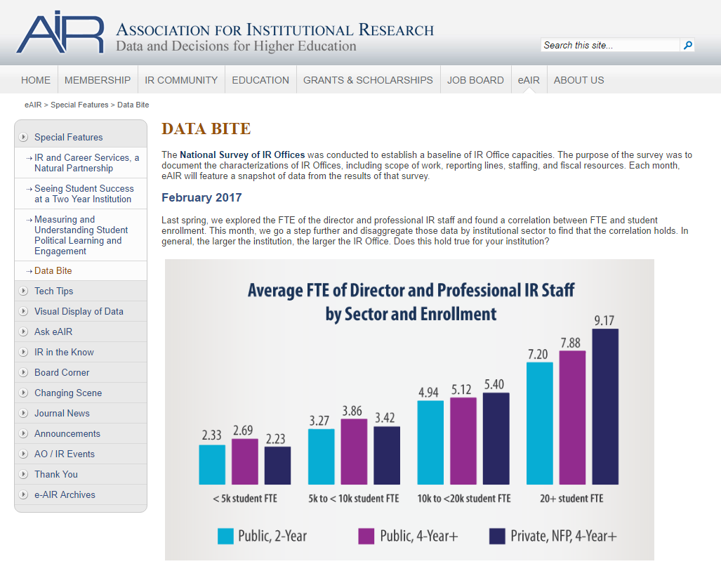
eAIR’s Date Bite
Monthly feature
An easily consumable “bite” of information
Accessible from AIR’s website

Slide 27
National Survey of IR Offices
Research and education
National benchmarking project
Your ideas?

Slide 28
Thank you!
Darlena Jones djones@airweb.org
Visit the website for this project at:
www.airweb.org/NationalSurvey

