Slide 1
Countdown to First Class Day: The Next Iteration
TAIR 2017
Clear Lake, Texas

Slide 2
In the Beginning…2008
On a daily basis, the San Jacinto College administration needed a year-to-year comparison of enrollment and contact hours
The IR&E office created a user-friendly template in Excel that was copied into an e-mail (and still had to be “tweaked” before it was sent)
After 3 years of manual labor, a significant improvement was made in the process
We wanted the report to be completely “hands-free”, so we automated the report to come directly out of SAS

Slide 3
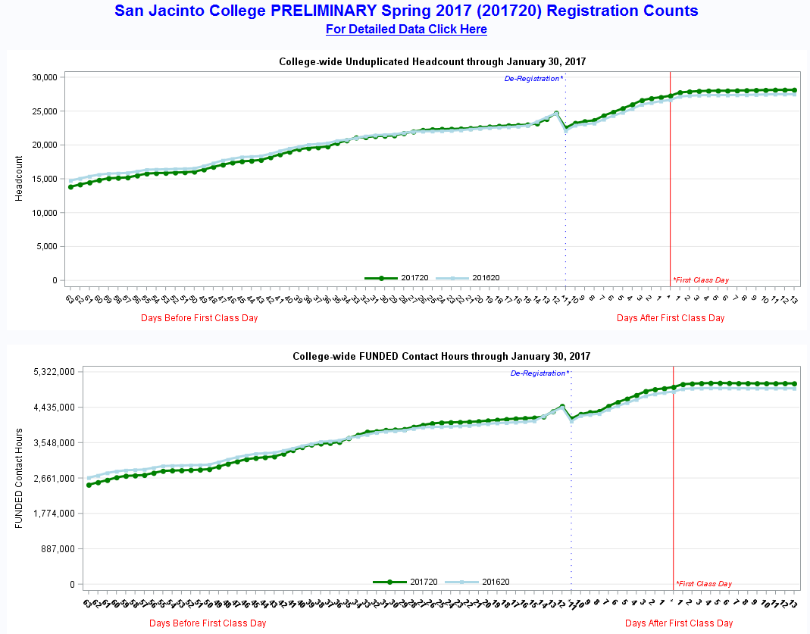
Enrollment Reporting System (ERS)

Slide 4
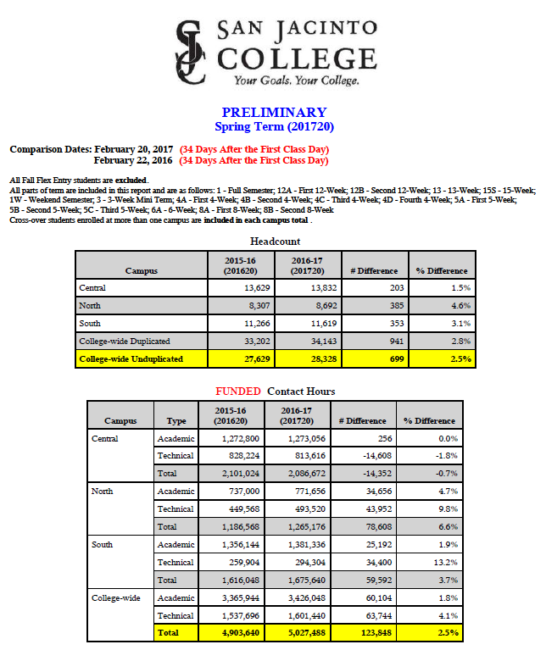
Enrollment Reporting System (ERS)

Slide 5
Planning Phase
We met with a focus group of Division Operations Coordinators (DOC) to understand the manual processes they were following to create their daily departmental reports
We created “mock-ups” in Excel to visualize the drill-down levels we would need and how they interconnected
Due to the high volume of end-users, the most efficient way to create the SAS output was to use HTML as the output delivery system (ODS)

Slide 6
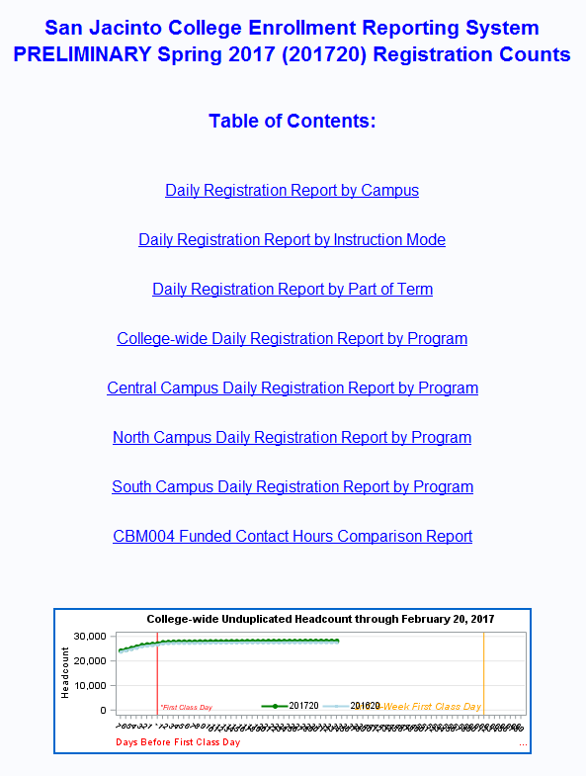
Enrollment Reporting System (ERS)

Slide 7
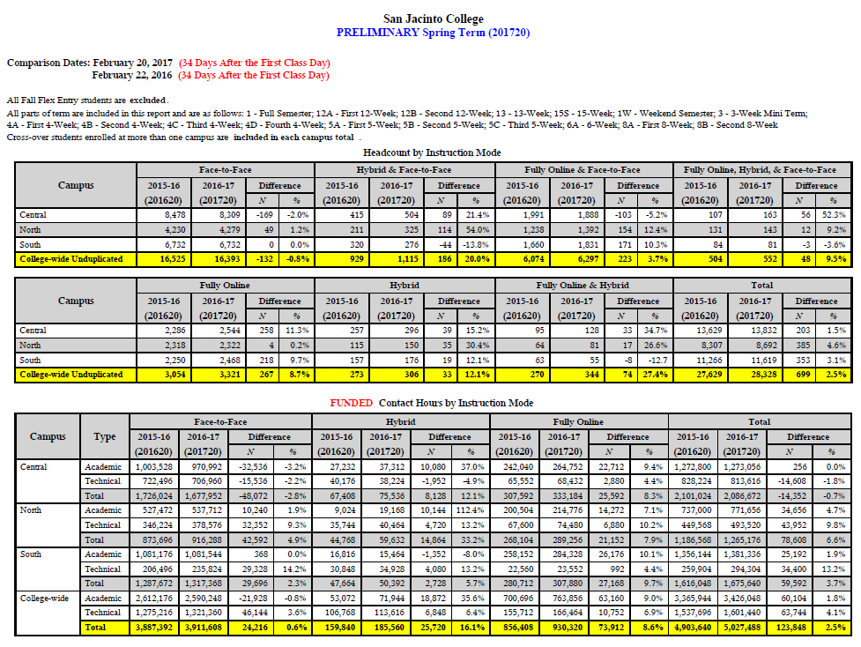
Enrollment Reporting System (ERS)

Slide 8
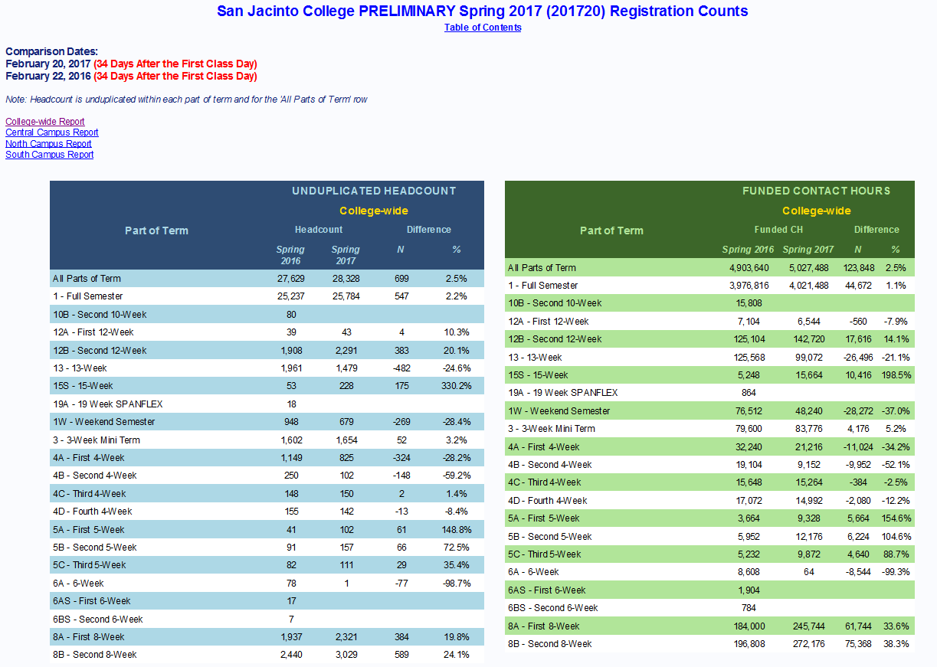
Enrollment Reporting System (ERS)

Slide 9
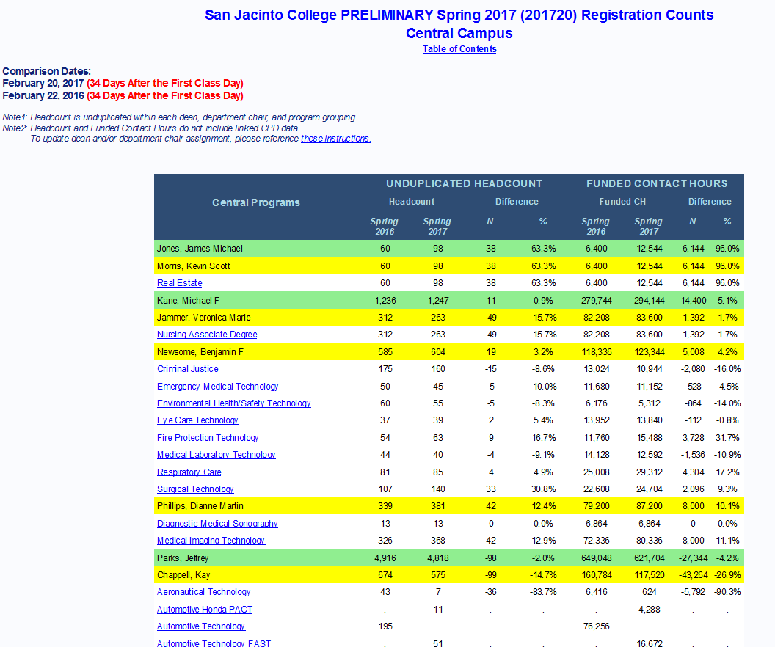
Enrollment Reporting System (ERS)

Slide 10
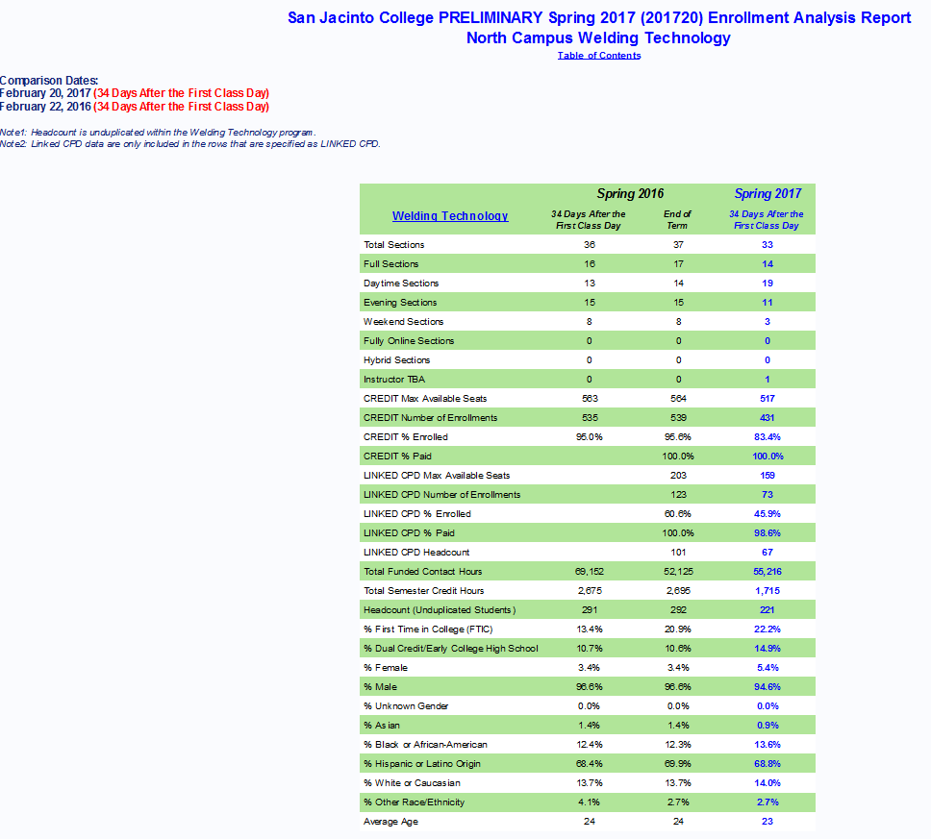
Enrollment Reporting System (ERS)

Slide 11
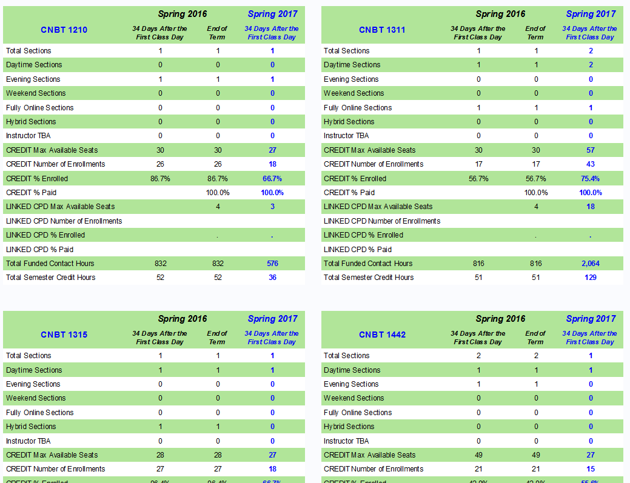
Enrollment Reporting System (ERS)

Slide 12
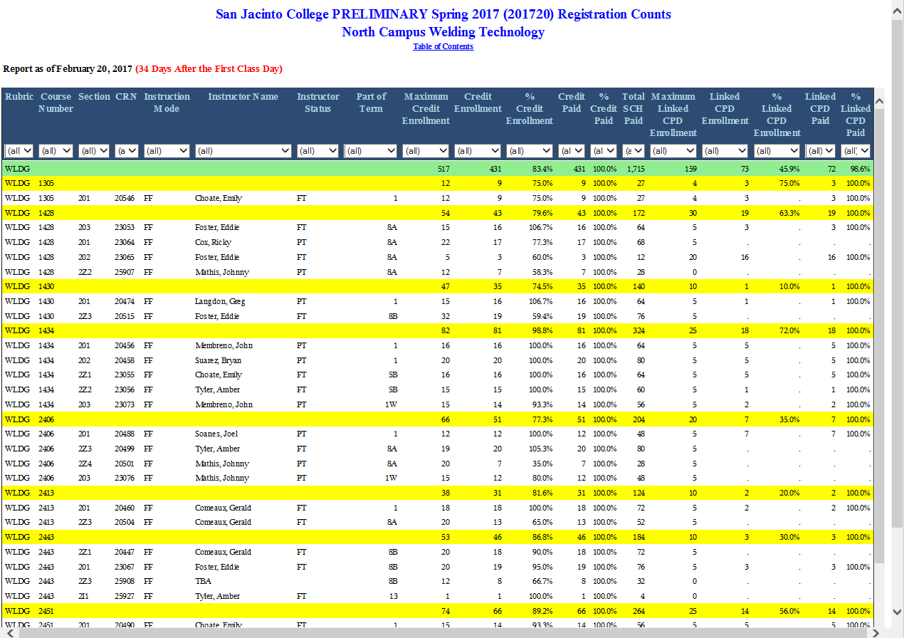
Enrollment Reporting System (ERS)

Slide 13
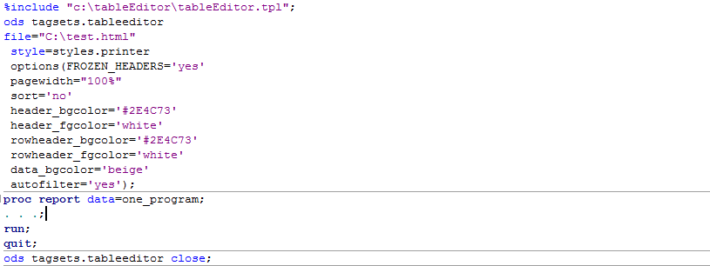
Automation of Section Level Report
Download the tableeditor tagset here:
http://support.sas.com/rnd/base/ods/odsmarkup/tableeditor/index.html

Slide 14
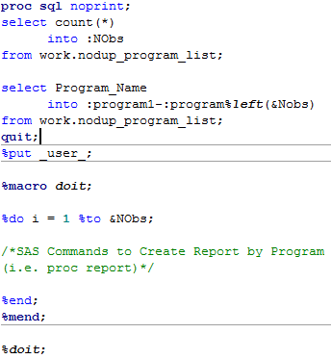
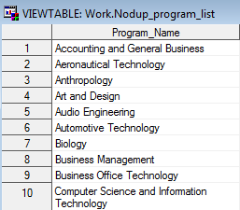
Automation of Data Story – Program Level

Slide 15
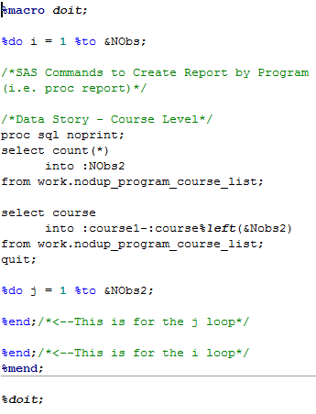
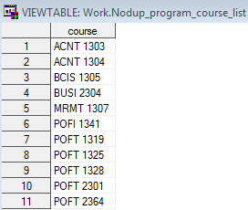
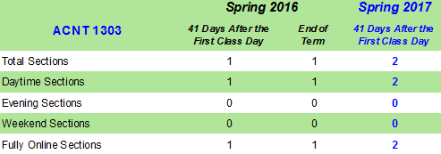
Automation of Data Story – Course Level

Slide 16
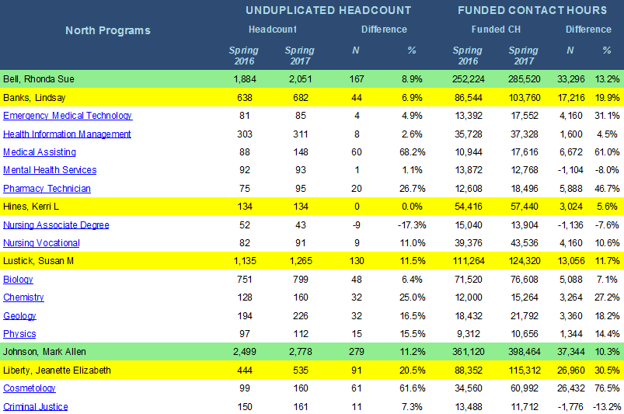
Automation of Dean Level Report

Slide 17
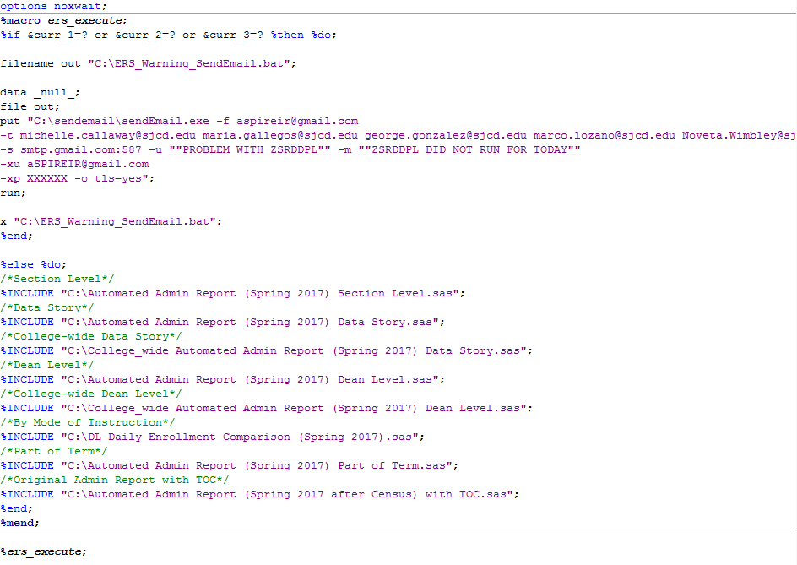
Putting It All Together

Slide 18
Return on Investment
Number of DOCs: 20
Approximate # of Hours Spent per Day per DOC: 2 hrs
Days per Semester: 60 days
Semesters: 3
Total Hours Spent on Reporting by DOCs in 1 yr: 20 x 2 x 60 x 3 = 7,200 hrs
Total Hours Spent by IR&E (Maria and Michelle) on Programming and Development: 212 hrs
Net Savings in Hours by College Personnel: 7,200-212 = 6,988 hrs
FTE Savings in First Year: 6,988/2,080 (number of working hrs in 1 yr) = 3.4 FTE
On-going Savings in Subsequent Years: *7,194/2,080 (number of working hrs in 1 yr) = 3.5 FTE
*Estimated total number of hours for updates and maintenance by IR&E in future years: 6 hrs per year

Slide 19
Questions?
George González, e-mail: george.gonzalez@sjcd.edu
Michelle Callaway, e-mail: michelle.callaway@sjcd.edu
Maria Fargo, e-mail: maria.fargo@sjcd.edu

