Slide 1
State Reporting
Moving State Reporting into the World of Interactive Dashboards and Visualizations

Slide 2
State Reporting
Cortni Haralson
Manager, Texas State Reporting
Analytics and Institutional
Reporting

Slide 3
Outline
Introduction
LSC State Reporting
THECB Reports
Current LSC Reports
Power BI
Future Possibilities
Summary, Questions, Thoughts

Slide 4
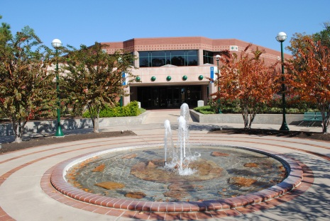
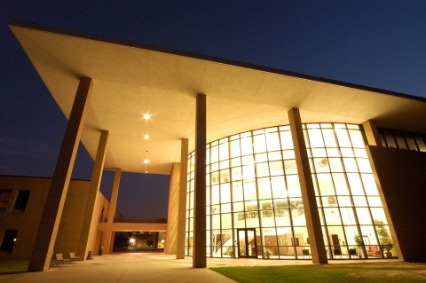
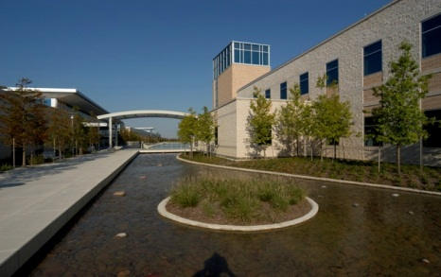
About LSC
Lone Star College
84,000 credit students each semester, total enrollment of more than 95,000 (credit and non-credit).
Largest institution of higher education in the greater Houston area.
One of the fastest-growing college systems in U.S.
Added 38,810 students fall 2005 to fall 2015, a 86% increase.
11 school districts, 1,400 square miles, population of 2 million.
6,300 employees (part-time and full-time).

Slide 5
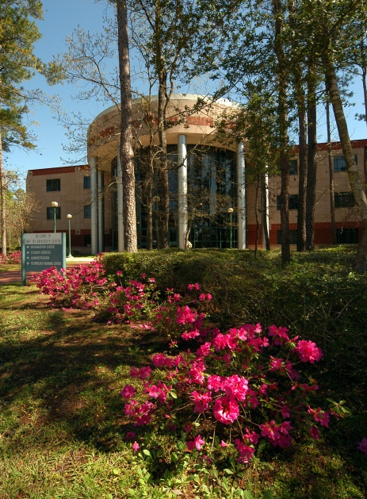
About LSC
Lone Star College
Six colleges, seven centers, two University Centers.
Top 10 associate degree producer, ranked 5th among all community colleges in the U.S. (2013-14).
Leads state-wide Texas Completes and Texas Reverse Transfer student success initiatives.
Maintains AAA bond rating with S&P.
Economic impact of $3.1 billion annually.
Recognized as a 2015 Military-Friendly School and helps veterans fast-track to new careers with special grant funding.

Slide 6
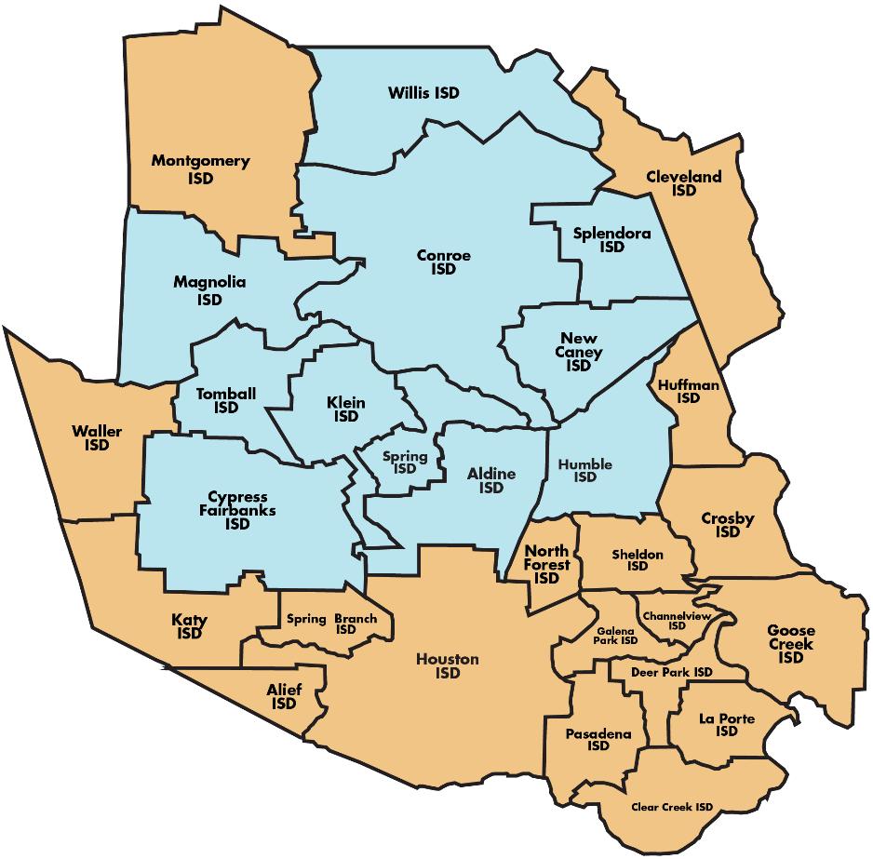
About LSC
11 school districts
More than 95,000 students
2.4 M population
1,400 square miles
$342 M operating budget
6,300+ employees

Slide 7
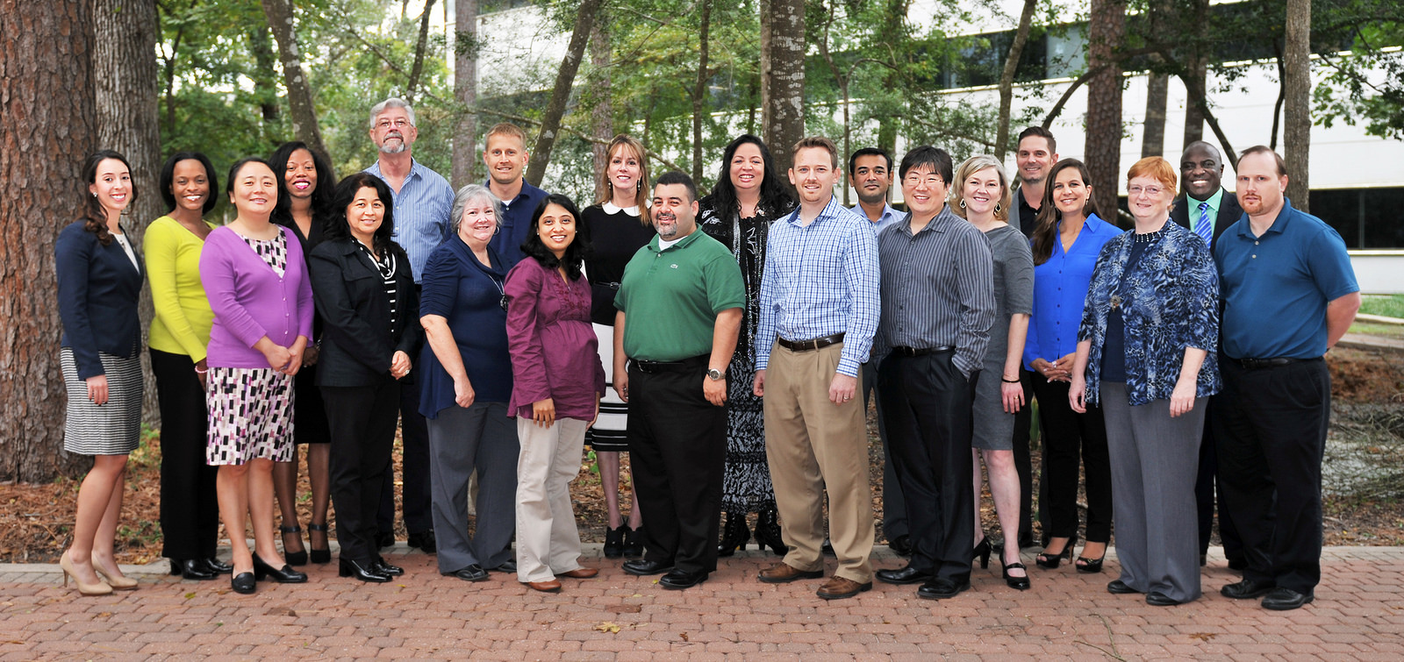
Office of Analytics and Institutional Reporting

Slide 8
Texas State Reporting (TSR)
2 Team members (Manager and Analyst)
System Registrar
Multiple Campus Partners
TSR Contacts
1-2 persons per campus
Credit and CE
**It Takes a Village!**

Slide 9
What is State Reporting?
Notes:
TSR is a reporting entity; Produce fundable and non-fundable Texas State Reports for the Educational Data Center (CBM Reports);
Communicate data problems with campuses - Communicate THECB policy changes to campuses

Slide 10
State Reporting Data
State Reporting Data
http://www.txhighereddata.org/
Higher Education Accountability System
Higher Education Almanac
The THECB provides reports on specific topics
Developmental Ed Data (TSI)
Dual Credit Data
Graduation Rates

Slide 11
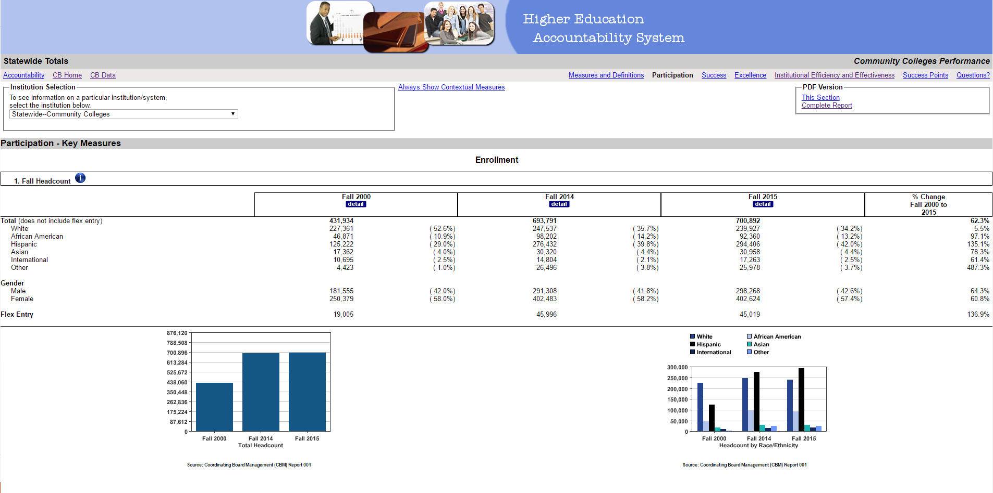
State Reporting Data (examples)
Accountability Data

Slide 12
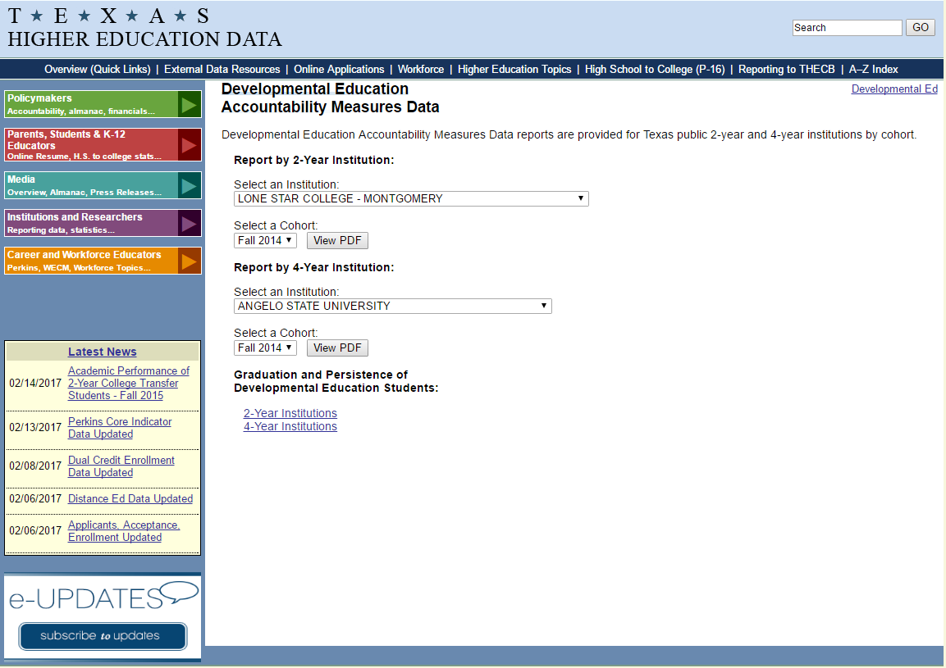
State Reporting Data (examples)
Development Education Data

Slide 13
State Reporting Data
How do we move forward as an office in this world of Analytics and Visualization?
What do our current reports look like?
What do our customers need (want)?
Notes:
Move forward – transition of the office to Interactive Reporting and Self Service
Current Reports – Actually were in the process of doing this with previously created static reports
Customers – Easily Accessible data for decision making

Slide 14
Data Visualization
Data visualization is the presentation of data in a pictorial or graphical format.
It enables decision makers to see analytics presented visually, so they can grasp difficult concepts or identify new patterns.
Because of the way the human brain processes information, using charts or graphs to visualize large amounts of complex data is easier than poring over spreadsheets or reports.
www.sas.com

Slide 15
Data Visualization

Slide 16
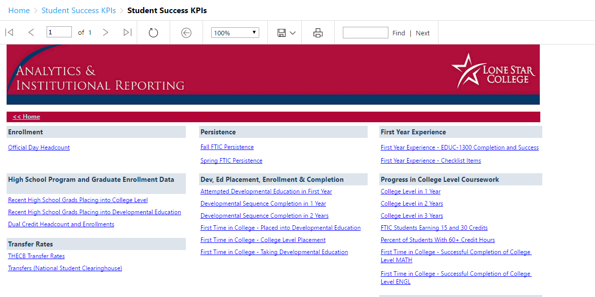
AIR.Lonestar.edu
Notes:
SSRS – SQL Server Reporting Services
SQL Server Reporting Services is a solution that customers deploy on their own premises for creating, publishing, and managing reports, then delivering them to the right users in different ways, whether that’s viewing them in web browser, on their mobile device, or as an email in their in-box.

Slide 17
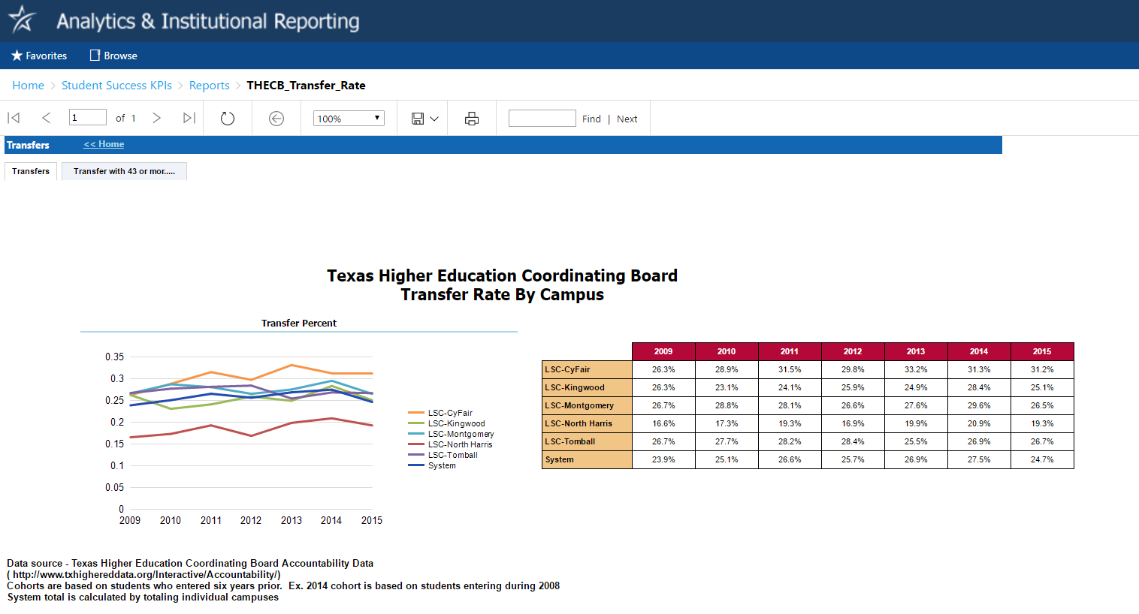
AIR.Lonestar.edu

Slide 18
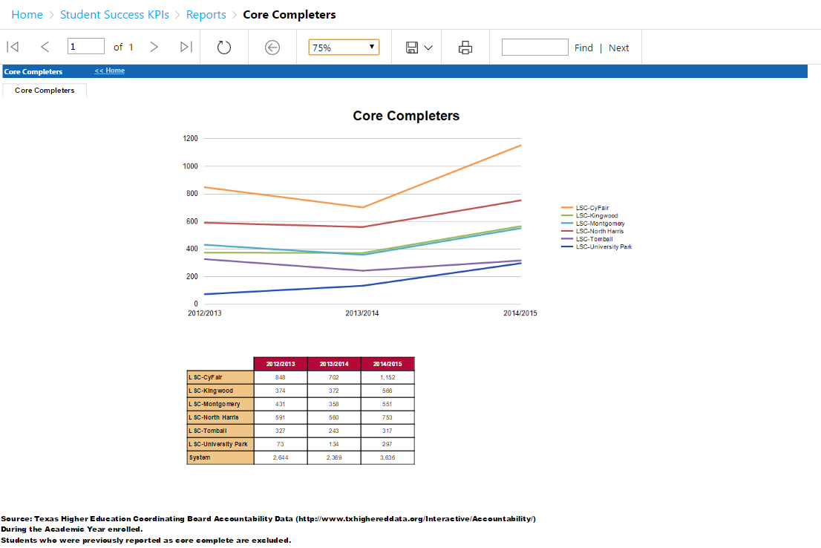
AIR.Lonestar.edu

Slide 19
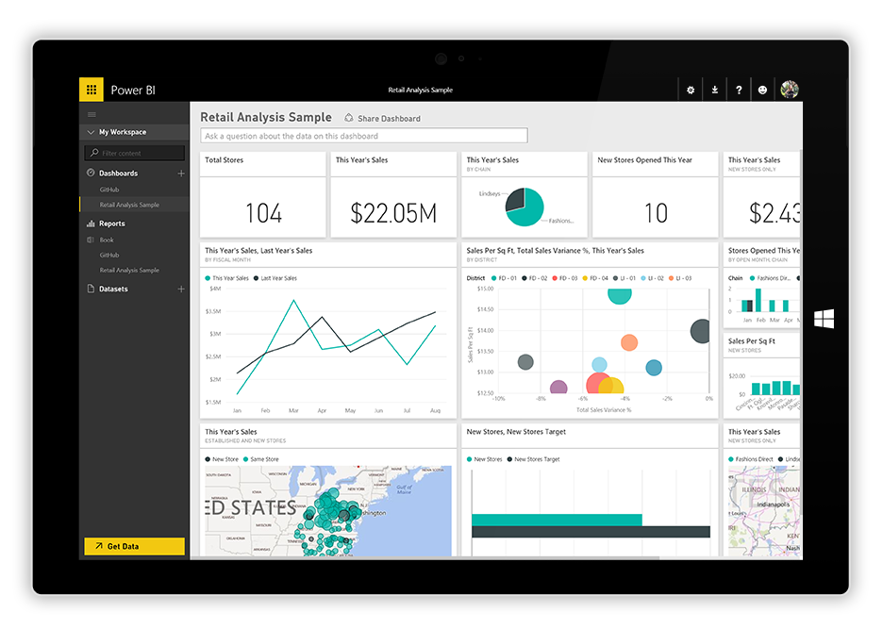
Power BI
What is Power BI?
Power BI is a suite of business analytics tools to analyze data and share insights.
It provides our team as well as our customers with the capability of creating customized interactive reports.

Slide 20
State Reporting Data (examples)
Texas Public Higher Education Almanac

Slide 21
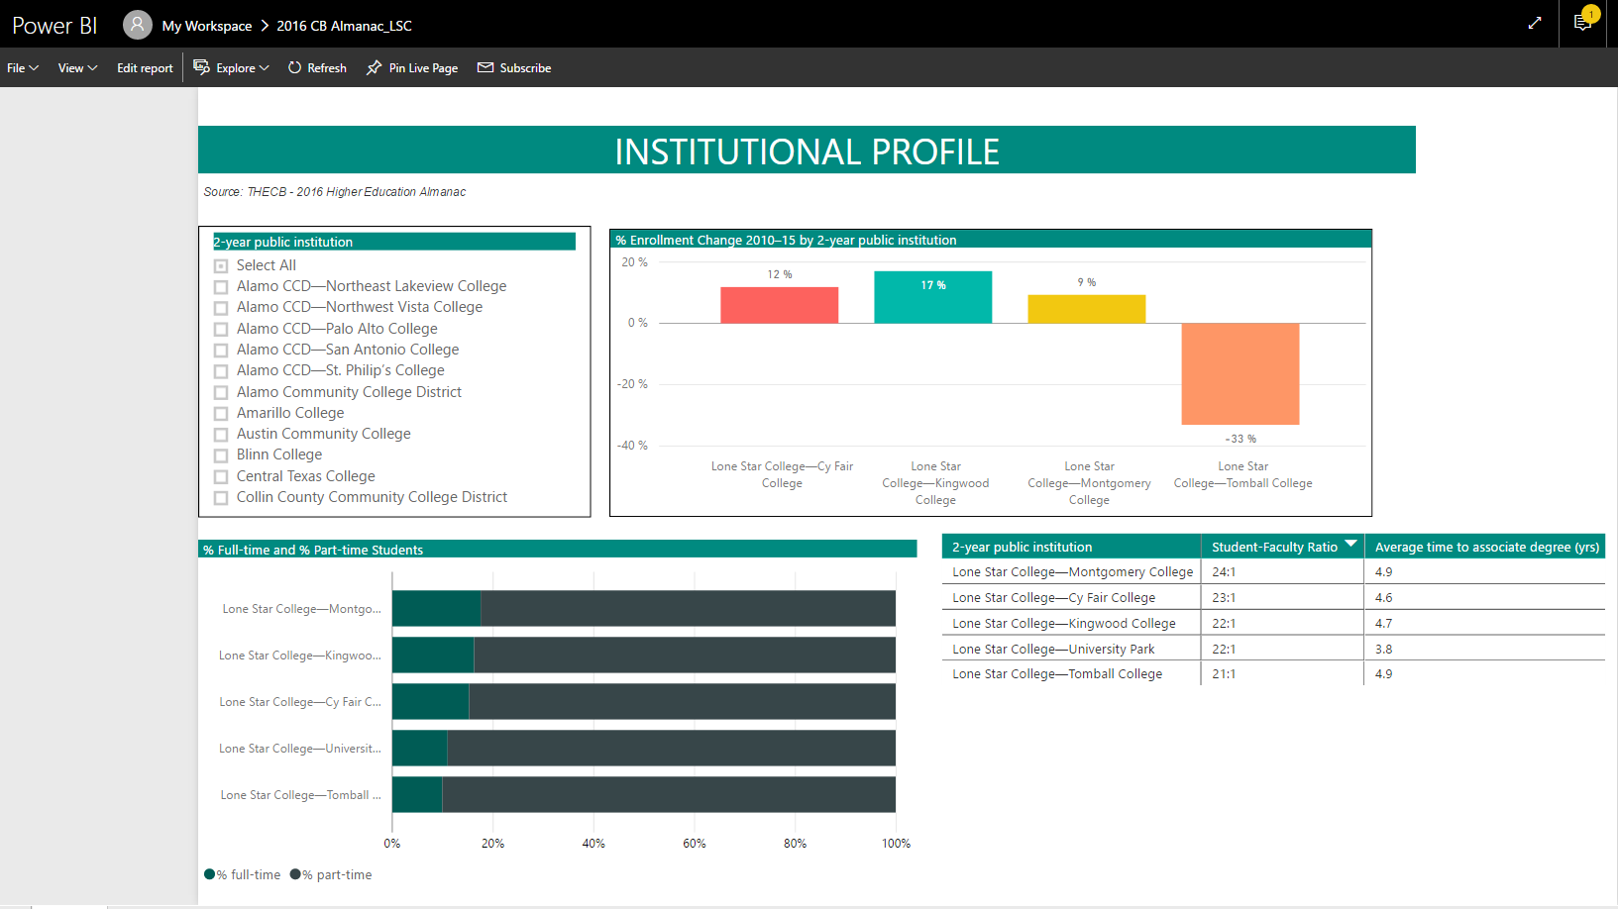
Power BI – State Reporting

Slide 22
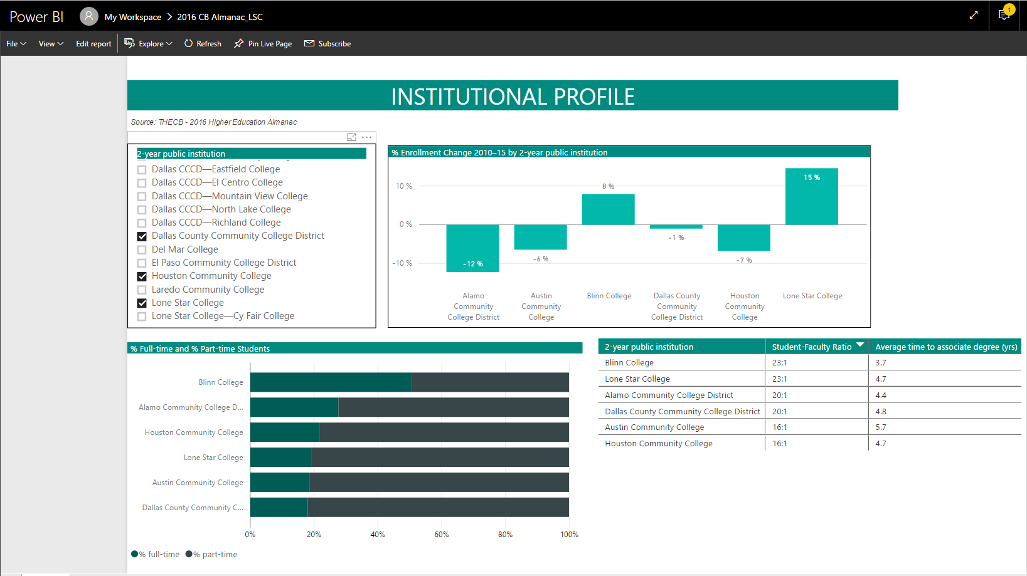
Power BI – State Reporting

Slide 23
Future Possibilities
TSI Data
Success Points
Dual Credit
Peer Institution Comparisons
????

Slide 24
Summary/Future Thoughts
“The mission of the Office of Analytics and Institutional Reporting is to serve as a trusted partner providing data and analytical expertise to support planning and decision-making.”
We have the data and now we have the tools to make some advancements in this area.
Continue to look for ways to improve our internal processes in TSR and opportunities to work with our IR counterparts to make state reporting data accessible to our system users.

Slide 25
Thank you!
Notes:
Thank you for attending our session today!!

Slide 26
Questions?
Notes:
Thank you for attending our session today!!

