Slide 1
Using SAS to Create Multi-Sheet Excel Workbooks
TAIR 2017
Amber Lummus
College of the Mainland

Slide 2
SAS Background
Moving from SPSS to SAS
SAS Programming Courses
COM’s Program Review
The power of Google and SAS Instructors

Slide 3
What is the ExcelXP Tagset?
ODS (Output Delivery System) allows you to indicate where SAS output goes
There are several ODS options
ExcelXP Tagset is part of ODS MARKUP
The markup language translates the SAS output to an XML file that can be opened with Excel
Requirements
  SAS 9.1 or later
  Excel 2002 or later

Slide 4
Basic Syntax
SAS code is “wrapped” in ODS statements
The opening statement specifies which ODS output destination you are using (ExcelXP Tagset) and the location for the XML file
The closing statement closes the ODS output destination, in this case, the XML file
Following the closing statement, specify where you want the next output to go (typically ODS listing)

Slide 5
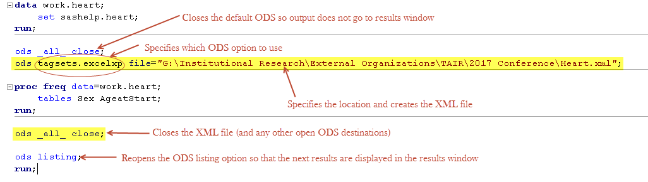
Basic ODS Syntax

Slide 6
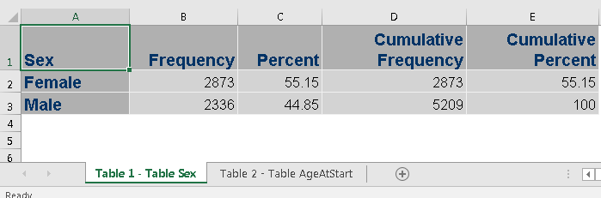
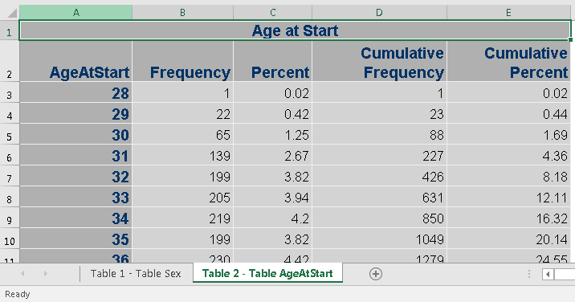
Default Style for XML Output

Slide 7
Style Templates
There are many style templates that change the overall appearance of the output
Options can also be added to the opening ODS statement
  Overall appearance
  Printing

Slide 8
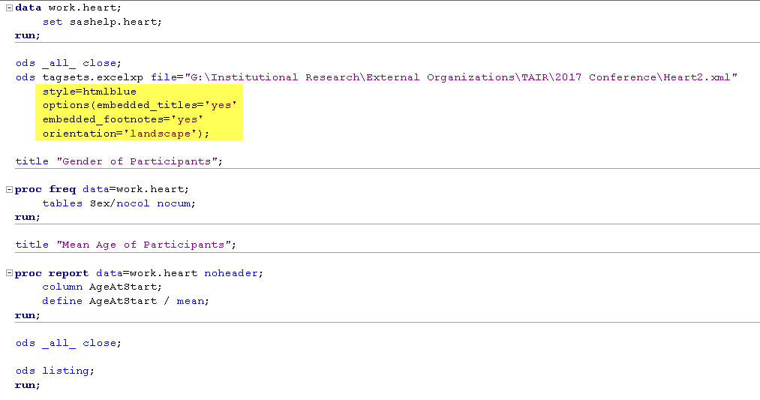
Style Template and Tagset Options

Slide 9
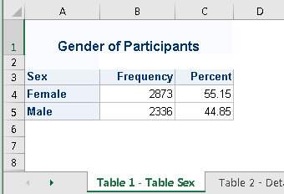
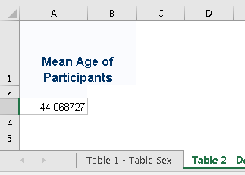
XML Output with a Style Template

Slide 10
Style Details
Some of the standard SAS formatting options don’t work in the XML output files
TAGATTR Style Attributes
  Specify type
  Specify Excel format
  Assign Excel formulas (R1C1 style)

Slide 11
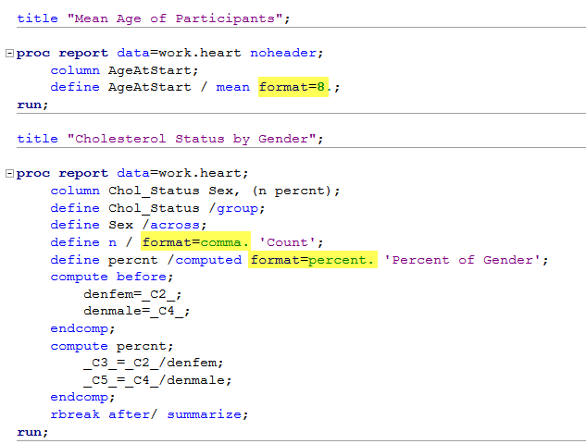
SAS Code with Standard SAS Formats

Slide 12
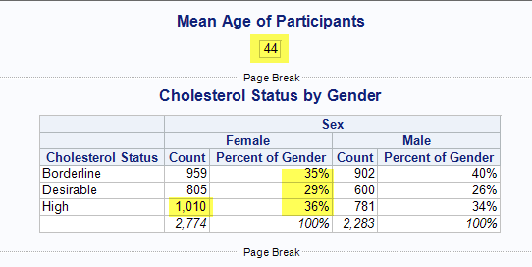
SAS Results Window Output

Slide 13
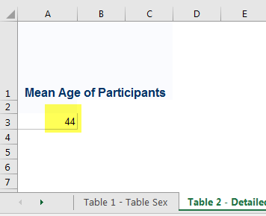
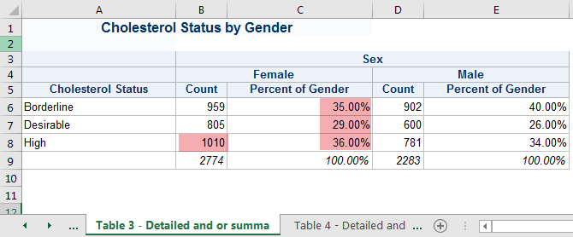
XML File Output with Standard SAS Formats

Slide 14
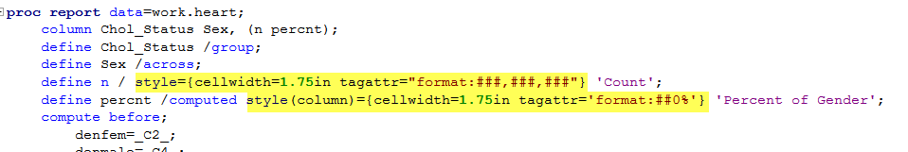
SAS Code with TAGATTR Style Attributes

Slide 15
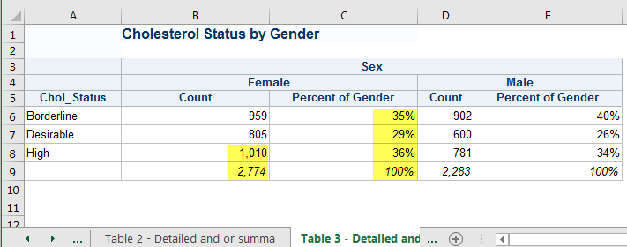
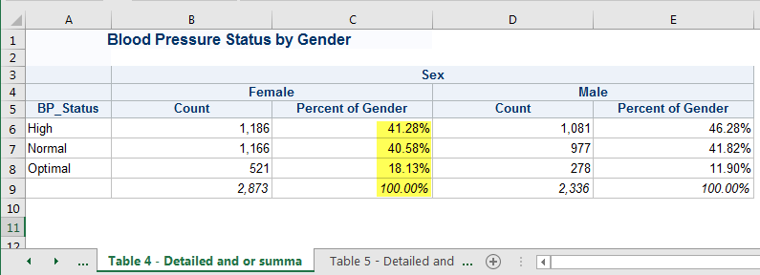
XML File Output with TAGATTR Style Attributes

Slide 16
Sheet Options
Control which output is on which Excel sheet within the workbook
Sheet names
Change options for individual sheets

Slide 17
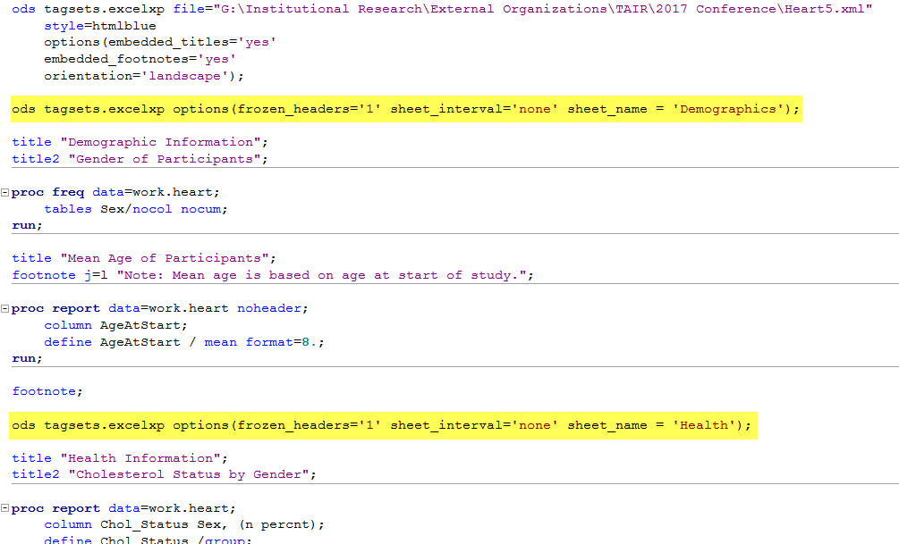
SAS Code with Sheet Specific Options

Slide 18
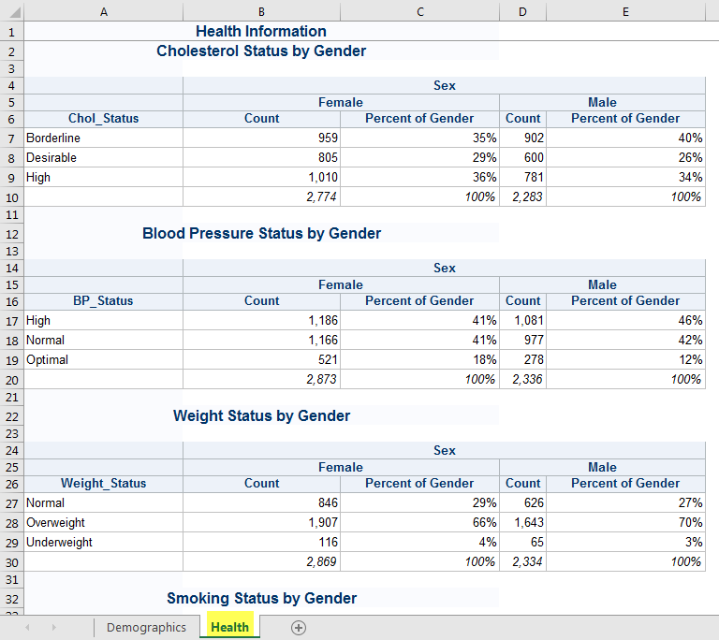
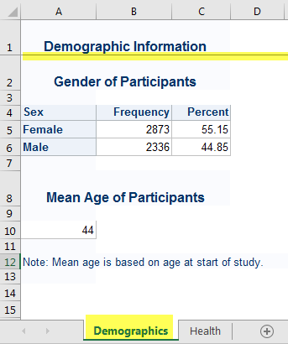
XML File Output with Sheet Specific Options

Slide 19
Additional Enhancements
Macros
  Create multiple workbooks, each with multiple sheets
  Convert the XML output to XLSX
    Download convert macro from SAS support site
    Add code to invoke the macro

Slide 20
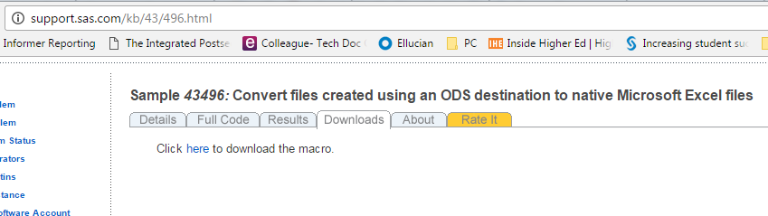
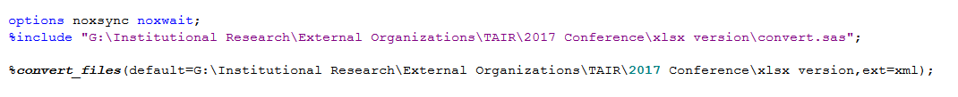
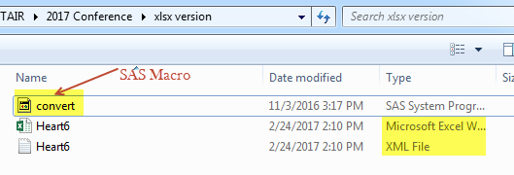
SAS Macro to Convert XML files to XLSX files

Slide 21
References and Resources
ODS Excel XP Tip Sheet https://support.sas.com/rnd/base/ods/odsmarkup/TipSheet_ods_xl_xp.pdf
Base SAS Demo: The ExcelXP Tagset and Microsoft Excel https://support.sas.com/rnd/base/ods/odsmarkup/excelxp_demo.html#formats
Understanding the ExcelXP Tagset Lecture Transcript https://support.sas.com/training/tutorial/el/libsppg1_et.pdf
Convert files created using an ODS destination to native Microsoft Excel files http://support.sas.com/kb/43/496.html
Create or Delete a Custom Number Format (Excel) https://support.office.com/en-us/article/Create-or-delete-a-custom-number-format-78f2a361-936b-4c03-8772-09fab54be7f4
Creating Stylish Multi-Sheet Excel Workbooks the Easy Way with SAS http://support.sas.com/resources/papers/proceedings11/170-2011.pdf
Don’t Gamble with Your Output: How to Use Microsoft Formats with ODS https://support.sas.com/resources/papers/proceedings11/266-2011.pdf

