Slide 1
Uses of National Student Clearinghouse StudentTracker
TAIR 2017
Discussion Group/Panel/Working Session
Carol Tucker
University of Houston – Downtown (UHD)
TuckerCa@uhd.edu

Slide 2
National Student Clearinghouse (NSC) StudentTracker
How many of you have used StudentTracker?
What types of requests are you submitting to the NSC?
  SE – Subsequent Enrollment
  DA - Declined Attendance/Admissions
  PA - Prior Attendance
  SB - Sibling/Parent Enrollment
  CO - Cohort query

Slide 3
National Student Clearinghouse (NSC) StudentTracker
How are you using the returned data?
What types of reports are you creating?
Who is your audience for such reports?
How do you structure reports?

Slide 4
National Student Clearinghouse (NSC) StudentTracker
How do you organize the data sent to/received from the NSC?
Is the NSC data integrated into your Student Information System?
Do you make use of the text entries they are now providing?
Do you have any tips/tricks to work with the data?

Slide 5
Subsequent Enrollment (SE)
How UHD currently uses:
Concurrent enrollment
Graduates – enrollment (and degrees) after graduation from UHD
  Used for grant proposals
Attrition – where did they go? internal reports
  Also used for IPEDS Graduation rate survey (transfers out)

Slide 6
Declined Attendance/Admissions (DA)
How UHD currently uses:
Find out about those who applied and didn’t enroll

Slide 7
Prior Attendance (PA)
How UHD currently uses:
Used mostly as data checking/cleaning process
Ensure applicants are coded correctly – i.e. FTICs
Admissions - make sure have received transcripts (or have holds) for transcripts for all institutions attended

Slide 8
Cohort query (CO)
How UHD currently uses:
College Portrait (VSA)/SAM reporting

Slide 9
Sibling/Parent Enrollment (SB)
UHD does not currently use
Does anyone use this inquiry type?

Slide 10
Reports
Types of summary reports run at UHD:
  Concurrent Enrollment – SE
  Enrollees who didn't graduate or return (various time frames) – SE
  Graduates going on to grad school – SE
  Applicants didn't enroll – DA

Slide 11
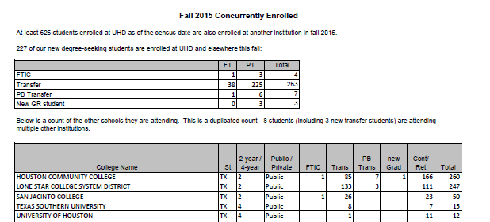
Sample Reports
Concurrent Enrollment (SE query)
Also provide student level information to offices as needed

Slide 12
Sample Reports
Retention/Attrition one year later (SE query)
Also break it down by specific transfer schools

Slide 13
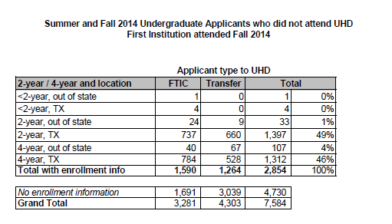
Sample Reports
Declined Attendance (DA query)
Also break it down by specific schools

Slide 14
Tips/Tricks
File creation:
  where you can, let tools do the formatting for you
  Create file with extra identifiers to the right in Excel (Column M onward)
  send a few large files – for example send one file with FTIC and transfer cohorts (can parse them out as needed)
NSC will email you if have low match rate, if what expected confirm (via email) that it is and they will then run the file
Recent improvement from NSC – returned file incorporates name of the file you submitted, making it easier to match up

Slide 15
Tips/Tricks
Working with file receive back:
  create intermediate queries to get each person only once --- depending on what need could be:
    minimum college sequence (in case went to multiple)
    minimum attendance date
    maximum attendance date
    graduated, bring back enrollment only if not graduated
  I make sure to exclude my own institution in the queries, if I want UHD data I can get to it from our SIS with more details

