Slide 1


IR to BI Analytics
IR to BI Analytics
Making the Transition Work

Slide 2

IR to BI Analytics
Marian Chaney
Associate Vice Chancellor
Analytics and Institutional
Reporting

Slide 3

IR to BI Analytics
James “Kent” McShan
Director, IR
Analytics and Institutional
Reporting

Slide 4



IR to BI Analytics
Lone Star College
85,000 credit students each semester, total enrollment of more than 95,000 (credit and non-credit).
Largest institution of higher education in the greater Houston area.
One of the fastest-growing college systems in U.S.
Added 39,603 students fall 2006 to fall 2016, an 86% increase.
11 school districts, 1,400 square miles, population of 2 million.
6,000 employees (part-time and full-time).

Slide 5


IR to BI Analytics
Lone Star College
Six colleges, eight centers, two University Centers.
Top 5 associate degree producer, ranked 4th among all community colleges in the U.S. (2014-15).
Leads state-wide Texas Completes and Texas Reverse Transfer student success initiatives.
Maintains AAA bond rating with S&P.
Economic impact of $3.1 billion annually.
Recognized as a 2016 Military-Friendly School and helps veterans fast-track to new careers with special grant funding.

Slide 6

IR to BI Analytics
11 school districts
More than 98,000 students
2.1 M population
1,400 square miles
$347 M operating budget
6,300+ employees

Slide 7
IR to BI Analytics
Why BI
Analytics?
Notes:
Not going to talk about why BI Analytics today because you’ve either been told to move to it by your college leaders or you’ve been asked to deliver dashboards, etc. We’re going to talk more about how LSC is making a successful transition to BI Analytics.

Slide 8

IR to BI Analytics
What is Institutional Research?
Notes:
What is the definition of IR?

Slide 9
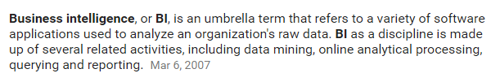
IR to BI Analytics
What is BI Analytics?
Notes:
What is the definition of BI?

Slide 10
IR to BI Analytics
Institutional Research
BI Analytics
Notes:
In looking at both definitions…..

Slide 11
IR to BI Analytics
Institutional Research
BI Analytics
Notes:
….it appears that they would go together perfectly!

Slide 12

IR to BI Analytics
Notes:
Just like peanut butter and jelly!

Slide 13

IR to BI Analytics
Notes:
But most times it seems like they go together more like what we’ve seen and heard from around higher ed. Anyone know what that is? Oil and water.

Slide 14

IR to BI Analytics
Notes:
Even though the transition from IR to BI Analytics can feel like this sometimes, we’re going to walk you through what LSC has done to successfully make that transition work for us.

Slide 15
IR to BI Analytics
Keys to Our Successful Transition:
Develop a project management standard operating procedure (SOP) for the team to follow
Demonstrate to staff how working together makes us better
Implement the utilization of tools that make the transition to BI Analytics easier
Track and manage all projects with a focus on documentation
Notes:
We will be going over these keys to our successful transition today….

Slide 16
IR to BI Analytics
Keys to Our Successful Transition:
Develop a project management standard operating procedure (SOP) for the team to follow
Notes:
First we will be discussing how we developed a PM SOP….

Slide 17

IR to BI Analytics
Project Management
Standard Operating Procedure (SOP)
Work on standardizing our Project Management Processes and Procedures across departments to make us EFFICIENT
Notes:
We worked on standardizing our PM processes and procedures to make us more EFFICIENT.

Slide 18
IR to BI Analytics
We Created the Following SOP Documents:
Project Management SOP Document
Requirements Document
Quality Assurance Test Plan
Acceptance Test Plan
SNOW Projects User Guide
Notes:
We created the following SOP documents to assist with project management (discuss each then show examples on next few slides).

Slide 19
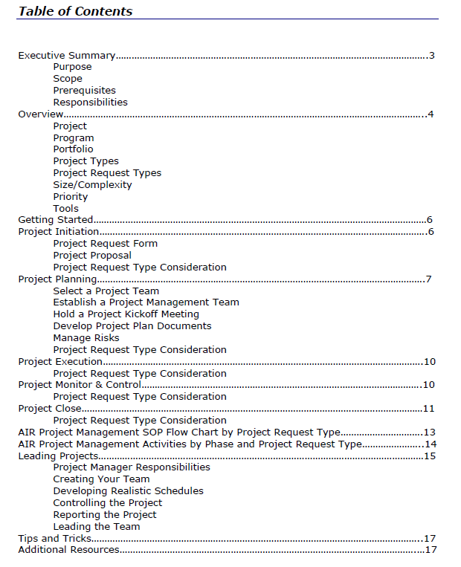

IR to BI Analytics
Notes:
Project Manage SOP document

Slide 20
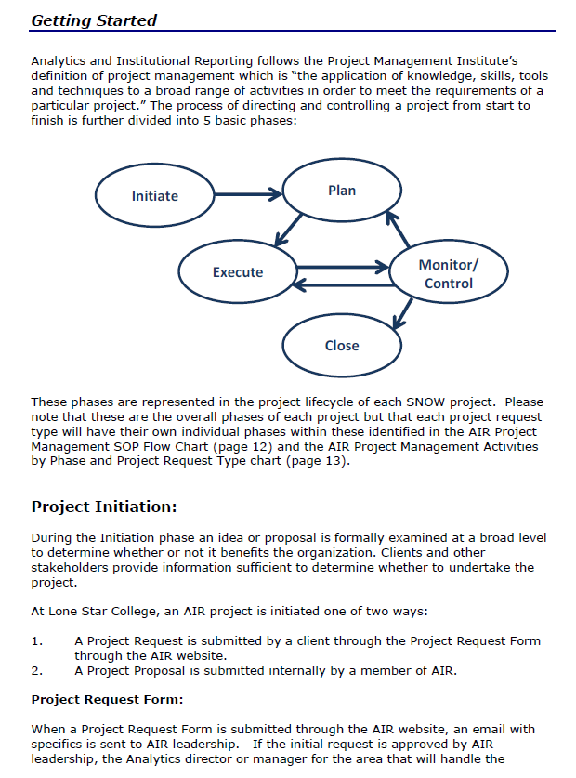
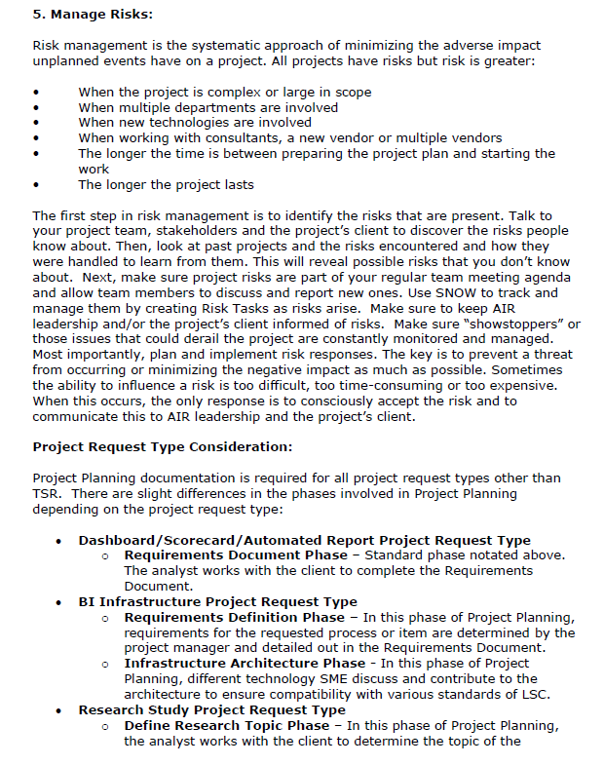
IR to BI Analytics
Notes:
Project Manage SOP document

Slide 21
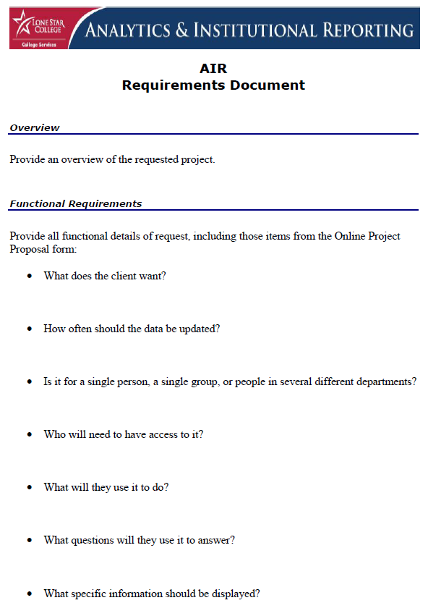
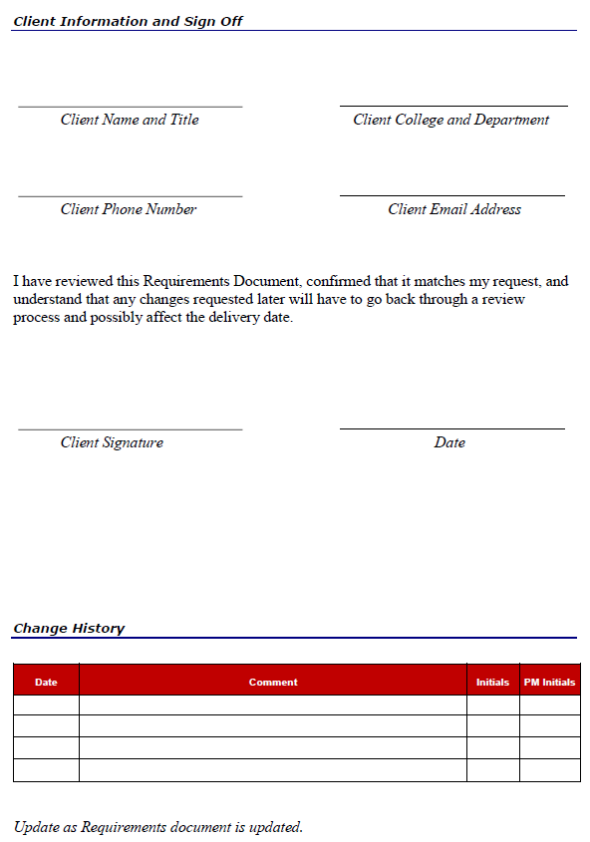
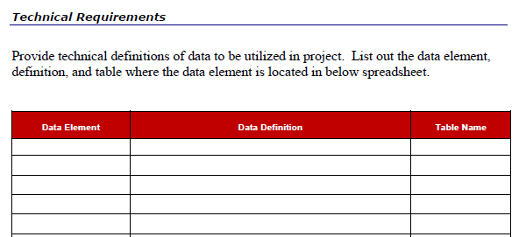
IR to BI Analytics
Notes:
Requirements document

Slide 22
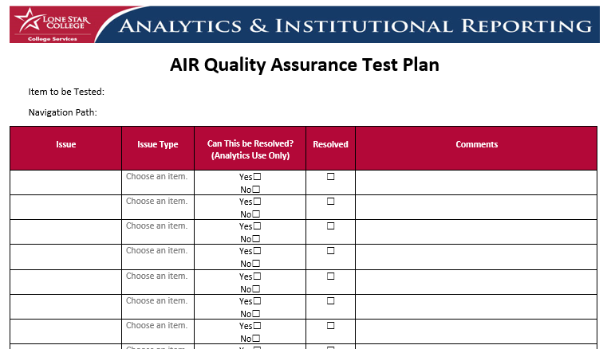
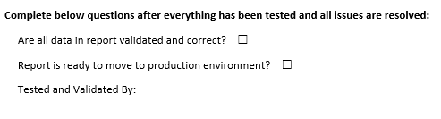
IR to BI Analytics
Notes:
Quality Assurance Test Plan

Slide 23
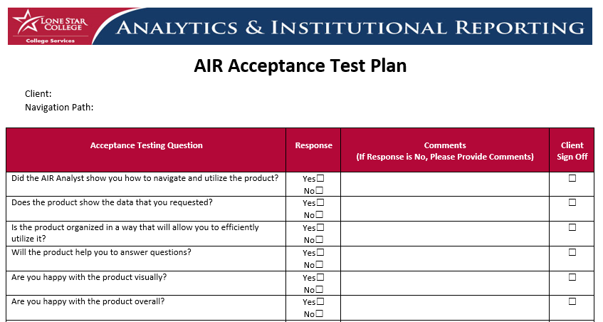
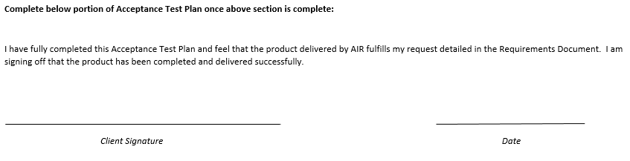
IR to BI Analytics
Notes:
Acceptance Test Plan

Slide 24
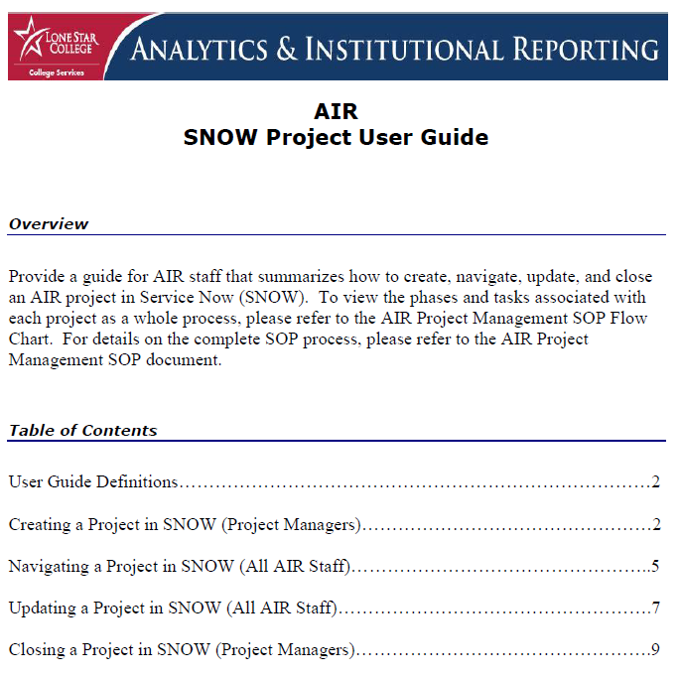
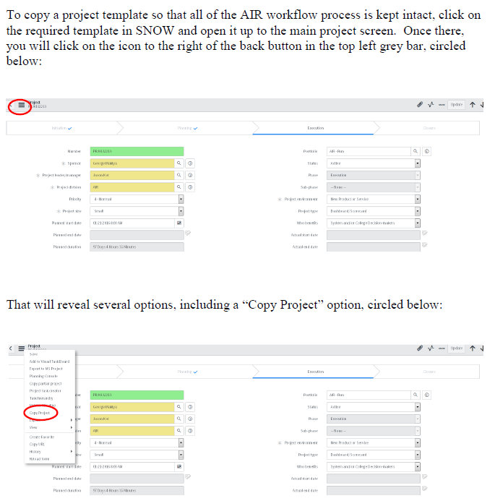
IR to BI Analytics
Notes:
Service Now Project User Guide

Slide 25
IR to BI Analytics
Keys to Our Successful Transition:
Develop a project management standard operating procedure (SOP) for the team to follow
Demonstrate to staff how working together makes us better
Implement the utilization of tools that make the transition to BI Analytics easier
Track and manage all projects with a focus on documentation
Notes:
Now let’s discuss the next key to our successful transition….

Slide 26
IR to BI Analytics
Keys to Our Successful Transition:
Demonstrate to staff how working together makes us better
Notes:
…....Better Together.

Slide 27

IR to BI Analytics
Teamwork
Work on our Teamwork across departments to make us EFFECTIVE
Notes:
We found that we needed to work on our teamwork to make us effective.
So SOPs are used to make us more Efficient and Teamwork is used to make us more EFFECTIVE.

Slide 28

IR to BI Analytics
Notes:
We needed to break down the walls between the two areas that had been built up over time.

Slide 29
IR to BI Analytics
Better Together:
Break down walls and silos between Analytics and IR
Make transparent what each side does and how important it is to everyone as a team
Start holding more “all staff” meetings and events
Set the expectation that all staff should be working together by including that in as an integral part of the Project Management SOP process
Notes:
To become “Better Together”, we did the following…….

Slide 30

IR to BI Analytics
Analytics
IR
Notes:
The end result was a newfound appreciation for each area and what they do and a new sense of TEAM.

Slide 31
IR to BI Analytics
Keys to Our Successful Transition:
Develop a project management standard operating procedure (SOP) for the team to follow
Demonstrate to staff how working together makes us better
Implement the utilization of tools that make the transition to BI Analytics easier
Track and manage all projects with a focus on documentation
Notes:
Now let’s discuss the next key to our successful transition….

Slide 32
IR to BI Analytics
Keys to Our Successful Transition:
Implement the utilization of tools that make the transition to BI Analytics easier
Notes:
How we implemented tools that made the transition easier.

Slide 33


IR to BI Analytics
Dashboards and Automation
TMI (Too Much Information)
Just enough to look good and perform well
Notes:
The focus here was on delivering dashboards and automation. We had dashboards but they took very specialized skills to create and maintain and could sometimes provide TMI!
We needed to move to something that was easier to create and maintain while looking good and performing well.

Slide 34

IR to BI Analytics
Notes:
What that meant to us was moving away from Oracle BI……

Slide 35

IR to BI Analytics
Notes:
…..to Microsoft BI, which provided way more benefits for us by….
Offering a lower cost solution with unlimited licenses due to that lower cost.
Being easier for our developers to pick up and utilize without additional training and expense.

Slide 36



IR to BI Analytics
Notes:
Utilizing:
SSRS – Is for Analytics to use to create large scale dashboards that require interactive drilldown capability
SSAS – Is for Analytics and IR to use to assist in more in depth research and analysis
Power BI – Is for Analytics and IR to use to quickly visualize data, allow our IR analysts to create interactive reports for the first time to take the place of static ones, and for us to allow data savvy clients to analyze and report their own data instead of waiting on us to do so.

Slide 37
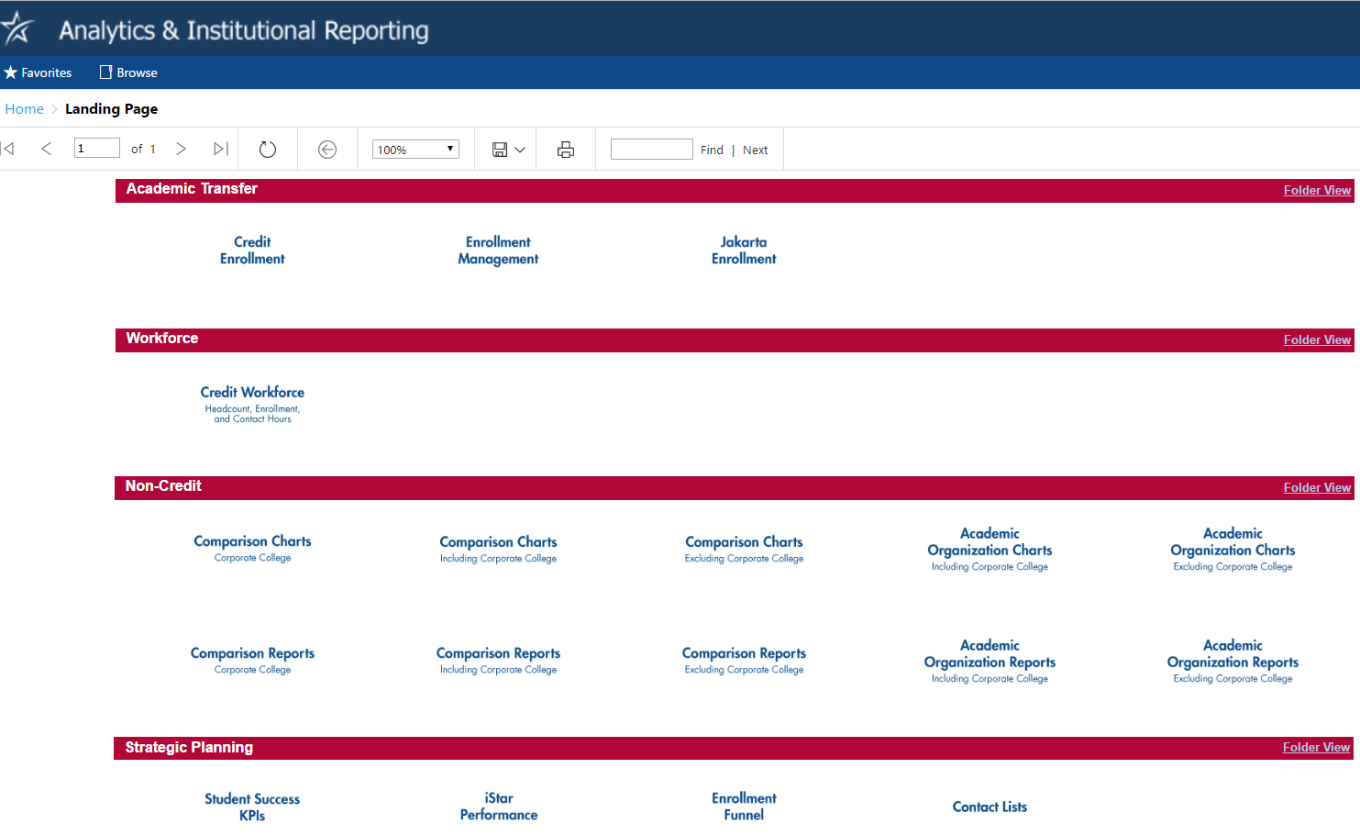
IR to BI Analytics
Notes:
SSRS Dashboards Landing Page showing examples of dashboards that were duplicated utilizing MSBI.

Slide 38
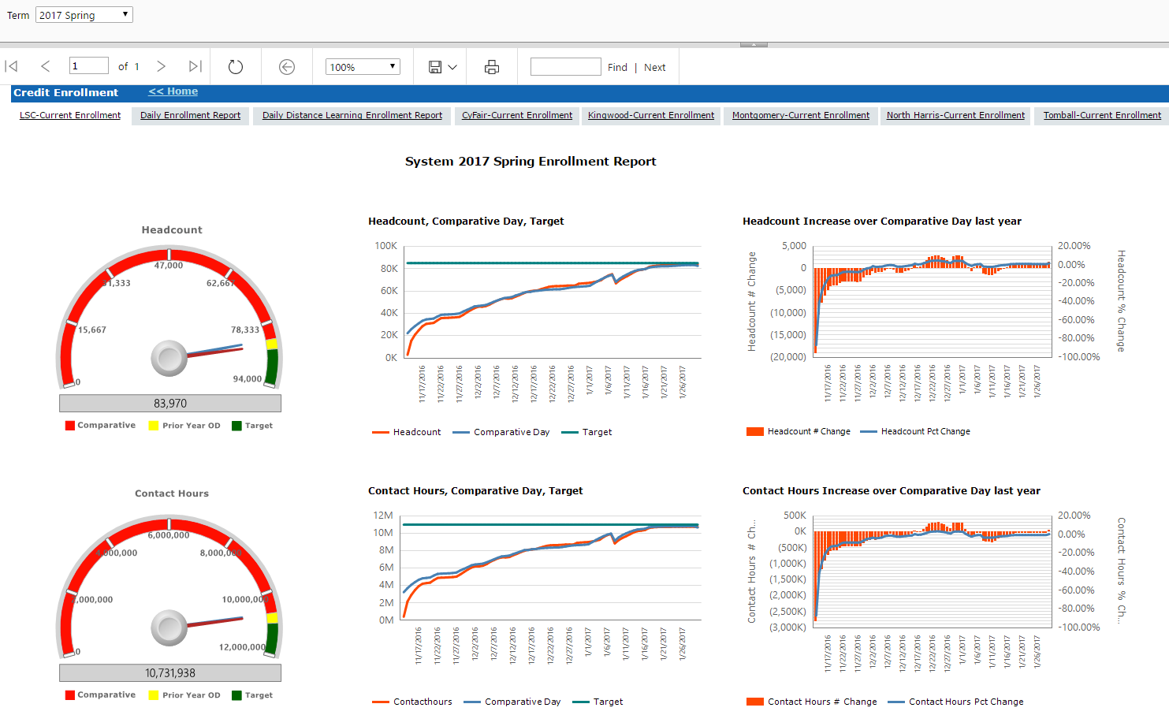
IR to BI Analytics
Notes:
SSRS Enrollment Dashboard

Slide 39
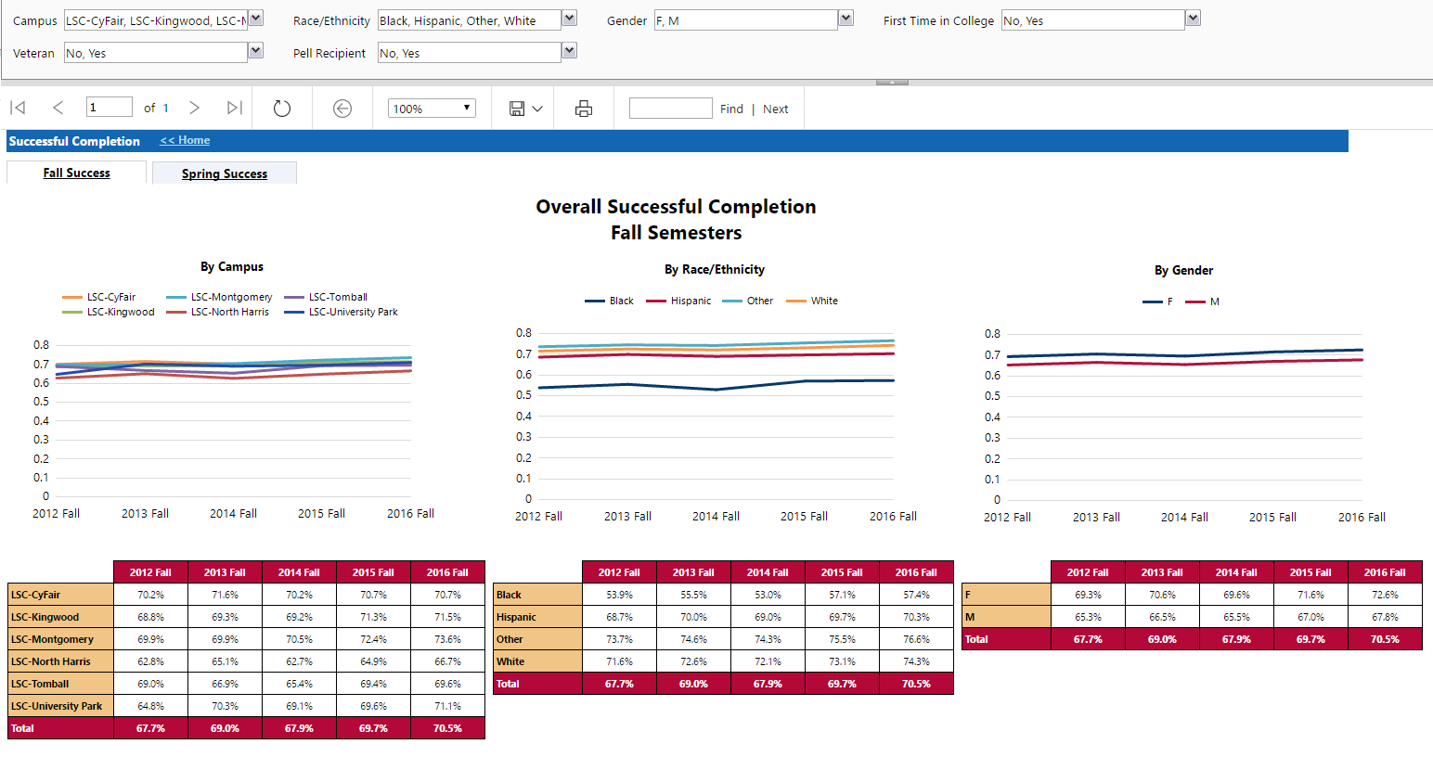
IR to BI Analytics
Notes:
SSRS Completion Dashboard

Slide 40
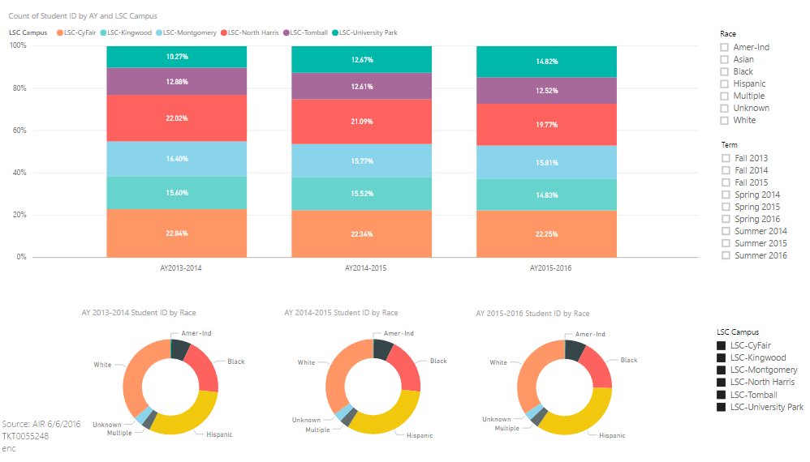
IR to BI Analytics
Notes:
Power BI visualization

Slide 41
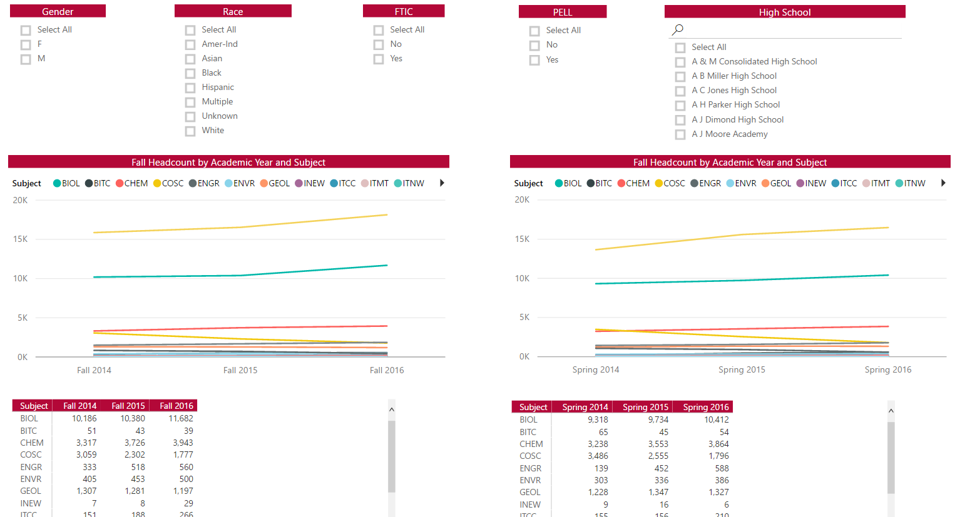
IR to BI Analytics
Notes:
Power BI visualization

Slide 42
IR to BI Analytics
Keys to Our Successful Transition:
Develop a project management standard operating procedure (SOP) for the team to follow
Demonstrate to staff how working together makes us better
Implement the utilization of tools that make the transition to BI Analytics easier
Track and manage all projects with a focus on documentation
Notes:
The last key to our successful transition….

Slide 43
IR to BI Analytics
Keys to Our Successful Transition:
Track and manage all projects with a focus on documentation

Slide 44

IR to BI Analytics
Notes:
We utilize Service Now, or SNOW as we call it, to manage our projects and documentation.

Slide 45
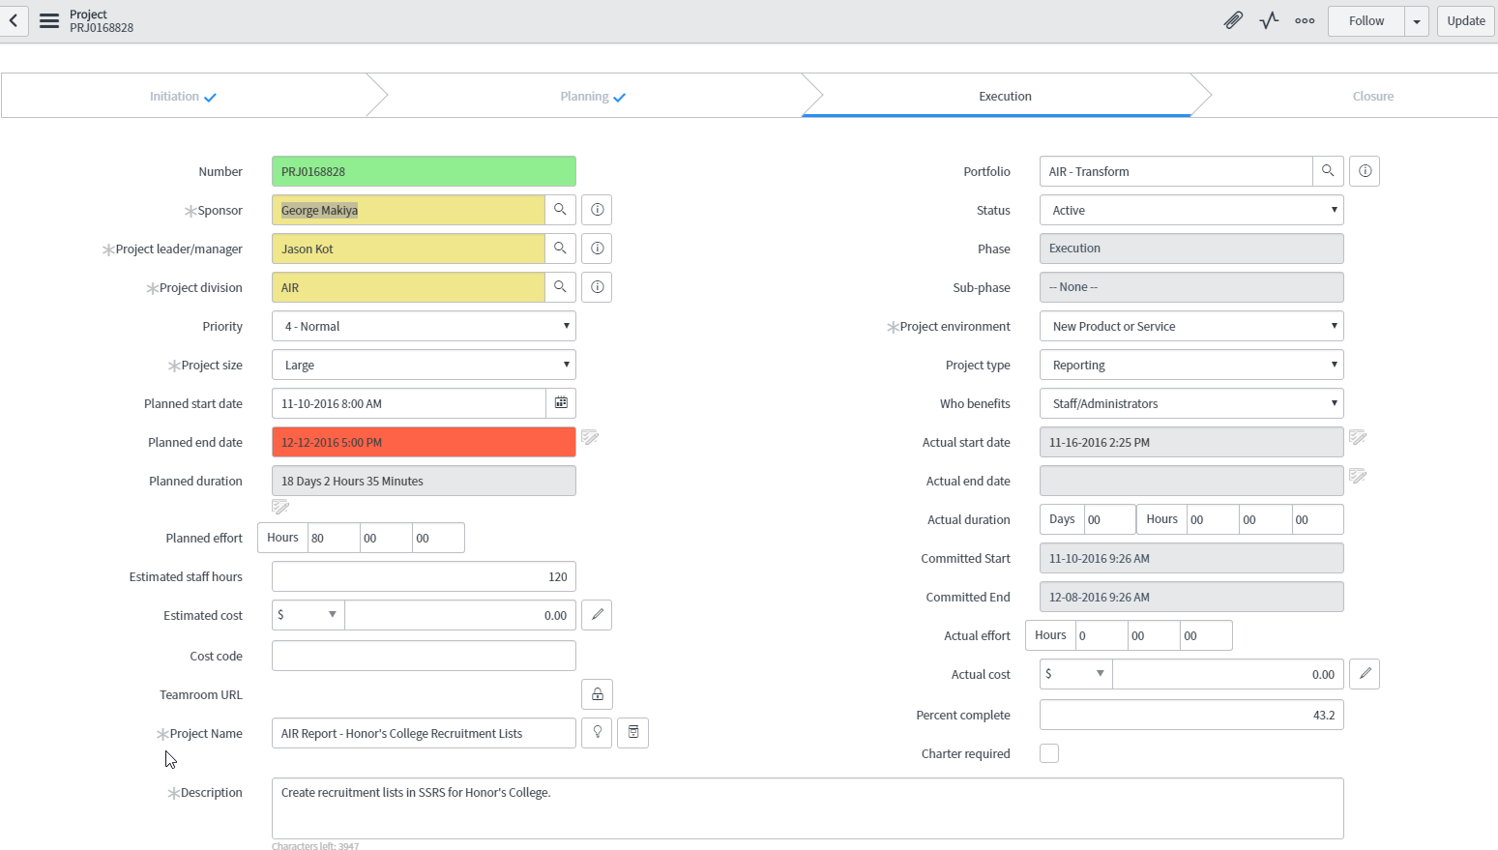
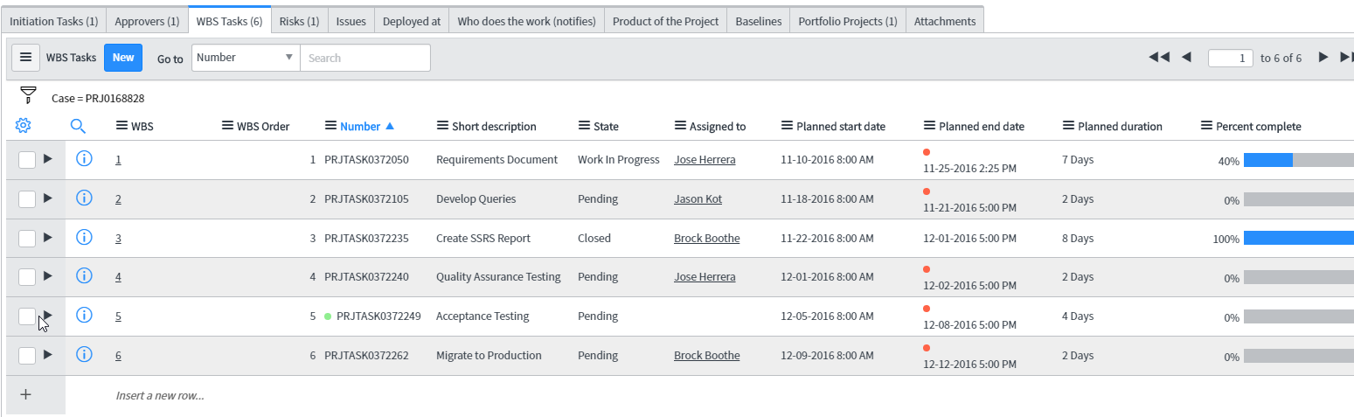
IR to BI Analytics
Notes:
It allows us to be able to create and monitor projects with several layers of tasks that can be assigned out to individual staff members.
We can also add in updates, attach documents, and notate the location of project folders on our share drive so assignees know where to save documents for review and future reference.

Slide 46
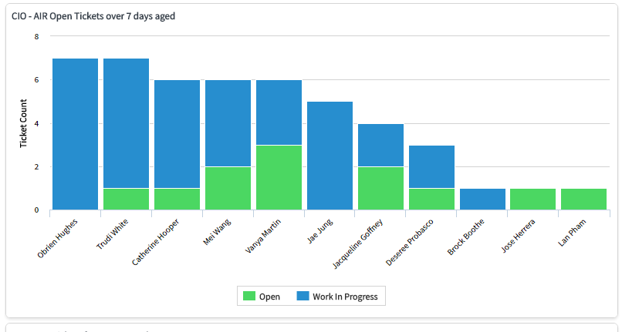
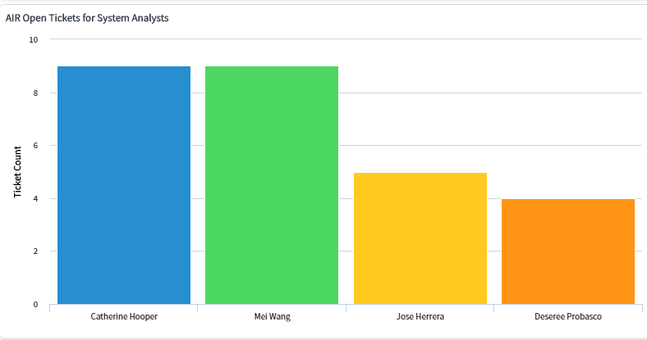
IR to BI Analytics
Notes:
It allows us high level views of projects and tickets for leadership to review.

Slide 47
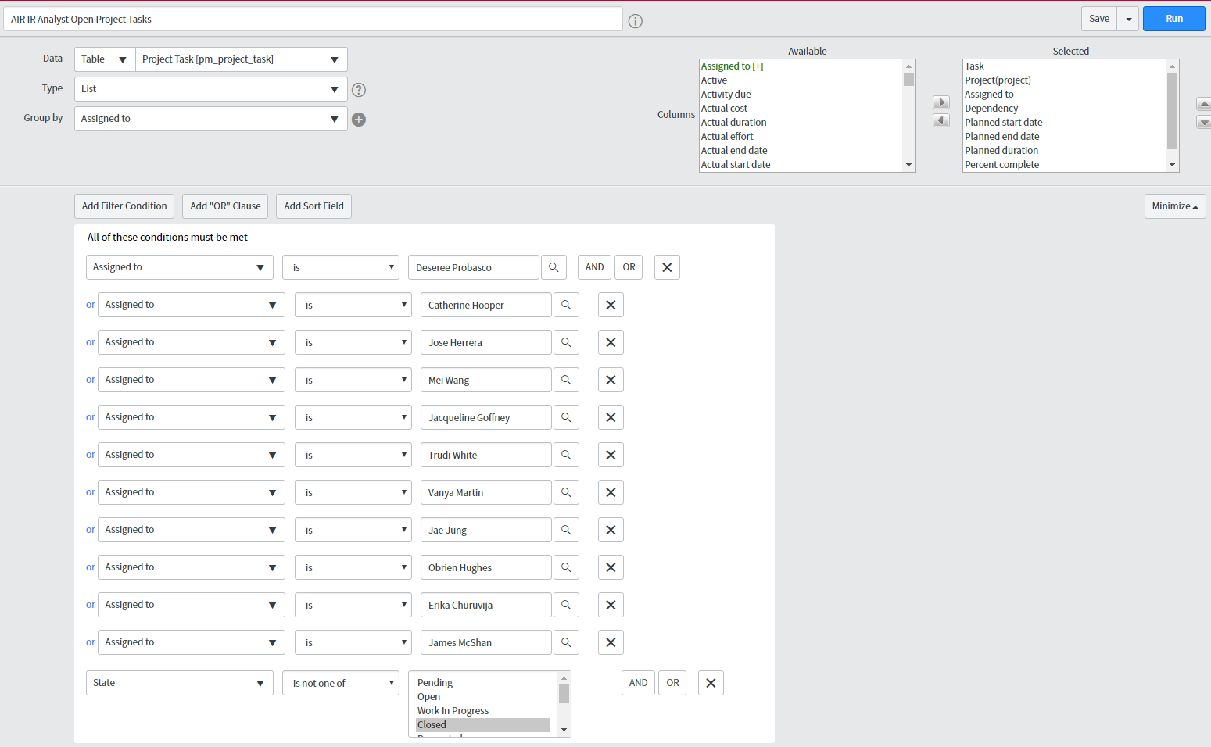
IR to BI Analytics
Notes:
It allows us to create and run our own reports to assist in project management.

Slide 48
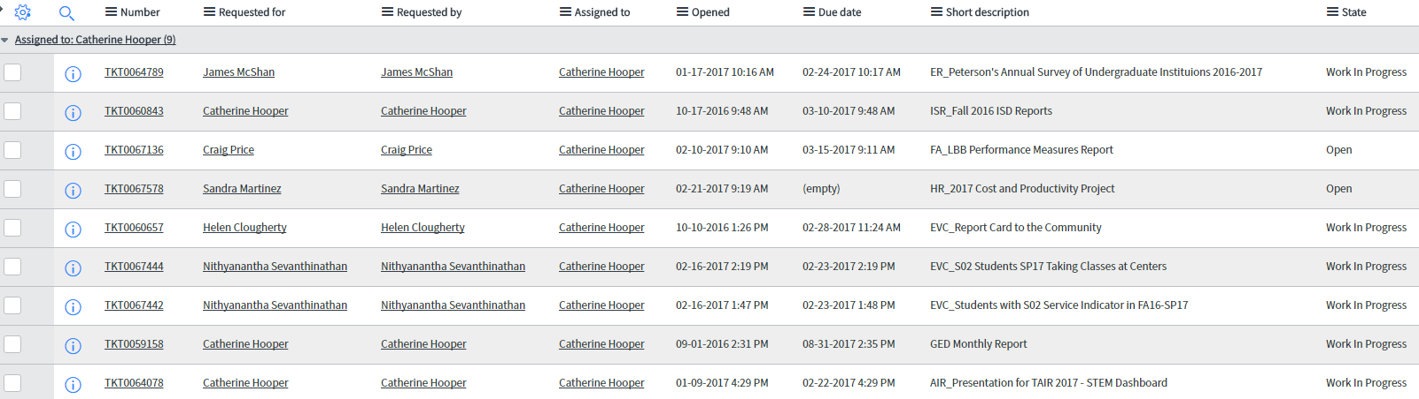
IR to BI Analytics
Notes:
It also allows staff to keep track of their own assignments so that they can stay on task.

Slide 49
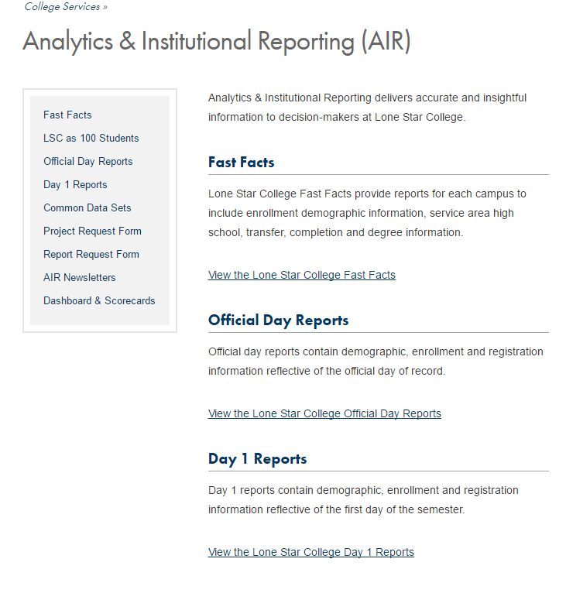
IR to BI Analytics
Notes:
Our clients make requests via links on our webpage or through our Service Catalog in our portal.

Slide 50
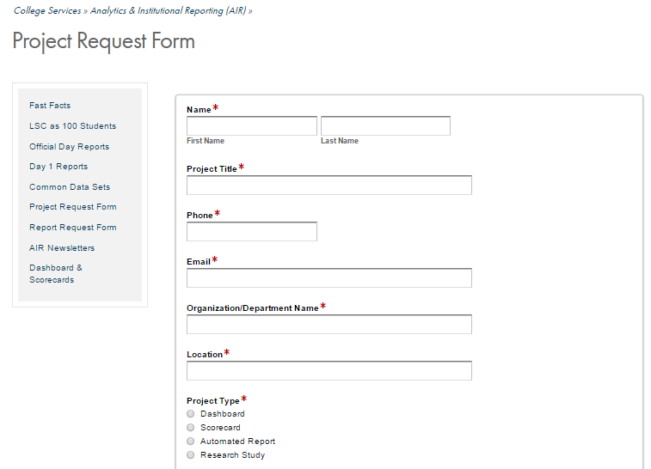
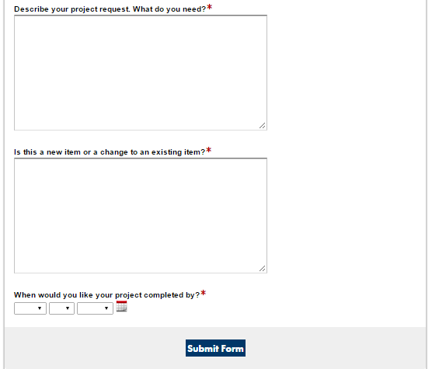
IR to BI Analytics
Notes:
Our clients request projects through the form and, once they go through an initial review, a project is created in SNOW by a project manager and assignments are made.

Slide 51
IR to BI Analytics
Keys to Our Successful Transition:
Develop a project management standard operating procedure (SOP) for the team to follow
Demonstrate to staff how working together makes us better
Implement the utilization of tools that make the transition to BI Analytics easier
Track and manage all projects with a focus on documentation
Notes:
And those are all of our keys to our successful transition……

Slide 52
Infographics
Questions?
Notes:
Does anyone have any questions?

Slide 53
Infographics
Thank you!
Notes:
Thank you for attending our session today!!

