Slide 1

A Predictive Model for Student Retention Using Logistic Regression
Fangyu Du, Sam Shi
TAIR 2017

Slide 2

Strategic Analysis and Reporting
UNT Dallas
Strategic Analysis and Reporting. New Trend.

Slide 3
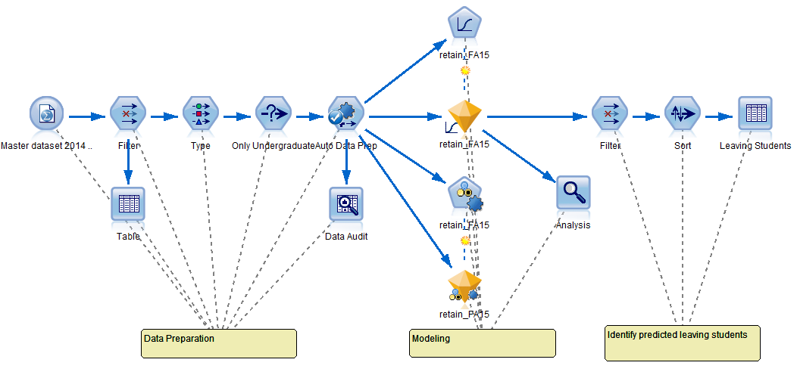
At a Glance

Slide 4
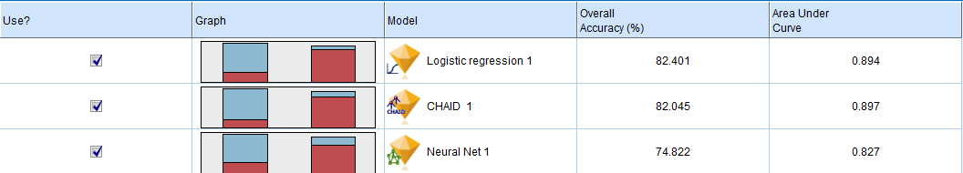
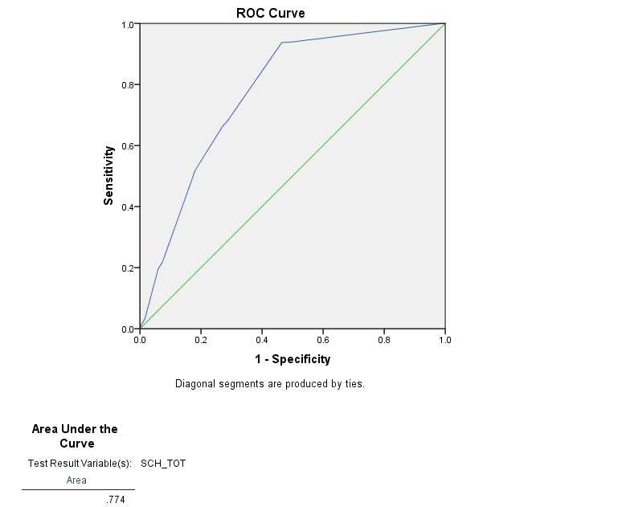
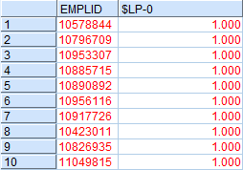
At a Glance 2

Slide 5
Structure of the Presentation
Background Information of the dataset
Data Preparation
Modeling
Use the results

Slide 6
Background Information of Dataset
Goal : Predicting whether or not the students will retain after one year and patterns

Slide 7
Background Information of Dataset 2
Students who are in:
Enrolled in Fall 2014
Only Undergraduate students
Get rid of students who graduated

Slide 8
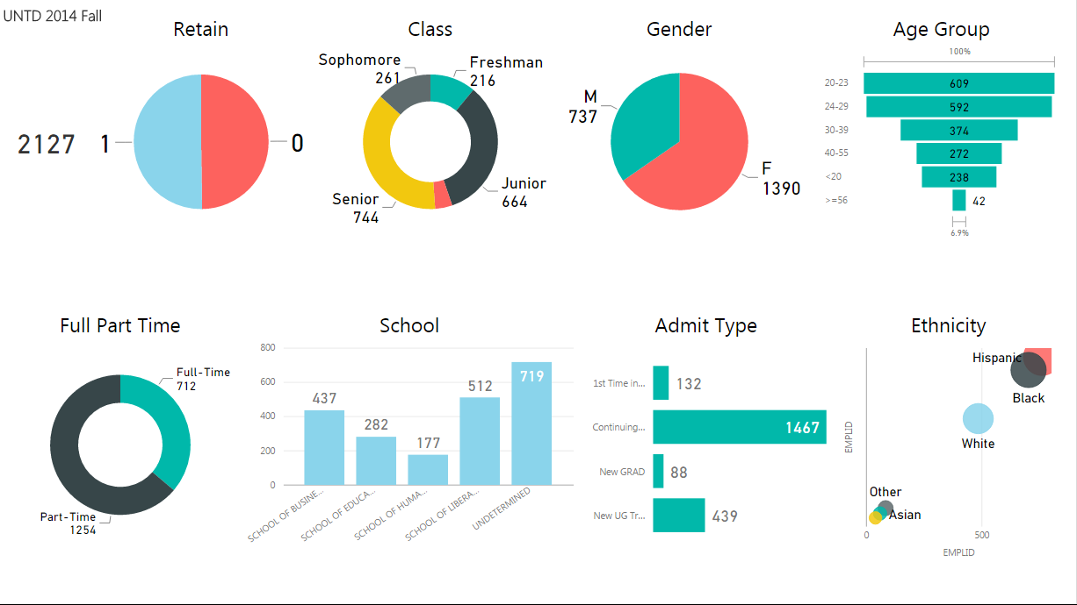
Background Information of Dataset 3

Slide 9
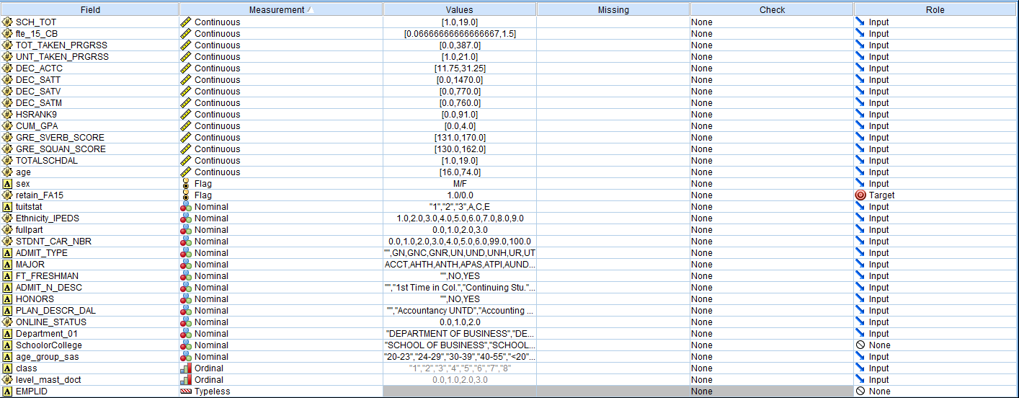
Data Preparation, Data Type

Slide 10
Data Preparation, Data Type 2
Measurement
Continuous: height, weight, length
Flag: Yes-NO
Nominal: Hair color, city you live
Ordinal: How you feel, how satisfied
Categorical: Number to present discrete
Role
Target: Y
Input: Xs

Slide 11
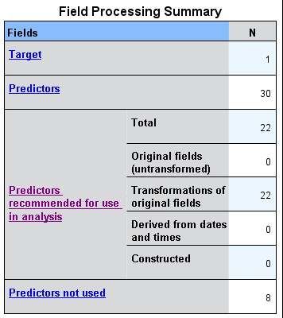
Data Preparation, Auto Data Prep
Target: Y
Predictors: Xs
Recommended for use: In Equation
Predictor not used: Discard

Slide 12
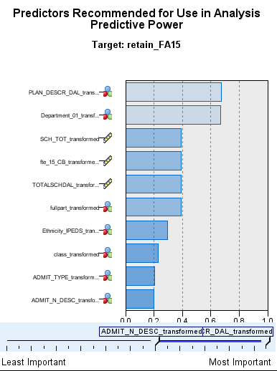
Data Preparation, Auto Data Prep 2
Predictive Power of Predictors / Xs
Missing value: Keep or Drop - 50%
Standardize Continuous: Easy to compare

Slide 13
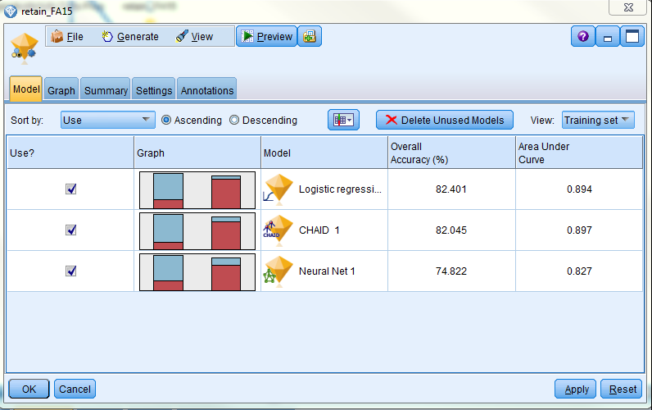
Modeling, Algorithms Selecting
Logistic Regression
CHAID
Neural Net

Slide 14
Modeling, Logistic regression
Logistic regression is the appropriate statistical technique when the dependent variable is a categorical variable and the independent variables are metric or nonmetric variables.
---Multivariate Data Analysis (Seventh Edition)
Y is pass/fail, win/lose, alive/dead, healthy/sick, retain/drop and you want to know the possibility based on the predictors.

Slide 15
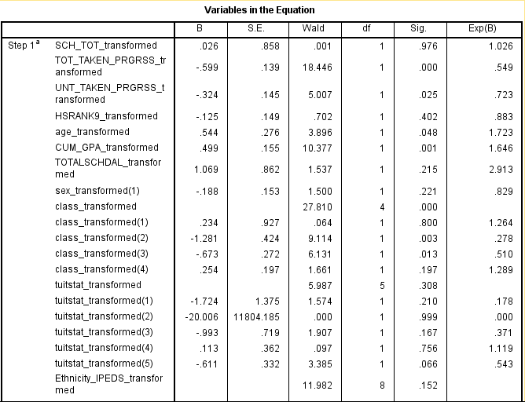
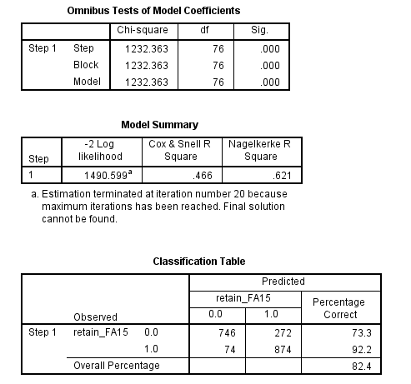
Modeling, Logistic regression (Continue)

Slide 16
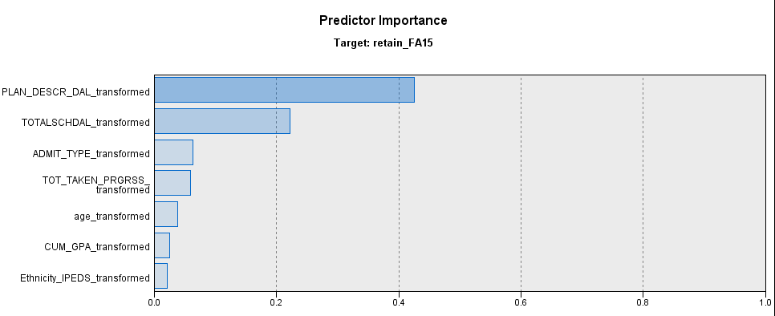
Modeling, Logistic regression (Continue2)
Predictor Importance

Slide 17
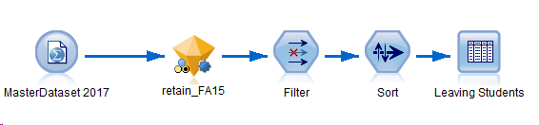
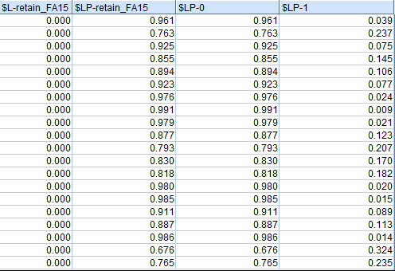
Use the Result, Possible Leaving Students
Feed new data and get result

Slide 18
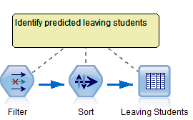
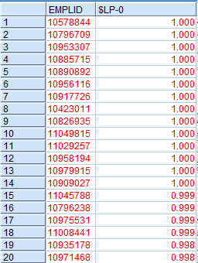
Use the Result, Possible Leaving Students (Continue)
Sort the predictive index $LP-0 (possibility of drop)

Slide 19
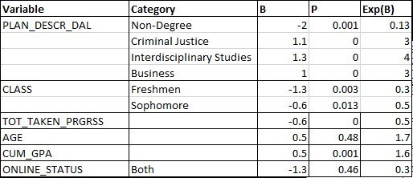
Use the Result, What matters the most

Slide 20
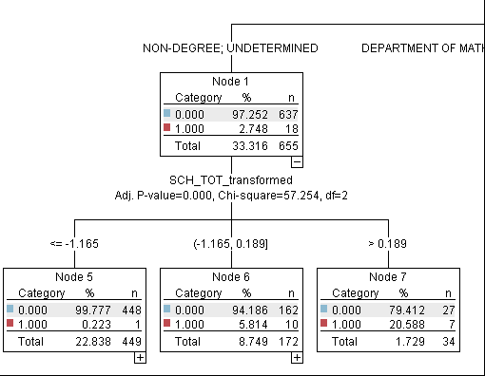
Use the Result, Decision Tree
CHAID (Chi-square automatic interaction detection)

Slide 21
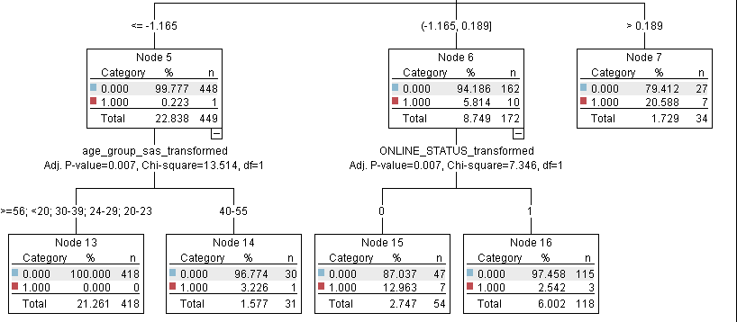
Use the Result, Decision Tree 2
CHAID (Chi-square automatic interaction detection)

Slide 22
Summary

Slide 23
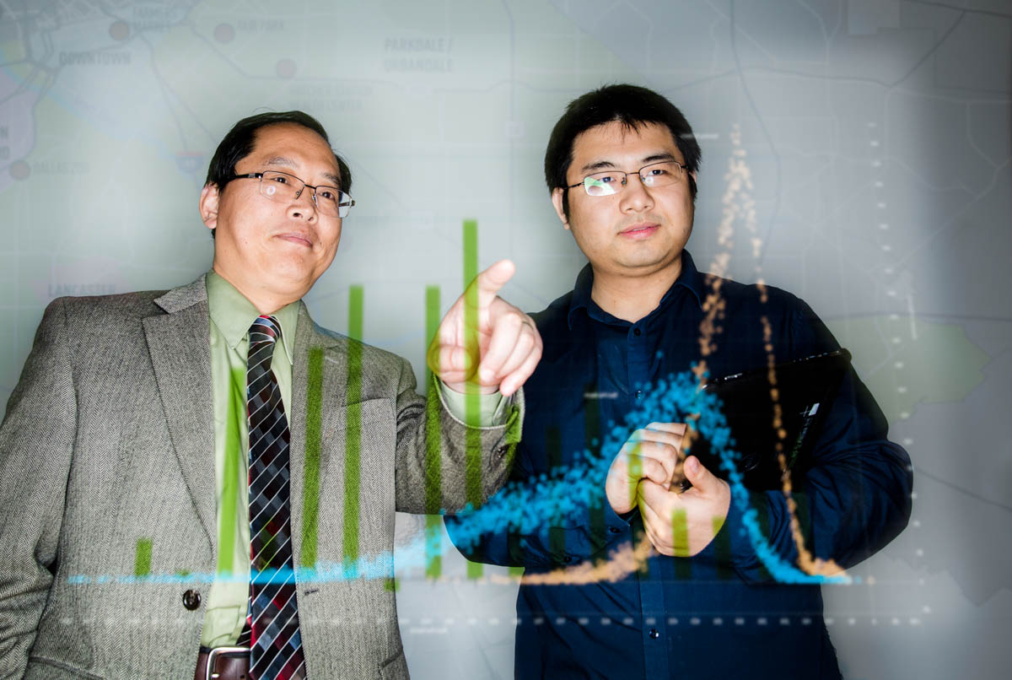
Thank you! Questions?
Contact us anytime if you need help!
Sam Shi (Director) Sam.Shi@untdallas.edu 972-338-1785
Fangyu Du Fangyu.Du@untdallas.edu 972-338-1343

