Slide 1
Practical Application of AIR’s
Duties & Functions of Institutional Research
TAIR Conference
Houston, TX | February 27, 2017
Gina Johnson, PhD
Strategy Director for IR Capacity Initiatives
Association for Institutional Research

Slide 2
Presentation Outline
  Why develop Duties & Functions of IR?
  The Duties & Functions of IR
  Using the Duties & Functions of IR
  Conversation

Slide 3
Why develop the Duties & Functions of Institutional Research?

Slide 4
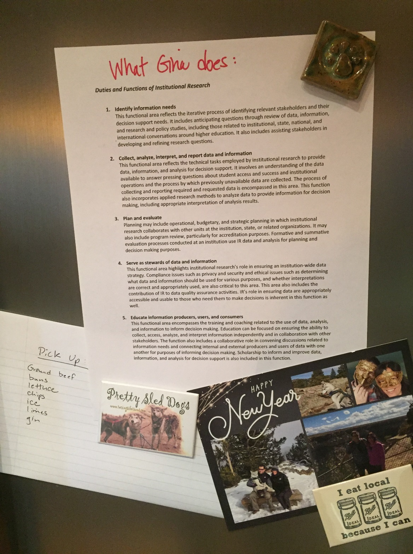
My mom’s fridge

Slide 5
Why the Duties & Functions of IR?
Policy Governance Ends
Institutional researchers have the knowledge and skills necessary to perform the duties and functions of institutional research, including: methods and tools; internal institutional effectiveness; external accountability; professional and interpersonal skills; and research and scholarship
Notes:
In order to define the knowledge and skills, we first needed to define the duties and functions (lengthy review of scholarship related to IR)
Knowledge and skill development is occurring now, and will allow AIR to purposefully identify and develop new professional development and resources to enhance those already available

Slide 6
Why the Duties & Functions of IR?
Further defining the field can lead to enhanced professionalization
Further defining the field allows easier “marketing” of our work to stakeholders
Assessment of IR functions
Assessment of professional development needs of IR professionals

Slide 7
The Duties & Functions of Institutional Research

Slide 8
The Duties & Functions of IR
Identify information needs
Collect, analyze, interpret, and report data and information
Plan and evaluate
Serve as stewards of data and information
Educate information producers, users, and consumers
https://www.airweb.org/Resources/Pages/IR-Duties-Functions.aspx

Slide 9

Identify information needs
This functional area reflects the iterative process of identifying relevant stakeholders and their decision support needs. It includes anticipating questions through review of data, information, and research and policy studies, including those related to institutional, state, national, and international conversations around higher education. It also includes assisting stakeholders in developing and refining research questions.

Slide 10

Collect, analyze, interpret, and report data and information
This functional area reflects the technical tasks employed by institutional research to provide data, information, and analysis for decision support. It involves an understanding of the data available to answer pressing questions about student access and success and institutional operations and the process by which previously unavailable data are collected. The process of collecting and reporting required and requested data is encompassed in this area. This function also incorporates applied research methods to analyze data to provide information for decision making, including appropriate interpretation of analysis results.

Slide 11

Plan and evaluate
Planning may include operational, budgetary, and strategic planning in which institutional research collaborates with other units at the institution, state, or related organizations. It may also include program review, particularly for accreditation purposes. Formative and summative evaluation processes conducted at an institution use IR data and analysis for planning and decision making purposes.

Slide 12

Serve as stewards of data and information
This functional area highlights institutional research’s role in ensuring an institution-wide data strategy. Compliance issues such as privacy and security and ethical issues such as determining what data and information should be used for various purposes, and whether interpretations are correct and appropriately used, are also critical to this area. This area also includes the contribution of IR to data quality assurance activities. IR’s role in ensuring data are appropriately accessible and usable to those who need them to make decisions is inherent in this function as well.

Slide 13

Educate information producers, users, and consumers
This functional area encompasses the training and coaching related to the use of data, analysis, and information to inform decision making. Education can be focused on ensuring the ability to collect, access, analyze, and interpret information independently and in collaboration with other stakeholders. The function also includes a collaborative role in convening discussions related to information needs and connecting internal and external producers and users of data with one another for purposes of informing decision making. Scholarship to inform and improve data, information, and analysis for decision support is also included in this function.

Slide 14
Using the Duties & Functions of Institutional Research

Slide 15
Definition of IR Examples
“As an institutional researcher, I provide data, reporting and research that supports institutional planning, strengthens teaching and learning, and provides an understanding of the meaning and quality of education at Harvey Mudd College.”
Laura Palucki Blake, Harvey Mudd College
“IR’s mission is to collect, organize, analyze, interpret, and disseminate institutional data and intelligence for the purpose of decision-making, policy formation, planning, and assessment of programs and activities. In other words, if you have a question about your institution, we will work to find you meaningful and actionable information to answer it.”
Erika Farfan, Kenyon College

Slide 16
“Institutional research comprises the collection, analysis, interpretation, and provision of data to support decision-making by colleges and universities, government offices, higher education associations, and for individual students, prospective students, and their families.”
Julie Carpenter-Hubin, The Ohio State University
“IR is work to support decision making and planning at the university. For example, helping understand why students drop out, comparing faculty salaries with peer universities, and doing lots of federal and state reporting.”
Bill Knight, Ball State University

Slide 17
“The IR office serves to connect people with the information they need to make good decisions about Olin, whether they are trustees trying to solve a difficult problem or prospective students who are trying to decide where to apply to college.”
Jeremy Goodman, Olin College of Engineering
“I am a professional storyteller… My role at the university is to tell a coherent story using data. Like any great story, there is a history that led us to where we are, a current conflict to overcome, and if we do the ‘right thing’ then we will have a flourishing future.”
Michael Le, Humboldt State University

Slide 18
IR Function descriptions
Forbes 4 essential questions your mission statement must answer:
  What do we do?
  How do we do it?
  Whom do we do it for?
  What value are we bringing?
What
Why
For Whom

Slide 19

IR Poetry

Slide 20
Conversation
Notes:
Explain companion Knowledge and Skills piece
Guiding questions:
Initial reaction to the D&F of IR?
How might they be useful in your setting?
What other companion resources might AIR produce with its members related to the Duties & Functions that would be useful to you in your work?

Slide 21
Gina Johnson, PhD
Strategy Director for IR Capacity Initiatives
Association for Institutional Research
Email: gjohnson@airweb.org
Twitter: @GinaJohnsonIR

