Slide 1
Value Added: The Benefits of Enhancing Program Assessment Using Indirect Methods

Slide 2

Assessment Pathway

Slide 3
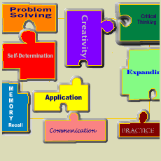
Direct Assessment
“require[s] that students display the extent of their learning by doing something.”
Mary J. Allen

Slide 4

Indirect Assessment
“involve[s] a report about learning rather than a direct demonstration of learning”
Mary J. Allen

Slide 5

Some Types of Indirect Assessment
End of Course Grades
Graduation Rates
National surveys like NSSE or Your First College Year

Slide 6

Reflective Essays
Backward looking
Clarify opinions or gain insight
Qualitative statements
Quantitative uses – Content analysis

Slide 7
Critical thinking skills include research, analysis, and effective development of thesis/argument. Identify History courses that increased your critical thinking skills. Describe specific ways in which these courses utilized your critical thinking skills.

Slide 8

Self-Evaluation
Consider their own skill level
Insight into confidence
Gap analysis

Slide 9
Student self-ratings 1= none, 2= poor, 3=average, 4= good, 5=excellent
I am able to evaluate and analyze historical sources for validity.
I am able to develop an historical question for research.
I can create a thesis statement.
I can maintain a thesis throughout a paper supported by evidence.
I am able to critique peer papers based on valid criteria for historical inquiry.

Slide 10
Surveys
Some Guidelines
  Simple questions first
  Level of language
  Focus your questions
  Avoid compound questions
  Provide all possible answers

Slide 11
Surveys
Some Guidelines
  Strive for clarity
  Avoid bias
  Avoid negative wording
  Avoid cultural bias
  Be careful asking demographic information

Slide 12
Program Questions
Keeps accurate records
Organizes tasks well
Follows proper sequences
Strives to satisfy clients
Can identify need for research/data
Can evaluate information for relevance and accuracy

Slide 13
Soft Skills
Is punctual
Avoids wasting time
Listens well
Willing to serve others
Tries to reach agreement
Speaks up when things are going wrong

Slide 14
  What insight may this survey give you that classroom evaluation may not?
  Why ask non-programmatic questions?

Slide 15

Weaknesses of Indirect
Difference between what they say they know and what they do know
Gaining validity
Can be time-consuming to evaluate or difficult to analyze

Slide 16
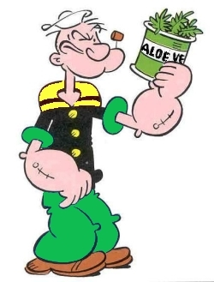
Strengths of Indirect
Insight into student decision making
Elicit unanticipated results
Insight into student perceptions and attitudes

Slide 17

Assessment Pathways

