Slide 1
Where are the Data?
Joseph Meyer, Director
Office of Institutional Research
Texas State University-San Marcos
To guess is cheap. To guess wrongly is expensive.
Chinese proverb

Slide 2
Our Mission
To provide timely and accurate data and information designed to meet the needs of our customers
Joe Meyer, Director
Lesley Prewitt, Administrative Assistant III
Tami Reeves, Senior Research Analyst
Richard Batey, Research Analyst
Susan Thompson, Senior Research Analyst
Bruce Lockhart, Research Analyst

Slide 3

Institutional Research has on-line resources to support…
Initiatives in your Strategic Plan
Grant proposals
Publications
Research

Slide 4
Did you know…
Texas State’s six-year graduation rate of 54% ranks among the top 5 Texas public universities.
Texas State ranks 1st nationally in the number of Geography-Cartography degrees awarded, granting twice as many as any other university.
Texas State ranks in the top 20 nationally in the number of Hispanics earning bachelor’s degrees.

Slide 5

Main Topics
How to use improved data sources:
Texas State University-San Marcos
Texas public universities
U.S. universities
Other (as time permits):
  Digest of Education Statistics
  College Results Online
  NCHEMS Information Center
  Texas State Data Center
  U.S. Census Bureau
Everything is getting easier!

Slide 6
Data about Texas State
First get your facts; then you can distort them at your leisure
Mark Twain (1835-1910)

Slide 7
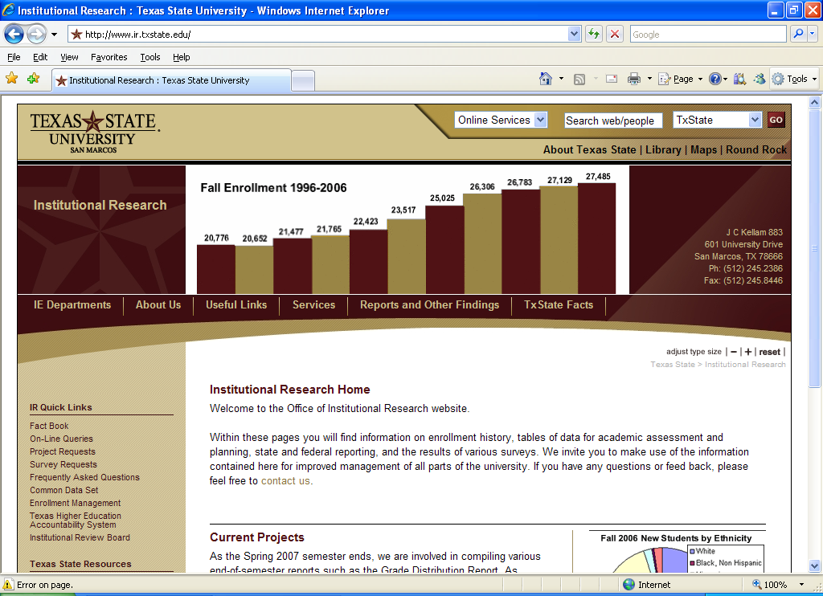
Institutional Research for Texas State Data
www.ir.txstate.edu

Slide 8
From Many Sources to One
On-Line Fact Book
Ad Hoc Reports
MS Excel Pivot Tables
On-Line Query
Data Warehouse

Slide 9
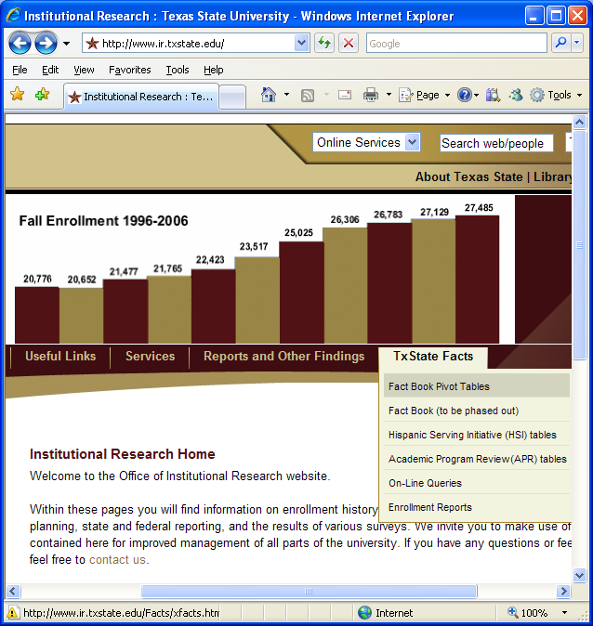
Why change to pivot tables?
Key Advantages:
Appropriate technology
User friendly
Easy to update quickly
More flexible
Tables and graphs
Single version of truth
More data
Like a data warehouse in look & feel transition

Slide 10
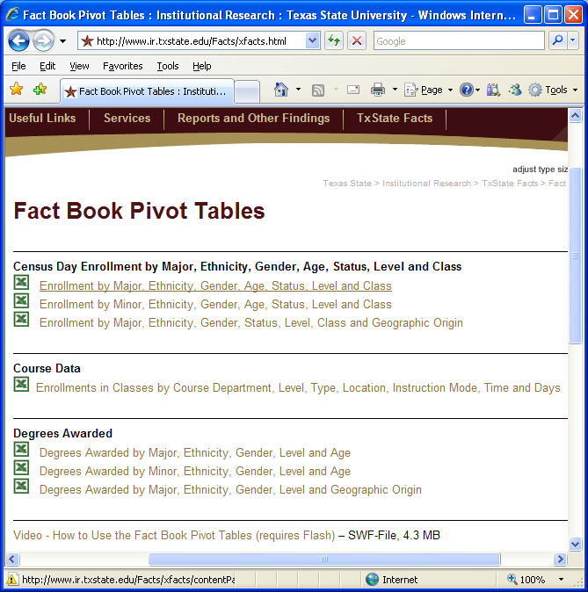
Consistent and Comprehensive
About 90% of the information available in older Fact Book tables and the On-Line Query system are now available in this common format. We are working to provide additional information in the near future.

Slide 11
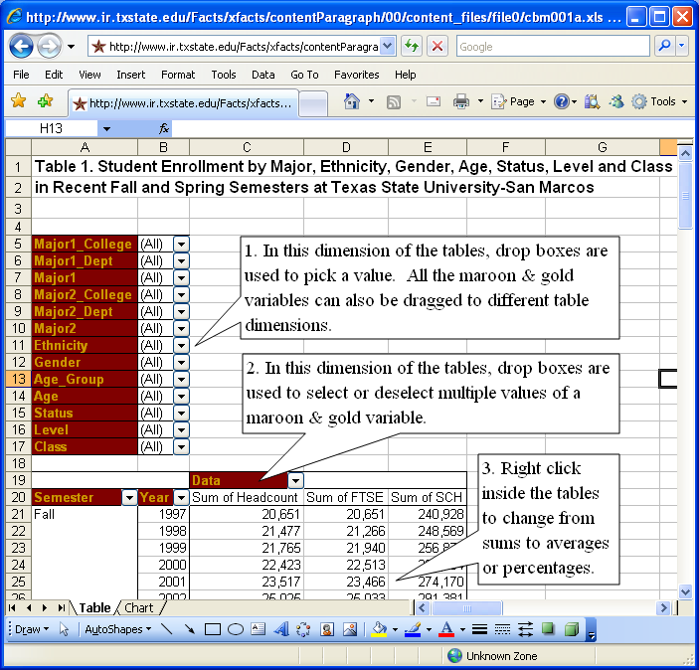
Let’s Take a Look at the First One
If you are familiar with a computer mouse and Microsoft Excel spreadsheets, then navigating a pivot table is almost as easy as 1, 2, 3...

Slide 12
Data about
Texas Public Universities
Facts are stubborn, but statistics are more pliable
Mark Twain (1835-1910)

Slide 13
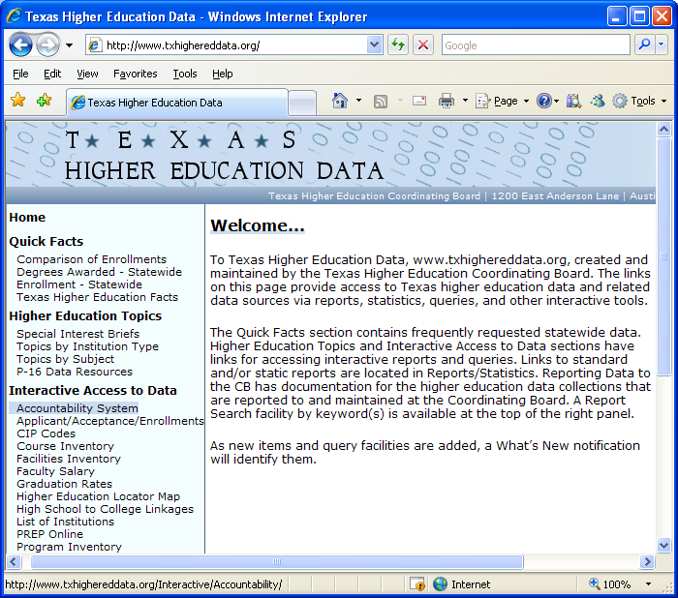
THECB for Texas Public University Data
www.txhighereddata.org
The Accountability System at the Texas Higher Education Coordinating Board is a way to compare the performance of Texas public colleges and universities
on a standard set of measures used by the legislature.

Slide 14
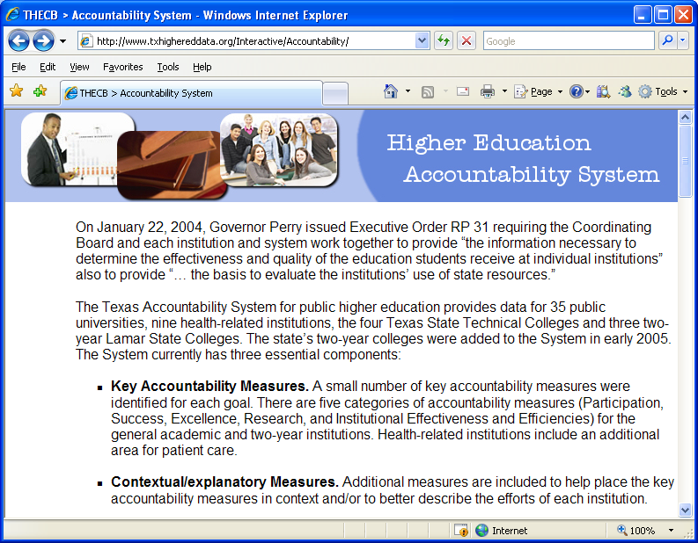
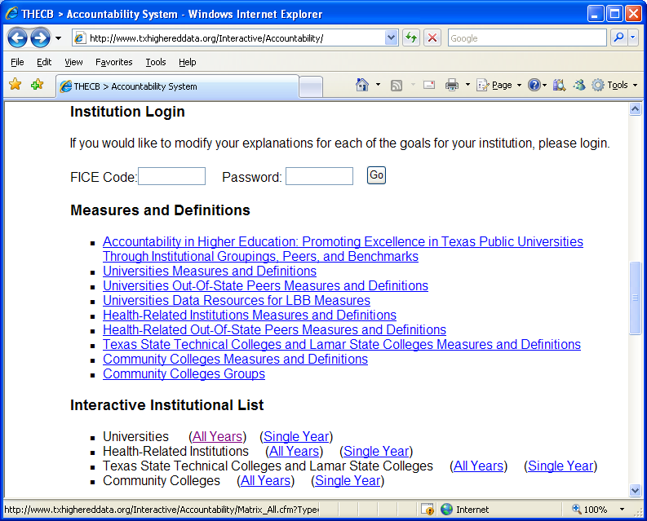
Accountability System
Scroll down to Universities (All Years)

Slide 15
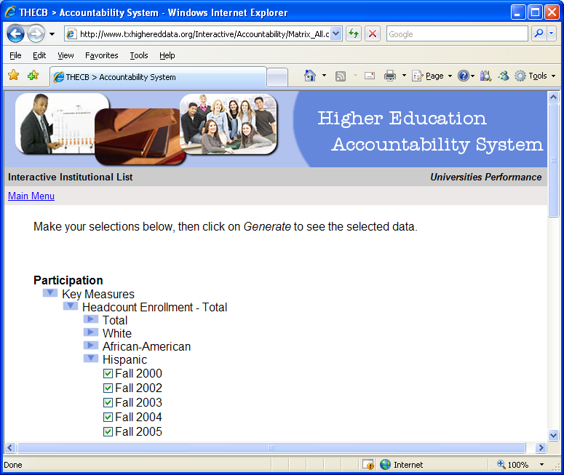
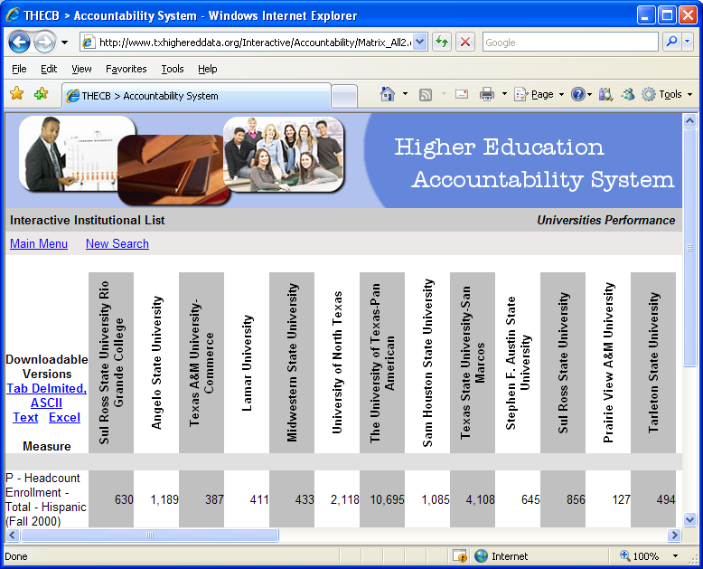
Accountability System

Slide 16

THECB for Texas Public University Data
www.txhighereddata.org
PREP Online at the Texas Higher Education Coordinating Board has an improved look and feel. It is being expanded currently and is an easy-to-use source of information about Texas public colleges and universities.

Slide 17
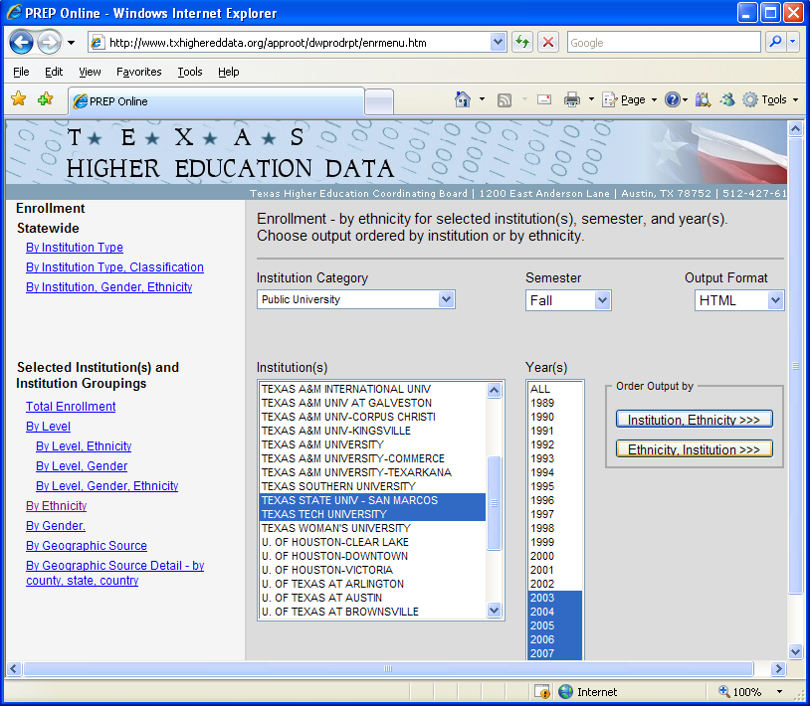
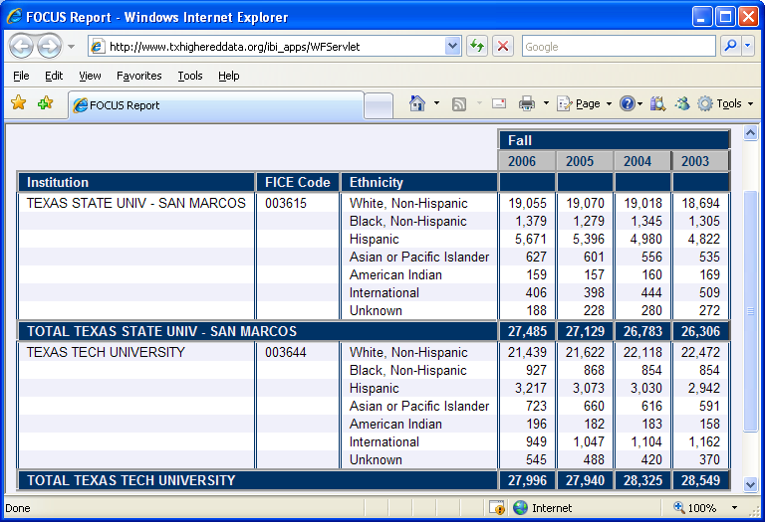
PREP
Online

Slide 18
Data about
U.S. Universities
There are two kinds of statistics:
The kind you look up and the kind you make up
Rex Stout (1886-1975)

Slide 19
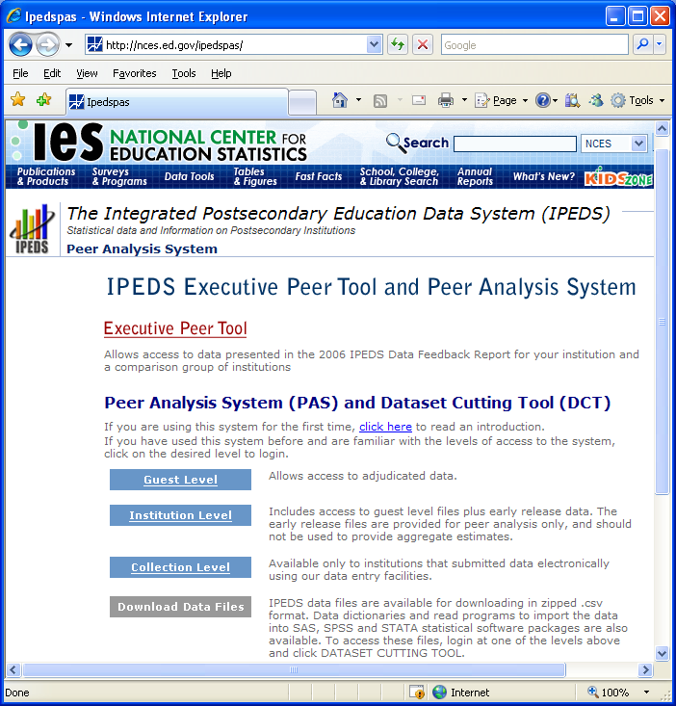
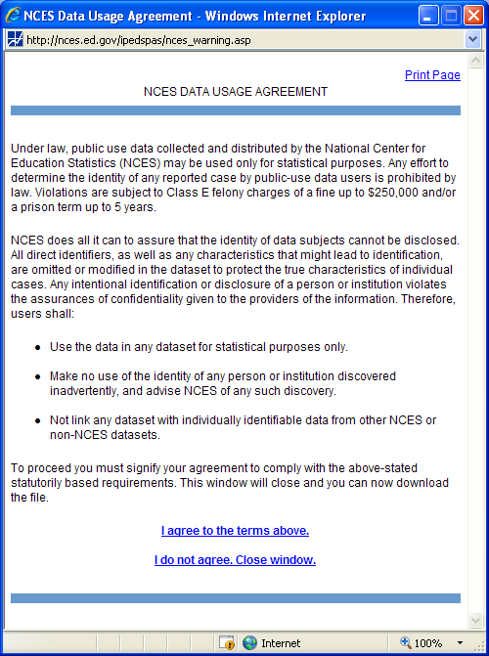
U.S. Department of Education: IPEDS
http://nces.ed.gov/ipedspas/
1. Click Institutional Level and accept usage agreement

Slide 20
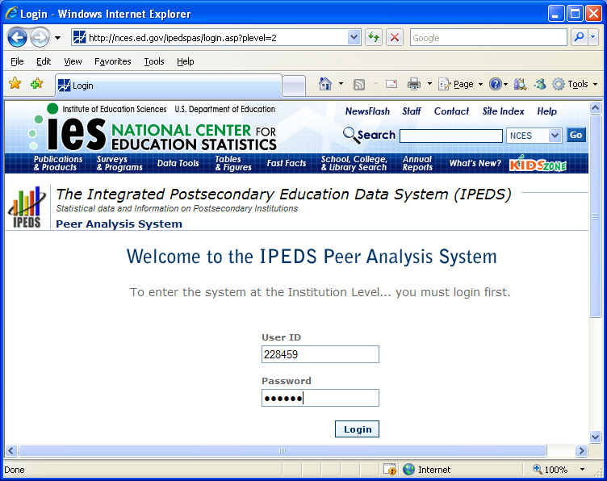
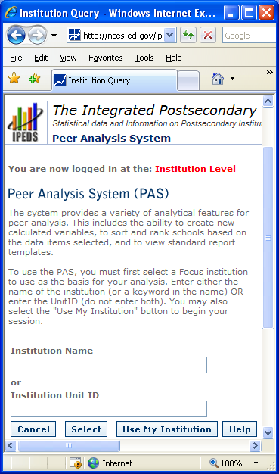
U.S. Department of Education: IPEDS
2. Login with 228459 as username and password
3. Click Use My Institution

Slide 21
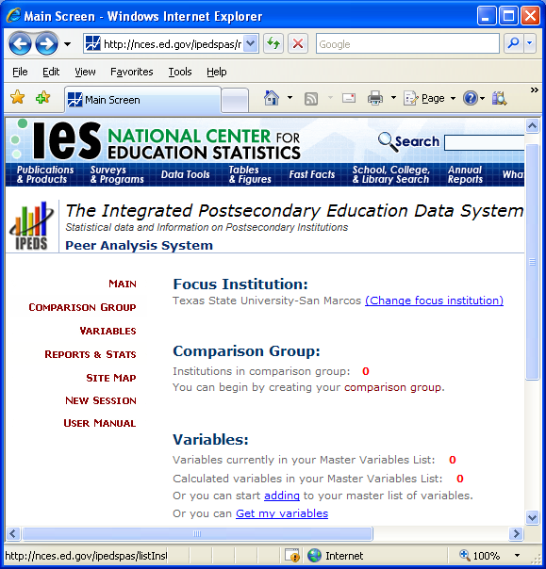
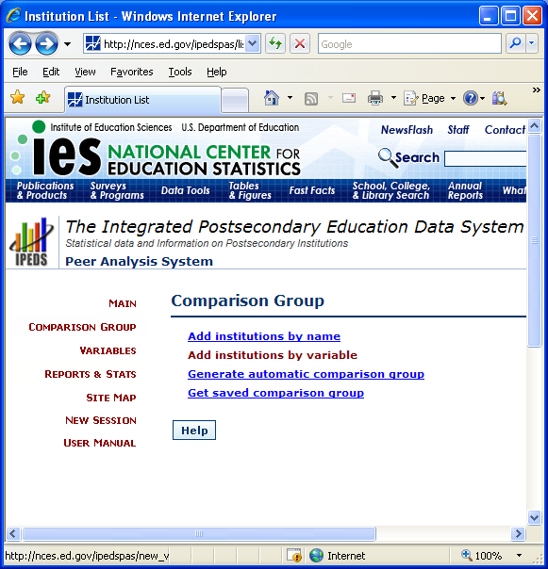
U.S. Department of Education: IPEDS
5. Add institutions by variable
4. Click Comparison Group

Slide 22
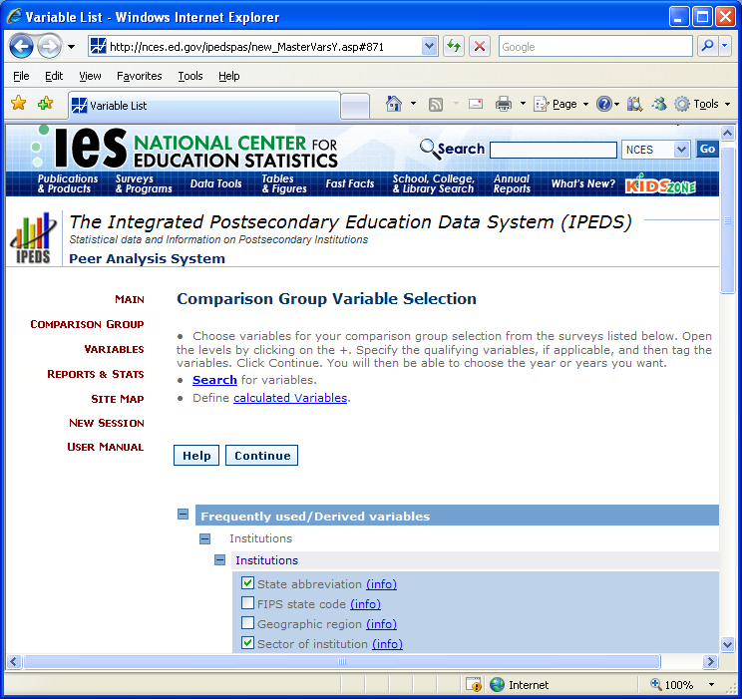
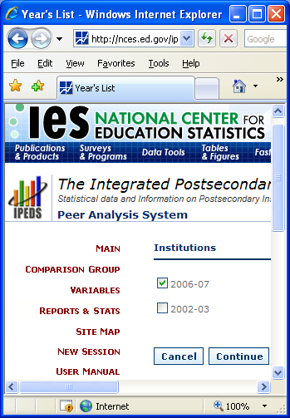
U.S. Department of Education: IPEDS
6. Pick “state” and “sector” from frequently used variables list
7. Pick a year and Continue

Slide 23
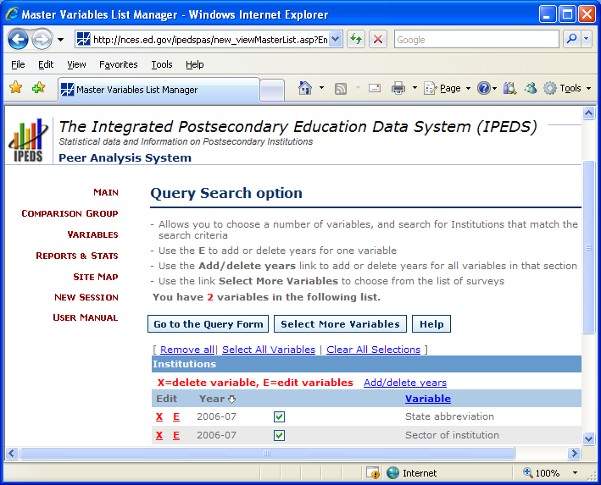
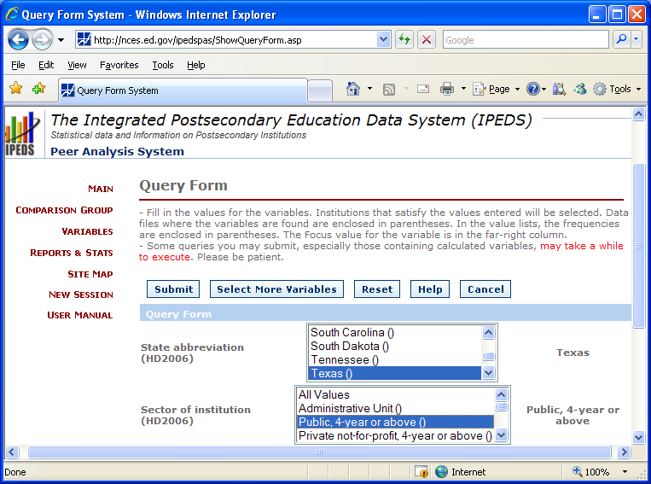
U.S. Department of Education: IPEDS
8. Select more variables or Go to Query Form
9. Pick “Texas” and “Public 4-year”
and Submit

Slide 24
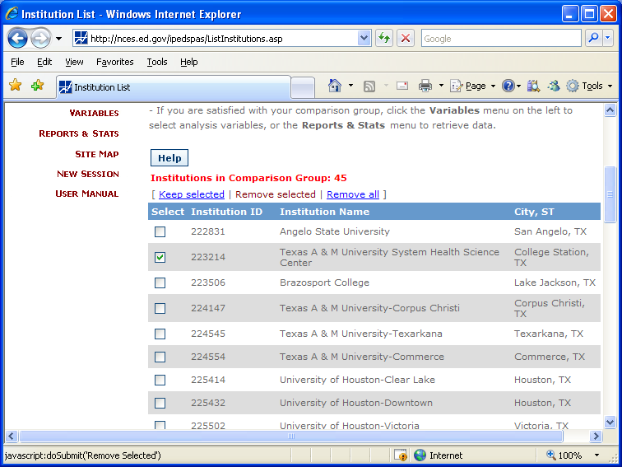
U.S. Department of Education: IPEDS
11. Click Reports and Stats and choose a type of report to run. Pick a ranking report in this example.
10. Check and Remove selected schools

Slide 25
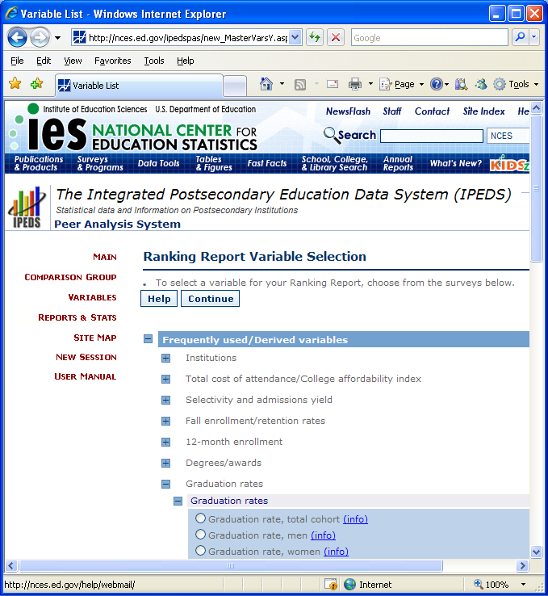
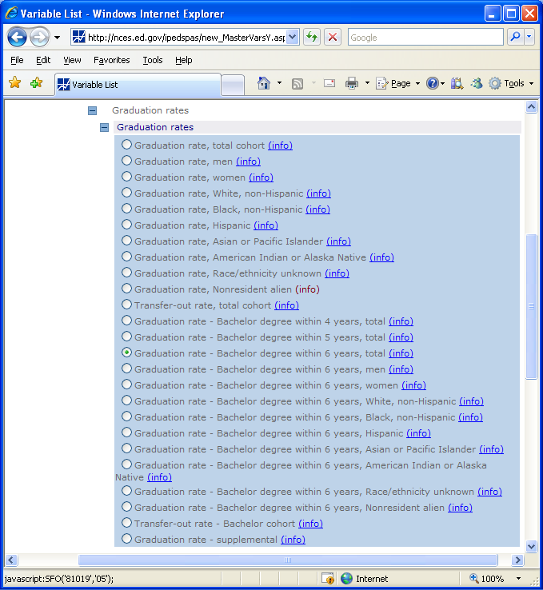
U.S. Department of Education: IPEDS
12. Pick a ranking variable such as graduation in 6 years

Slide 26
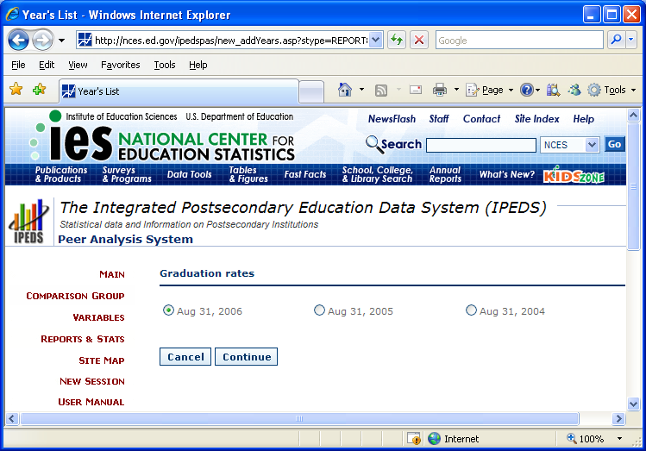
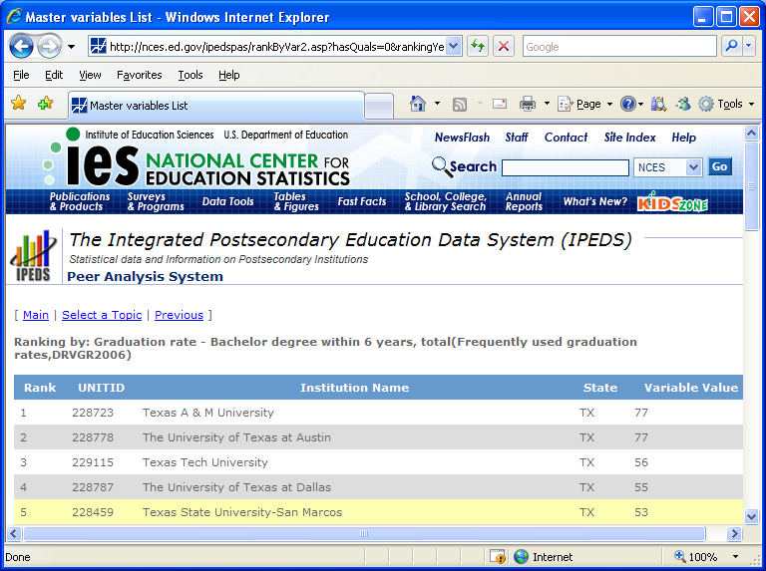
U.S. Department of Education: IPEDS
Pick a year and click Continue to see the ranking of Texas State’s graduation rate among Texas public universities

Slide 27
Some Additional Data Sources
Digest of Educ. Statistics http://nces.ed.gov/programs/digest
College Results Online: http://www.collegeresults.org
NCHEMS Information Center: http://www.higheredinfo.org
Texas State Data Center: http://txsdc.utsa.edu
U.S. Census Bureau: http://www.census.gov
It is easy to lie with statistics, but it is easier to lie without them
Frederick Mosteller (1916-2006)

Slide 28
Main Topics
Data sources we discussed today:
Texas State University-San Marcos
Texas public universities
U.S. universities
Other:
  Digest of Education Statistics
  College Results Online
  NCHEMS Information Center
  Texas State Data Center
  U.S. Census Bureau
Everything is getting easier!

Slide 29
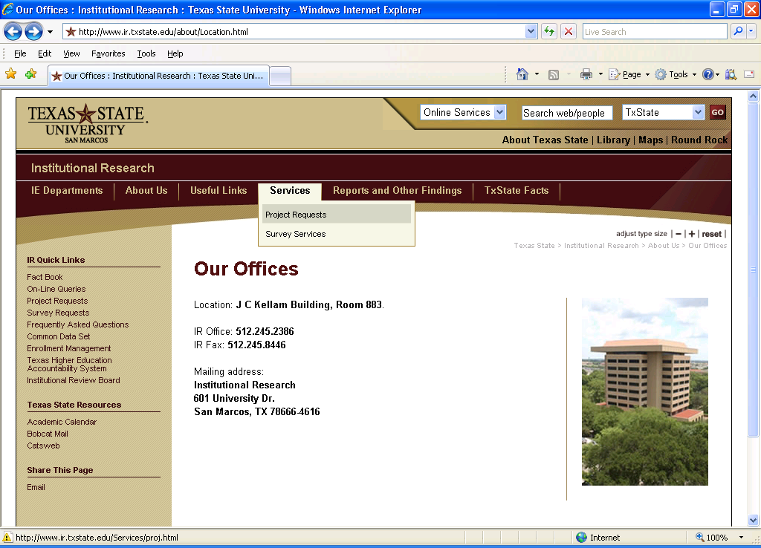
Can’t find what you need?
Visit our home page to contact us for help:
www.ir.txstate.edu

