Slide 1

Using IDEA Results in Assessment of Core Curriculum Student Learning Objectives
Jeff Roberts M.A., Assessment Coordinator
M. Rita Caso PhD, Director
Office of Institutional Research & Assessment
Sam Houston State University
A Member of The Texas State University System

Slide 2
Core Curriculum Assessment Considerations
TexReg 4109
§4.27 (effective May 27, 2003)
“Each institution’s core curriculum must be designed to satisfy the exemplary educational objectives specified for the component areas of the ‘Core Curriculum: Assumptions and Defining Characteristics’ adopted by the board.” (The TX Higher Education Board – THECB) (See EEO Example in EEO-ISLO Matrix)
§4.30
Criteria for Evaluation of Core Curricula: (a) Each public institution of higher education shall review and evaluate its core curriculum every five years and report the results of that evaluation to the Board. The evaluation should include:
  (1) the extent to which the core curriculum is consistent with the elements of the core curriculum recommended by the Board;
  (2) the extent to which the core curriculum is consistent with the Texas Common Course Numbering System (TCCNS);
  (3) the extent to which the core curriculum is consistent with the elements of the core curriculum component areas, intellectual competencies, and perspectives as expressed in Core Curriculum: Assumptions and Defining Characteristics adopted by the Board; and
  (4) the extent to which the institution's educational goals and the exemplary educational objectives of the core curriculum recommended by the Board are being achieved

Slide 3
Core Curriculum Assessment Considerations
  Example From Sam Houston State University:
    Component Area 1 - Communication 6 HOURS
    Component Area 2 - Mathematics 3 HOURS
    Component Area 3 - Natural Sciences 8 HOURS
    Component Area 4 - Humanities & Visual & Performing Arts 9 HOURS
    Select 3 hours from Visual & Performing Arts
    Select 3 hours from Literature or Philosophy
    Select 3 hours from Cultural Studies:
    Component Area 5 - Social and Behavioral Sciences 15 HOURS
    Select 9 hours from: History, Political Science, GOVT
    Select 3 hours from: Political Science, GOVT
    Select 3 hours from: Agriculture, Economics, Geography, Philosophy, Psychology, Sociology, Speech Communication
    Component Area 6 - Institutionally Designated –Kinesiology 1 HOUR

Slide 4
Core Curriculum Assessment Considerations
The Commission on Colleges of the Southern Association of Colleges and Schools (SACS)
Compliance Criterion 3.5.1 : College-level competencies
  The institution identifies college-level general education competencies and the extent to which graduates have attained them.
Good Practice of Program Evaluation and University-wide Academic Assessment at ANY University

Slide 5
History of Core Curriculum Assessment at Sam Houston State University
Assessment of the core curriculum at Sam Houston State University (SHSU) has evolved.
(1999) The University’s Core Curriculum Assessment Committee is charged with developing “recommendations for an assessment process for the University’s core curriculum.”
(1999-2004) Student learning assessment was based upon grades earned in core curriculum courses. ☹
(2004-2005) THECB’s exemplary educational objectives were mapped to the student learning outcome objectives measured by the IDEA Evaluation System. (EEO-ISLO Matrix example) ☺

Slide 6
The IDEA System
What is IDEA?
  A product of the IDEA Center of Kansas State University, it is a class evaluation system used nationally by hundreds of universities each semester.
  Piloted at Sam Houston State University in Spring 2005.
  Full university-wide implementation of IDEA Evaluation System at SHSU in Fall 2005, coordinated by Institutional Research & Assessment Office (IRA)

Slide 7
The IDEA System (cont.)
  On the IDEA Faculty Information Form (FIF)Instructors rate 12 Student Learning (Outcome) Objectives (SLOs) in relation to each class.
    “Important” or “Essential” or of “Minor or No Importance”
  Instructors are directed limit their “Important” or “Essential” ratings to 3-5 IDEA SLOs
  Students evaluate their progress on the IDEA SLOs, and on other matters of instructional interest, using a 47 question student form. (IDEA Student Form example)
    Up to 20 institution-specific, questions may be added to the standard 47.
  Students rate their progress on the 12 IDEA SLOs using a 5 point Likert Scale ranging from..
    1 - “No Apparent Progress” to
    5 - “Exceptional Progress; I made outstanding gains on this objective.”
  The IDEA Center scores student responses in the light of instructor weightings of IDEA SLOs and scores are compared against national norms, institutional norms and subject area norms in result reports.

Slide 8
How is IDEA Used to Evaluate the Core Curriculum?
THECB EEO – IDEA SLO Matrix
Correspondences were identified between the THECB’s Exceptional Educational Objectives and the twelve IDEA SLO’s, for each Core Curriculum area.
For each Core Curriculum area a matrix was generated, mapping the THECB EEOs to the IDEA SLOs with which they best associated

Slide 9
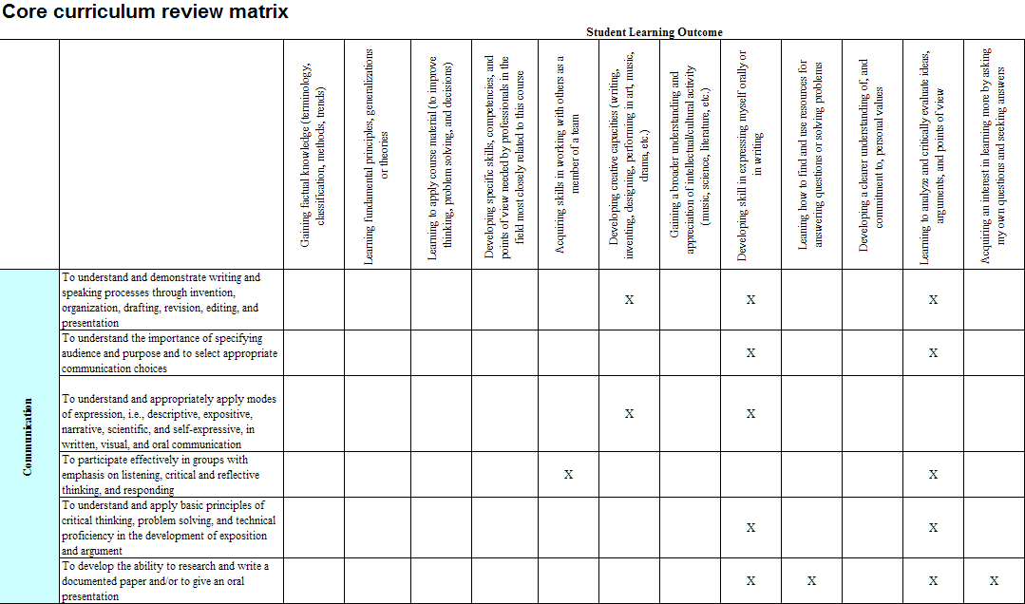
Example of THECB EEO - IDEA SLO Matrix
Communications Core Area

Slide 10
How is IDEA Used to Evaluate the Core Curriculum?
IDEA Data for the classes within each Core Curriculum area are analyzed to determine:
  On which of the 12 IDEA SLOs students perceive that they have made the greatest progress
  Which of the 12 SLOs are most frequently rated by the course instructors as Important or Essential
  If the IDEA SLOs most often rated by instructors as Important or Essential generally match the THECB Exceptional Educational Objectives.

Slide 11
History of Core Curriculum Assessment at SHSU (cont.)
The evolution of core curriculum assessment at SHSU:
(2006-2007) Institutional Research & Assessment (IRA) Office compiled and analyzed raw student and instructor response-data from Fall 05, Spring 06, & Fall 06 IDEA surveys, for all courses pertaining to each of 9 Core Curriculum areas ( and sub-areas) in order to compute…
  students’ perceived progress on the 12 IDEA Student Learning Objectives (SLOs) and
  instructors’ ratings of their emphasis upon the same 12 SLOs.
  Agreement between student and instructor responses re. IDEA SLOs
  Alignment of student progress and instructor emphasis on IDEA SLOs with THECB EEOs

Slide 12
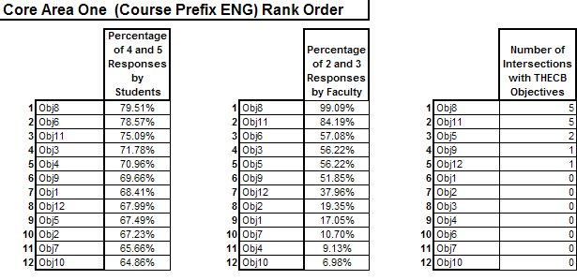
Sample 2005-2007 Core Curriculum Report: Tables 1, 2 & 3
1
2
3

Slide 13
Core Curriculum Assessment With IDEA: 2005-2007
Tables 1, 2, & 3
  A table displaying the percentages of only high level (4-5 on a 1-5 scale) responses given by students for each of the 12 Learning Outcome Objectives assessed in the IDEA instrument rank ordered by magnitude of percentage.
  A table displaying the percentages of only high level (2-3 on a 1-3 scale) responses given by instructors for each of IDEA’s 12 Learning Outcome Objectives, rank ordered by magnitude of percentage.
  A table displaying the number of intersections each of the 12 IDEA Learning Outcome Objectives has with each of the Expected THECB Learning Outcome Objectives, rank ordered by frequency of intersections.

Slide 14
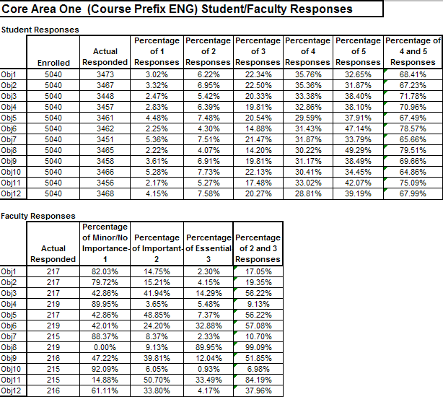
Sample 2005 – 2007 Core Curriculum Report: Tables 4 & 5
4
5

Slide 15
Core Curriculum Assessment With IDEA: 2005-2007
Tables 4 & 5
  A table of the total number of students surveyed; the total number of student responses returned ; and the percent frequencies of student responses at each level of the 1-5 scale for each of the 12 Learning Outcome Objectives assessed in the IDEA instrument.
  A table of the total number of instructors surveyed; the total number of instructor responses returned ; and the percent frequencies of instructor responses at each level of the 1-3 scale for each of the 12 Learning Outcome Objectives assessed in the IDEA instrument.

Slide 16
History of Core Curriculum Assessment at SHSU (cont.)
The evolution of core curriculum assessment at SHSU:
(2007-2008)
Using only response data from Academic Year (AY) 2007-2008, the SHSU IRA Office repeated the raw IDEA data compilation and analysis process from previous year, computing the same IDEA SLO student progress and instructor emphasis measures for comparison
The organization of courses in the sub groups within some very broad Core Areas was modified to achieve greater response coherence from courses that were more alike
The number of data summary tables reported was reduced to 3

Slide 17
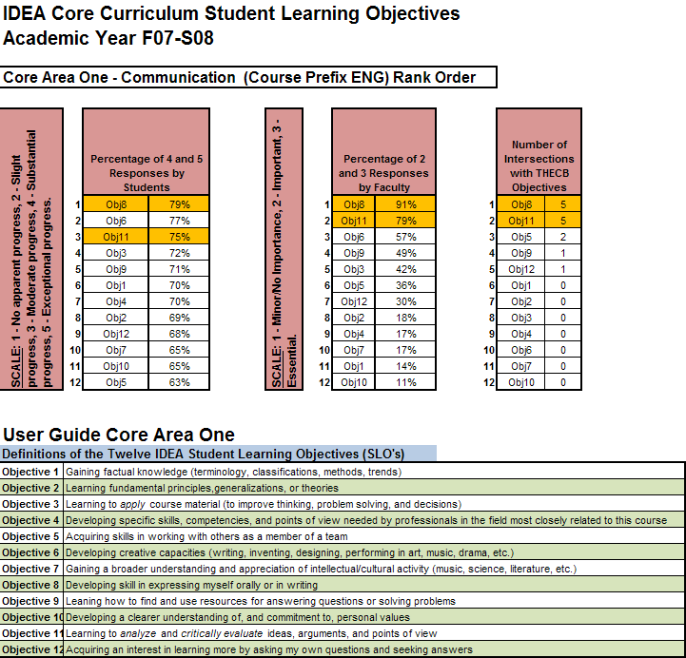
Sample AY 2007-2008 Core Curriculum Report

Slide 18
History of Core Curriculum Assessment at SHSU (cont.)
The evolution of core curriculum assessment at SHSU:
(2007-2008)
Direct Assessment of student learning through embedded assessment, IS ADDED TO previously mentioned IDEA SLO measures. ☺ ☺
  The Core Curriculum Assessment Committee ordered the Collection of directly measured evidence of student learning and the collaborative creation of rubric-based instruments by the academic departments within core-areas
  The SLOs that were directly assessed in courses were aligned with the THECB exemplary educational objectives for pertinent core-areas.

Slide 19
Direct vs. Indirect Assessment
Definitions
Direct Assessment:
  Observation and first-hand evaluation of student outcome behaviors or their products
  Specific student skills or knowledge are judged against standards of excellence external to the student
  Outcomes of student learning are tested; or products of learning outcomes are collected (papers, portfolios, performances) and evaluated, using scales or rubrics
Indirect Assessment:
  Collection of student-reported perceptions, or opinions of their own learning
  IDEA indirectly assesses student learning because it asks them to evaluate and report their own progress.

Slide 20
Direct vs. Indirect Assessment
Qualifications
Direct assessment of student learning outcomes is always superior to Indirect assessment;
Indirect assessment can add depth and nuance to direct measurement by providing insight into the learner.
Under certain circumstances, direct assessment is not possible. Then, systematic and consistent indirect measures (preferably more than one kind) can serve as proxies

Slide 21
Core Curriculum Assessment With IDEA Fall 2007-Spring 2008
Departments in most core-areas responded, however, those in the Communication (English) and Math core areas were most successful at collaboratively formulating assessment instruments that met all of the following criteria:
  Could be used by all instructors across several courses
  Could be embedded within regularly scheduled class testing for convenient administration.
  Could provide evidence of learning directly related to the THECB “Exemplary Objectives” for their particular core-area.

Slide 22
Methodology of Direct Core Curriculum Assessment From the Department of English
  Students taking Freshman English were asked to write a short essay on the following prompt from The Longwood Guide to Writing, Custom Edition, (Lunsford and Bridges, Boston: Pearson Longman, 2005):
    “Identify a problem, something that bothers you. Explore it, and offer a possible solution. The first part of your job is to identify a specific problem, define it clearly, and explore its implications. The second part is to consider potential solutions, evaluate those solutions, and then make an argument for the one you think is best.”
  A random collection of the short essays (78 of 530, or 15%) were graded on a 4 point scale using a rubric that had been aligned with relevant THECB exemplary educational objectives.
Notes:
Is that the title or is that a typo in the title of that book?

Slide 23
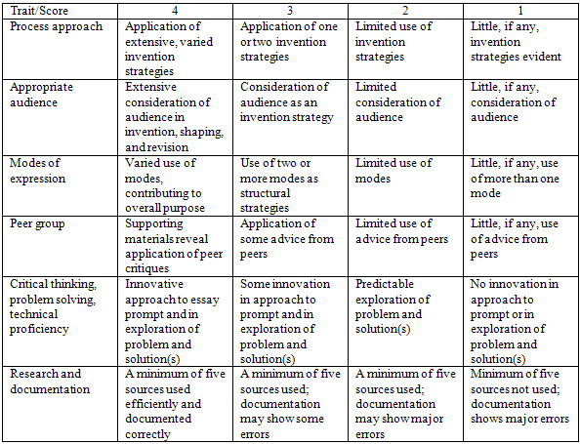
Rubric for English Core Curriculum Assessment

Slide 24
Methodology of Direct Core Curriculum Assessment From the Department of English, (cont.)
  Each essay was evaluated by an independent faculty member with each giving a score. Both scores were then combined to provide a final score for the essay.
  Essays with a score of 5 or higher were deemed to demonstrate satisfactory attainment of the desired core competencies.

Slide 25
History of Core Curriculum Assessment at SHSU (cont.)
Evolution continues:
(2008-2009)
More direct assessments of student learning are coordinated across courses within core curriculum areas. ☺
IDEA Center summary reports are ordered from the IDEA Center with aggregated results of all classes in each core curriculum area. These reports provide data for comparing student SLO progress vs. instructor SLO weighting, and for examining correspondences between IDEA SLO results and the THECB EE0. ☺ ☺

Slide 26
AY 2008-2009 Improvements on Core Curriculum Assessment with IDEA
Following the time consuming process of creating the AY 2007-2008 Core Curriculum Report, the IRA Office investigated the reduction of time and work in the production for future IDEA assessment reports by strategically coding IDEA data from Core Curriculum courses such that the IDEA Center could produce aggregated summary reports for each core curriculum area
The IRA Office IDEA Coordinator manipulated the “Local Code” feature in IDEA to flag the classes comprising the different Core Curriculum Areas.
  Using the Local Codes, aggregated reports could be ordered from the IDEA Center for each Core Area that could provide the same or comparable basic information as had been previously generated by the IRA Office at much greater great effort

Slide 27
AY 2008-2009 Improvements:
IDEA Center Reports Ordered by Core Curriculum Areas
Core Area I – Communication
Core Area II – Mathematics
Core Area III – Natural Sciences
Core Area IV A – English/Philosophy
Core Area IV B – Visual and Performing Arts
Core Area IV C – Cultural Studies
Core Area V A – History/Political Science
Core Area V B – Social/Behavioral Sciences
Core Area VI A – Kinesiology
Core Area VI B – Computer Science/Library Science
Notes:
Jeff , this is the first slide that mentions all the core areas and in the 2007-2008 slides you mention reorganizing the courses within the sub-groups of the core groups to obtain more coherent responses from more similar courses. So… does this list also describe the core groups and sub groups that were used in the Summer 08 report on AY 07-08 that we produced with Dr. M for SACS? Can we introduce it here with a different title or should we reserve it for the 2008-2009 discussion?

Slide 28
Excerpts from the Fall 2008 IDEA Group Summary Report for Core Curriculum
Area I – Communications

Slide 29
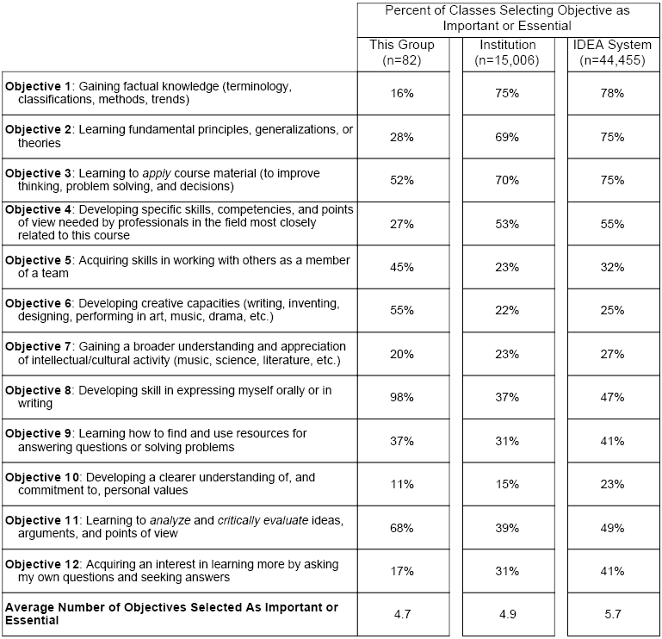
Percent of Instructors Rating Each IDEA SLO Objectives “Important” or “Essential”

Slide 30
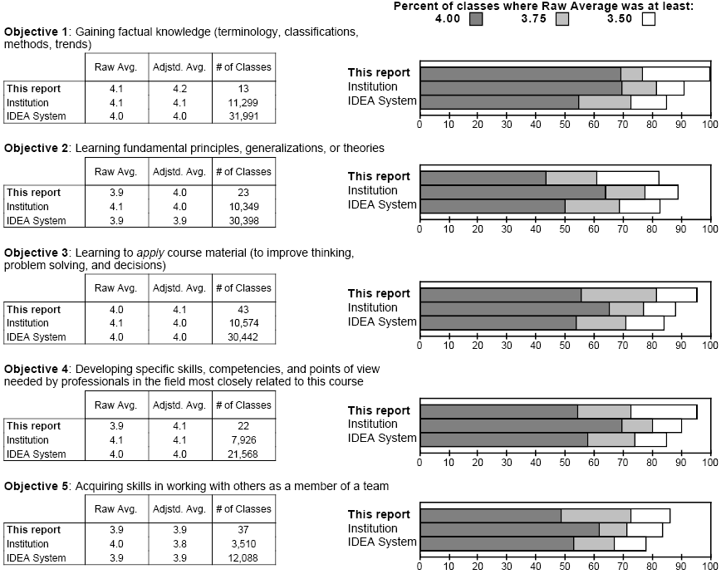
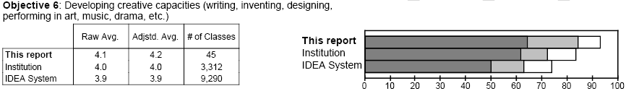
Student Rating of Progress on IDEA SLOs

Slide 31
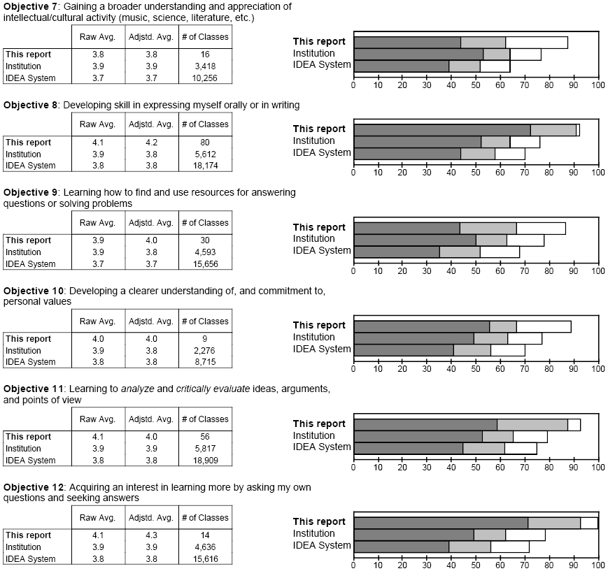
Student Rating of Progress on the 12 IDEA SLOs,
(cont.)

Slide 32
Additional Information Provided by the IDEA Group Summary Report
In addition, the Group Summary Report provides other valuable information.
  Comparison of scores to similar courses within the IDEA Database, and to past SHSU results, for the following categories:
    Progress on Relevant Objectives
    Excellence of Teacher
    Excellence of Course
  Additional student perceptions regarding their involvement and interest in the course, course difficulty, as well as the effort they put forward

Slide 33
History of Core Curriculum Assessment at SHSU (cont.)
The Future:
(2009-2010)
Addition of measures from the CLA, MAAP or CAAP for the assessment of core curriculum learning, as part of the Association of American State Colleges and Universities’ (AASCU) Voluntary System of Accountability (VSA). ☺ ☺
Continued improvements in embedded direct assessment and increased reliance upon IDEA Center reports for shortcuts in computing IDEA SLO concordances among students, instructors and THECB EEOs. ☺

Slide 34
Conclusions

Slide 35
Uses for IDEA in Core Curriculum Evaluation
Used to help address #1 and #4 of the THECB Criteria for Evaluation of Core Curricula:
Criteria for Evaluation of Core Curricula: (a) Each public institution of higher education shall review and evaluate its core curriculum every five years and report the results of that evaluation to the Board. The evaluation should include:
  (1) the extent to which the core curriculum is consistent with the elements of the core curriculum recommended by the Board;
  (2) the extent to which the core curriculum is consistent with the Texas Common Course Numbering System (TCCNS);
  (3) the extent to which the core curriculum is consistent with the elements of the core curriculum component areas, intellectual competencies, and perspectives as expressed in Core Curriculum: Assumptions and Defining Characteristics adopted by the Board; and
  (4) the extent to which the institution's educational goals and the exemplary educational objectives of the core curriculum recommended by the Board are being achieved

Slide 36
Uses for IDEA in Core Curriculum Evaluation
IDEA results were used to demonstrate:
1. That there was a correspondence between the SLO’s being selected by the faculty and those identified by the THECB/IDEA matrix.
2. That the students perceptions of their progress on those same objectives would be high.
3. That there would be a high correspondence between the SLO’s rated most important by faculty and those in which students perceived greatest progress.

Slide 37
How Else is IDEA Used at SHSU?
Student feedback to Instructors and Departments regarding their perceptions of class instruction and self-reported areas of learning.
Evaluation of classroom instructors at SHSU for tenure and promotion.
Monitoring, tracking and comparing self-reported student learning and interest in courses targeted within program evaluation plans
  (i.e., ..courses that are part of the SACS QEP Initiative vs. comparison courses; Baseline and Post measurement for assessing value-added).
Evaluation of self-reported student progress on key learning objectives.

Slide 38
Contact Information
M. Rita Caso, PhD, Director, Institutional Research & Assessment
  DR_RITA@shsu.edu
  (936) 294-3618
Jeff Roberts, MA, Assessment Coordinator , Institutional Research & Assessment
  JLR022@shsu.edu
  (936) 294-4321

