Slide 1
Forecasting Supply of College Graduates for Texas’ Growth Industries
TAIR Conference
Lubbock, March 4, 2009

Slide 2
Presenters
Gabriela Borcoman
Texas Higher Education Coordinating Board
Ruben Garcia
Texas Workforce Commission

Slide 3
Objectives
Explain the supply/demand concept
Introduce the TX Governor’s Cluster Project
Identify the targeted industry clusters
Describe the cluster to occupation to instructional program crosswalk and other methodological processes
Show examples of occupational demand vs. supply of college graduates
Recommendations
Question and answer session

Slide 4
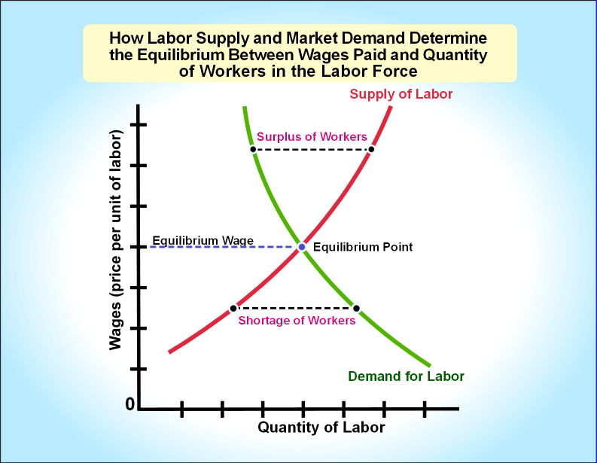
Occupational Supply/Demand from Froeschle, R (2008) –Labor supply/demand analysis: Approaches and concepts
Ideally, all the available jobs in a given occupation and the number of people with the skills required for that job would be equal;
If not, shortages can be determined

Slide 5
Labor supply/demand analysis from Froeschle, R (2008) –Labor supply/demand analysis: Approaches and concepts
Useful only:
  If the supply is centrally controllable
  If the projections are for future time periods
Made difficult by the vagueness of occupational titles – same occupational title may require different skills sets
  Solution: use clustering of occupations

Slide 6
Estimating Labor Supply from Froeschle, R (2008) –Labor supply/demand analysis: Approaches and concepts
Number of persons entering the labor force with skills acquired through formal education (degree, diploma, certificate)
The formal supply represents a higher portion for occupations that require licensure or certification
A number of jobs require only on-the-job training

Slide 7
Estimating Labor Supply from Froeschle, R (2008) –Labor supply/demand analysis: Approaches and concepts
Limitations:
  Not enough information about employer-supplied training programs (for example, people who become Microsoft certified)
  Not enough information about proprietary schools graduates or exiters with marketable skills but no award earned
  Formal credentials are limited to being the formal supply for the occupation linked to that major
  People choose to work in an occupation that requires lower skills

Slide 8
Estimating Labor Demand from Froeschle, R (2008) –Labor supply/demand analysis: Approaches and concepts
It uses two major types of job openings:
  Growth
  Replacement (turnover)
The further in time the projection is made, the higher the error
Skills set for a certain occupation may change in time
Ideally, the ratio between supply and demand should be 1

Slide 9
What is an Industry Cluster?
Industry cluster is a concentration of businesses and industries in a geographic region that are interconnected by the markets they serve, the products they produce, their suppliers, the trade associations to which their employees belong, and the educational institutions from which their employees or prospective employees receive training.

Slide 10
Why clusters?
Because regional economies are specialized with each region exhibiting competitiveness in a different mix of industry clusters (Porter)
Clusters can be identified using a given methodology and compared with other regions.
The Cluster Mapping Project can be found at http://www.isc.hbs.edu/njcmp/help.html

Slide 11
Texas Target Clusters
Advanced Technologies and Manufacturing, including four sub-clusters:
  Nanotechnology and Materials
  Micro-electromechanical Systems
  Semiconductor Manufacturing
  Automotive Manufacturing
Aerospace and Defense
Biotechnology and Life Sciences

Slide 12
Texas Target Clusters
Information and Computer Technology, including three sub-clusters:
  Communications Equipment
  Computing Equipment and Semiconductors
  Information Technology
Petroleum Refining and Chemical Products
Energy, including three sub-clusters:
  Oil and Gas Production
  Power Generation and Transmission
  Manufactured Energy Systems

Slide 13
Industries within Clusters
Core – industries generating primary economic activity
  For example: Petroleum and Coal Products Manufacturing
Ancillary – industries related to core cluster that buy or sell products to a core industry
  For example: Natural Gas Distribution
Support – provide support services that allow core industries to do business
  For example: Legal and Transportation

Slide 14
Occupations within Industries
Industry-Occupation Composition
Example: Oil and Gas Industry
  Petroleum Pump System Operators, Refinery Operators and Gaugers (7.14%)
  Petroleum Engineers (7.05%)
  General and Operations Managers (5.55%)
  Geoscientists, ex. Hydrologist (5.47%)
  Accountants and Auditors (5.27%)

Slide 15
Identify Projected Openings
Texas-specific BLS data projections from 2006 to 2016 covering 704 occupations
Limit to top 10 occupations within the core industries
Limit to occupations requiring postsecondary education only

Slide 16
Texas Occupations Requiring Postsecondary Education by Highest Average Annual Openings
Registered Nurse 8,565
General and Operations Managers 5,225
Accountants and Auditors 3,960
Computer Systems Analysts 2,740
Construction Managers 2,525
Computer Software Engineers, Applications 1,880

Slide 17
Projected Openings by Occupation
Computer Software Engineers, Applications
  Educational requirement = Baccalaureate
  Average Annual Openings (growth + replacement) = 1,430 + 450 = 1,880

Slide 18
Crosswalk Occupations to Education Programs
Link Occupations to Education Programs using the SOC to CIP crosswalk
  SOC – Standard Occupational Classification
  CIP – Classification for Instructional Programs
using Direct and Close relationships

Slide 19
SOC-CIP by Relationship
Occupation | Instructional Program (6-digit CIP) | Relationship
Computer Programmers | Computer Programming (11.0201) | Direct
 | Mgmt Info Systems (52.1201) | Close
 | Computer Graphics (11.0803) | General

Slide 20
CIP to SOC Relationships according to institutions
Direct – The “directness” has to do with the fit between academic training and job requirements.
Less Direct – The “fit” is still very close. They call for skills in writing, editing, listening and speaking.
Indirect – At first glance, the jobs listed may not appear to have much to do with the program. However the skills required for these jobs overlap substantially with some of the skills the major normally imparts.

Slide 21
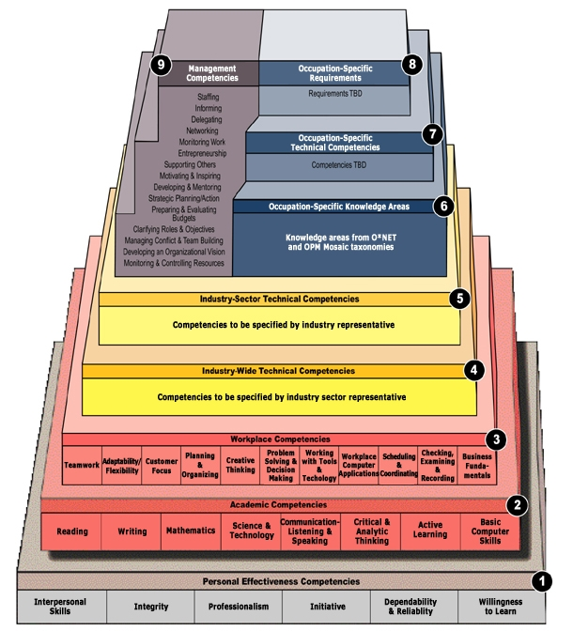
BLS Competency Model

Slide 22
Occupational Supply/Demand
Example: Computer Software Engineers, Applications
  Educational requirement = Baccalaureate
  Average Annual Openings (growth + replacement) = 1,880
  2005-2006 Graduates in CIPs 11.0103, 11.0701, 14.0901, 14.0903, 26.1103, 51.2706 = 1,174
  Number of graduates is 706 less than projected openings --- is there Undersupply?

Slide 23
Recap of Methodology
Top 10 Occupations within industry
Governor’s Clusters
Core Industries
Identify Direct and Closely Related Education programs (CIP)
Append Ave Annual Openings
Limit to occs requiring postsec ed
Compare
Grads vs
Openings
Append Graduation Data

Slide 24
Limitations of the Study
Handout

Slide 25
Results
Compare Supply vs. Demand
Undersupply - not enough graduates for projected openings?
Oversupply – too many graduates for projected openings?

Slide 26
Examples of Supply/Demand by Occupation (most openings)
Occupation | Average Projected Annual Openings | 2004-2005 Graduates | 2005-2006 Graduates | 2006-2007 Graduates
Registered Nurses | 8,565 | 7,010 | 7,769 | 8,304
General and Operations Managers | 5,225 | 10,892 | 10,947 | 11,182
Accountants and Auditors | 3,960 | 4,528 | 4,580 | 5,020
Computer Systems Analyst | 2,740 | 2,788 | 2,418 | 2,070

Slide 27
Examples of Supply/Demand by Occupation
Occupation | Average Projected Annual Openings | 2004-2005 Graduates | 2005-2006 Graduates | 2006-2007 Graduates
Construction Managers | 2,525 | 10,272 | 10,377 | 10,607
Computer Software Engineers, Applications | 1,885 | 1,264 | 1,126 | 968
Management Analyst | 1,490 | 9,785 | 9,830 | 10,083
Computer Software Engrs | 1,385 | 763 | 610 | 552

Slide 28
Examples of Supply/Demand by Occupation
Occupation | Average Projected Annual Openings | 2004-2005 Graduates | 2005-2006 Graduates | 2006-2007 Graduates
Network and Computer Systems Administrator | 1,415 | 3,594 | 3,101 | 2,673
Network Systems and Data Communications | 1,345 | 3,745 | 3,236 | 2,811
Medical and Health Services Mgrs | 940 | 723 | 767 | 798
Computer Programmers | 760 | 2,115 | 1,732 | 1,523

Slide 29
Graduates of engineering programs may not be employed evenly across the state
Engineering graduates were found employed in counties all over Texas for Texas A&M, UT Austin, and Texas Tech Universities
More than half of the graduates from the three universities were employed in the Austin, Houston, and Dallas areas

Slide 30
TAMU, UT AUSTIN, and Texas Tech have graduates employed statewide
University | % Employed Regionally | % Employed Dallas, Austin, Houston
TEXAS A&M UNIVERSITY | 18% | 65%
TEXAS TECH UNIVERSITY | 18% | 62%
U. OF TEXAS AT AUSTIN | 47% | 86%
TEXAS STATE UNIV - SAN MARCOS | 34%

Slide 31
Graduates of engineering programs may not be employed evenly across the state
Graduates from the engineering programs from other state universities were found mainly clustered in counties surrounding the institution

Slide 32
University | % Employed Regionally
LAMAR UNIVERSITY | 78%
MIDWESTERN STATE UNIVERSITY | 50%
MIDWESTERN STATE UNIVERSITY | 72%
SAM HOUSTON STATE UNIVERSITY | 56%
SUL ROSS STATE UNIVERSITY | 100%
TARLETON STATE UNIVERSITY | 52%
TEXAS A&M UNIV AT GALVESTON | 94%
TEXAS A&M UNIV-CORPUS CHRISTI | 40%
TEXAS A&M UNIVERSITY-COMMERCE | 80%
TEXAS A&M UNIV-KINGSVILLE | 51%
TEXAS SOUTHERN UNIVERSITY | 100%

Slide 33
University | % Employed Regionally
U. OF HOUSTON-CLEAR LAKE | 100%
U. OF HOUSTON-DOWNTOWN | 100%
U. OF TEXAS AT ARLINGTON | 79%
U. OF TEXAS AT BROWNSVILLE | 100%
U. OF TEXAS AT DALLAS | 75%
U. OF TEXAS AT EL PASO | 77%
U. OF TEXAS AT SAN ANTONIO | 82%
U. OF TEXAS AT TYLER | 54%
U. OF TEXAS-PAN AMERICAN | 60%
UNIVERSITY OF HOUSTON | 87%
UNIVERSITY OF NORTH TEXAS | 60%
WEST TEXAS A&M UNIVERSITY | 75%

Slide 34
Supply and Demand by Governor’s Clusters
Cluster | Cluster Name | Yearly total need (replacements and growth) | Projected yearly enrollment change | Percent supplied by HE
GA1 | Aerospace and Defense Core | 44,905 | -5,222 | -11.6%
GB1 | Biotech and Life Sciences Core | 59,166 | 16,733 | 28.3%
GE1 | Energy Core | 53,187 | 5,434 | 10.2%
GI1 | Information and Computer Technology Core | 69,083 | -15,083 | -21.8%
GP1 | Petroleum Refining and Chemical Products Core | 43,925 | -200 | -0.5%
GT1 | Advanced Technologies and Manufacturing Core | 45,276 | 7,558 | 16.7%
NA | Unassigned | NA | 72,538 | na

Slide 35
Next Steps
Align programs of study with demand occupations
  Open additional programs to address occupations with shortages of skilled workers
  Provide additional funding to institutions
  Reduce enrollment in “oversupply” programs and divert students to “undersupply” programs
  Do a better job of providing students with labor market information for improved decision-making in selecting programs of study.

Slide 36
Contact Information
Gabriela Borcoman, Ph D
  Senior Program Director
  Texas Higher Education Coordinating Board
  Gabriela.borcoman@thecb.state.tx.us
  (512) 427-6124
Ruben Garcia
  Manager
  Labor Market and Career Information
  Texas Workforce Commission
  Ruben.garcia@cdr.state.tx.us
  (512) 491-4965

