Slide 1
SAS Code Library
Veeru Konangi
Institutional Research Analyst
Institutional Research and Assessment
Notes:
We use a code library to store commonly coded functions used in our regular reporting.
We build views or modules in SAS, execute the code, and save the view as an object in our EDW.
We then join the modules to PROC SQL statements when generating reports.
A set of routines for a particular operating system.
Depending on the environment, code libraries may be source code, in an intermediate language or in executable form

Slide 2
Welcome
SAS Success story
Create and access library
BASE SAS Proc SQL vs data step
Creating a data views
Difference between data set and view
Practical applications
Discussion
Notes:
Today, I would like to share with you how SAS came to be,
How to create and use SAS libraries,
How to create modules,
And how to use those modules.
Then, I would like to share with your some of the code we use.

Slide 3
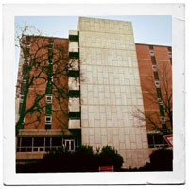
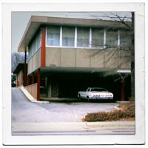
The history of SAS
Project Lead: Dr. Jim Goodnight and Dr. Jim Barr
Team members: Jane Helwig, John Sall
1966 – SAS did not exist
USDA and NIH funded project
8 land grant universities formed consortium
1972 – NIH discontinued funding
1976 – SAS Incorporated
Notes:
The inventers of SAS recognized a need for a simple statistical software.
Capable of performing calculations on large data sets
And, very affordable.

Slide 4
SAS offers a wide array of products
Base SAS
SAS Enterprise Guide
SAS Enterprise miner
SAS Studio
SAS Text Miner
Notes:
SAS has grown to offer a great many products to serve a great many needs
You can easily identify the products you own by ....

Slide 5
Ways to define libraries in SAS
libname myoralib oracle user=myusr1 password=mypwd1 path='mysrv1‘
libname EDW 'S:\EDW';
libname SATURN oracle user = "&id" password = "&pass" path = AWSODSP schema = saturn;
Notes:
Associating a library in SAS is simple
You first...
Then you....
Finally, you...

Slide 6
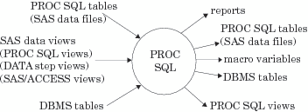
The advantages of Proc SQL
Proc SQL is a powerful tool for aggregating and joining data using BASE SAS.
Notes:
Proc SQL is a powerful tool.
Join Tables
Access database
COALESCE function
Summarize data by group by statement

Slide 7
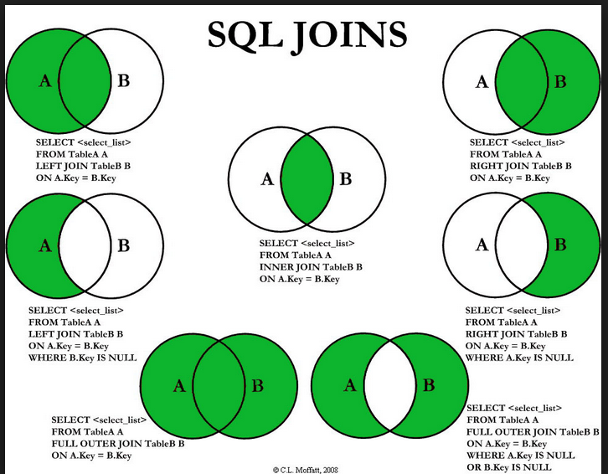
What is an SQL join?
Proc SQL;
create table temp as
select t1.*, t2.var1, t2.var2
from library.table1 as t1
left join library.table2 as t2
on t1.var1 = t2.var1 and
t1.var2 = t2.var2;
Quit;
Notes:
Simply put a join in SQL takes one or more fields from one or more tables and associates the records in each table to combine the two tables in to one.
There are seven types of joins and each serves a valuable purpose
In this sample code, we demonstrate a left join where we include all the records from the first table and the matching fields from the records in the second table.

Slide 8
What is a SAS View?
Views are virtual tables
View are formed using a query expression
Views contain no static data
Improves data security
Proc SQL;
create view library.temp as
select T1.var1, T1.Var2, T2.Var1
from library.table1 as t1
left join library.table2 as t2
on t1.var1 = t2.var1;
Quit;
Notes:
SAS Proc SQL allows users to crate tables, which are static data sets.
It also allow the creation of view, which are dynamic data sets.
These objects call on tables and other views when referenced in code.

Slide 9
Step 1: Create a View
PROC SQL;
Create view EDW.ID_to_PIDM as
Select SPBPERS_SSN as SSNWID, SPBPERS_PIDM as PIDM
from saturn.SPBPERS
where (SPBPERS_SSN is not null) and
substr(SPBPERS_SSN, 1, 1) in ('0', '1', '2', '3', '4', '5', '6', '7', '8', '9’)
UNION select SPRIDEN_ID as SSNWID, SPRIDEN_PIDM as PIDM
from SATURN.SPRIDEN
where (Spriden_Entity_Ind = 'P');
QUIT;
Notes:
First step in this process is to create a view which is similar to Database query.
This code creates an object and I can use it over and over again.
This module uses a union to append on e view to another view.
We do this to place all the social security numbers and SIS ids in one field and their associated SIS primary IDs in the adjacent field.
This lets us convert the CBMID on any CBM report to a PIDM, and then we can join SIS data to our CBM data.

Slide 10
Step 2: Use the View
Proc SQL;
create table temp as
select t1.ID, t1.var2, t2.PIDM
from library.CBM001 as t1
left join EDW.Id_to_PIDM as t2
on t1.ID = t2.ID
Quit;
Notes:
The next step is to use the view by joining the view to a data set using Proc SQL

Slide 11
Residency Module
Proc SQL;
create view EDW.Resident as
select c.ID, MAX(a.STU_Res) as ResCode,
Case when calculated ResCode <= 254 then ‘Texas Resident’
when calculated ResCode <= 366 then 'US Resident’
else 'NonResident’ end as Resident
from EDW.CBM001 as a
left outer join EDW.ID_TO_PIDM b on a.STU_CBMID = b.SSNWID
left outer join EDW.PIDM_TO_ID c on b.PIDM = c.PIDM
group by c.ID;
Quit;
Notes:
This module pulls the reported latest residency codes from our CBM001 reports into a view
These can then be applied to any ad hoc requested data pull.

Slide 12
Financial Aid Module
Proc SQL;
create view EDW.Aid as
select a.RPRATRM_PIDM as PIDM label='PIDM', a.RPRATRM_PERIOD as Term label='Term',
SUM(SUM(case when b.RFRBASE_FTYP_CODE = 'LOAN’
then a.RPRATRM_ACCEPT_AMT else 0 end, 0)) as Loan,
SUM(SUM(case when b.RFRBASE_FTYP_CODE = 'SCHL’
then a.RPRATRM_ACCEPT_AMT else 0 end, 0)) as Schl,
SUM(SUM(case when b.RFRBASE_FTYP_CODE = 'GRNT’
then a.RPRATRM_ACCEPT_AMT else 0 end, 0)) as Grant,
SUM(SUM(case when b.RFRBASE_FTYP_CODE = 'WORK’
then a.RPRATRM_ACCEPT_AMT else 0 end, 0)) as Work
from FAISMGR.RPRATRM as a
left outer join FAISMGR.RFRBASE b on
a.RPRATRM_FUND_CODE = b.RFRBASE_FUND_CODE
group by a.RPRATRM_PIDM, a.RPRATRM_PERIOD;
Quit;
Notes:
A very common request is a subset of students and their financial aid.
proc sql;
describe view Edw.Aid;
select a.RPRATRM_PIDM as PIDM label='PIDM',
a.RPRATRM_PERIOD as Term label='Term',
SUM(SUM(case
when b.RFRBASE_FTYP_CODE = 'LOAN' then a.RPRATRM_ACCEPT_AMT
else 0
end, 0)) as Loan, SUM(SUM(case
when b.RFRBASE_FTYP_CODE = 'SCHL' then a.RPRATRM_ACCEPT_AMT
else 0
end, 0)) as Schl, SUM(SUM(case
when b.RFRBASE_FTYP_CODE = 'GRNT'
then a.RPRATRM_ACCEPT_AMT
else 0
end, 0)) as Grant, SUM(SUM(case
when
b.RFRBASE_FTYP_CODE = 'WORK' then a.RPRATRM_ACCEPT_AMT
else
0
end,
0)) as Work
from FAISMGR.RPRATRM a left outer join FAISMGR.RFRBASE b on a.RPRATRM_FUND_CODE =
b.RFRBASE_FUND_CODE
group by a.RPRATRM_PIDM, a.RPRATRM_PERIOD;
quit;

Slide 13
Military Status Module
Proc SQL;
create view EDW.Military as
select distinct a.PIDM,
case when COALESCE(b.act, c.act, a.act, d.act) = 1 then 'Active'
when COALESCE(b.vet, c.vet, d.vet) = 1 then 'Veteran'
when COALESCE(b.spouse, c.spouse, a.spouse, d.spouse) = 1 then 'Spouse'
when COALESCE(b.child, c.child, a.child, d.child) = 1 then 'Child'
else 'Non Military’ end as Military
from (select sgbstdn_pidm as pidm label='PIDM’,
MAX(case when sgbstdn_rate_code in ('MILSM') then 1 else . end) as act,
MAX(case when sgbstdn_rate_code in ('MILSP') then 1 else . end) as spouse,
contd ………………………
Notes:
We frequently are ask about military status of students. We need to pull various tables to fully identify a student population.
In these cases, we employ a coalesce function and order the fields by priority. The function returns the value of the first non-missing field at the record level.
proc sql;
create view Edw.Military as
select distinct a.pidm, case
when COALESCE(b.act, c.act, a.act, d.act) = 1 then 'Active'
when COALESCE(b.vet, c.vet, d.vet) = 1 then 'Veteran'
when COALESCE(b.spouse, c.spouse, a.spouse, d.spouse) = 1 then 'Spouse'
when COALESCE(b.child, c.child, a.child, d.child) = 1 then 'Child'
else 'Non Military'
end as Military
from ( select sgbstdn_pidm as pidm label='PIDM', MAX(case when sgbstdn_rate_code in ('MILSM') then 1 else . end) as act,
MAX(case when sgbstdn_rate_code in ('MILSP') then 1 else . end) as spouse,
MAX(case when sgbstdn_rate_code in ('MILDC') then 1 else . end) as child
from SATURN.SGBSTDN
group by sgbstdn_pidm ) as a
left outer join
( select szrhemb_pidm as PIDM, MAX(case when szrhemb_military_type in ('30V', '31', '33V', '06', '07') then 1 else . end) as vet,
MAX(case when szrhemb_military_type in ('30A', '33A') then 1 else . end) as act,
MAX(case when szrhemb_military_type in ('33S', '35S') then 1 else . end) as spouse,
MAX(case when szrhemb_military_type in ('33D', '35D') then 1 else . end) as child
from TXCNMGR.szrhemb
group by szrhemb_pidm ) as b on a.pidm = b.pidm
left outer join
( select a.account_uid as pidm, MAX(case when detail_code in ('3505') then 1 else . end) as vet,
MAX(case when detail_code in ('3004', '3006', '3008', '3010', '3014', '3026') then 1 else . end) as act,
MAX(case when detail_code in ('3038', '3508') then 1 else . end) as spouse,
MAX(case when detail_code in ('3506', '3507') then 1 else . end) as child
from ODSMGR.RECEIVABLE_ACCOUNT_DETAIL a
left outer join
ODSMGR.RECEIVABLE_ACCOUNT b on a.account_uid = b.account_uid
group by a.account_uid ) as c on a.pidm = c.pidm
left outer join
( select robnyud_PIDM as pidm, MAX(case
when robnyud_value_322 in ('4', '5') then 1
else .
end) as vet, MAX(case
when robnyud_value_322 in
('1', '2', '3') then 1
else .
end) as act, MAX(case
when
robnyud_value_324 in ('1', '2', '3', '4', '5') then 1
else .
end) as
spouse, MAX(case
when robnyud_value_325 in ('1', '2', '3', '4', '5') then 1
else .
end) as child
from FAISMGR.ROBNYUD
group by robnyud_PIDM
) as d on a.pidm = d.pidm;
quit;

Slide 14
Guidelines for building a library
Create modules for CBM report and SIS attributes
Create reports by joining modules to tables
Organize modules using a standard nomenclature
Store modules in library in a shared location
Notes:
Before you start to build your library, make sure you apply a few guidelines.

Slide 15
Question?
Contact
Veeru (Veeranand) Konangi
Institutional Research Analyst
Institutional Research and Assessment
Texas A&M University-Central Texas
Veeru.konangi@tamuct.edu
254-519-5734
Notes:
And, that is what we are doing and it is really working well. We have reduced response times and improved accuracy in the process.

