Slide 1
Accountability System
Bill Abasolo, JD
Director of Strategic Planning and Analysis
Division of Strategic Planning and Funding

Slide 2
Builds on Past Achievements
Notes:
60x30TX builds on the success of the Closing the Gaps by 2015 strategic plan.

Slide 3
Four Student-Centered Goals
Notes:
The Strategic Planning Committee developed four student-centered goals.
The first deals with educational attainment, which is a fraction of the Texas population actually holding a degree or undergraduate certificate.
The second goal deals with degree and undergraduate certificate completion at Texas colleges and universities.
The third goal highlights the need for graduates to know the marketable skills they have acquired through their degree program, and through their higher education experience.
The fourth goal recognizes the need to address student loan debt.
Supporting students through completion to become more actively engaged citizens and to strengthen the Texas economy means addressing college affordability and making explicit the workplace skills students obtain in their programs.

Slide 4
Background
In January 2004, Governor Perry issued an Executive Order requiring the CB and state institutions to work together on an accountability system.
Community colleges agreed to participate in spring 2005.
The measures were identified with the help of the Council of University Presidents and Chancellors and the Texas Association of Community Colleges.
Career schools were added in 2011.

Slide 5
Accountability Has Several Related Purposes
Determine the effectiveness and quality of institutions
Evaluate and compare institutional data to improve student and institutional outcomes
Highlight state priorities for institutions and other users

Slide 6
Who Uses Accountability?
Decision makers
Legislators
University Systems
Community College Boards
Institutions
CB Staff

Slide 7
How Does THECB Use Accountability Data?
New program reviews and requests
Online institutional resumes
Texas Higher Education Almanac/Compare College TX
Community college success points
Institutional comparisons
Regional planning

Slide 8
Accountability Peer Groups
Universities (5 Groups)
Research (2)
Emerging Research (8)
Doctoral (7)
Comprehensive (6)
Masters (14)
Health-Related Institutions (10), plus data for medical schools at universities (2)
Texas State Technical Colleges and Lamar Institutions (9)
Community Colleges (4 Groups)
Very Large (10)
Large (9)
Medium (22)
Small (9)

Slide 9
Timeline for System Updates
Redesign of software architecture and user interface – Dec 2015
Institutions involved in review of measures - Spring and Fall 2016
New measures and redesigned system soft-launch – Feb 2017
Why?
Measures aligned to the goals and targets of 60x30TX
Fewer, clearer indicators of performance
Improve ease of navigation
Provide access to interactive data

Slide 10
Types of Data Available
Closing the Gaps
60x30TX
Enrollment
Degrees awarded, graduation, and persistence rates
Faculty and research
Institutional efficiency and effectiveness
Completion (credentials awarded, graduation, and persistence rates)
Post-graduation workforce and education outcomes
Student debt and SCH to degree
Sector-specific/other

Slide 11
Finding Accountability
http://www.txhighereddata.org

Slide 14
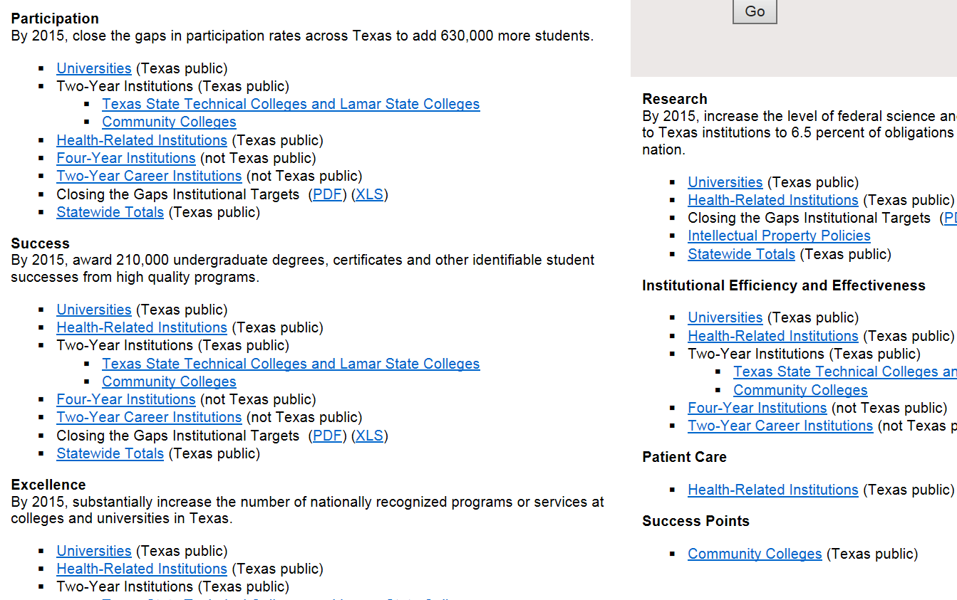

Slide 16
New Public Portal
Notes:
Here is the draft design of the new public facing portal. Compared with the existing home page, the new design aims to make the site simple and well organized, at the same time visually appealing to the site visitors.

Slide 17
New Reports

Slide 18
Sector Specific/Other

Slide 19
Resources

Slide 20
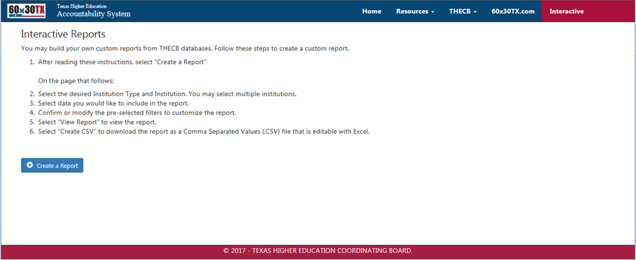
Interactive

Slide 21
Responsive Web Design Provides Greater User Experience
Responsive Web Design is incorporated in the new Accountability public portal to provide a greater user experience for all visitors, regardless of the device they use to interact with the website.
Notes:
Responsive web design is incorporated in the new public portal to provide a greater user experience for all visitors. The new site can adjust the size and position of images, columns, and other elements based on the size of the device used by a visitor when interacting with the website.

