Slide 1
Improving Report Turnaround Time: SAS EG, SAS Access/ODBC, Tableau
SUSHIL PALLEMONI | DEL MAR COLLEGE

Slide 2
Agenda
SAS Enterprise Guide
SAS Access
Demo: Automating Reports using SAS EG/SAS Access
Tableau Dashboards
Tableau Public / Tableau Server
Demo: Tableau Dashboards (Tableau Public/Tableau Server)
Accessing Dashboards via Laptop / iPad App / iPhone app
SAS Resources
Tableau Resources

Slide 3
Can you press that Magic Button and pull the report?
Notes:
May require more than one slide

Slide 4
SAS Enterprise Guide / SAS Access
SAS – Data Management / Analysis / Reporting / Visual Analytics
SAS Enterprise Guide:
Non Technical/Technical
Less Programming
Query Multiple data sets
Visual Process Flow
Complex Joins using Query builder/
SAS / Access:
Interface between SAS and other Databases
Easy Access to Enterprise data from different platforms
Fast Performance
Supports Multiple Relational Databases (SQL, Oracle, Sybase, Teradata, MySQL etc)
Notes:
May require more than one slide

Slide 5
Common Data Requests / Reports
Student Headcount/Enrollment (Credit/Continuing Education)
Student Distribution List / Mailing Lists (PIA Requests)
Graduation: Degrees/ Certificates
Grade Distribution Reports
Student Declared Majors
Semester Credit Hours / Contact Hours
Graduation Rates
Retention Rates
Notes:
May require more than one slide

Slide 6
Live Demo
SAS Access – Connecting to your Institutions Database from SAS EG
Enrollment Data by department
Headcount by Ethnicity and Gender
Grade Distribution Report by Department
Grade Distribution Report by Department – Tableau Dashboard
Graduation (Degrees & Certificates)
Retention/Graduation Rates
Notes:
May require more than one slide

Slide 7
Why Dashboards?
Easy to read, access and interpret
Concise one point access
Key Performance Indicators (Steps leading to success of a goal)
Enrollment data
Graduation data
Persistence data
Visual Analytics
Visually analyze data to identify Trends and Patterns
Notes:
May require more than one slide

Slide 8
Best Practices
Identify key metrics that matter to your institution
Cleanse your data.
Keep it simple.
Make it Interactive.
Five to ten years of data for longitudinal analysis.
Easy to use and access.

Slide 9
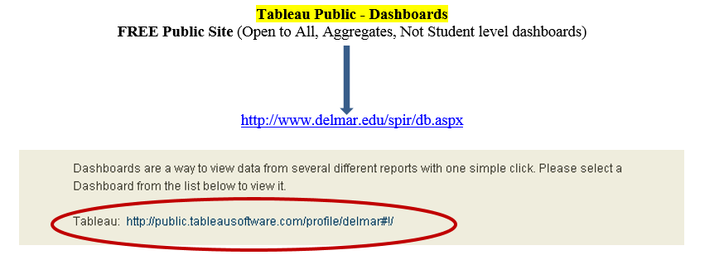
Tableau Public (Free)
Support for data sets of up to 10 million rows
An increased storage limit of 10 GB
The ability to limit the downloading of files from Tableau Public
Del Mar College: Tableau Public

Slide 10
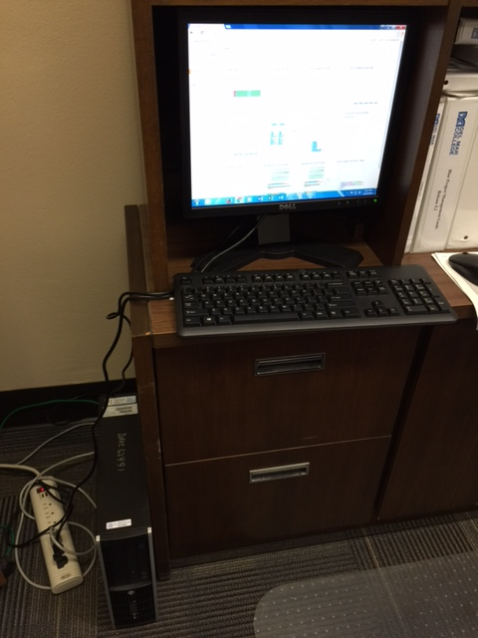
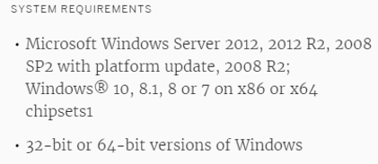
Tableau Server
Student Level Dashboards
Create dashboards in Tableau Desktop and share them securely with Tableau Server
Secure Data (In-House Server)
Empower everyone to use data
Tableau Server is fast and easy to install and maintain

Slide 11
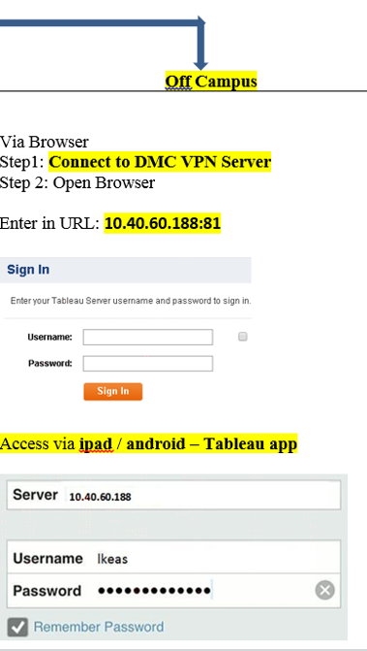
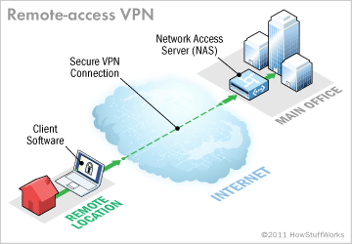
Tableau Server Access (off Campus)

Slide 12
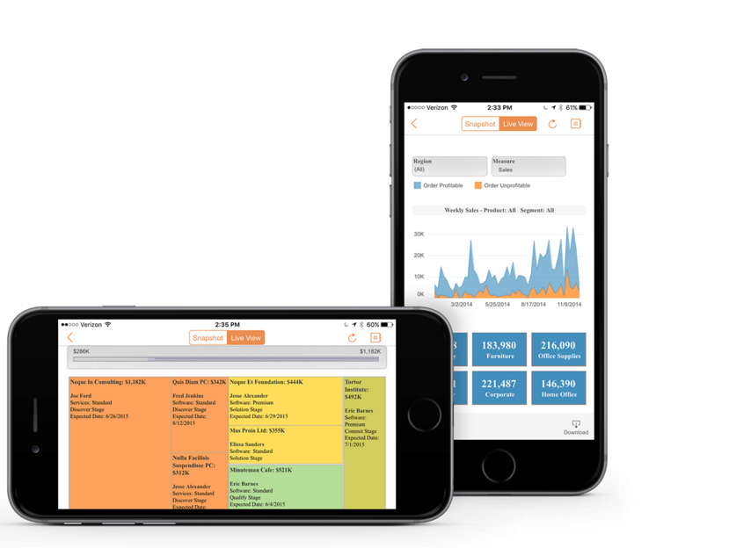
Tableau Mobile
Touch your data (Data at your finger tips)
Interact with your data using controls that are automatically optimized for touch
Live Demo

Slide 13
SAS Beginner Training Resources:
Video Tutorials:
http://support.sas.com/training/tutorial/
https://www.youtube.com/watch?v=r1Yy_sYbfy0
Tutorial with Sample Code
http://dist.stat.tamu.edu/flash/SAS/
Types of Procedures
http://www.stat.purdue.edu/docs/scs/SASshortcourse.pdf
SAS Enterprise Guide
https://www.sas.com/storefront/aux/en/spstateg/57255_excerpt.pdf
http://puffnet.dk/wp-content/uploads/EG_Self_Study.pdf
https://www.youtube.com/watch?v=jyCaDAysEMg

Slide 14
Tableau Resources:
Video Tutorials:
http://www.tableau.com/learn/training
Step by Step Tutorial: Reporting & Charting
http://www.tutorialgateway.org/tableau/
Practice Dataset
http://www.peteraldhous.com/CAR/tableau_demo.pdf
Tableau Public Tutorial
http://www.mulinblog.com/annotated-tableau-public-tutorial-video-a-quick-start-guide-for-instructors-and-first-timers/
https://youtu.be/AZ-cy67GJck
Tableau Server Tutorial
http://www.tableau.com/learn/tutorials/on-demand/getting-started-tableau-server-and-tableau-online
https://www.youtube.com/watch?v=UcZyjQTdnpY
YouTube Training
https://www.youtube.com/watch?v=C67VPldr09E
https://www.youtube.com/watch?v=CAZ3IAJEuCI

