Slide 1
TAIR 2017
State Reporting
Data Warehouse
for Texas Public Universities
using Banner
Mr. John Carroll
Institutional Research Analyst
j.carroll@tamuct.edu
27 Feb 2017
Notes:
Thanks you for the introduction
Welcome to my presentation on how we created a data warehouse using our CBM Reports and data from Banner.

Slide 2
We all have limited resources!
Small
Shop of three
Limited resources
Limited time
New
Reporting since 2009
Special
Unique reporting requirements
No First-time in College
Upper-level only
Notes:
Texas A&M University-Central Texas became a stand-alone university on May 27, 2009 as a member of The Texas A&M University System. A&M-Central Texas is an upper-level institution offering bachelor’s and master’s degrees.
The student population at A&M-Central Texas is diverse and growing, currently serving over 2,500 students. Classes are offered at several convenient sites, including area community colleges and Fort Hood in order to accommodate both full- and part-time students and to serve the entire Central Texas area. The University provides a wide range of flexible course schedules, including online, evening and weekend classes.

Slide 3
Reporting Challenges
Time consuming, manually intensive process to produce reports.
Different people produce reports with the same information but have different results.
What is the real answer?
How do you know if reported information is correct?
No time available for analysis because of the extensive time required to produce information.
Transactional systems don’t provide sufficient reporting capabilities.
Notes:
We can all recognize these challenges. By creating this warehouse we have been able to overcome some of these challenges.

Slide 4
Reasons for Data Warehouse
Banner database structures are very complex
Reporting results are subject to:
Users understanding of database structure.
Interpretation of variables.
No easy way to combine data across multiple systems and databases.
Notes:
Trying to use just Banner has its set of challenges?
Complex: How many tables does it take to get a students name and address?
Interpretation: What does “transfer mean?”
Interdependencies: To get class information and student information you may need multiple points of contact. (PIDM, CRN, TERM, SEQUENCE)

Slide 5
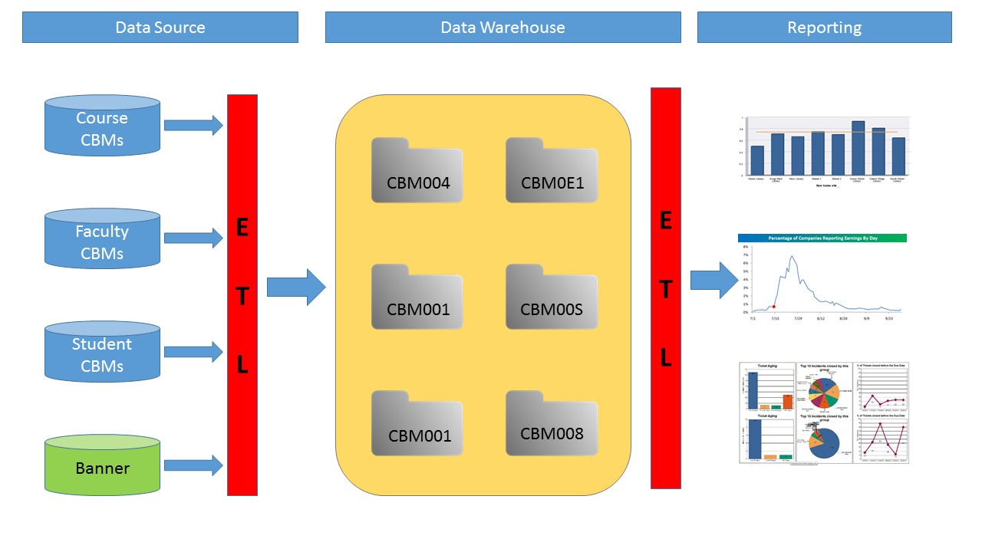
A data warehouse will maximize resources
Notes:
Basic overview of system

Slide 6
Categorize CBMs reports by focus
Report | Report Name | Schedule | Type
CBM001 | Student Report | Semester I | Student
CBM002 | Texas Success Initiative Report | Semester II | Student
CBM009 | Graduation Report | Annual | Student
CBM00B | Admissions Report | Annual | Student
CBM00E | Doctoral Exception Report | Annual X 2 | Student
CBM00N | Student Number Change Report | As Needed | Student
CBM00S | Student Schedule Report | Semester II | Student
CBM00X | Students in Self-supporting Courses and Programs | Annual | Student
CBM0E1 | Student End of Semester Report | Semester II | Student
CBM004 | Class Report | Semester I | Instructor
CBM008 | Faculty Report | Semester II | Instructor
CBM005 | Building And Room Report | Annual | Facilities
CBM011 | Facilities Room Inventory Report | As Needed | Facilities
CBM014 | Facilities Building Inventory Report | As Needed | Facilities
CBM003 | Course Inventory | Annual | Course
Notes:
First we characterized the CBM’s by focus. This allowed us to better align the information in them.

Slide 7
Use descriptive field names
Adopt a standardized naming convention
Standardize across all CBMs
Don’t use CBM item numbers
Causes confusion
What is Item_6?
May not be the same across all CBMs?
CBM Item | Variable | Label
Item_1 | STU_RC | ‘Record Code’
Item_2 | STU_IC | ‘Institution Code’
Item_3 | STU_CBMID | ‘Student Identification Code’
Item_4 | STU_GNDR | ‘Gender’
Item_5 | STU_CLASS | ‘Classification’
Item_6 | STU_DOBY | ‘Birth Year’
 | STU_DOBM | Birth Month
 | STU_DOBD | Birth Day
Item_7 | STU_TUT_STA | ‘Tuition Status’
Item_8 | STU_RES | ‘Residence’
Notes:
Then we standardized the names across the CBM’s for easy alignment and easier merging when needed.

Slide 8
Identify common field names
Item # | Item | CBM001 | CBM002 | CBM009 | CBM00B | CBM00S | CBM00X | CBM0E1 | Common SAS Name
1 | Record Code | Item 01 | Item 01 | Item 01 | Item 01 | Item 01 | Item 01 | Item 01 | STU_RC
30 | Last Name | Item 28 |  | Item 14 | Item 04 |  | Item 10 | Item 28 | STU_LNAME
31 | First Name | Item 29 |  | Item 15 | Item 05 |  | Item 11 | Item 29 | STU_FNAME
32 | Middle Initial | Item 30 |  | Item 16 | Item 06 |  | Item 12 | Item 30 | STU_MI
33 | Dual Credit SCH | Item 31 |  |  |  |  |  | Item 31 | STU_DUAL
34 | Restricted Program Admissions | Item 32 |  |  |  |  |  | Item 32 | STU_RP
35 | Non-Degree Seeking | Item 33 |  |  |  |  |  | Item 33 | STU_NDS
36 | Non-Disclosure | Item 34 | Item 06 | Item 12 |  | Item 09 | Item 17 | Item 34 | STU_ND
37 | Grad SCH of Seniors | Item 35 |  |  |  |  |  | Item 35 | STU_GSCH_SENIOR
38 | High School Code | Item 36 |  |  |  |  |  | Item 36 | STU_HS_CDE
39 | PEIMS Identification Code | Item 37 |  |  |  |  |  | Item 37 | STU_PEIMS
40 | Ethnic Origin | Item 38 | Item 11 | Item 18 | Item 27 |  | Item 20 | Item 38 | STU_ETHN
41 | White | Item 39A | Item 12A | Item 19A | Item 28A |  | Item 21A | Item 39A | STU_WH
42 | African American | Item 39B | Item 12B | Item 19B | Item 28B |  | Item 21B | Item 39B | STU_BL
Notes:
Next we identified common fields to help determine where we could merge tables together when needed.

Slide 9
Inputting CBM’s
Data Work.&cbm;
INFILE "&Input_File" missover FIRSTOBS = 2;
Input INST_RC 1.
INST_IC 6.
INST_SUBJ $7.
INST_CRSE 7.
INST_CRN $7.
INST_INST_TYP $1.
INST_SCH_VAL 4.
INST_LOC_CDE $1.
INST_HED_SITE $6.
Item_8B 1.
*Create CRN Variable from INST_CRN;
Length CRN $5;
CRN = INST_CRN;
Format CRN $5.;
run;
Pull in data from DAT file
First table is header only
Second table is CBM data
Third table is end of file
If checking CBMs, leave variables set as “Item_”# for ease of checking and referencing.
Notes:
When inputting data you should break up the DAT file into three tables, Header, Body, EOF
These files can be used to conduct data checks of the CBM’s before submitting them to THECB.

Slide 10
Checking CBM’s
Use CBM manual to check data in CBM files
Individual CBM reports
CBM001, CBM004, CBM008,. . .
Multiple CBM reports
Balance check CBM001 vs. CBM004
Output results to PDF to share with data owners to fix errors.
*Questionable Error check of Tuition Exemption (Item 20).;
Proc Print Data = work.CBM1 noobs label;
Where Item_7 = "3" and Item_8 > 254 and Item_20 NE 1;
Var Item_3 Item_7 Item_8 Item_20;
run;
Title4;
*Error check of Tuition Exemption (Item 20).;
Proc Print Data = work.CBM1 noobs label;
Where Item_7 = "3" and Item_20 NE 1 or Item_7 = "E" and Item_20 not in (21 .);
Var Item_3 Item_7 Item_20;
run;
*Error check of SCH-UG Degree Program (Item 26).;
Proc Print Data = work.CBM1 noobs label;
Notes:
We run these checks prior to submitting to THECB. This cuts down on errors and re-run numbers.

Slide 11
What SIS data is not on CBM reports?
Review previous requests and reports for data points that are moved.
High Focus Areas
Enrollment / Registration information
Student address
Student Demographics
Retention
GPA
Determine location of information needed
Needs to be consistent
May need to be semester specific
Notes:
These are different things to look at when determining what info to add to the CBM’s for warehousing.

Slide 12
Snapshot of SIS data added to CBMs when reported
ODSMGR.AS_STUDENT_DATA | ODSMGR.AS_CATALOG_SCHEDULE | Military
PIDM_KEY | TERM_CODE_KEY | sgrvetn_vetc_code
TERM_CODE_KEY | TERM_DESC | szrhemb_military_type
TERM_DESC | CRN_KEY | sgbstdn_rate_code
TERM_CODE_LAST_ATTENDED | SEQ_NUMBER_KEY | receivable_account.detail_code
APPLIED_FOR_DEGREE_IND | COLL_CODE | receivable_account.detail_code_desc
GRADUATED_IND | DEPT_CODE
ID | SUBJ_CODE
AGE | CRSE_NUMBER | SHRDGMR (Graduation Information)
ETCT_CODE | CREDIT_HOURS | Term_Code_Grad
ETHN_CODE | CREDIT_HOURS_LOW | Grad_Date
ETHN_DESC | CREDIT_HOURS_HIGH | Coll_Code_1
STREET1_LINE1 | CAMP_CODE | MAJR_Code_1
Notes:
Not all info maybe found in one location and multiple locations maybe needed to determine on variable.

Slide 13
Line up Data to CBM
We focused in on:
CBM001
CBM004
CBM008
ODSMGR.AS_STUDENT_DATA | CBM001 | CBM002 | CBM009
PIDM_KEY | X | X | X
TERM_CODE_KEY | X | X
TERM_DESC | X | X
TERM_CODE_LAST_ATTENDED | X |  | X
APPLIED_FOR_DEGREE_IND | X
GRADUATED_IND | X
ID | X | X | X
AGE | X | X | X
ODSMGR.AS_CATALOG_SCHEDULE | CBM004 | CBM008 | CBM005
TERM_CODE_KEY | X | X
TERM_DESC | X | X
CRN_KEY | X | X | X
SEQ_NUMBER_KEY | X | X | X
COLL_CODE | X | X | X
DEPT_CODE | X | X | X
SUBJ_CODE | X | X | X
CRSE_NUMBER | X | X | X
Notes:
Once you have the data you will need to determine the best place to put this data. We used the 1,4, & 8 as these where the most places we pulled data from.

Slide 14
Extract, Transform and Load into data warehouse
Notes:
This takes us up to this point

Slide 15
Reporting Categories
Student Demographics
Enrollment Trends
Retention
Class Offerings and Utilization
Student Class Enrollments
Graduations
Faculty Information
Notes:
We took and looked at the data and came up with some basic areas for reporting.

Slide 16
Reporting Process

Slide 17
Consistent Reporting
SAS datasets can easily be used in Tableau, Access, and Excel for reporting.
Notes:
Here are some examples of reports that we use.

Slide 18
Questions

